Slide 1
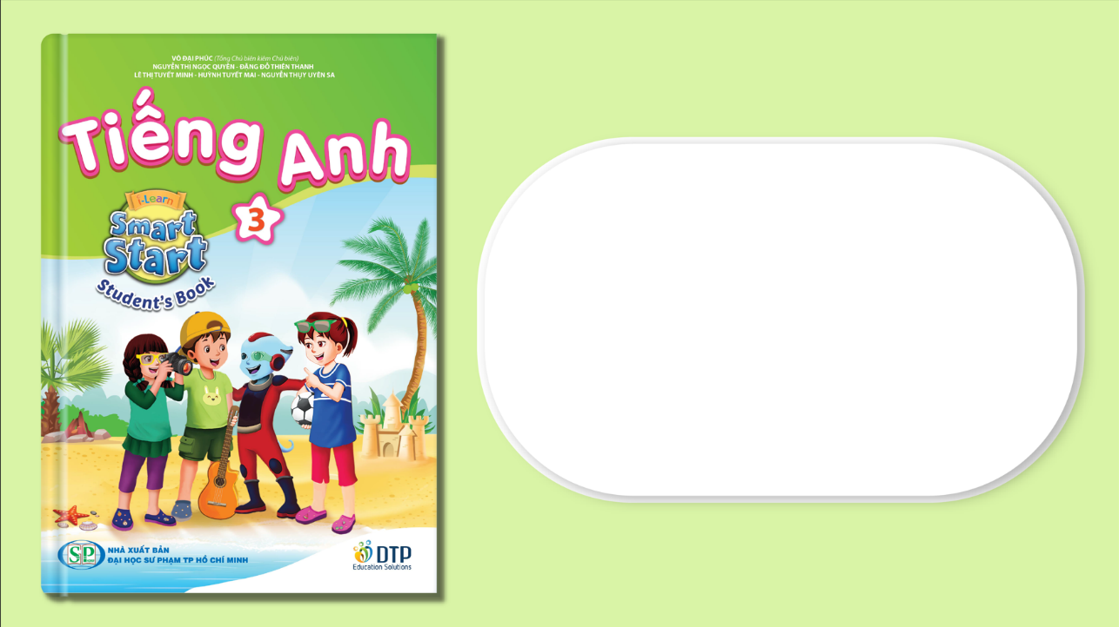
Unit 8: Food
Lesson 4.1
Page 119

Slide 2

Tuesday, 18th April 2023
Unit 8 - Lesson 4
1. New words
2. Structures
We eat ____with a ____.
We often eat ____.
My favorite food is ____.
knife
fork
spoon
chopsticks
noodles

Slide 3



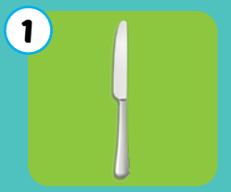
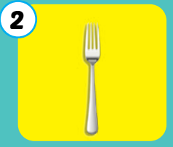
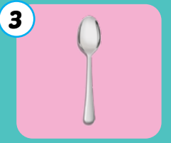
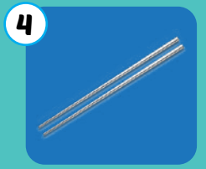
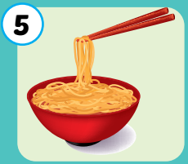
Giấu các icon audio
Click each picture to hear the sound.
knife
fork
spoon
chopsticks
noodles
/naɪf/
Con dao
/fɔːrk/
Cái nĩa
/spuːn/
Cái thìa
/ˈtʃɑːpstɪks/
Đôi đũa
/ˈnuːdlz/
Mì,bún, phở

Slide 4
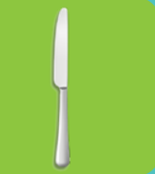

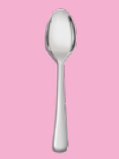
Sound here
Listen and choose the correct picture
Notes:
Click vào hình headphone để nghe âm thanh. click vào câu trả lời đúng để thấy hiệu ứng

Slide 5
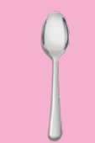
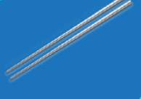
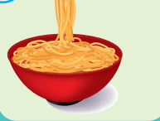
Listen and choose the correct picture

Slide 6


Listen and choose the correct picture

Slide 7


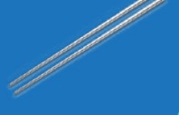
Listen and choose the correct picture

Slide 8
Listen and choose the correct picture

Slide 9
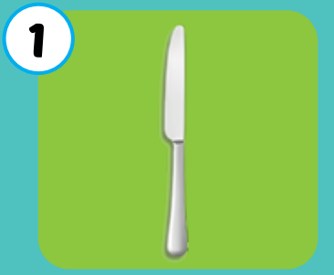
What is it?
folk
noodles
knife
chopsticks
spoon
Click the picture to see the answer

Slide 10
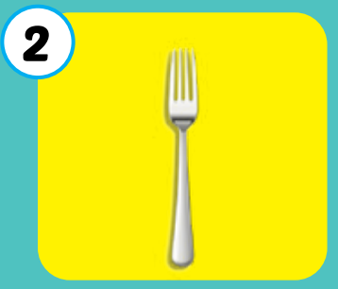
What is it?
folk
noodles
knife
chopsticks
spoon
Click the picture to see the answer

Slide 11
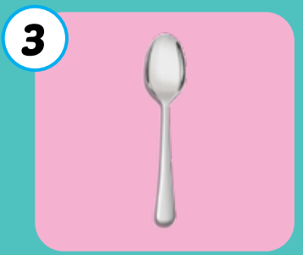
What is it?
folk
noodles
knife
chopsticks
spoon
Click the picture to see the answer

Slide 12
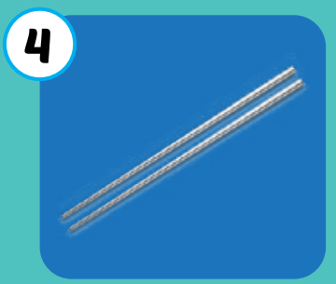
What is it?
folk
noodles
knife
chopsticks
spoon
Click the picture to see the answer

Slide 13
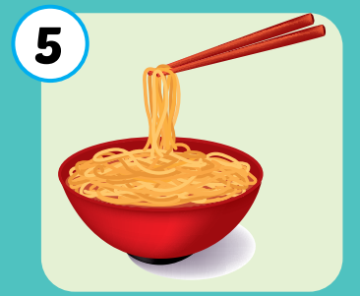
What is it?
folk
noodles
knife
chopsticks
spoon
Click the picture to see the answer

Slide 14
Listen and choose the correct answer
A. spoon
B. chopsticks
C. fork
D. noodles
Notes:
Click vào câu trả lời sai> sẽ bay đi mất
Câu trả lời đúng: có tiếng vỗ tay

Slide 15
Listen and choose the correct answer
A. spoon
C. chopsticks
B. fork
D. noodles

Slide 16
Listen and choose the correct answer
A. spoon
B. knife
C. fork
D. noodles

Slide 17
Listen and choose the correct answer
A. spoon
B. knife
C. fork
D. noodles
Notes:
Click on the picture to hear the sound
Click on incorrect answer-> disappear
Click on correct answer->applause sound

Slide 18
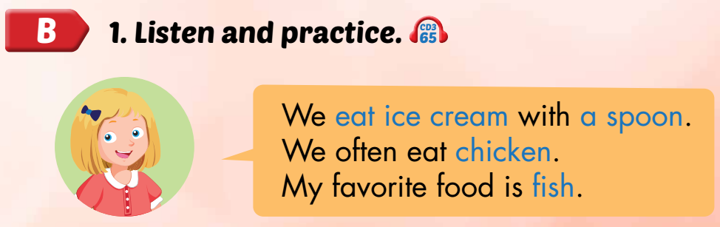
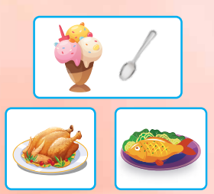

Slide 19

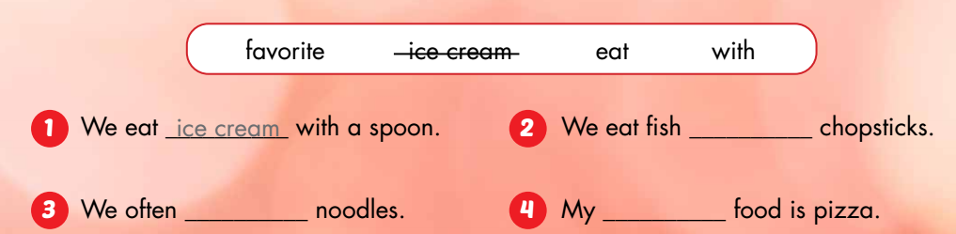
with
eat
favorite

Slide 20

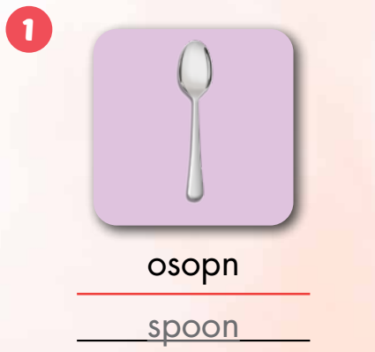
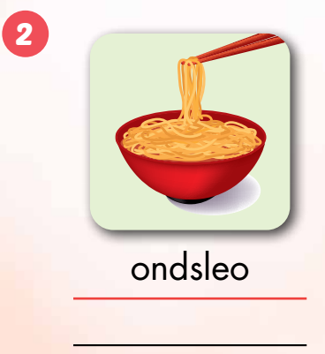
Extra Practice
WB, P. 88
noodles

Slide 21
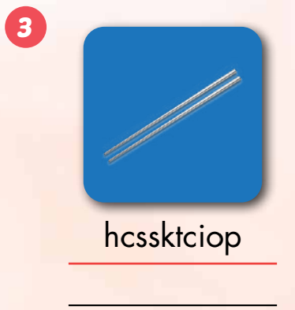
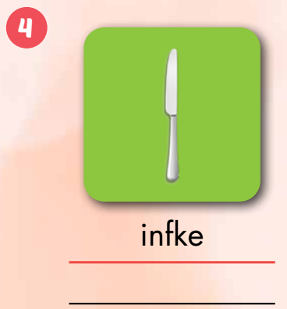
chopsticks
knife

Slide 22
