Slide 1

Unit 8: Food
Lesson 3.1
Page 116

Slide 2

Thursday, 13th April 2023
Unit 8 - Lesson 3.1
1. New words
2. Structures
Would you like some fries?
- Yes, please. / Sure, thanks!
- No, thank you.
fries
pizza
cake
ice cream
chicken
fish

Slide 3



Slide 4


Slide 5
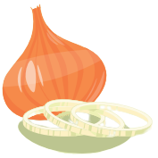

Slide 6


Slide 7
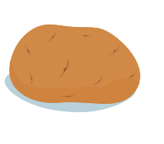

Slide 8

It’s time to learn …

Slide 9



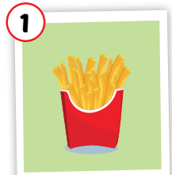
Click each picture to hear the sound.
fries
/fraɪz/
khoai tây chiên
Notes:
Click chữ nghe đọc

Slide 10
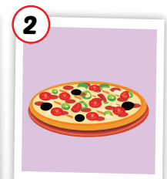
Click each picture to hear the sound.
pizza
/ˈpiːtsə/
Bánh pi-za
Notes:
Click chữ nghe đọc

Slide 11
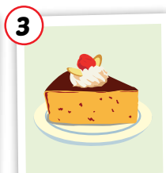
Click each picture to hear the sound.
cake
/keɪk/
bánh ngọt
Notes:
Click chữ nghe đọc

Slide 12
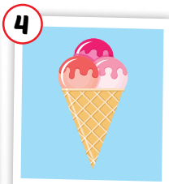
Click each picture to hear the sound.
ice cream
/ˈaɪs kriːm/
kem
Notes:
Click chữ nghe đọc

Slide 13
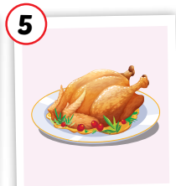
Click each picture to hear the sound.
chicken
/ˈtʃɪkɪn/
thịt gà
Notes:
Click chữ nghe đọc

Slide 14
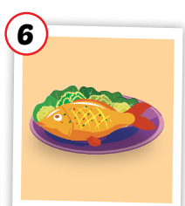
Click each picture to hear the sound.
fish
/fɪʃ/
con cá, món cá
Notes:
Click chữ nghe đọc

Slide 15
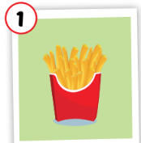

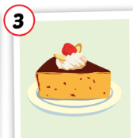
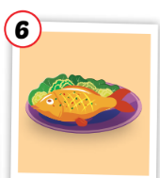
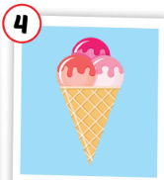

Click each picture to hear the sound.
fries
pizza
cake
ice cream
chicken
fish
/fraɪz/
khoai tây chiên
/ˈpiːtsə/
Bánh pi-za
/keɪk/
bánh ngọt
/ˈaɪs kriːm/
kem
/ˈtʃɪkɪn/
thịt gà
/fɪʃ/
con cá, món cá
Notes:
Click chữ nghe đọc

Slide 16

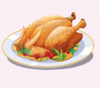





MEMORY GAME
1
2
3
4
5
6
7
8
9
10
11
12
13
14
15
16
17
18

Slide 17
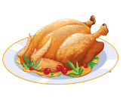
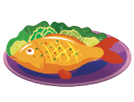
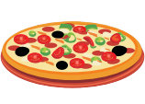

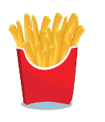

SLAP THE BOARD

Slide 18







Click on each sentence to listen
Would you like some fries?
Yes, please./Sure, thanks!
Would you like some cake?
No, thank you.

Slide 19
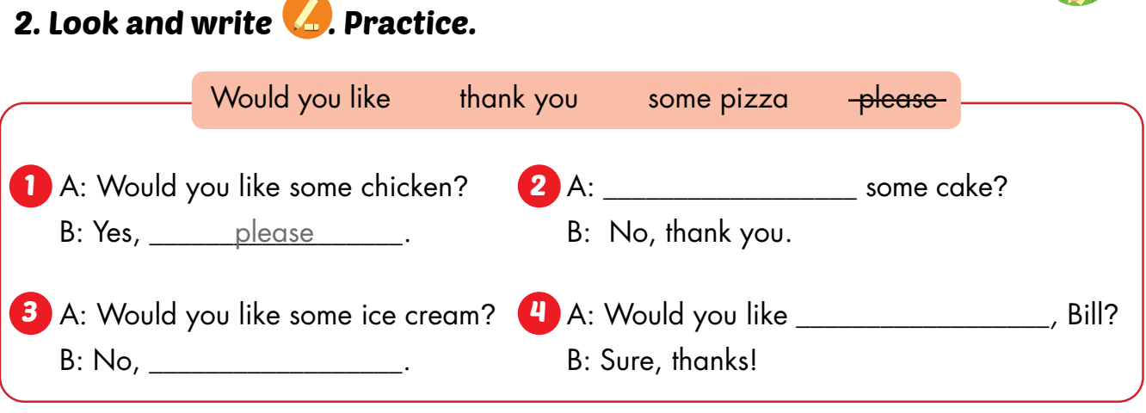
Would you like
some pizza
thank you

Slide 20
some chicken
Would you like ____________?
Yes, ________.
please

Slide 21
some ice cream
Would you like _______________?
No, ________.
thank you

Slide 22
some cake
Would you like ___________?
Yes, ________.
please

Slide 23
some fish
Would you like __________?
No, ________.
thank you

Slide 24
some fries
Would you like ____________?
Yes, ________.
please

Slide 25
some pizza
Would you like _________?
Yes, ________.
please

Slide 26

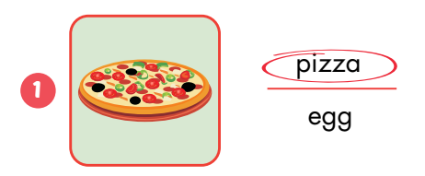
Extra Practice
WB, P. 82

Slide 27
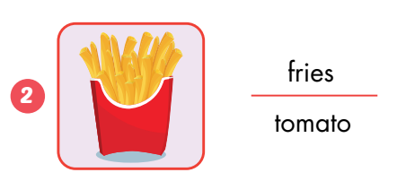

Slide 28
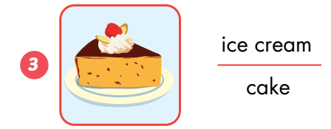

Slide 29
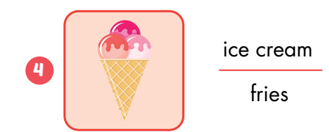

Slide 30
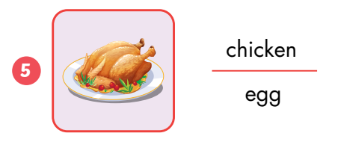

Slide 31
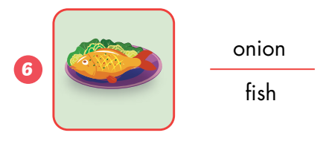

Slide 32
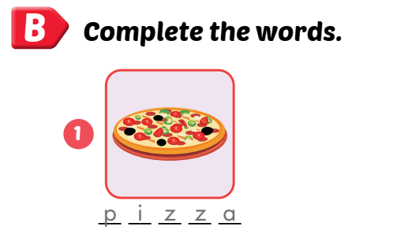
Extra Practice
WB, P. 82

Slide 33

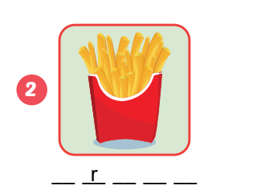
fries

Slide 34
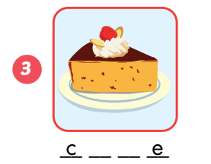
cake

Slide 35
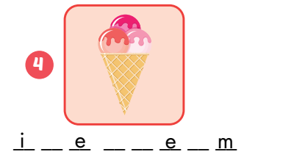
ice cream

Slide 36
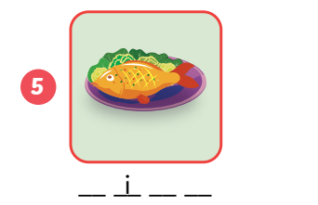
fish

Slide 37
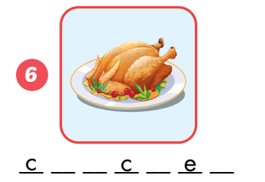
chicken

