Slide 1

Unit 6: Clothes
Review& Practice 2
Page 95

Slide 2
belt
thắt lưng
scarf
khăn choàng
shirt
áo sơ mi
skirt
Chân váy
dress
Váy liền

Slide 3
jacket
áo khoác
boots
đôi ủng
jeans
quần jean
pajamas
quần áo ngủ
skiing
trượt tuyết

Slide 4
tie
cà vạt
polo shirt
áo thun có cổ
sneakers
giày thể thao
socks
đôi tất
pants
quần dài

Slide 5

It’s time to learn …

Slide 6

Speaking

Slide 7
PRE-SPEAKING
Rearrange these words to make a sentence.
do want what you ?
What do you want?

Slide 8
PRE-SPEAKING
Rearrange these words to make a sentence.
What you are wearing ?
What are you wearing?

Slide 9
PRE-SPEAKING
Rearrange these words to make a sentence.
those your Are jeans ?
Are those your jeans?

Slide 10
PRE-SPEAKING
Rearrange these words to make a sentence.
aren’t No, they
No, they aren’t.

Slide 11
PRE-SPEAKING
Rearrange these words to make a sentence.
want shorts I some
I want some shorts.

Slide 12
PRE-SPEAKING
Rearrange these words to make a sentence.
‘m a I T-shirt green wearing
I’m wearing a green T-shirt.

Slide 13

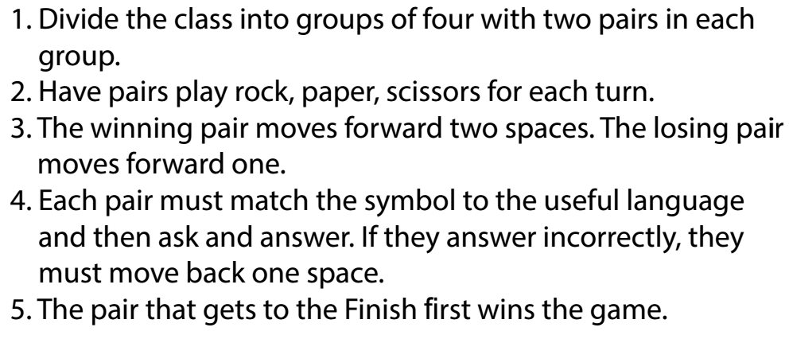
HOW TO PLAY?

Slide 14
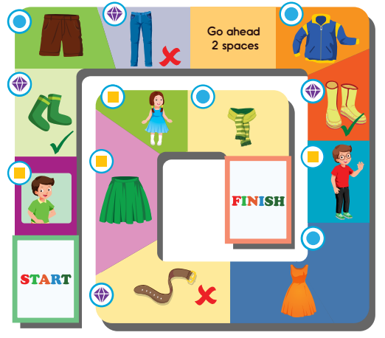

Slide 15



A: What are you wearing?
B: I’m wearing a green
T-shirt.
A: Are those your socks?
B: Yes, they are.
A: What do you want?
B: I want some shorts.

Slide 16
A: Are those your jeans?
B: No, they aren’t.

Slide 17
A: What do you want?
B: I want a jacket.
A: Are those your boots?
B: Yes, they are.
A: What are you wearing?
B: I’m wearing a red polo shirt and black jeans.

Slide 18
A: What do you want?
B: I want a dress.
A: Is that your belt?
B: No, it isn’t.
A: What are you wearing?
B: I’m wearing a green skirt.

Slide 19
A: What are you wearing?
B: I’m wearing a blue drees.
A: What do you want?
B: I want a scarf.

Slide 20
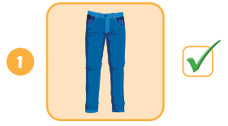
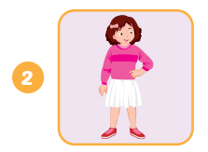
Look and write.
A: Are your ?
B: Yes, they are.
those
jeans
A: What’s she ?
B: She’s wearing a pink
and a white .
wearing
sweater
skirt

Slide 21
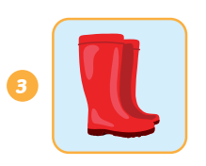
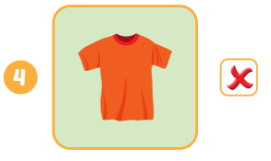
Look and write.
A: What want?
B: I want .
do you
some boots
A: your ?
B: .
Is that
T-shirt
No, it isn’t

