Slide 1

Unit 6: Clothes
Lesson 4.3
Page 93

Slide 2
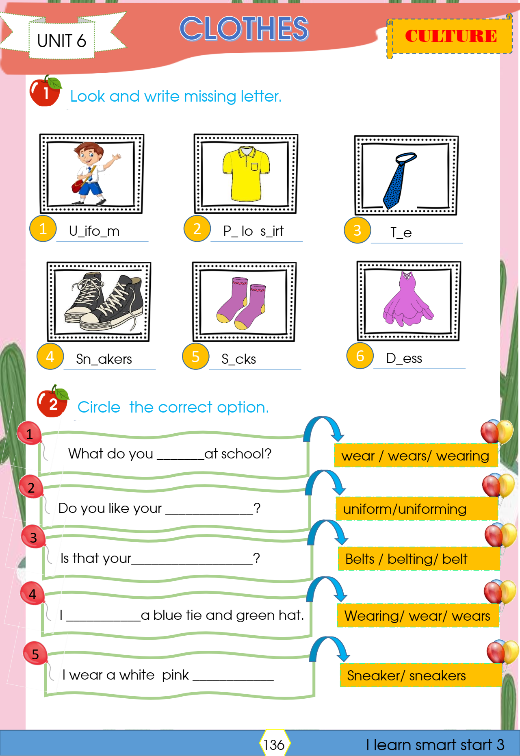

Slide 3
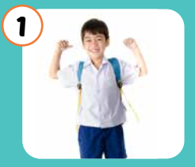
What it is behind these boxes?
Uniform

Slide 4
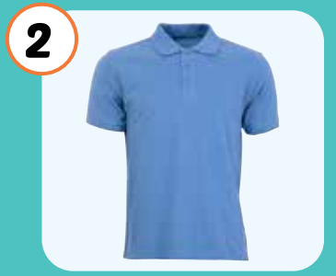
What it is behind these boxes?
Polo shirt

Slide 5
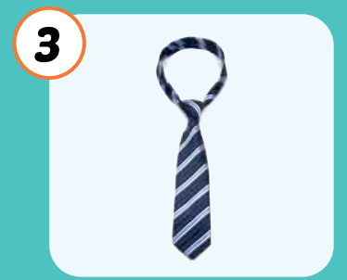
What it is behind these boxes?
tie

Slide 6
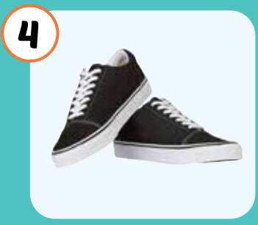
What it is behind these boxes?
sneakers

Slide 7

It’s time to learn …

Slide 8

Reading

Slide 9


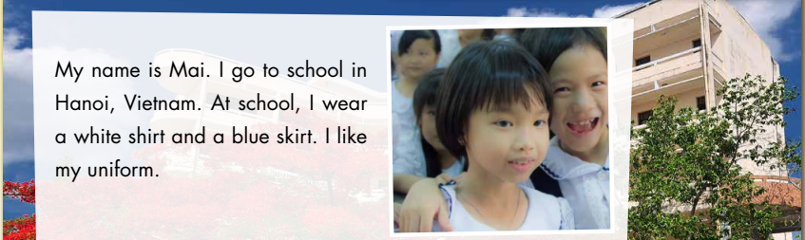



Slide 10


Slide 11


Slide 12


Slide 13
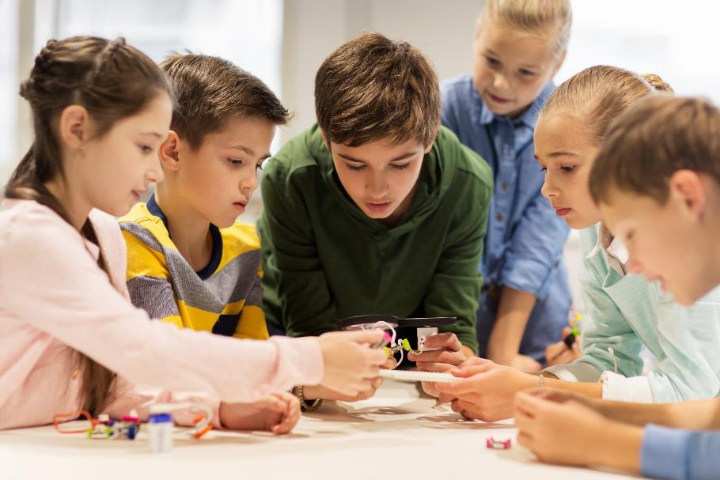
Let’s play a game

Slide 14
Continue the lesson
3
4
2
1
7
8
5
6
The class is divided into 2 groups.
Each group takes turn to choose the star.
Teacher click on each star chosen by students. Students answer the questions. If they have the correct answer, they earn the points for each question.
There is one lucky and one unlucky star
LUCKY STAR

Slide 15
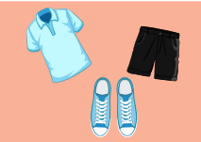
I wear black shorts.
FALSE
TRUE
10 POINT

Slide 16
I wear a white polo shirt.
TRUE
FALSE
15 POINT

Slide 17

CONGRATULATION. YOU EARN 30 POINTS

Slide 18
I wear blue sneakers.
TRUE
FALSE
10 POINT

Slide 19

I like my uniform.
TRUE
FALSE
15 POINT

Slide 20

OH, NO.YOU LOSE 20 POINTS

Slide 21

Writing

Slide 22
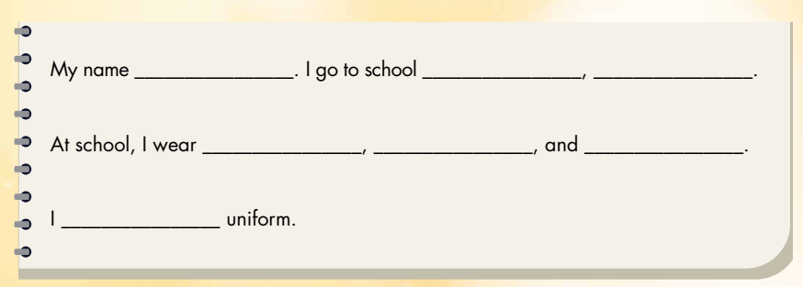
Is Mary
in Ha Noi Viet Nam
a white shirt
blue pants
black shoes
like my

Slide 23

Hello, my name is……..
I’m from……………………………………………………… ……………………………………………………………………………………………………………………………………………..
Mary
Ha Noi.
At school, I wear a white shirt and a blue skirt. I like my uniform.

