Slide 1

Unit 6: Clothes
Lesson 4.1
Page 91

Slide 2

Tuesday, 28th February 2023
Unit 6 – Lesson 4.1
1. New words
2. Structures
- What do you wear at school?
I wear a blue tie.
- Do you like your uniform?
Yes, I do.
uniform
polo shirt
sneakers
tie

Slide 3

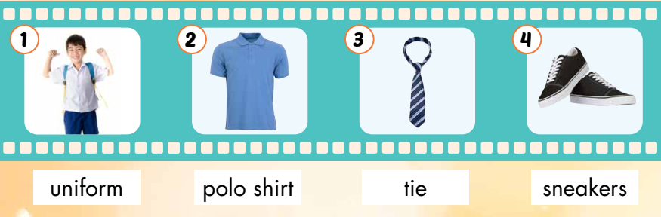
Click each picture to hear the sound.

Slide 4

Practice

Slide 5



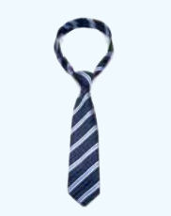
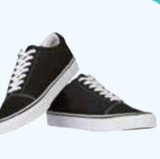
Listen and choose the correct picture.

Slide 6
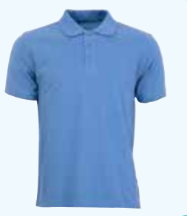
Listen and choose the correct picture.

Slide 7
Listen and choose the correct picture.

Slide 8
Listen and choose the correct picture.

Slide 9
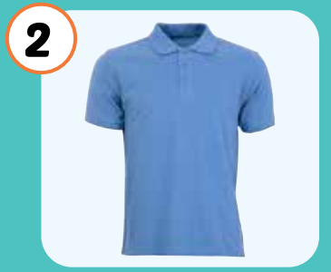
What is it?
a tie
sneakers
a uniform
a polo shirt

Slide 10
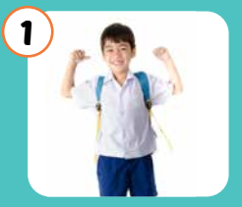
What is it?
a tie
sneakers
a uniform
a polo shirt

Slide 11
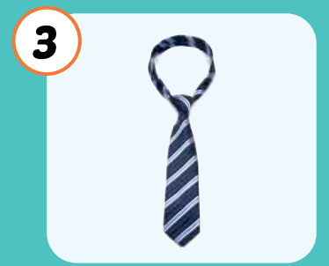
What is it?
a tie
sneakers
a uniform
a polo shirt

Slide 12
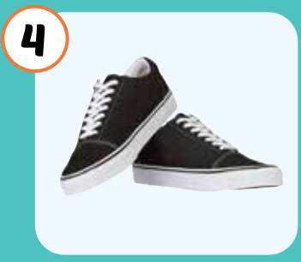
What is it?
a tie
sneakers
a uniform
a polo shirt

Slide 13
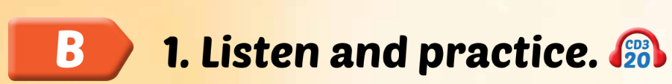
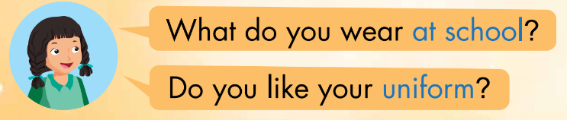
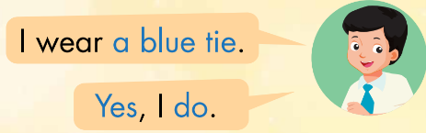
Click the earphone to hear the sound.

Slide 14

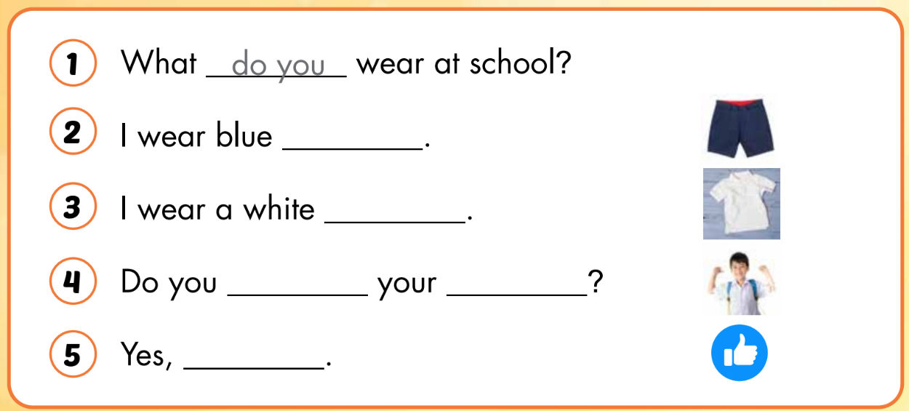
do you
shorts
polo shirt
like
uniform
I do

Slide 15

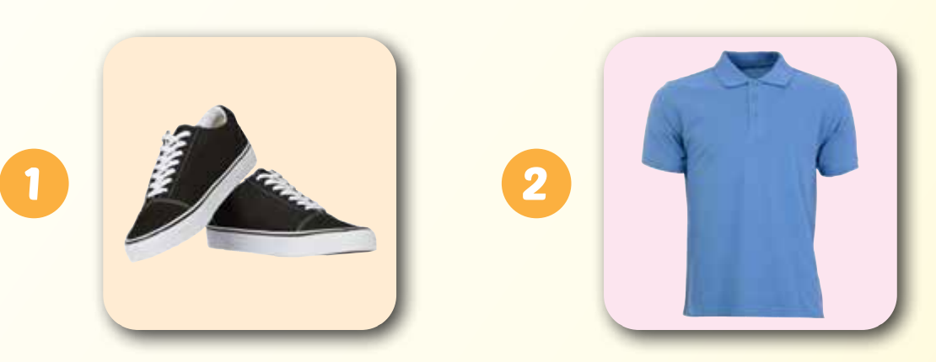
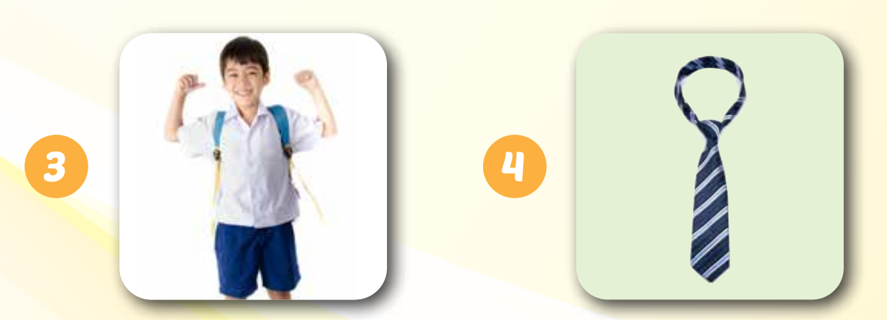
skanerse
loop thsri
sneakers
polo shirt
fmruoin
ite
uniform
tie

Slide 16

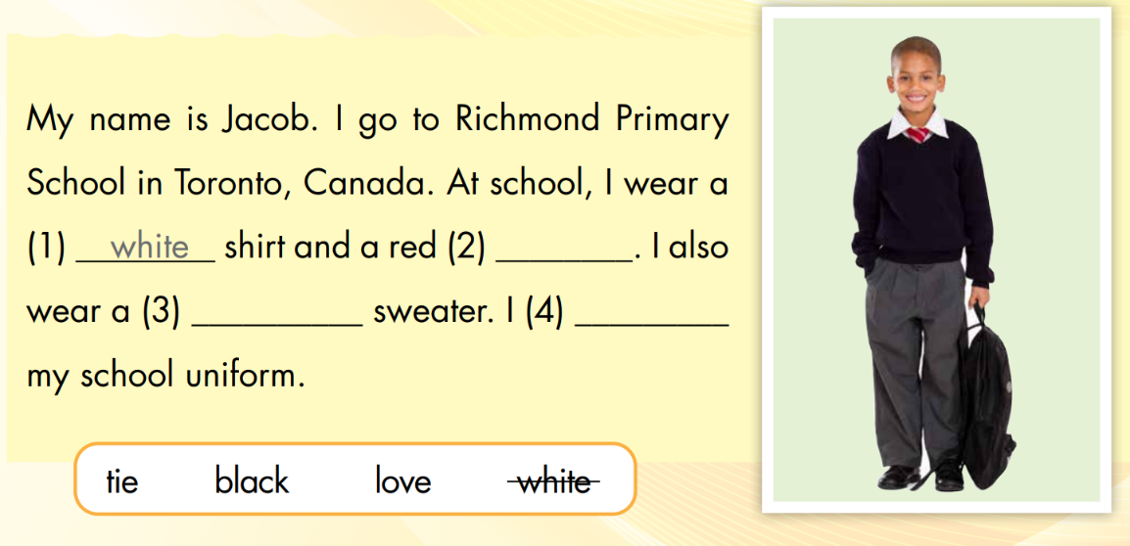
white
tie
black
love

Slide 17
tie
Áo thun có cổ
uniform
Giầy thể thao
polo shirt
Cà vạt
sneakers
Đồng phục

