Slide 1

Unit 6: Clothes
Lesson 3.3
Page 90

Slide 2
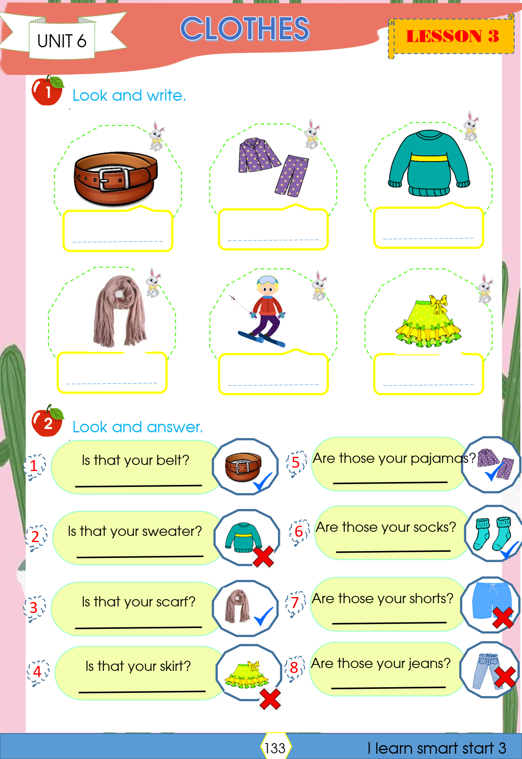

Slide 3
Yes, it is
Yes, they are
No, it isn’t
Yes, they are
No, they aren’t
Yes, it is
No, it isn’t
No, they aren’t

Slide 4
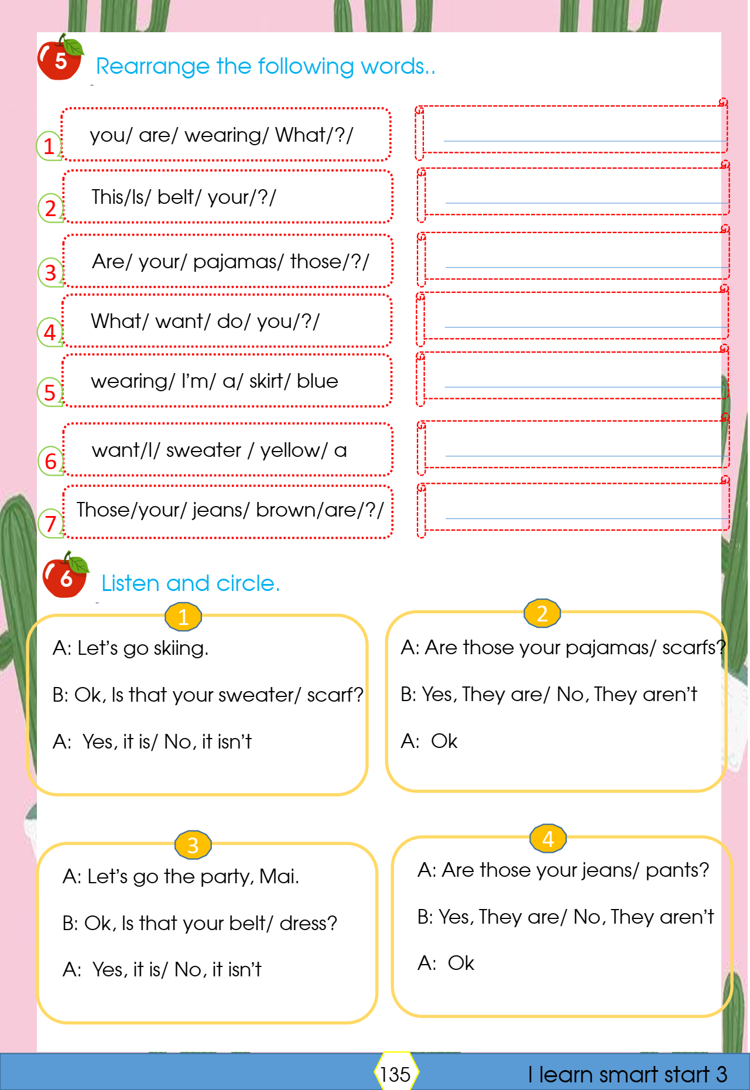
What are you wearing?
Is this your belt?
Are those your pajamas?
What do you want?
I’m wearing a blue skirt.
I want a yellow sweater
Are those your brown jeans?

Slide 5
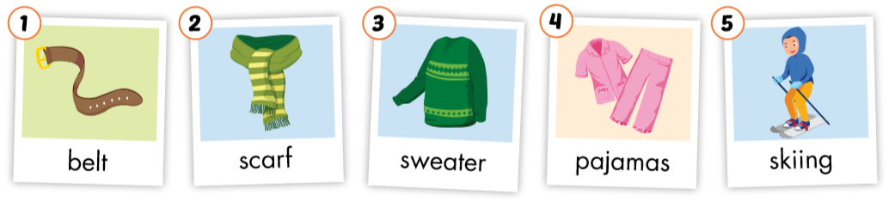

Slide 6
Let’s play!
Pictionary

Slide 7

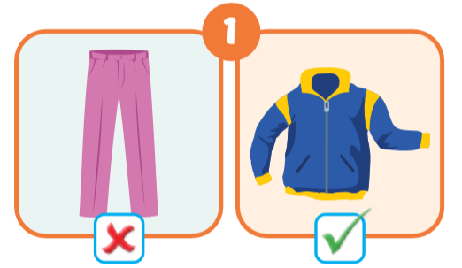
Are those your pants?
No, they aren’t.
Is that your jacket?
Yes, it is.

Slide 8
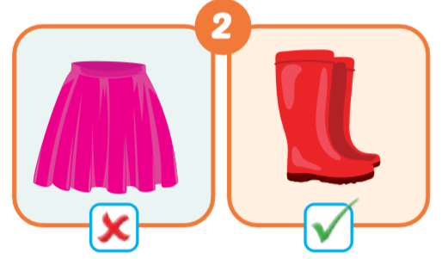
Is that your skirt?
No, it isn’t.
Are those your boots?
Yes, they are.

Slide 9
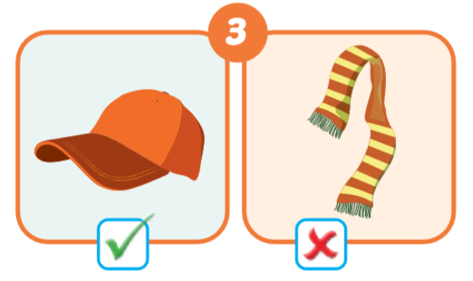
Is that your hat?
Yes, it is.
Is that your scarf?
No, it is’nt.

Slide 10
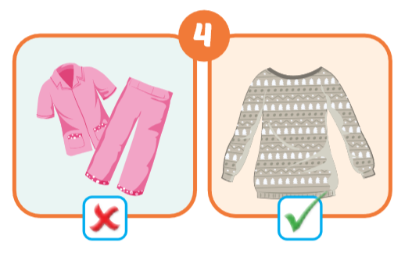
Are those your pajamas?
No, they aren’t.
Is that your sweater?
Yes, it is.

Slide 11
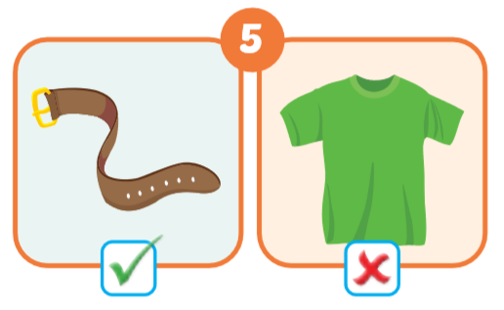
Is that your belt?
Yes, it is.
Is that your T-shirt?
No, it is’nt.

Slide 12
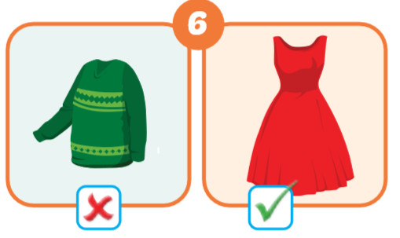
Is that your sweater?
No, it is’nt.
Is that your dress?
Yes, it is.

Slide 13
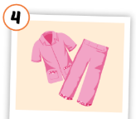
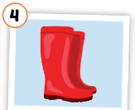
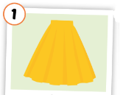
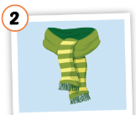
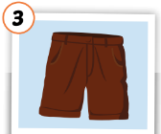
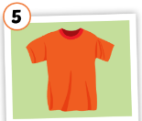
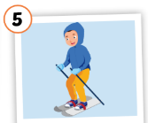
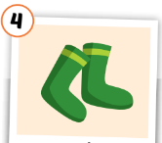
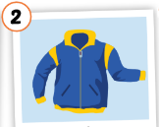
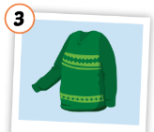
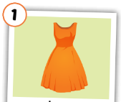
Put the pictures in the right group.
◆
❖
summer
winter

Slide 14

Speaking

Slide 15

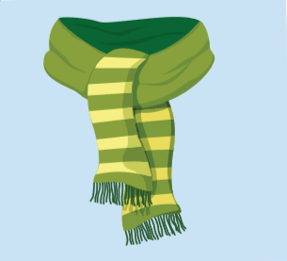

What is behind the question marks?
s
c
a
r
f

Slide 16
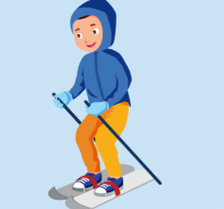
What is behind the question marks?
s
k
i
i
n
g

Slide 17
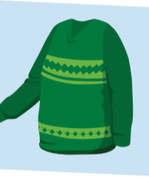
What is behind the question marks?
s
w
e
a
t
e
r

Slide 18
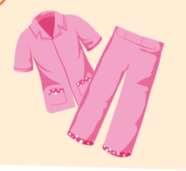
What is behind the question marks?
p
a
j
a
m
a
s

Slide 19
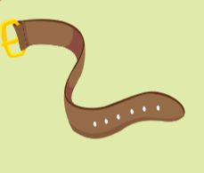
What is behind the question marks?
b
e
l
t

Slide 20

