Slide 1

Unit 1: MY FRIENDS
Lesson 4.3
Page 21

Slide 2
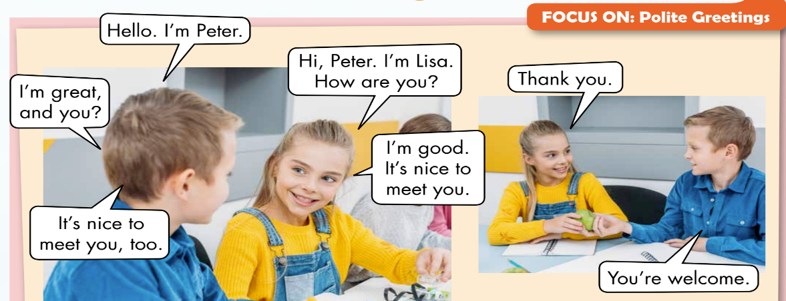
Activity 2
1
2
6
3
4
5
7
1. The boy is Lisa.
True/ False
3. The girl says, ”Thank you.”
True/ False
2. The girl is Peter.
True/ False
4. The boy says, “I’m good”
True/ False
Notes:
Read and circle True or False
Check the answer

Slide 3
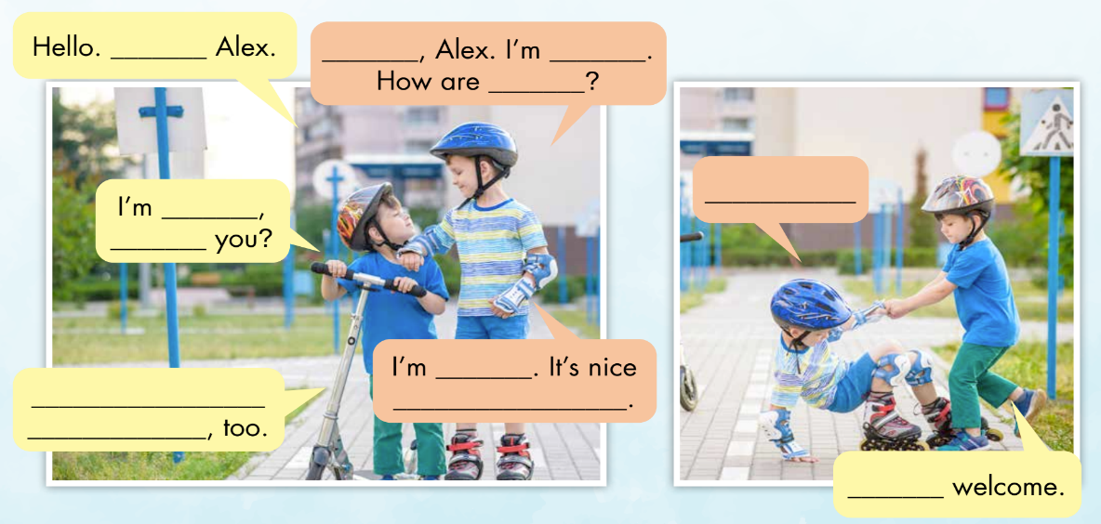
Look and read. Then write the correct words
1
I’m
2
Hi
3
John
4
you
10
Thank you.
5
fine
6
and
7
great
9
It’s nice to
meet you
8
to meet you
11
You’re
Notes:
In groups, ask ss to write the correct answers to complete the “Polite greetings”
Show answers and check. Accept suitable answers

