Slide 1

Unit 1: MY FRIENDS
Lesson 4.1
Page 19

Slide 2


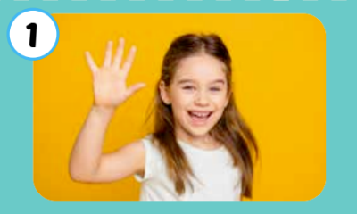
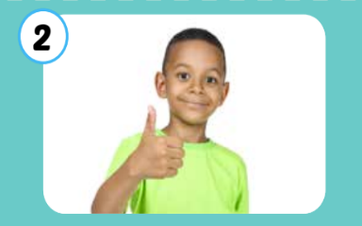

Click each English word to hear the sound.
hi
good
great
﻿/haɪ/
﻿xin chào
﻿/ɡʊd/
﻿﻿khỏe, tốt
﻿﻿/ɡreɪt/
﻿﻿﻿tuyệt vời, rất tốt

Slide 3

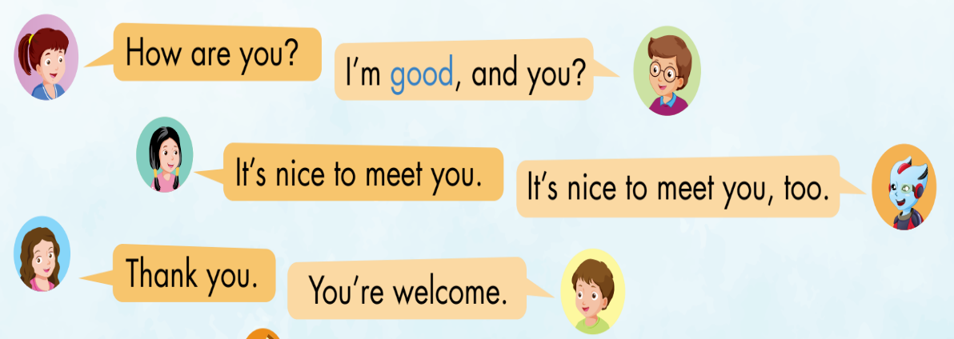
1
Nick
Lucy
2
Jill
3
Alfie
Anna
Tom
Notes:
Set context, analyze picture
Listen to each conversation
Repeat from whole class => big group => small group => pair => individual

Slide 4
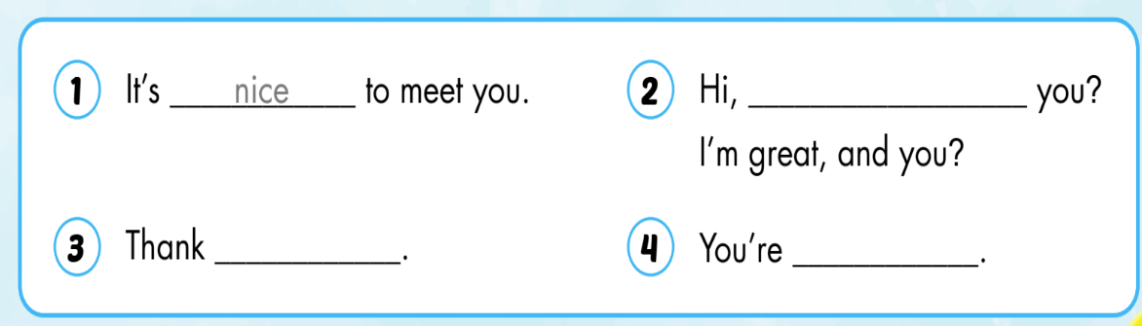
Activity 2
SB p.19
how are
you
welcome

Slide 5

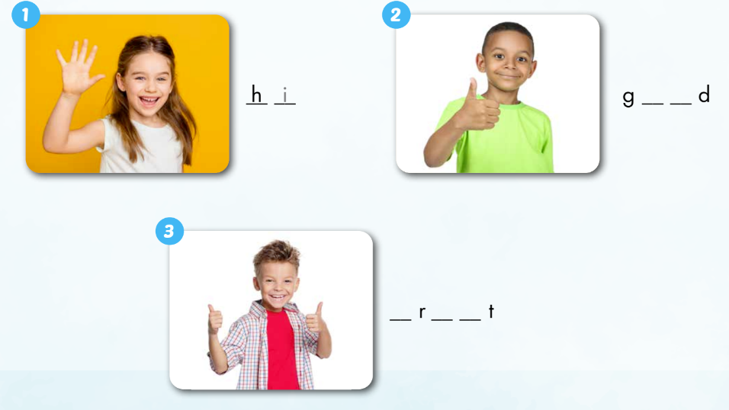
_
i
o o
g e a

Slide 6
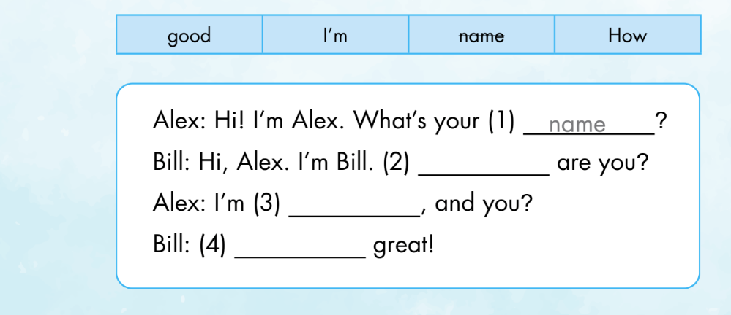
Extra Activity WB p.14
Read and write. Then do the role-play
How
good
I’m
Now it’s your turn. Let’s do the role-play.

