Slide 1

Unit 1: My Friends
Lesson 2
Page 14

Slide 2
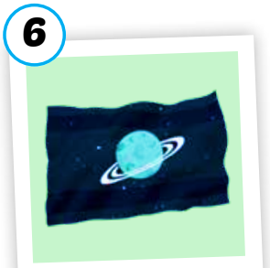

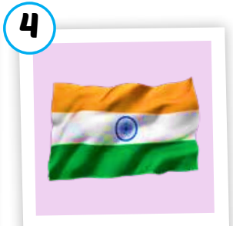




c
1. Listen and repeat
India
Alpha
Notes:
Click the speakers to listen.
Click the light bulb to show the words.
Get student to pay attention to highlighted “a” which is /ə/ sound . Pronounce it correctly.

Slide 3











c
2. Listen and chant.
/ə/, /ə/, /ə/,
/ə/, /ə/, /ə/,
India, Alpha,
/ə/, /ə/, /ə/.
(x2)
Notes:
Click the mic to listen.
Get student to listen and repeat carefully.
Click to show the lyrics.

Slide 4

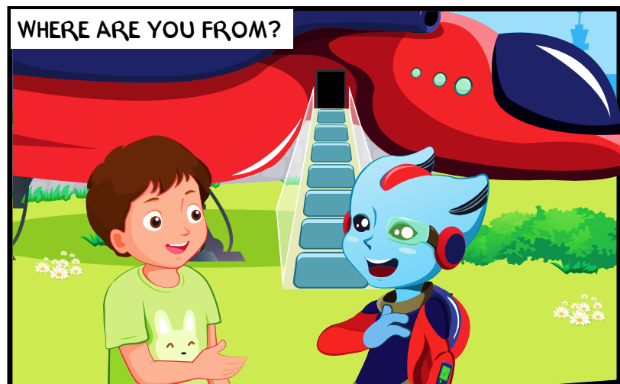
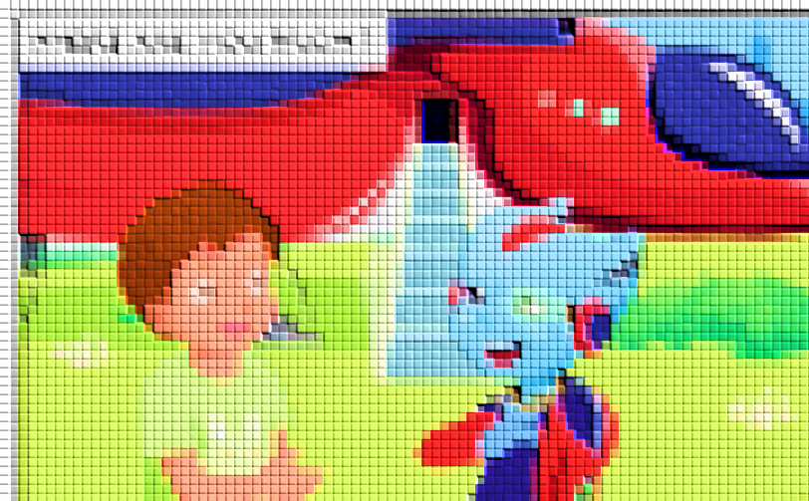
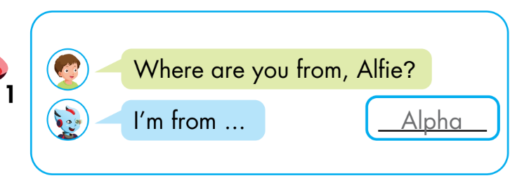
Notes:
Instructions:
Let students guess who are in the picture. Then click on the picture to open it. Say their names.
Ask:
What are they doing? ( talking)
Can you read the question? (Where are you from?)
- Click to show the conversation. Read and then listen. (click the conversation to listen) Explain to students what they have to do.

Slide 5
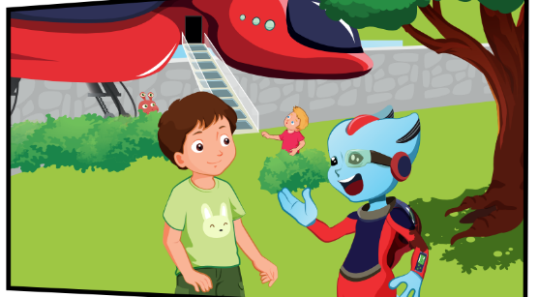
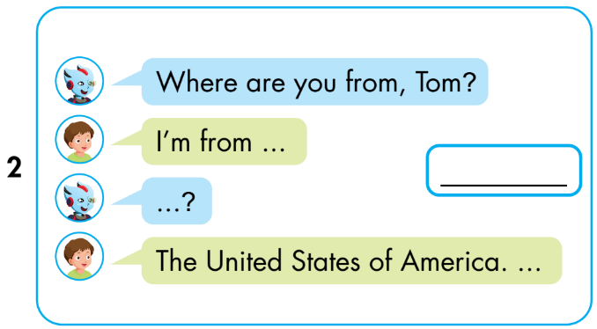
the USA.
U-S-A?
Notes:
Instructions:
Let students guess who are in the picture. Then click on the picture to open it. Say their names.
Ask:
What are they doing? ( talking)
Can you read the question? (Where are you from?)
- Click to show the conversation. Read and then listen. (click the conversation to listen) Explain to students what they have to do.

Slide 6
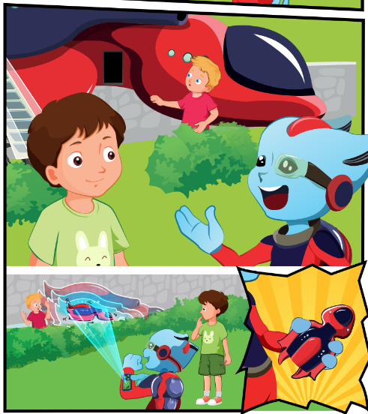
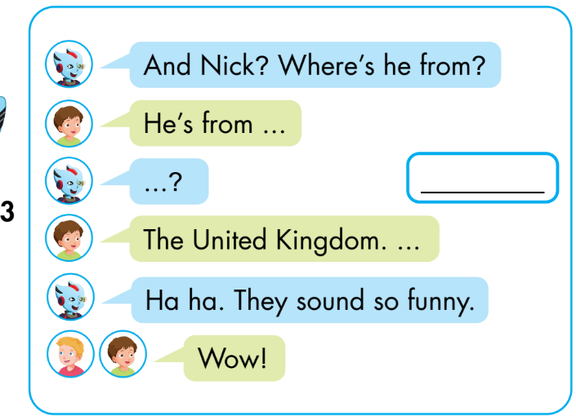
U-K?
the UK.
the UK.
Notes:
Instructions:
Let students guess who are in the picture. Then click on the picture to open it. Say their names.
Ask:
What are they doing? ( talking)
Can you read the question? (Where are you from?)
- Click to show the conversation. Read and then listen. (click the conversation to listen) Explain to students what they have to do.

