Slide 1

Unit 1: My friends
Lesson 2.1
Page 13

Slide 2

It’s time to learn …

Slide 3


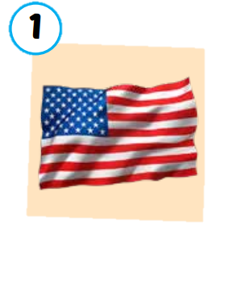

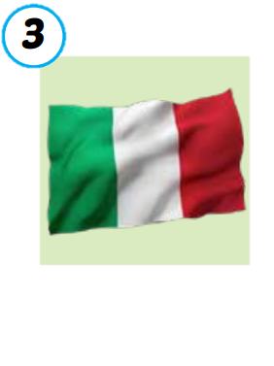
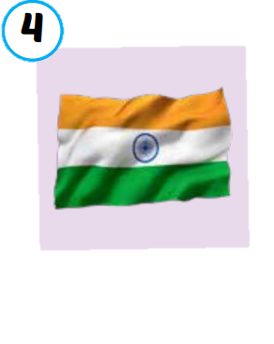
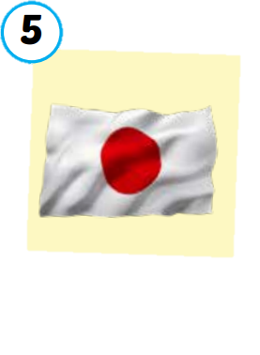
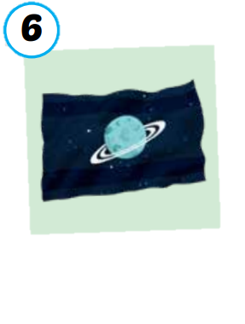
the USA
the UK
Italy
India
Japan
Alpha
/ðə ˌjuː es ˈeɪ/
nước Mỹ,
Hoa Kỳ
/ðə ˌjuː ˈkeɪ/
Vương quốc Anh
/ˈɪtəli/
nước Ý
/ˈɪndiə/
nước Ấn Độ
/dʒəˈpæn/
Nước Nhật
/ˈælfə/
Hành tinh Alpha

Slide 4
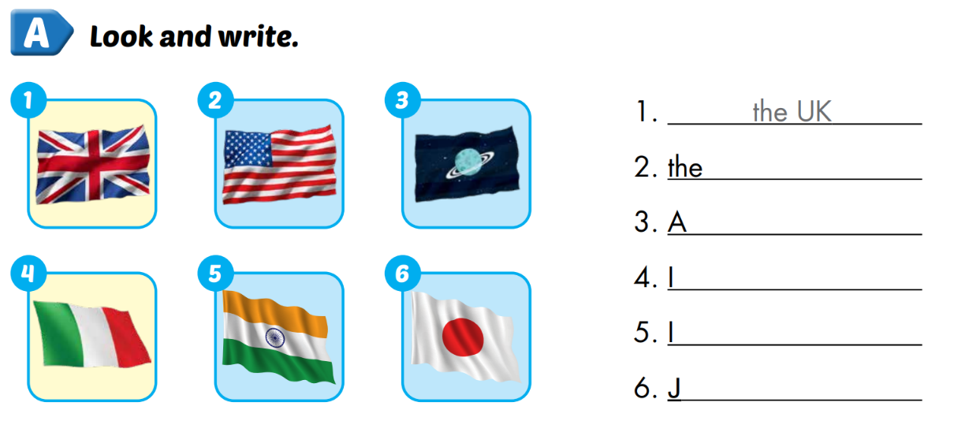
Extra 1 – WB P.10
USA
lpha
taly
ndia
apan

Slide 5








Notes:
Click on each sentence to hear the sound.
Click on the headphone CD1 19 to hear the entire audio.

Slide 6

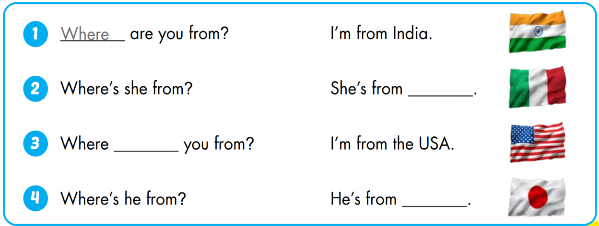
Italy
are
Japan

Slide 7
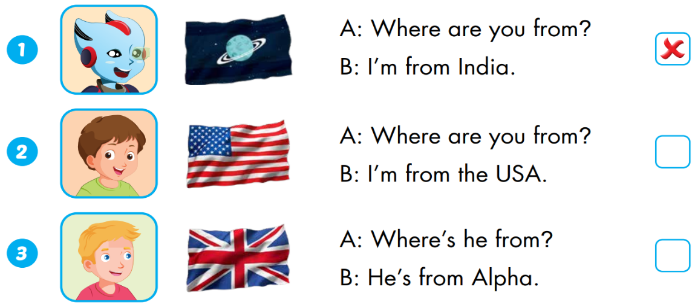


Extra 1 – WB P.10
Alpha
the UK

