Slide 1

Unit 1: My friends
Lesson 1.2
Page 11

Slide 2

It’s time to learn …

Slide 3

Phonics
/sp/

Slide 4


spell
space
Act1. Read and say YES
or NO Listen and check.
spider
spring
strong
speak
spider
spring
surprise
spicy
sport
speak
sport
star
spoil
spicy
spoil
spa
spa
Notes:
(spider, strong, surprise, sport, spoil, spring, speak, spicy, star, spa) audios from Cambridge Dictionary
Click the picture to hear the sound the Aud 14
Click each word to hear the sound of each word
Act 1; click the words to hear the sounds

Slide 5


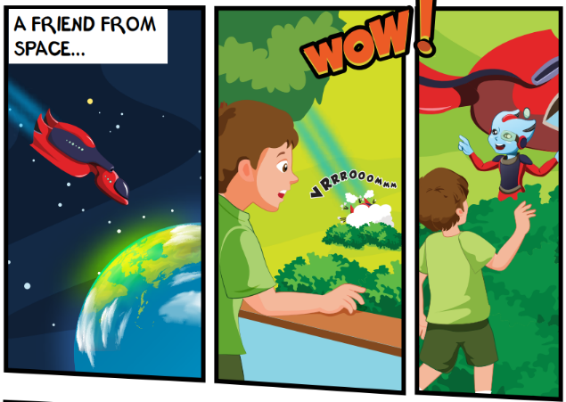
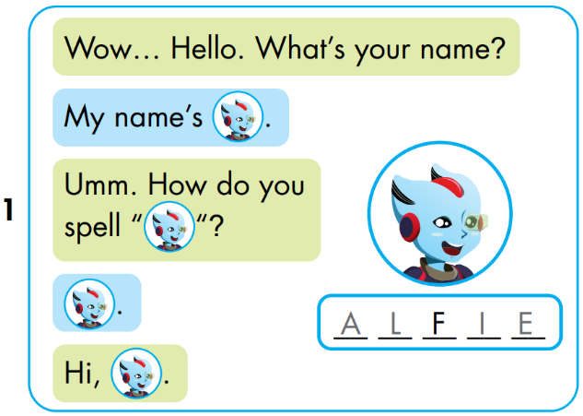


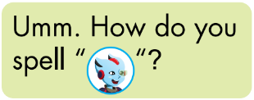


A
L
I
E
Notes:
Click the picture to hear the entire story
Click on the BIG PORTRAIT OF ALFIE to hear the CONVERSATION
Click on each sentence to hear the sound.
Click on THE SPACE (BACKGROUND) to reveal the answer.

Slide 6
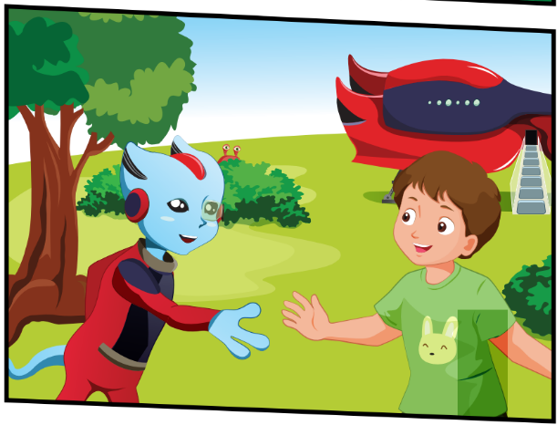
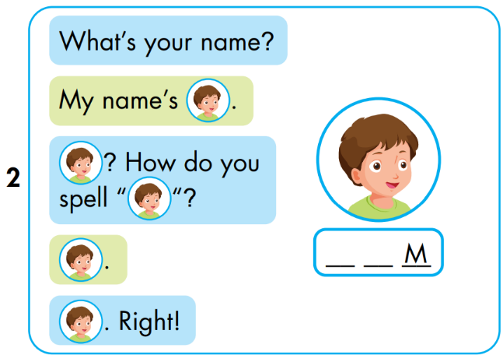


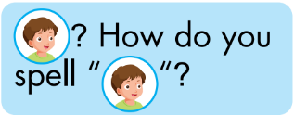


T
O
Notes:
Click the picture to hear the entire story
Click on the BIG PORTRAIT OF ALFIE to hear the CONVERSATION
Click on each sentence to hear the sound.
Click on THE SPACE (BACKGROUND) to reveal the answer.

Slide 7
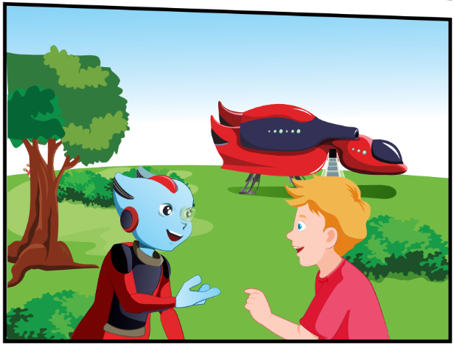
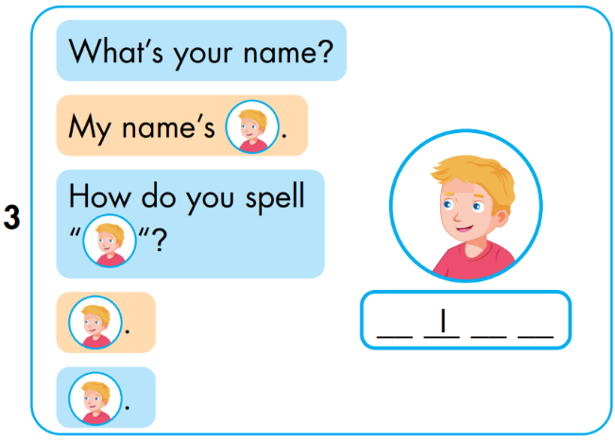


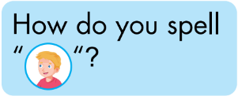


N
C
K
Notes:
Click the picture to hear the entire story
Click on the BIG PORTRAIT OF ALFIE to hear the CONVERSATION
Click on each sentence to hear the sound.
Click on THE SPACE (BACKGROUND) to reveal the answer.

Slide 8
Lesson 3
Today’s lesson
Vocabularies
The Alphabet
Structures/ Sentence patterns
Tom: What’s your name?
Alfie: My name’s Alfie.
Tom: How can you spell “Alife”?
Alfie: A-L-F-I-E.
Phonics
“sp”, spell, space

