Slide 1

Unit 1: My friends
Lesson 1.1
Page 10

Slide 2

New words
The alphabet
A B C...

Slide 3

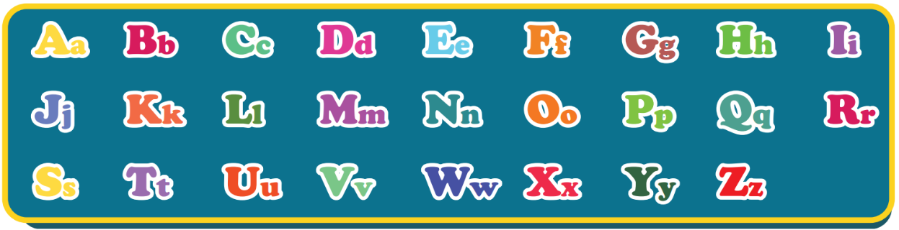
The Alphabet Song
Notes:
Click on the picture to listen to the Alphabet song.
For the first time, the arrow icon automatically appears in group of two-three letters along with the music.
For the second time, guider has to point every single letter for students.

Slide 4

Structures
How do you spell “Alfie”?
A-L-F-I-E.

Slide 5

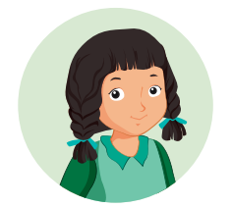
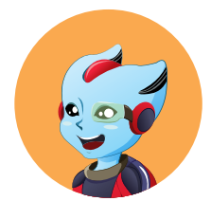
How do you spell “Alfie”?
A-L-F-I-E.
Mai
Alfie
Notes:
- Click on the WORDS to hear the SOUND

Slide 6
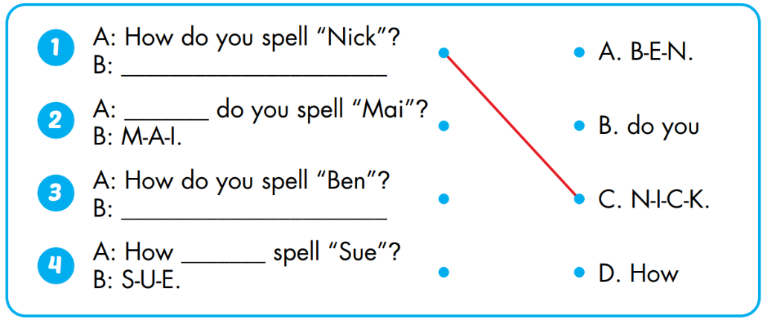
Act1. Look and match. Practice.

Slide 7
Today’s lesson
Vocabularies
The Alphabet
Structures/ Sentence patterns
How do you spell “Alfie”?
A-L-F-I-E.

