Slide 1
Unit 5
CAN YOU SWIM?
Lesson 3

Slide 2
Phonics

Slide 3
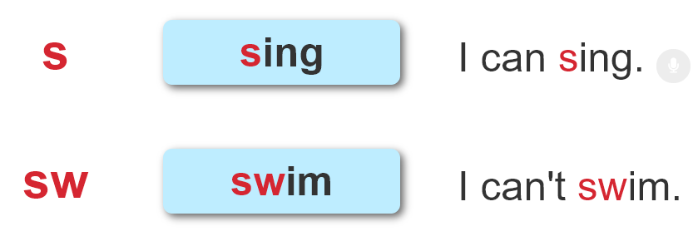


1. Listen and repeat.
.
.

