Slide 1
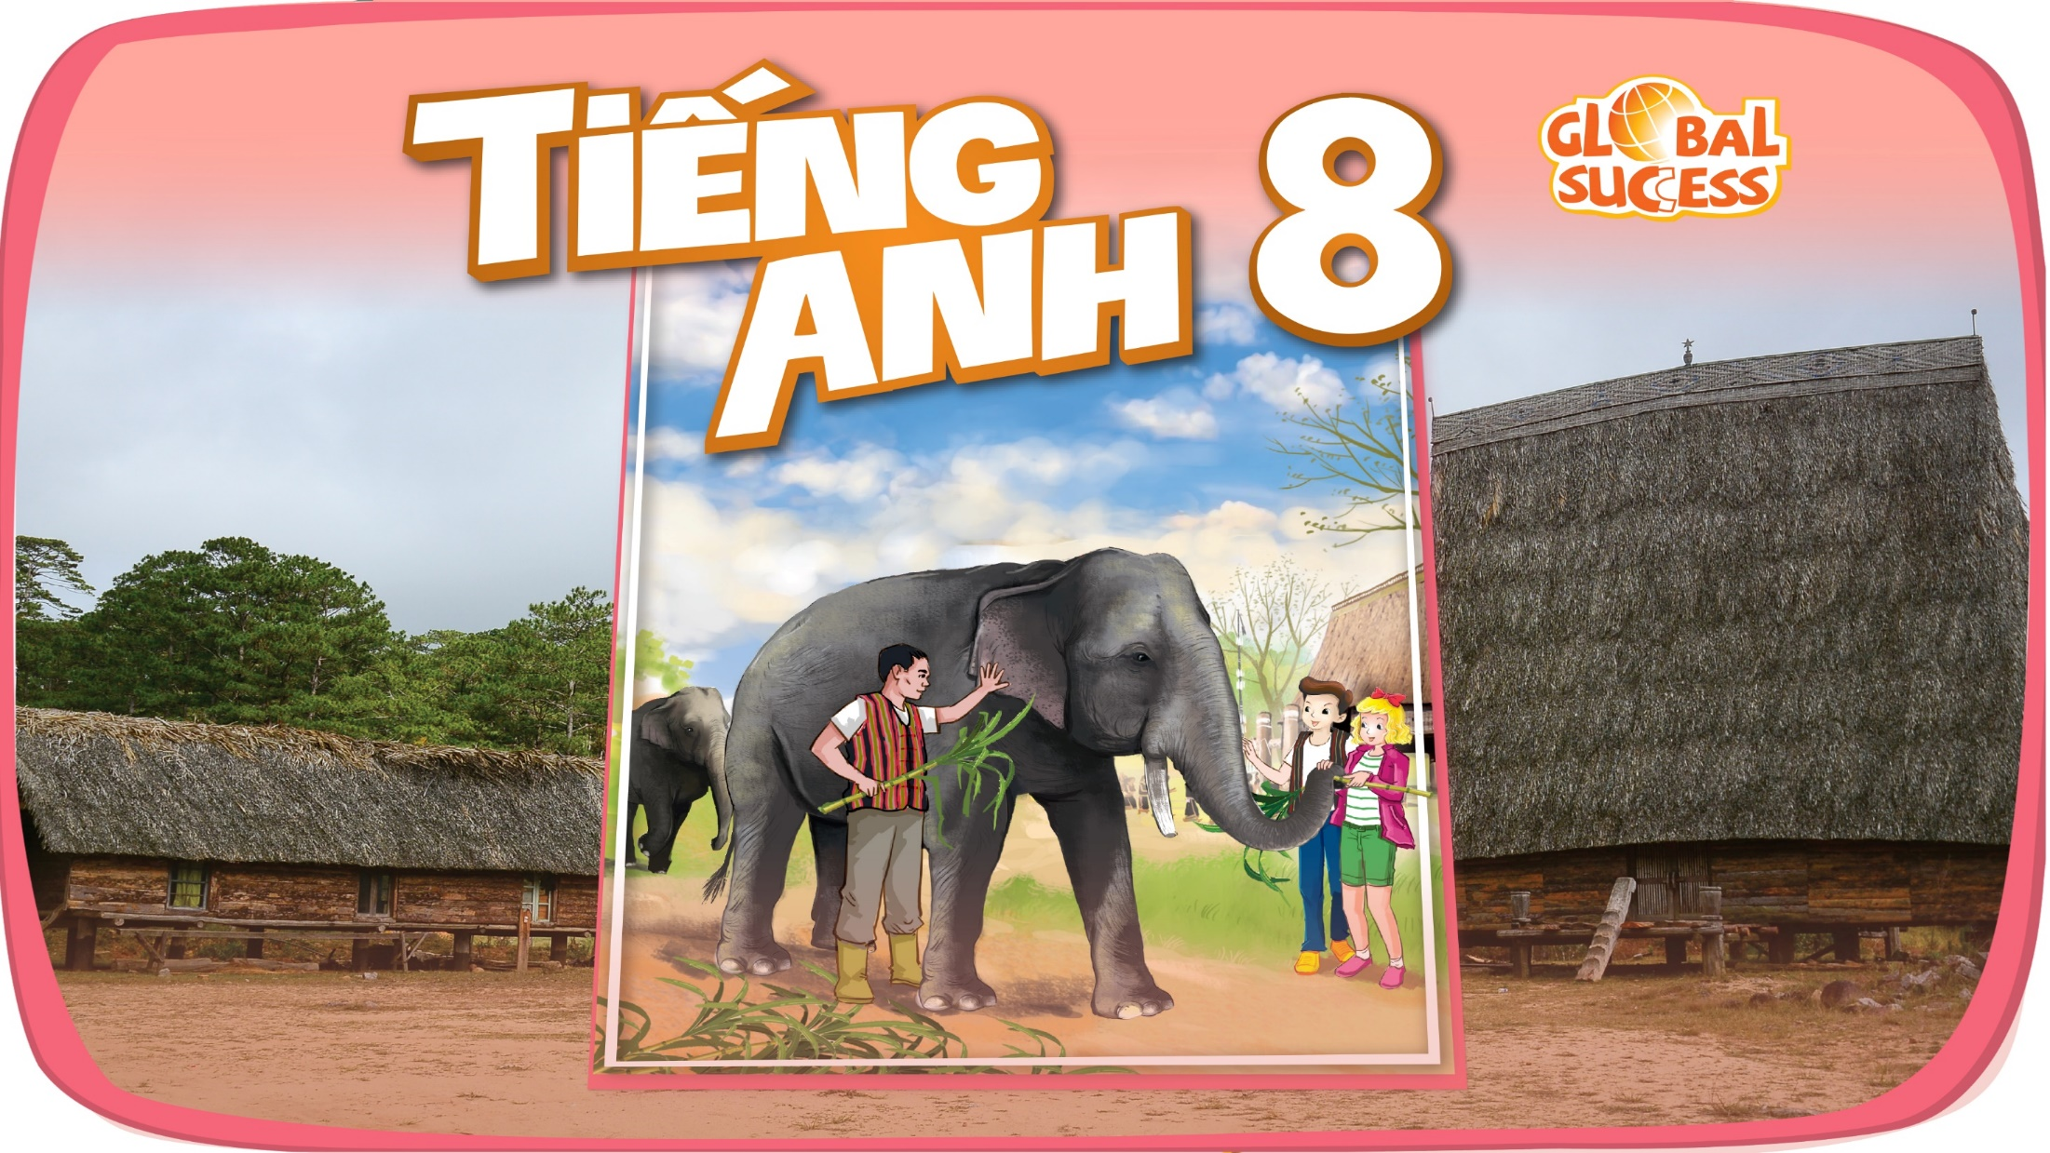

Slide 2

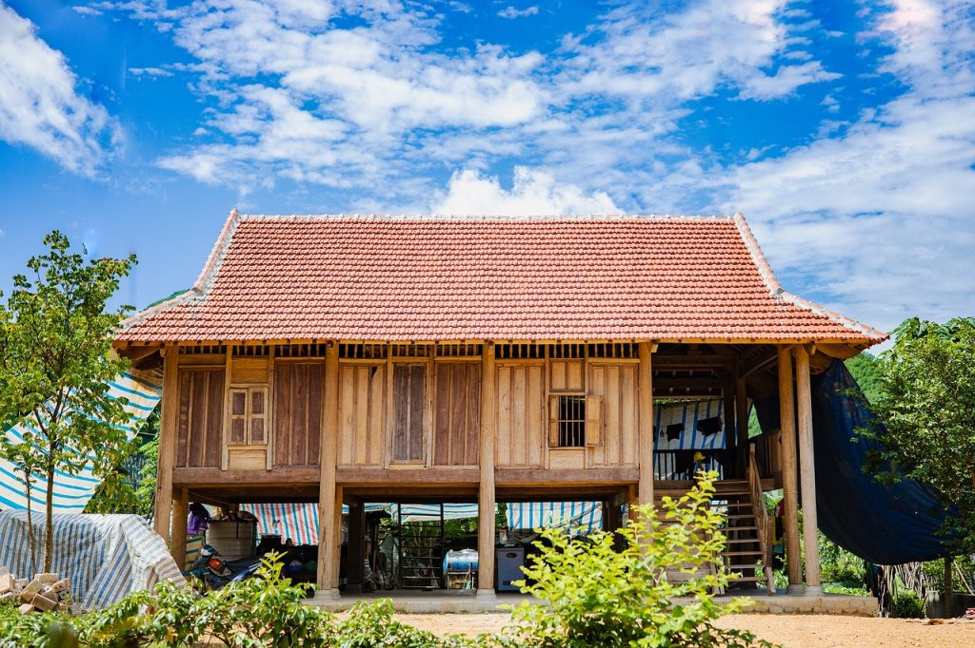
Unit
4
ETHNIC GROUPS OF VIET NAM
Unit
ETHNIC GROUPS OF VIET NAM
PERIOD 31 - LESSON 5: SKILLS 1
LESSON 3: A CLOSER LOOK 2
Unit
HOBBIES

Slide 3
PERRIOD 31 - LESSON 5: SKILLS 1
WARM-UP
Play a game: Word race!
READING
Vocabulary
Task 1: Do matching
Task 2: Read the passage and tick T (true) or F (false)
Task 3: Read the passage again and fill in each blank with one word
SPEAKING
Task 4: Work in pairs. Discuss and tick the features of a stilt house from the list below. Share your opinions with the class.
Task 5: Work in groups. Ask and answer about the type of home each of you lives in. Take notes of your partner’s answer and report what you find to the class
CONSOLIDATION
Wrap-up
Homework

Slide 4
WORD RACE
Instructions
- Work in 4 groups in 2 minutes
List the types of house you can see in the pictures
Check with the others
The winner is the group having the most correct answers.

Slide 5
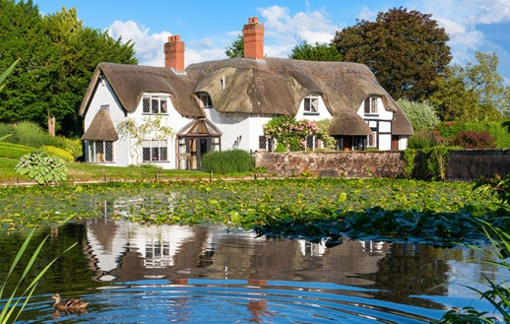
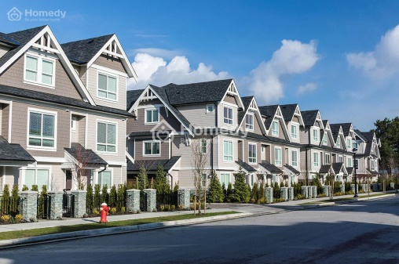
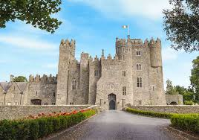
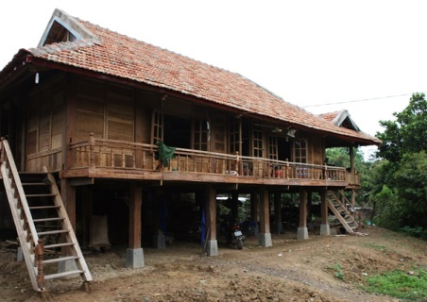
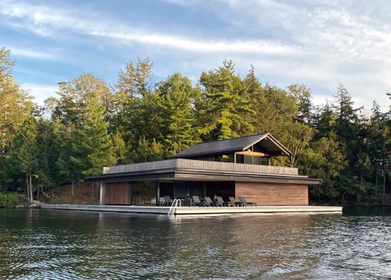
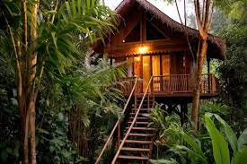
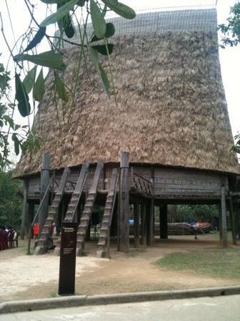
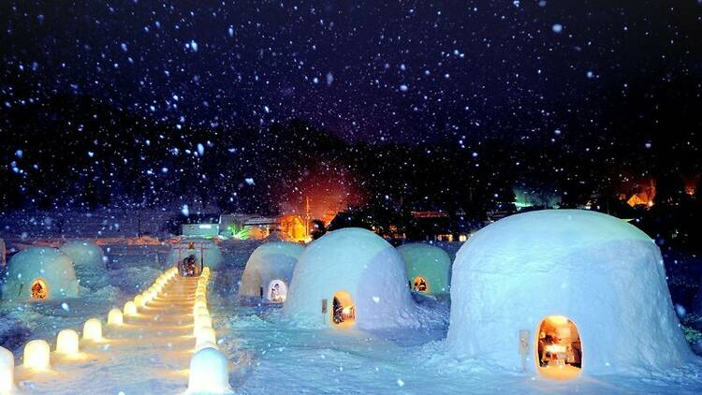
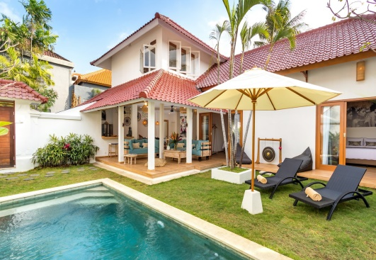

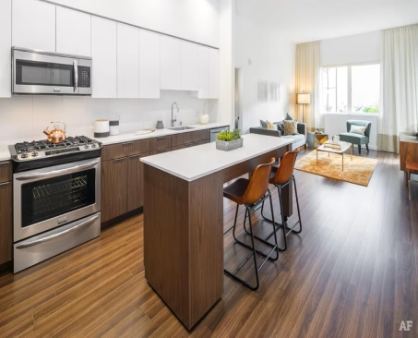
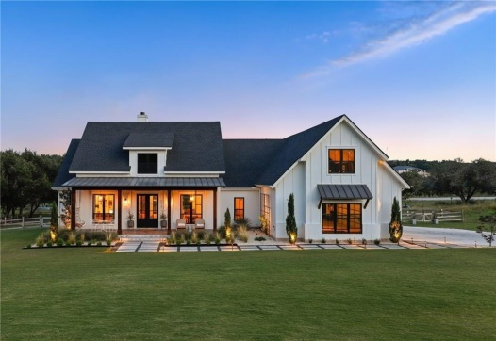


Slide 6
Types of house

Slide 7
COTTAGE
TOWNHOUSE
CASTLE
STILT HOUSE
BOATHOUSE
TREEHOUSE
RONG HOUSE
IGLOO
VILLA
MOTORHOUSE
APARTMENT
FARMHOUSE

Slide 8
READING
Unit
ETHNIC GROUPS OF VIET NAM
STILT HOUSE
LESSON 3: A CLOSER LOOK 2
Unit
HOBBIES

Slide 9
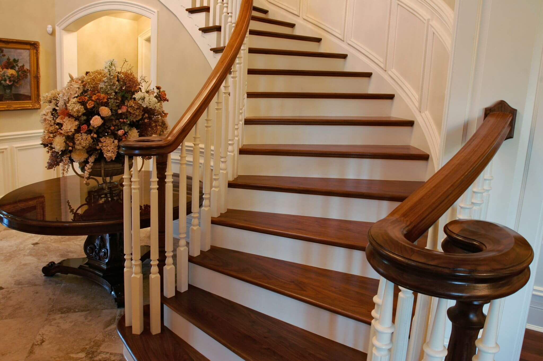

NEW WORDS
staircase (n)
/ˈsteəkeɪs/
cầu thang bộ

Slide 10

NEW WORDS
material (n)
/məˈtɪəriəl/
vật liệu

Slide 11
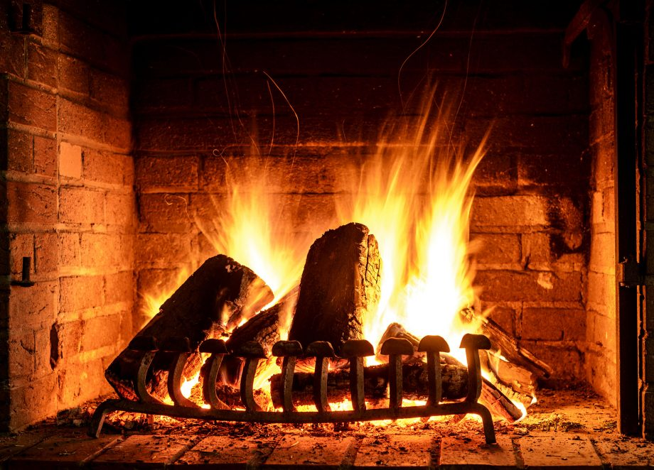
NEW WORDS
open fire (n)
/ˌəʊpən ˈfaɪə/
lò sưởi, bếp lửa

Slide 12

NEW WORDS
owner (n)
/ˈoʊnə/
người sở hữu, chủ

Slide 13
VOCABULARY
New words | Pronunciation | Meaning
1. staircase (n) | /ˈsteəkeɪs/ | cầu thang bộ
2. material (n) | /məˈtɪəriəl/ | vật liệu
3. open fire (n) | /ˌəʊpən ˈfaɪə/ | lò sưởi, bếp lửa
4. owner (n) | /ˈoʊnə/ | người sở hữu, chủ

Slide 14
READING
Unit
ETHNIC GROUPS OF VIET NAM
STILT HOUSE
LESSON 3: A CLOSER LOOK 2
Unit
HOBBIES

Slide 15
I. READING
1. Match the words and phrase from the box in the correct brackets. There is an extra word.
1
open fire
posts
materials
staircase
owners
Stilt houses are popular among different ethnic minority groups, from the Thai in the Northern Highlands to the Khmer in the Mekong Delta. The houses come in different sizes and styles, and show the traditional culture of their (1)………………..
Stilt houses are made from natural materials like wood, bamboo, and leaves. They stand on strong (2)………………, about two or three metres above the ground. This allows them to keep people safe from wild animals. People climb a seven- or nine-step (3)……………….. to enter the house. The most important place in the house is the kitchen. It has an (4)………………….. in the middle of the house. It is the place for family gatherings and receiving guests.
The stilt houses of the Tay and Nung usually overlook a field. The stilt houses of the Thai, however, face mountains or a forest. The Bahnar and Ede have a communal house (called a Rong house) as the heart of their village. These communal houses are the largest and tallest ones in the village.

Slide 16
I. READING
1. Match the words and phrase from the box in the correct brackets. There is an extra word.
1
open fire
posts
materials
staircase
owners
Stilt houses are popular among different ethnic minority groups, from the Thai in the Northern Highlands to the Khmer in the Mekong Delta. The houses come in different sizes and styles, and show the traditional culture of their (1)………………..
Stilt houses are made from natural materials like wood, bamboo, and leaves. They stand on strong (2)………………, about two or three metres above the ground. This allows them to keep people safe from wild animals. People climb a seven- or nine-step (3)……………….. to enter the house. The most important place in the house is the kitchen. It has an (4)………………….. in the middle of the house. It is the place for family gatherings and receiving guests.
The stilt houses of the Tay and Nung usually overlook a field. The stilt houses of the Thai, however, face mountains or a forest. The Bahnar and Ede have a communal house (called a Rong house) as the heart of their village. These communal houses are the largest and tallest ones in the village.

Slide 17
Stilt houses
Stilt houses are popular among different ethnic minority groups, from the Thai in the Northern Highlands to the Khmer in the Mekong Delta. The houses come in different sizes and styles, and show the traditional culture of their owners.
Stilt houses are made from natural materials like wood, bamboo, and leaves. They stand on strong posts, about two or three metres above the ground. This allows them to keep people safe from wild animals. People climb a seven- or nine-step staircase to enter the house. The most important place in the house is the kitchen. It has an open fire in the middle of the house. It is the place for family gatherings and receiving guests.
The stilt houses of the Tay and Nung usually overlook a field. The stilt houses of the Thai, however, face mountains or a forest. The Bahnar and Ede have a communal house (called a Rong house) as the heart of their village. These communal houses are the largest and tallest ones in the village.

Slide 18
READING
2
Read the passage and tick T (True) or F (False)
Statements | True | False
1. Only a few minority groups live in stilt houses.
2. All stilt houses look alike.
3. Family gatherings take place by the open fire in the middle of the house.
4. The Rong house serves as the centre of an Ede village

Slide 19

READING
2
Read the passage and tick T (True) or F (False)
Statements | True | False
1. Only a few minority groups live in stilt houses.
2. All stilt houses look alike.
3. Family gatherings take place by the open fire in the middle of the house.
4. The Rong house serves as the centre of an Ede village

Slide 20
Stilt houses
Stilt houses are popular among different ethnic minority groups, from the Thai in the Northern Highlands to the Khmer in the Mekong Delta. The houses come in different sizes and styles, and show the traditional culture of their owners.
Stilt houses are made from natural materials like wood, bamboo, and leaves. They stand on strong posts, about two or three metres above the ground. This allows them to keep people safe from wild animals. People climb a seven- or nine-step staircase to enter the house. The most important place in the house is the kitchen. It has an open fire in the middle of the house. It is the place for family gatherings and receiving guests.
The stilt houses of the Tay and Nung usually overlook a field. The stilt houses of the Thai, however, face mountains or a forest. The Bahnar and Ede have a communal house (called a Rong house) as the heart of their village. These communal houses are the largest and tallest ones in the village.

Slide 21
READING
2
Read the passage and tick T (True) or F (False)
Statements | True | False
1. Only a few minority groups live in stilt houses.
2. All stilt houses look alike.
3. Family gatherings take place by the open fire in the middle of the house.
4. The Rong house serves as the centre of an Ede village

Slide 22
Stilt houses
Stilt houses are popular among different ethnic minority groups, from the Thai in the Northern Highlands to the Khmer in the Mekong Delta. The houses come in different sizes and styles, and show the traditional culture of their owners.
Stilt houses are made from natural materials like wood, bamboo, and leaves. They stand on strong posts, about two or three metres above the ground. This allows them to keep people safe from wild animals. People climb a seven- or nine-step staircase to enter the house. The most important place in the house is the kitchen. It has an open fire in the middle of the house. It is the place for family gatherings and receiving guests.
The stilt houses of the Tay and Nung usually overlook a field. The stilt houses of the Thai, however, face mountains or a forest. The Bahnar and Ede have a communal house (called a Rong house) as the heart of their village. These communal houses are the largest and tallest ones in the village.

Slide 23
READING
2
Read the passage and tick T (True) or F (False)
Statements | True | False
1. Only a few minority groups live in stilt houses.
2. All stilt houses look alike.
3. Family gatherings take place by the open fire in the middle of the house.
4. The Rong house serves as the centre of an Ede village

Slide 24
Stilt houses
Stilt houses are popular among different ethnic minority groups, from the Thai in the Northern Highlands to the Khmer in the Mekong Delta. The houses come in different sizes and styles, and show the traditional culture of their owners.
Stilt houses are made from natural materials like wood, bamboo, and leaves. They stand on strong posts, about two or three metres above the ground. This allows them to keep people safe from wild animals. People climb a seven- or nine-step staircase to enter the house. The most important place in the house is the kitchen. It has an open fire in the middle of the house. It is the place for family gatherings and receiving guests.
The stilt houses of the Tay and Nung usually overlook a field. The stilt houses of the Thai, however, face mountains or a forest. The Bahnar and Ede have a communal house (called a Rong house) as the heart of their village. These communal houses are the largest and tallest ones in the village.

Slide 25
READING
2
Read the passage and tick T (True) or F (False)
Statements | True | False
1. Only a few minority groups live in stilt houses.
2. All stilt houses look alike.
3. Family gatherings take place by the open fire in the middle of the house.
4. The Rong house serves as the centre of an Ede village

Slide 26
Stilt houses
Stilt houses are popular among different ethnic minority groups, from the Thai in the Northern Highlands to the Khmer in the Mekong Delta. The houses come in different sizes and styles, and show the traditional culture of their owners.
Stilt houses are made from natural materials like wood, bamboo, and leaves. They stand on strong posts, about two or three metres above the ground. This allows them to keep people safe from wild animals. People climb a seven- or nine-step staircase to enter the house. The most important place in the house is the kitchen. It has an open fire in the middle of the house. It is the place for family gatherings and receiving guests.
The stilt houses of the Tay and Nung usually overlook a field. The stilt houses of the Thai, however, face mountains or a forest. The Bahnar and Ede have a communal house (called a Rong house) as the heart of their village. These communal houses are the largest and tallest ones in the village.

Slide 27
READING
2
Read the passage and tick T (True) or F (False)
Statements | True | False
1. Only a few minority groups live in stilt houses.
2. All stilt houses look alike.
3. Family gatherings take place by the open fire in the middle of the house.
4. The Rong house serves as the centre of an Ede village

Slide 28
READING
3
Read the passage again and fill in each blank with one word.
1. A stilt house shows the _________ culture of the owner.
traditional
2. The Tay’s and Nung’s stilt houses overlook a _________.
field
3. The Thai’s stilt houses overlook a _________ or __________.
forest
mountains
4. The largest and tallest house in an Ede village is the _________ house.
Rong

Slide 29
SPEAKING
Unit
ETHNIC GROUPS OF VIET NAM
LESSON 3: A CLOSER LOOK 2
Unit
HOBBIES

Slide 30


SPEAKING
4
Work in pairs. Discuss and tick ( )the features of a stilt house from the list below. Share your opinions with the class.
A stilt house ____________.
- has a flat cement roof
- stands on big posts
- is made from natural materials
- has a modern toilet
- is a flat in a big block
- is close to nature

Slide 31
SPEAKING
5
Work in groups of 4 or 5. Ask and answer about the type of home each of you lives in. Take notes of your partner’s answer and report what you find to the class.
1. What type of home do you live in?
2. What materials is it made from?
3. What is the most important part of your home? What do you do there?

Slide 32
SPEAKING: Take a note
 | Student 1 | Student 2 | Student 3 | Student 4
Type of house you live in
It’s made from
The most important part/ What you do there

Slide 33
SPEAKING: Report
 | Student 1 Nam | Student 2 | Student 3 | Student 4
Type of house you live in | Townhouse
It’s made from | Cement, brick,…
The most important part/ What you do there | The living room People in the family gather to talk about a hard-working day….

Slide 34

CONSOLIDATION
1
Wrap-up
In this lesson, you have:
learnt new words related to the topic of stilt house.
read a passage about stilt houses.
described the house you live in.

Slide 35

CONSOLIDATION
2
Homework
Learn by heart all the new words.
Do exercises in the workbook.
Prepare for Lesson 6 – Skills 2.

Slide 36

Website: hoclieu.vn
Fanpage: facebook.com/www.tienganhglobalsuccess.vn/

