Slide 1

Monday, October 04, 2021
ENGLISH 8

Slide 2
Fill each blank with a word/phrase in the box.
WARM UP
harvest time
rice
busiest time
buffalo-drawn carts
herding
noisier than
1. At the___________, my brother always helps my parents load the rice onto the truck and drives it home.
2. I often help my parents dry the __________ in the yard in front of my house.
3. Some farmers in my village still use _______________ to transport rice home.
4. He usually goes __________ the buffaloes with other boys in his village.
5. Harvest time is the ___________ of the year in the countryside.
6. My uncle lives in the city. He says it's __________ my village.

Slide 3



Monday, October 04, 2021
New lesson
UNIT 2: LIFE IN THE COUNTRYSIDE
LESSON 6: SKILLS 2

Slide 4
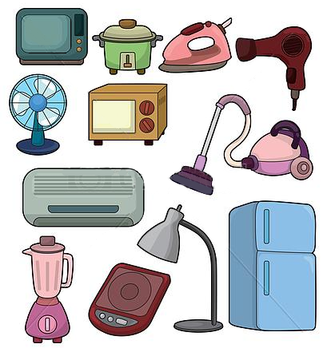
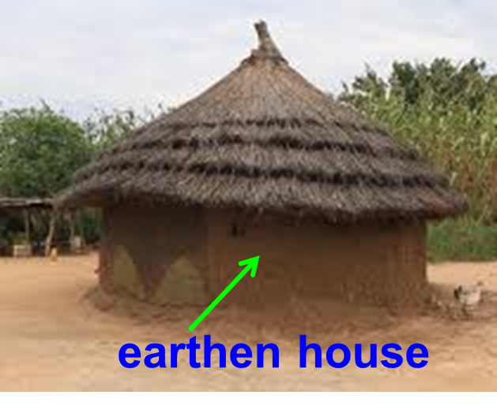
Vocabulary:
earthen /ˈɜːθn / (a)
equipped /ɪˈkwɪpt / (a)
thanks to /θæŋks tə/ (pre)
no longer /nəʊ ˈlɔːŋɡər/ (adv)
stream /striːm/ (n)
experience /ɪkˈspɪəriəns/ (v)
electrical appliances /ɪˈlektrɪkl əˈplaɪənsɪz/ (n)
: đất, bằng đất
: được trang bị
: nhờ vào
: không…còn nữa
: suối, dòng suối
: trãi nghiệm
: thiết bị điện

Slide 5
Checking vocabulary:
Monday, October 04, 2021
earthen /ˈɜːθn / (a)
equipped /ɪˈkwɪpt / (a)
thanks to /θæŋks tə/ (pre)
no longer /nəʊ ˈlɔːŋɡər/ (adv)
stream /striːm/ (n)
experience /ɪkˈspɪəriəns/ (v)
electrical appliances /ɪˈlektrɪkl əˈplaɪənsɪz/ (n)
: đất, bằng đất
: được trang bị
: nhờ vào
: không…còn nữa
: suối, dòng suối
: trãi nghiệm
: thiết bị điện

Slide 6
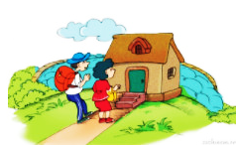

LISTENING:
1. Listen to a boy talking about changes in his village and tick (✓) the changes he mentions.
A. ____ the roads in the village
B. ____ electrical appliances in the homes
C. ____ means of transport
D. ____ entertainment
E. ____ school
F. ____ visitors
✓
✓
✓
✓

Slide 7
2. Listen again and say if the sentences are true (T) or false (F).
1. Nobody lives in an earthen house now.
2. The village has electricity now.
3. Horses are still the only means of transport in the village.
4. The children used to go a long way to school.
5. More visitors are coming to see them.
F
Some villagers now live in brick houses instead of earthen ones.
T
F
More villagers are using motorcycles for transport instead of riding a horse or walking.
T
T

Slide 8
3. Listen again and answer the questions in no more than FOUR words.
1. Who often tells the boy stories about the past?
2. What do the villagers now know more about?
3. Where is the new school?
4. What do the visitors want to experience in the village?
His parents
Life outside their village
Nearby / Near the village
The country life

Slide 9
Audio script: I live in a mountain village. My parents often tell me stories about their life in the past. It’s not much like the village I can see nowadays. Some villagers now live in brick houses instead of earthen ones. Our houses are better equipped with electric fans and TVs. Thanks to the TV, we now know more about life outside our village. We don’t use oil lamps any more. We have electric lights which are much brighter. More villagers are using motorcycles for transport instead of riding a horse or walking. We – village children – no longer have to walk a long way and cross a stream to get to school, which is dangerous in the rainy season. Now there’s a new school nearby. We also have more visitors from the city. They come to experience our way of life.

Slide 10
Writing:
Monday, October 04, 2021
4. What do you think?
Which change(s) in the Listening do you see as positive? Which do you see as negative? Support your opinion with a reason. Write it out.
Example:
It’s good for the villagers to have TVs. They can now have more fun and learn more about diﬀerent people and diﬀerent places.

Slide 11
More suggested ideas:
- I think electric light plays a very important part in the life of the villagers. It helps people see everything clearly at night so they can do more work.
- A nearby school is very helpful to people here because they don't have go to a long way to school, which very dangerous in rainy seasons. It will help develop the village.
- I believe that more people will go to the village to experience life here, which is a good thing for the villagers because they can develop tourism. They will have more work and more money.

Slide 12
5. Work in groups. Discuss and find some changes in a rural area. Make notes of the changes.
Suggested discussion 1:
A: The rural area changes so much now.
B: Really? What is the change?
A: People don't use buffaloes for transport. They use motorbikes. They have running water, electricity and TVs at home.
B: Anything else?
A: The school is near the village. There are also good hospitals there.

Slide 13
Suggested discussion 2:
A: Rural areas in our country are changing so much, aren't they?
B: Yes, they are. I think the first change is that nearly each household has modem appliances like a fridge, a washing machine or a TV.
A: Exactly. Another change is you can hardly see dirt roads in the country. Modern roads have replaced them. There are even cemented roads across the rice fields.
B: I think one more change is that people in rural areas have been richer than before. They use motorbikes, even cars instead of bicycles.

Slide 14
6. Write a short paragraph about the changes in a rural area/ your village
Writing sample 1
My hometown has changed a lot. Firstly, the local people have different appearance with fashionable clothes. Secondly, many of them now have cell phones and motorbikes or even cars. They are living in modem brick houses. Besides, the Internet is very popular among the residents and they use it for learning, making new friends and playing games. They really feel pleased about the changes.

Slide 15
Writing sample 2
My hometown changes so much. The first change is life of the local people. They lead a better life because they have electricity, TVs, better hospitals, schools near the village. The second change is that the people get richer and richer. They have built more brick houses to live in, not in earthen ones anymore. The last change is that famers now use machines such as tractors, combine harvesters … for their farm work. They don’t use cows or buffaloes anymore.

Slide 16
There are a lot of changes in my village in the recent years. The roads in the village are now very easy to travel on because they are made with cement and brick instead of dirt like in the past. Many villagers have TV and modern electric devices which help them know more about life in the country and even around the world. We had no TVs before and our knowledge was very little. Now we can watch TV, read newspaper and have more chances to do business with others. We also have the Internet which helps us communicate easily and conveniently.
Although this development is basically good, it also has some negative effects. Some factories cause air and water pollution. More entertainment centres have been set up. It makes some young people become lazier and they only want to play, they don't want to study hard anymore. I hope that they won't be addicted to games and will study for the sustainable development of themselves, of their family and of our country.
Writing sample 3

Slide 17


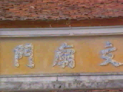
HOMEWORK
- Learn the new words by heart.
- Practice listening to a boy talking about changes in his village on page 23 again.
- Write a passage on the topic: What changes are there in your home village?
- Do exercises E1,2 in workbook (page 15)
- Prepare for Unit 2: Looking back
+

Slide 18
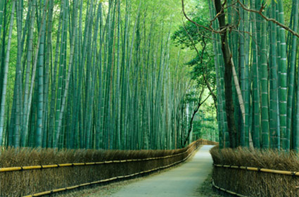
THANKS FOR YOUR ATTENTION!
Goodbye!
See you again!

Slide 19
rice countryside herding buffalo busiest time
harvest time buffalo-drawn carts colourful fantastic noisier than
1. At the__________, my brother always helps my parents load the rice onto the truck and drives it home.
2. I often help my parents dry the __________ in the yard in front of my house.
3. Some farmers in my village still use __________ to transport rice home.
4. He usually goes __________ the buffaloes with other boys in his village.
5. My pen pal friend says he would like to visit my __________ at harvest time to see what farmers do.
6. My friend has never ridden a __________ so he would like to try once.
7. Harvest time is the __________ of the year in the countryside.
8. Our garden is __________ in spring when almost flowers bloom.
9. I like looking at the stars on starry nights. It's __________.
10. My uncle lives in the city. He says it's __________ my village.

