Slide 1

Unit 1- LEISURE ACTIVITIES
Lesson 3- A CLOSER LOOK 2

Slide 2
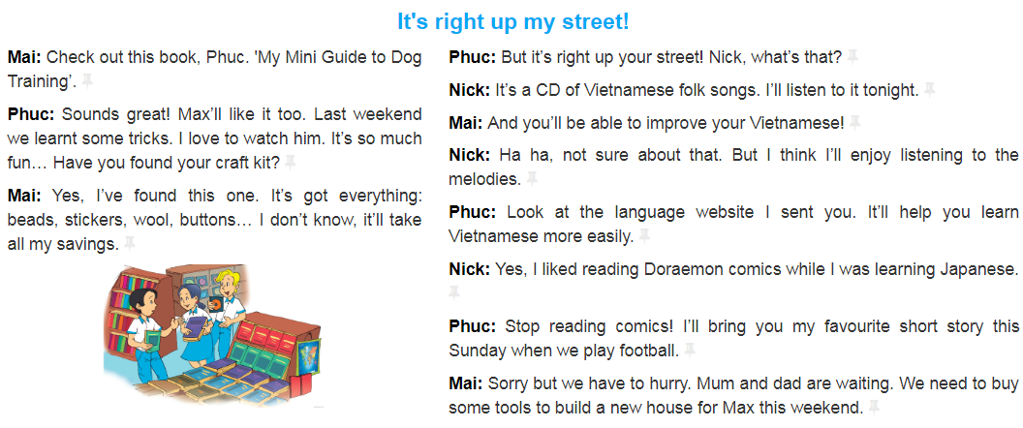

UNIT 1- LEISURE ACTIVITIES – A CLOSER LOOK 2
What is your favourite leisure activity?
Reading books

Slide 3
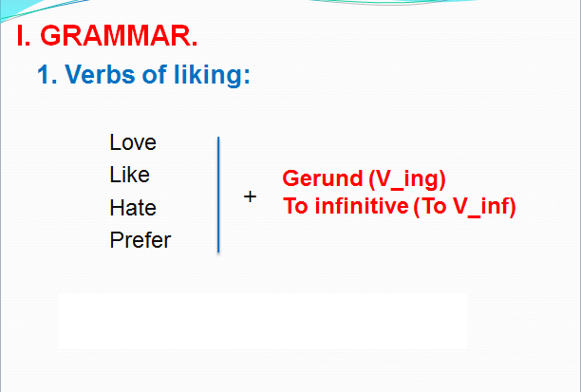

UNIT 1- LEISURE ACTIVITIES – A CLOSER LOOK 2
I. GRAMMAR.
adore
love
like, enjoy, fancy
don’t mind,
dislike/ don’t like
hate
detest
prefer
1. Verbs of liking:
+ gerund (V_ing)

Slide 4
UNIT 1- LEISURE ACTIVITIES – A CLOSER LOOK 2
2. Tick the box. Then listen to check.
 | V-ing | V–ing / To V
1. love
2. enjoy
3. detest
4. prefer
5. fancy
√
√
√
√
√

Slide 5
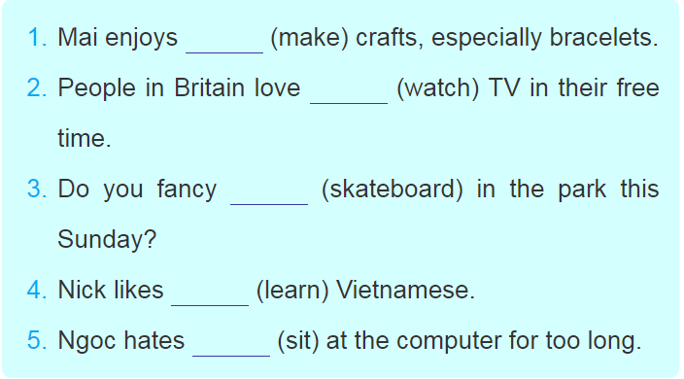
UNIT 1- LEISURE ACTIVITIES – A CLOSER LOOK 2
3. Write the correct forms of verbs
making
watching
/ to watch
skateboarding
  learning
/ to learn
sitting
/ to sit

Slide 6
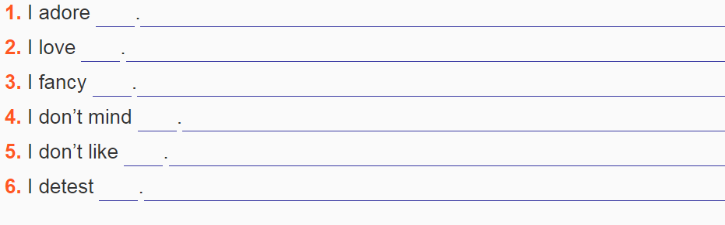
UNIT 1- LEISURE ACTIVITIES – A CLOSER LOOK 2
4. Write sentences using V-ing / To V.
reading books
riding / to ride a bike
doing aerobics
helping my mother with housework
watching/ to watch films
eating cucumber

Slide 7
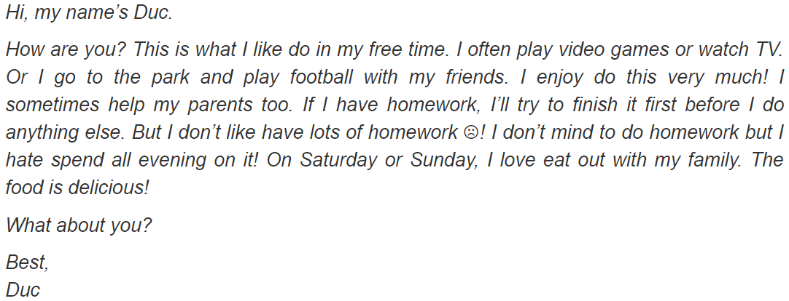
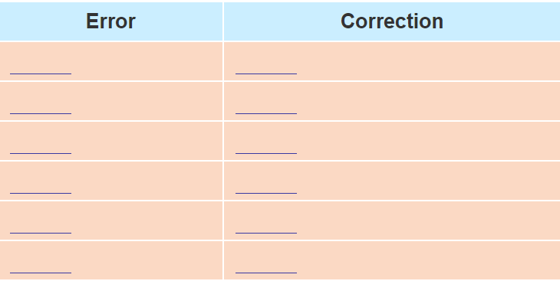
UNIT 1- LEISURE ACTIVITIES – A CLOSER LOOK 2
5. Read the letter and find 6 mistakes. Correct them
like do
like doing/ to do
enjoy do
enjoy doing
don’t like have
don’t like having/ to have
don’t mind to do
don’t mind doing
hate spend
hate spending/ to spend
love eat out
love eating/ to eat out

Slide 8
UNIT 1- LEISURE ACTIVITIES – A CLOSER LOOK 2
b. Answer the questions.
1. How many activities does Duc mention in his email?
2. Which two activities do you think he enjoys the most?
→ 7 activities ( playing video games, watching TV, going to the park, playing football, helping his parents, doing homework, and eating out with his family)
→ (The two activities he enjoys the most are) playing football with his friends, and eating out with his family.

Slide 9
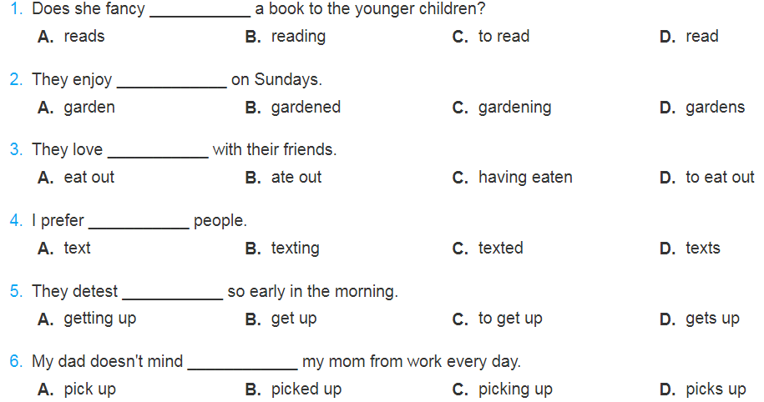
UNIT 1- LEISURE ACTIVITIES – A CLOSER LOOK 2
* Further practice:

Slide 10
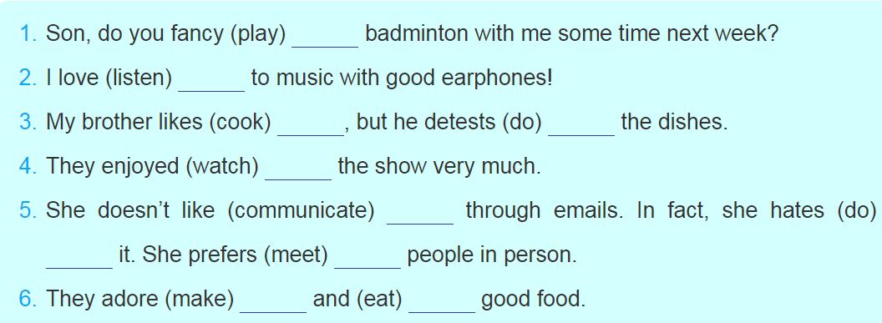
UNIT 1- LEISURE ACTIVITIES – A CLOSER LOOK 2
Exercise 6: Put the verbs in bracckets in the correct form
1. playing
2. listening
/ to listen
3. cooking
/to cook
- doing
4. watching
5. communicating
/to communicate
doing
- meeting
/ to meet
6. making, eating

Slide 11
UNIT 1- LEISURE ACTIVITIES – A CLOSER LOOK 2
I adore Taylor Swift’s songs. She’s a great singer. I also love to sing her songs even while I am having a bath. I prefer to learn English vocabulary by listening to English songs and I think listening to music, in general, makes me really relaxed.
My hobby is listening to music. I love listening to English songs. I spend much time on it. I like to listen to the songs while I am doing the housework such as cleaning the floor, doing the dishes, doing the laundry,

