Slide 1


Slide 2
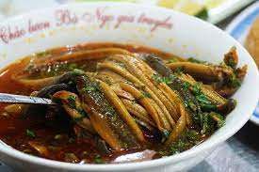
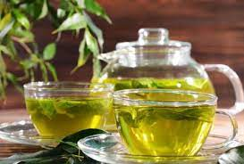
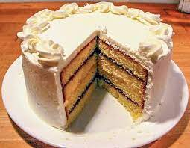
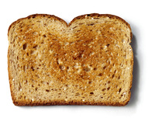

MINI GAME
Our eating habits
Look at picture, talk about:
What did you eat and drink yesterday?

Slide 3

- Eel soup:
Cháo lươn/ canh lươn

Slide 4
- toast:
bánh mì nướng

Slide 5
- Green tea:
trà xanh

Slide 6
- coffee:
cà phê

Slide 7
- Cake
bánh ngọt

Slide 8



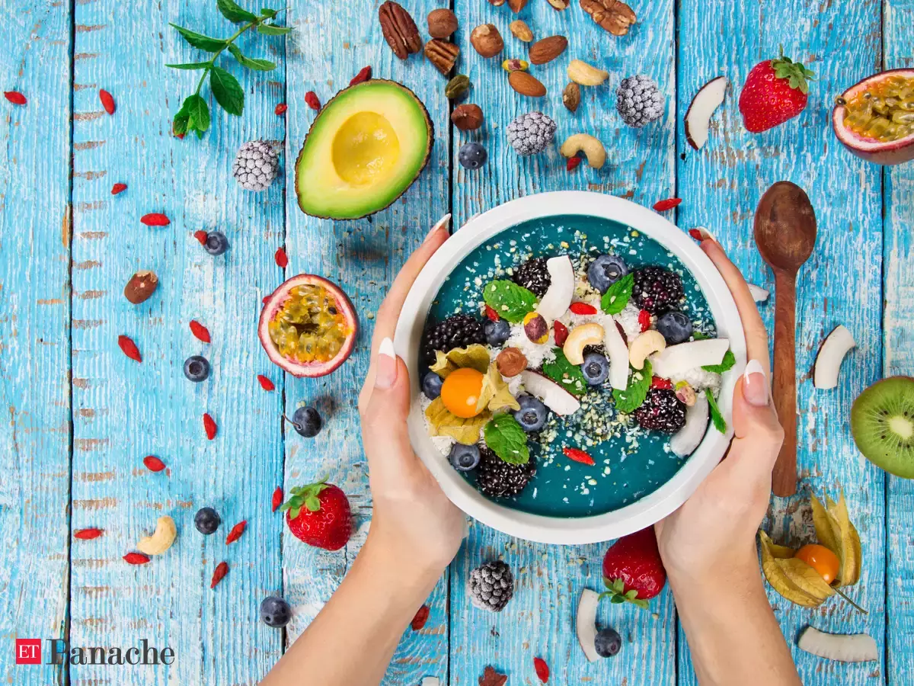

Unit
5
FOOD AND DRINK
Period 41: Lesson 6: SKILLS 2

Slide 9

I. LISTENING
1
Work in groups. Discuss the following questions.
1. What time do people in your area often have breakfast, lunch, and dinner?
2. What do they often have for breakfast, lunch, and dinner?
→ They usually have breakfast at 6.30 a.m. They usually have lunch at 11 a.m. They usually have dinner at 7 p.m.
→ They eat a light breakfast with many kind of foods like pho, bread and milk. They eat rice with many dishes such as fish, meat, or vegetables for lunch or dinner

Slide 10

2
Listen to Minh talking about the eating habits in his area. Circle the food and drink you hear.
eel soup | cakes | green tea
coffee | toast

Slide 11
3
Listen again and tick True (T) or False (F).
 | T | F
1. People in Minh's area often have four meals a day.
2. Most of them have lunch at home.
3. Lunch is the main meal of the day in his area.
4. People in his neighbourhood often have rice, fresh vegetables, and seafood or meat for dinner.
5. After dinner, they often have some fruit and green tea.
F
T
F
T
T
Audio script

Slide 12
II. WRITING
4
Make notes about the eating habits in your area.
 | Time | Food and drink
Breakfast
Lunch
Dinner
+ What time do they have breakfast, lunch and dinner?
+ What food and drink do they have then?

Slide 13
II. WRITING
4
Make notes about the eating habits in your area.
 | Time | Food and drink
Breakfast | At about 6.30 a.m | Bread or sticky rice, beef noodles
Lunch | 11.30a.m | Rice, meat, vegetable
Dinner | 7p.m | Rice , fish, vegetable, soup

Slide 14

5
Write a paragraph of about 70 words about the eating habits in your area. Use the information in 4 to help you.
People in our area usually eat breakfast at 6.30 a.m and they often have bread or sticky rice. They have meat and vegetable for lunch at 11.30 a.m. They have fish, vegetable, soup for dinner at 7 p.m.

Slide 15
* CONSOLIDATION
1
WRAP-UP
In this lesson, we have learnt to:
listen for specific information about eating habits
write a paragraph about eating habits in the area.

Slide 16

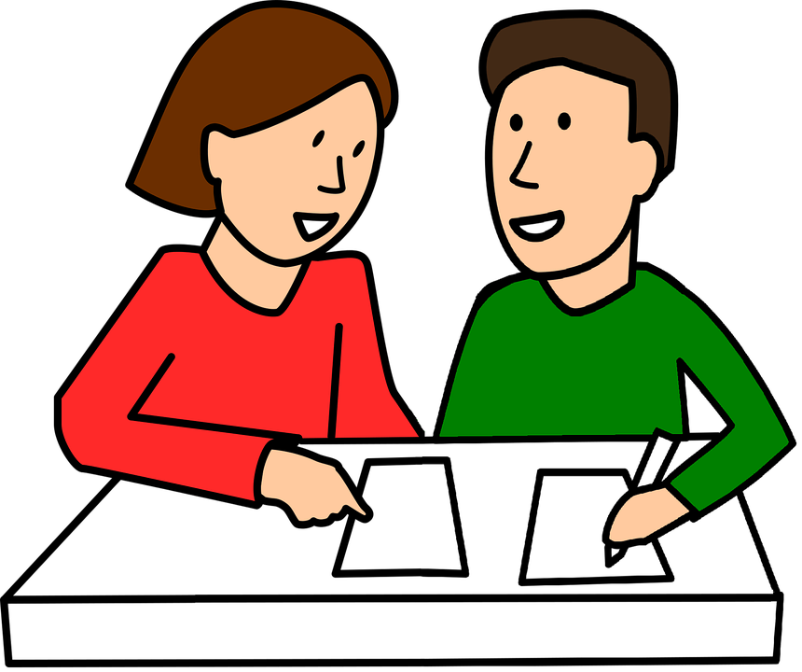
* HOMEWORK
Write a paragraph about your eating habits - Prepare “ Looking back and project.

Slide 17

Thank you!
Goodbye!

