Slide 1
WELCOME TEACHERS TO OUR CLASS

Slide 2
REVISION: THE PRESENT SIMPLE TENSE

Slide 3
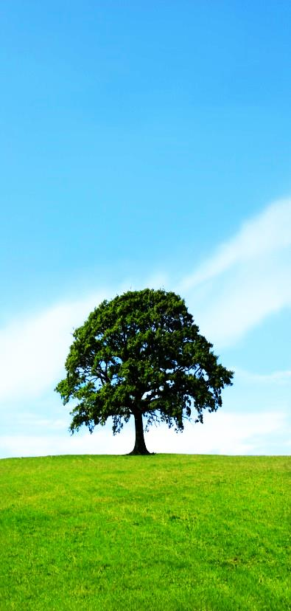
THE PRESENT SIMPLE TENSE
Objectives:
- Review forms, use and signals of the present simple tense.
- Practice exercises with the present simple tense.

Slide 4
WARM-UP
GAME: Sentence puzzling
Rule:
2 teams
Rearrange words to complete sentences in present simple tense.
The team with the most correct sentences is winner.

Slide 5
WARM-UP
Sentence puzzling
live
near
Peter
his school
=> Peter lives near his school.

Slide 6
WARM-UP
Sentence puzzling
students
We
be
=> We are students.

Slide 7
WARM-UP
Sentence puzzling
not have
new subjects
They
=> They don’t have new subjects.

Slide 8
WARM-UP
Sentence puzzling
always
We
smart
look
our uniforms
=> We always look smart our uniform.

Slide 9
WARM-UP
Sentence puzzling
play
he
Does
the guitar?
=> Does he play the guitar?

Slide 10
THE PRESENT SIMPLE TENSE
Form | Ordinary verbs | To be
Positive | S + V-inf/ V(s/es) + …. | S + is/ am/ are + ….
Negative | S + don’t/ doesn’t + V-inf + …. | S + is/ am/ are + not + ….
Interrogative | Do/ Does + S + V-inf + ….? | Is/ Am/ Are + S + ….?
He/ She/ It + V-s/es | He/ She/ It + is
I/ You/ We/ They + V-inf | I + am You/ We/ They + are
adverbs of frequency: never, rarely, sometimes, often, usually, always

Slide 11
Exercise 1. Put the verbs in the correct tense.
1. Ann always ______ (swim) in the pool.
2. Karl _________ (not/ read) the newspaper.
3. Helen and I _______ (study) a lot.
4. _____ John _____ (do) his homework very quickly?
5. They always ______ (be) at the club.
swims
doesn’t read
study
Does
do
are

Slide 12
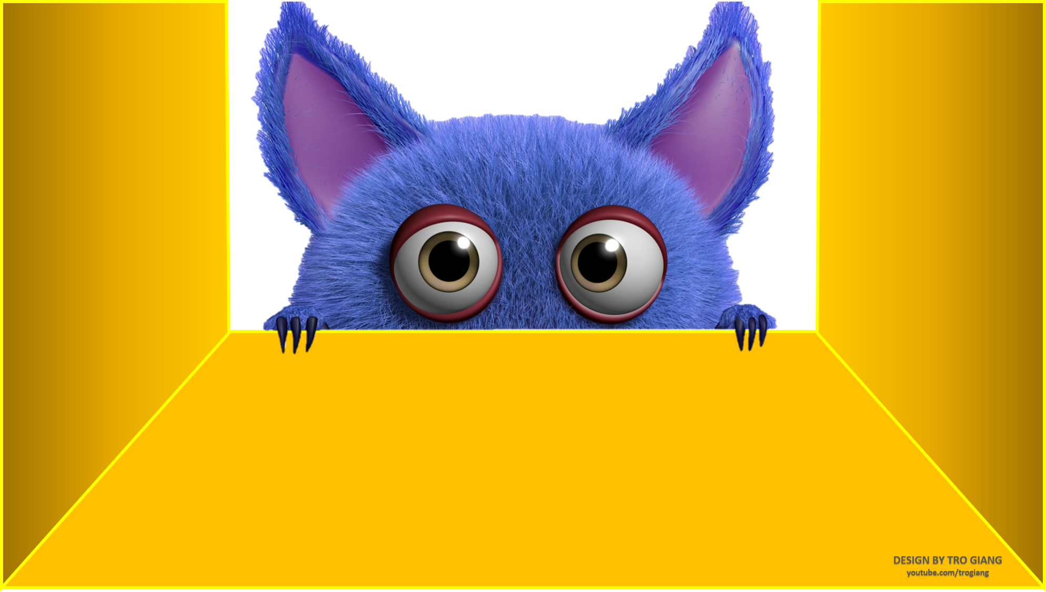
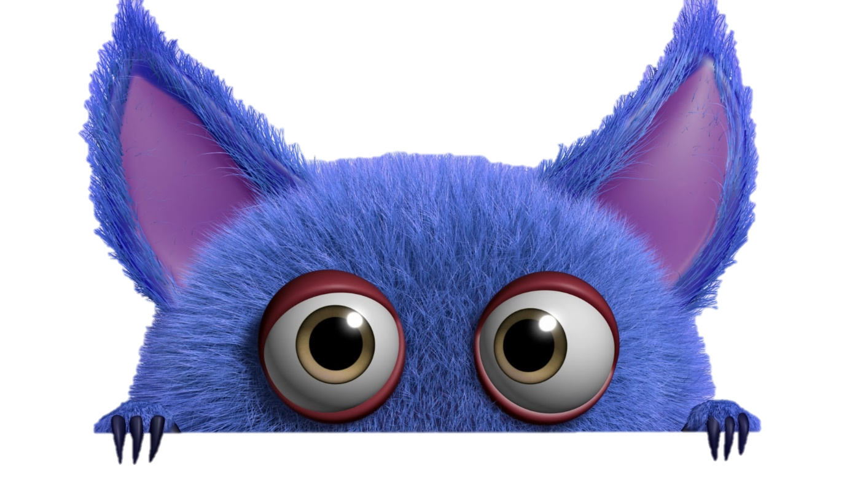

Gift box secret game

Slide 13
4 teams.
Gain the right to answer in order by choosing random number.
In each answer turn, you choose a gift box and answer the corresponding question. If you can’t answer that question, the next team will answer.
The team which has the most point is winner.

Slide 14


















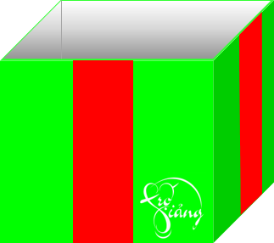




Slide 15









Question 1:
She ______ in Florida but prefers California.
A. lives B. living C. lived
A. lives
GO HOME
You are given 4 points

Slide 16
Question 2:
When we ________ on vacation, we never fly.
A. am B. is C. are
C. are
GO HOME
You are given 5 points

Slide 17
Question 3:
I ________ four languages, but I love Italian above all.
A. speaked B. speak C. speaks
B. speak
GO HOME
You are given 4 points

Slide 18
Question 4:
That dog always ________ with his head against the wall.
A. sleeping B. sleep C. sleeps
C. sleeps
GO HOME
You are given 4 points

Slide 19
Question 5:
They ______ to school on the weekends.
A. doesn’t go B. does go C. don’t go
C. don’t go
GO HOME
You are given 7 points

Slide 20
Question 6:
We don't ________ which airport the plane goes from.
A. know B. knows C. knowes
A. know
GO HOME
You are given 6 points

Slide 21
Question 7:
My girlfriend ________ her eyes when there's a horror movie on TV.
A. close B. closing C. closes
C. closes
GO HOME
You are given 5 points

Slide 22
Question 8:
They ____ good dancers.
A. is B. are C. am
B. are
GO HOME
You are given 7 points

Slide 23
Question 9:
She ________ to disco music, only tango.
A. no listen B. doesn't listen C. don’t listen
C. doesn’t listen
GO HOME
You are given 4 points

Slide 24
Question 10:
_____ Mr. Lam a doctor?
A. Is B. Am C. Are
A. Is
GO HOME
You are given 5 points

Slide 25
Exercise 3. Make the correct sentences.
1. she/ not/ sleep late on weekends.
=> ___________________________
2. we/ not/ be/ classmates.
=> ___________________________
3. you/ understand the question?
=> __________________________
4. they/ work late on Fridays.
=> ___________________________
5. David/ want some coffee?
=> ___________________________
She doesn’t sleep late on weekends.
We are not classmates.
Do you understand the question?
They work late on Fridays.
Does David want some coffee?

Slide 26
WRAP-UP
Review the present simple tense of forms, use and signals
Do exercises to practice the present simple tense
Make sentences with present simple tense

Slide 27
HOMEWORK
Do the other exercise in the handout.
Deadline: before Friday morning (30/9).
Make 5 sentences in present simple tense

Slide 28
THANK YOU EVERYONE!

