Slide 1

Ngo gia tu SECONDARY SCHOOL
WELCOME TO OUR CLASS 9

Slide 2
OBJECTIVES
1
2
Remember the lexical items related to local environment
Stress on content words in sentences

Slide 3

Unit 1:
Local Environment
Lesson 2: A Closer Look 1

Slide 4


traditional handicraft
drums
paintings
conical hats
marble sculptures
Handicrafts
Pottery
silk
lanterns
lacquerware

Slide 5

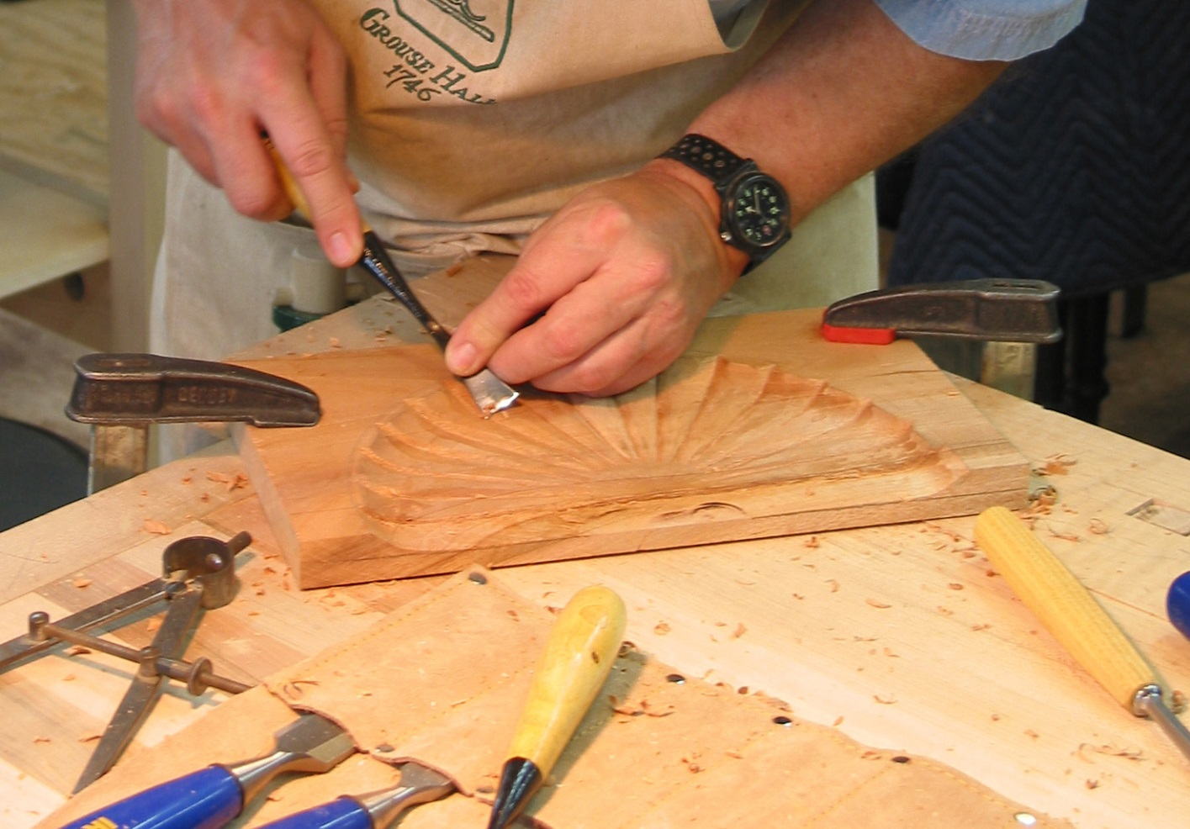
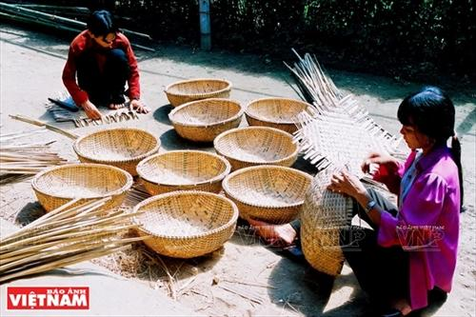
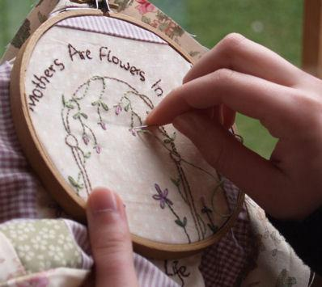
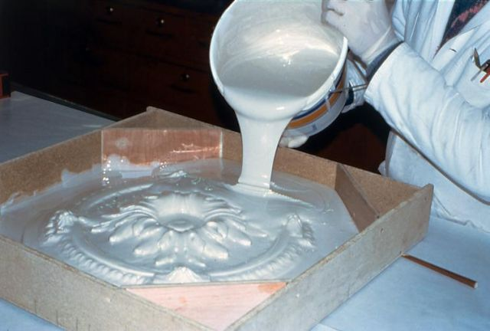
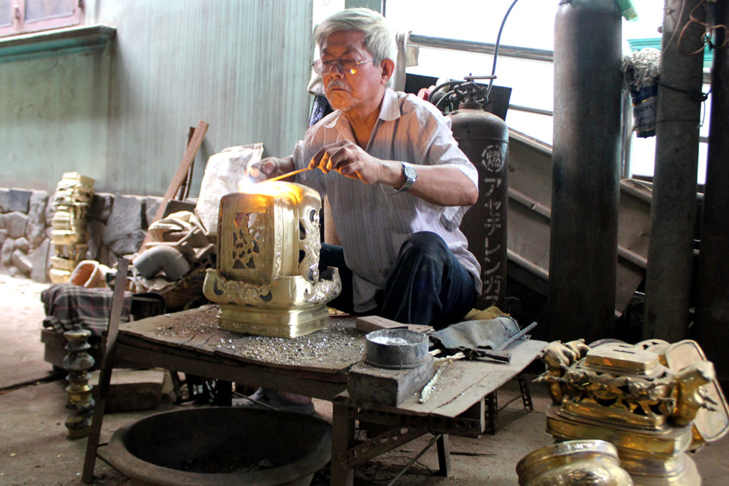
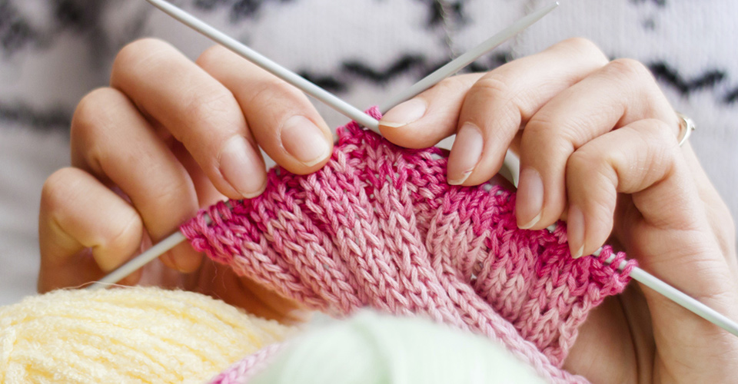
I. Vocabulary:
Carve (v):
Khắc, chạm, tạc, đục
Cast (v):
Đúc, trải, sắp xếp
Weave (v):
Đan (rổ rá), dệt (vải)
Embroider (v):
Thêu
Knit (v)
Đan (len, sợi...)
Mould
Đổ khuôn, tạo khuôn

Slide 6

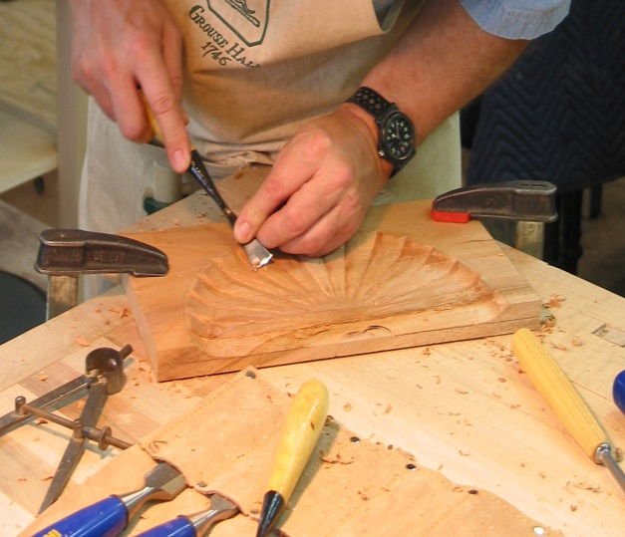
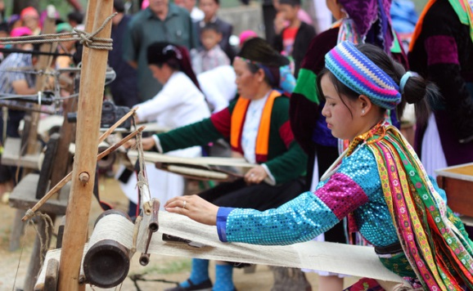

1. Match the verbs with the pictures
Carve
Cast
Weave
Embroider
Knit
Mould
A. .........................
B. .........................
C. .........................
D. ...................
E. ...................
F. ...................
G. ...................

Slide 7
2a. Match the verbs in column A with the group of nouns in column B
A | B
1. Carve | a. handkerchiefs, tablecloths, pictures
2. Cast | b. stone, wood, eggshells
3. Weave | c. clay, cheese, chocolate
4. Embroider | d. bronze, gold, iron
5. Knit | e. baskets, carpet, silk, cloth
6. Mould | f. sweaters, toys, hats

Slide 8
2b. Match the verbs in column A with the group of nouns in column B
Infinitive | Past tense | Past participle
1. to carve | I carved it. | It was carved.
2. to cast | I ...................... it. | It was ......................
3. to weave | I ...................... it. | It was ......................
4. to embroider | I ...................... it. | It was ......................
5. to knit | I ...................... it. | It was ......................
6. to mould | I ...................... it. | It was ......................
cast
cast
wove
woven
embroidered
embroidered
knitted
knitted
moulded
moulded

Slide 9
4. Complete the passage by filling suitable words.
attraction
historical
traditional
handicrafts
culture
exercise
Some people say that a place of interest is a place famous for its scenery or a well-known (1) .............................. Site. I don’t think it has to be so limited. In my opinion, a place of interest is simply one that people like going to.
In my town, the park is a(n) (2) ................................ because many people love spending time there. Old people do (3) ........................... and walk in the park. Children play games there while their parents sit and talk with each other. Another place of interest in my town is Hoa Binh market. It’s a(n) (4) ............................ market with a lot of things to see. I love to go there to buy food and clothes, and watch other people buying and selling. Foreign tourists also like this market because they can experience the (5) ............................ of Vietnamese people, and buy woven cloth and other (6) ................................. as souvenirs.

Slide 10

Pronunciation

Slide 11
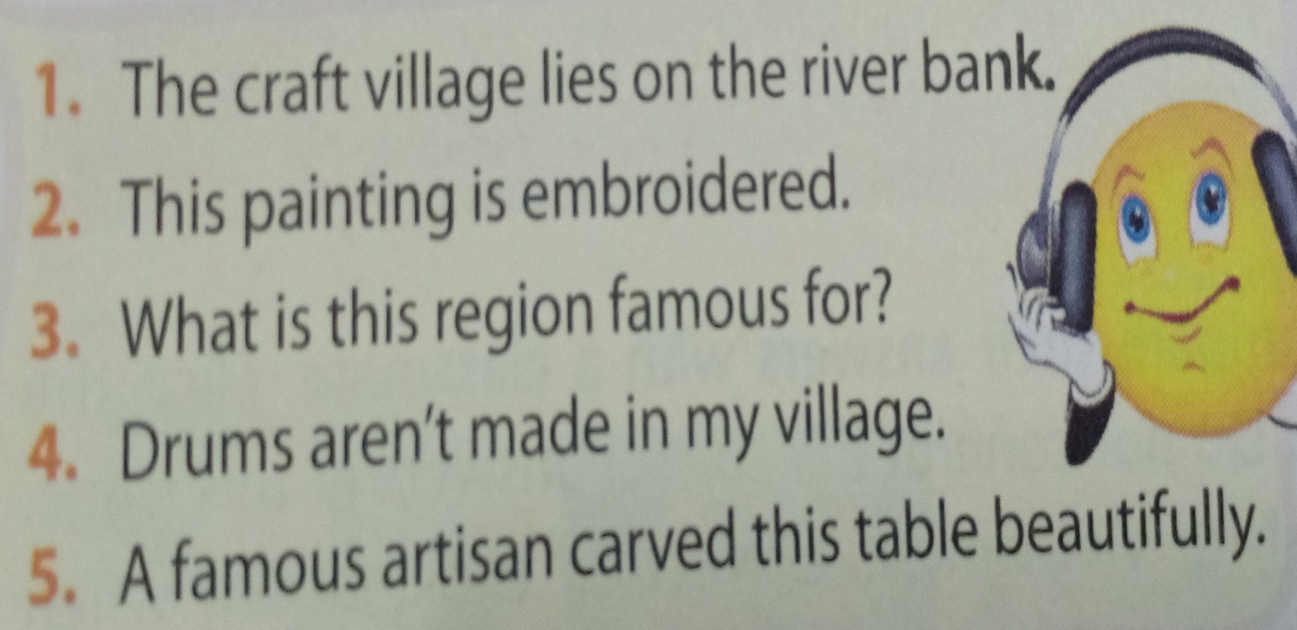
5a. Listen then answer the questions.
1. Which words are louder and clearer than the others?
2. What kinds of words are they?
3. Which words are not as loud and clear as the others
4. What kinds of words are they?

Slide 12

5a. 1. The craft village lies on the river bank.
2. This painting is embroidered.
3. What is this region famous for?
4. Drums aren't made in my village.
5. A famous artisan carved this table beautifully.
craft
village
lies
river bank
painting
embroidered
What
region famous
Drums
aren't
made
village
famous
artisan
carved
table
beautifully.

Slide 13
5a. Answerkey
2. What kinds of words are they?
They are: nouns, verbs, adjective, adverbs, wh-question words, and negative auxiliaries.
3. Which words are not as loud and clear as the others
2. this, is
3. is, this, for
1. the, on, the
4. in, my
5. a, this
4. What kinds of words are they?
They are: articles, prepositions, pronouns, and possessive adjectives.

Slide 14
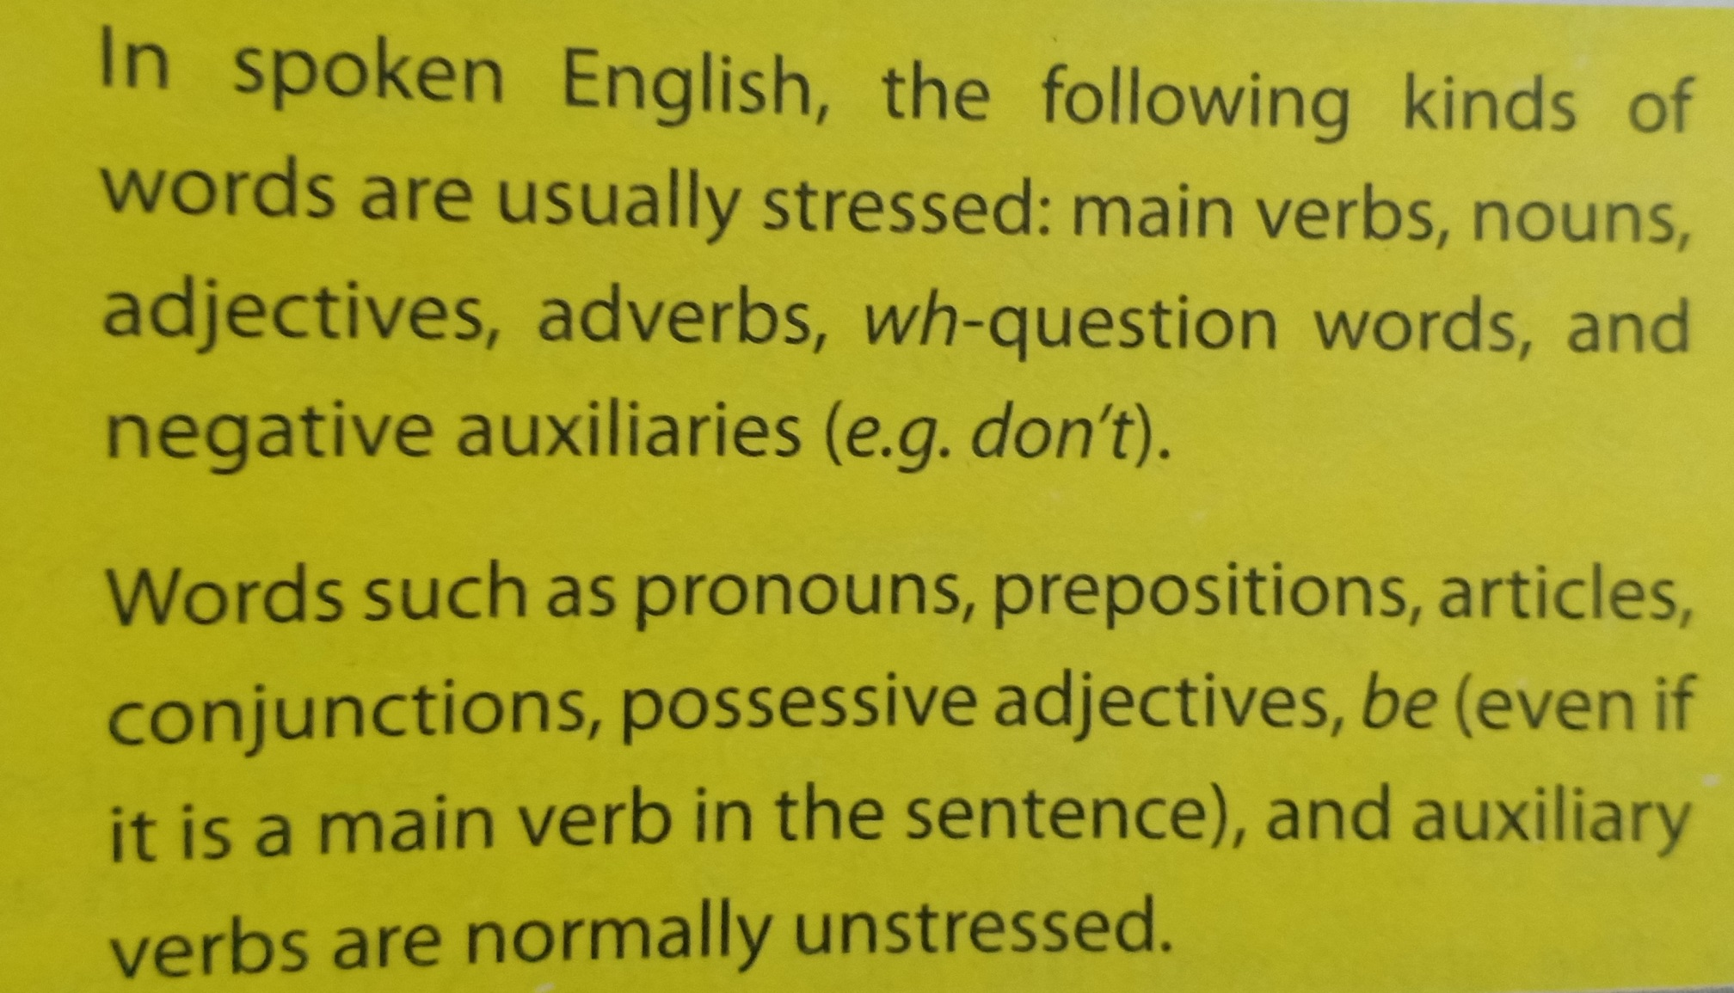
Remember

Slide 15
6b. Underline the content word in the sentences.
1. The Arts Museum is a popular place of interest in my city.
2. This cinema attracts lots of youngsters.
3. The artisans mould clay to make traditional pots.
4. Where do you like going at weekend?
5. We shoudn’t destroy historical buildings.

Slide 16
LET’S WRAP UP
Places of interest
Entertaining
- cinema
Educational
- library
Places of interest
Cultural
- Opera house
Historical
- building

Slide 17
HOMEWORK
Write newwords.
Prepare lesson 3: A closer look 2
Do exercises in workbook.
See you next time

