Slide 1
Unit 4: Life in the past
Friday, 12th November, 2022
Period 29:
Lesson 1: Getting started

Slide 2


Objectives
vocabulary:
Life in the past
expressions
in conversations: agreement, appreciation, surprise, wish

Slide 3
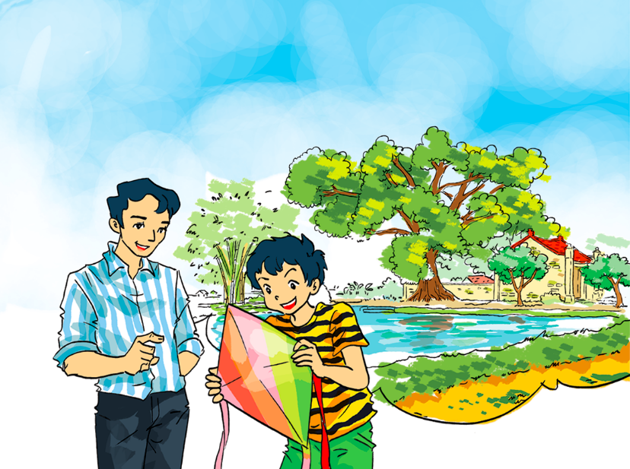
Who do you think the people in the picture are?
What do you think the people in the conversation are talking about?
How do you understand the title “Preserving the past”?

Slide 4
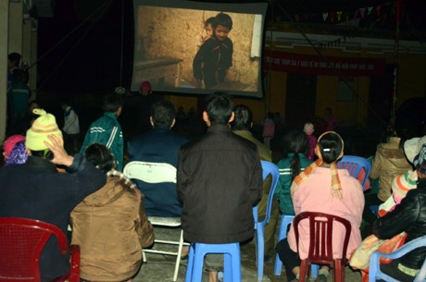
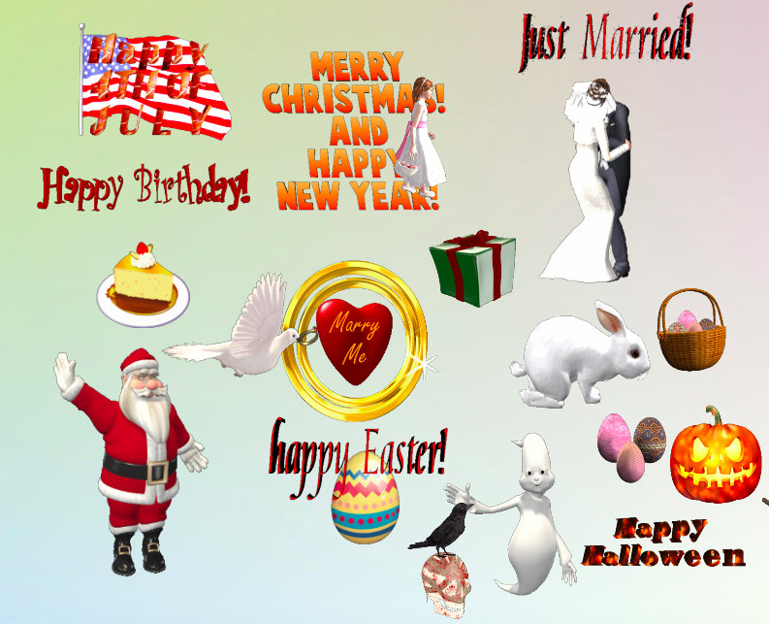
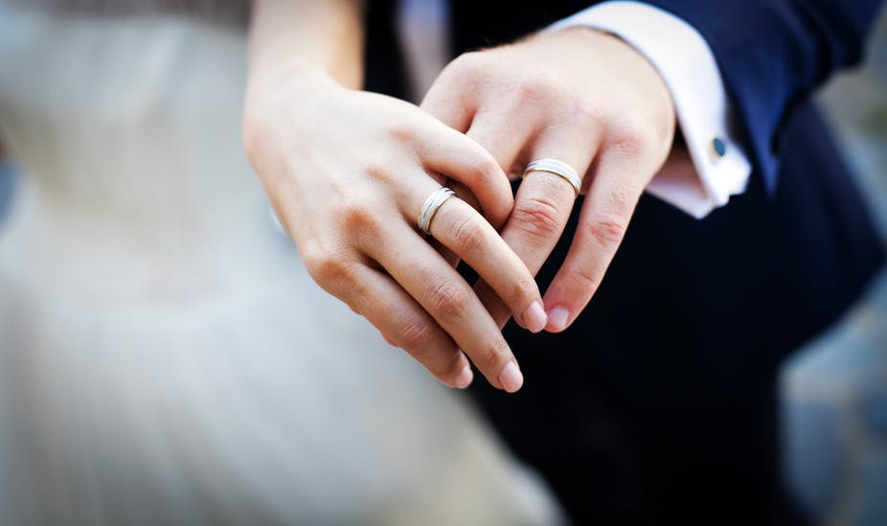
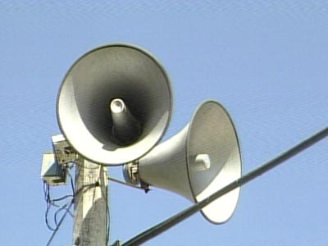
I. Vocabulary
a mobile movie team
a special occasion
wealthy
= rich
marriage
funeral
a loudspeaker

Slide 5
a loudspeaker
marriage
funeral
a mobile movie team
wealthy
a special occasion

Slide 6

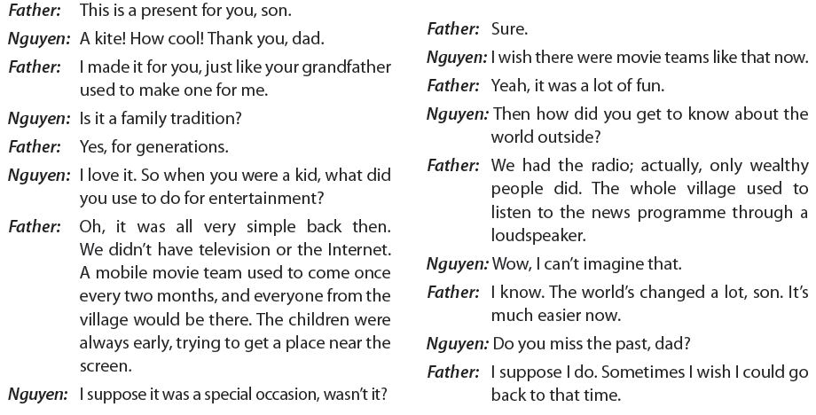
II. Practice
1. Listen and read (page 40)

Slide 7
a. Read the conversation again and answer the questions.
What is a tradition in Nguyen's family?
How often did the movie team come to the village?
What did the children use to do when the movie team came to the village?
Who in the village had a radio?
Does Nguyen's father miss the past? What did he say?
- Fathers make kites for sons.
- Once every two months.
- They used to come early, trying to get a place near the screen.
Only wealthy households.
- Yes, he does. He said: “Sometimes I wish I could go back to that time.”

Slide 8
b. Match the expressions from the conversations with their meanings.
Can you add some more expressions with the same meaning?
1. How cool!
a. expressing agreement
2. Sure.
b. expressing a wish
3. Wow, I can’t imagine that.
c. expressing appreciation
4. I wish I could go back to that time.
d. expressing surprise

Slide 9
c. Choose suitable expressions from 1b to complete the conversations.
Would you like to participate in this 'Preserving the Past' project?
2. Marriages used to be arranged by parents.
3. I've finished my painting. Look!
4. Children used to play outdoors with things they found, like stones or feathers.
5. The time machine in a science fiction novel by H. G. Wells can take people back to the past.
6. It's a tradition in Russia for people to take a bath in a hole dug in the ice
at New Year.
- Sure.
- I can’t imagine that.
- How cool!
- I wish I could go back to that time.
- How cool!
- I can’t imagine that.

Slide 10
2. Use the words/phrases in the box to complete the sentences.
a. loudspeaker
b. technological changes
c. generations
d. traditions
e. events
f. a special occasion
1. A ________________is used to make the sound much louder so that many people can hear it from a distance. 2. Every country has its own customs and ________________ .
3. There is always a big gap between ________________ . The old sometimes find it difficult to understand the young. 4. People in the past were slower in accepting ___________ than they are today. 5. Traditionally, weddings and funerals are considered important village ________________ in Viet Nam. 6. A wedding is ________________ , not only for the bride and groom but also for other attendants as they can meet friends and relatives.
loudspeaker
traditions
generations
technological changes
events
a special occasion

Slide 11
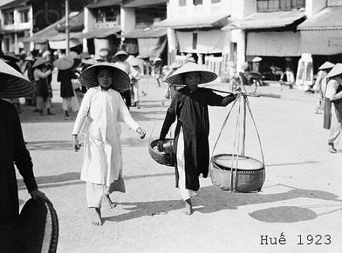
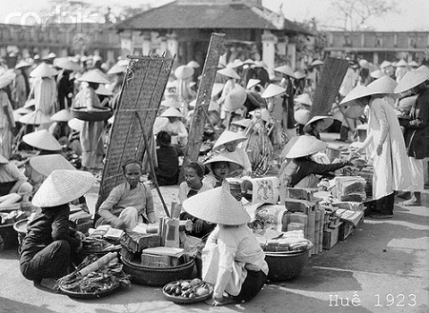
3. In groups, brainstorm some of the events and practices in your area. Make a list and present them to the class.
Example:
Women in Hue used to go swimming at the beach fully clothed, to wear palm leaf conical hats, to wear the traditional long dress whenever they went out, to stay at home as housewives, ...

Slide 12
Wrap-up
mobile movie team
technological changes
entertainment in the past
loudspeaker
special occasion
marriage, funeral
agreement: Sure, Certainly
appreciation: How cool!
expressions
surprise: Wow, I can't imgagine that.
wish: I wish I could ...

