Slide 1


Slide 2



Unit
2
HEALTHY LIVING
LESSON 7: LOOKING BACK & PROJECT
Vocabulary review
Grammar review
Project: Build healthy habits
Unit

Slide 3

OBJECTIVES
By the end of the lesson, students will be able to:
review the vocabulary and grammar of Unit 2
apply what they have learnt (vocabulary and grammar) into practice through a project

Slide 4
LESSON 7: LOOKING BACK & PROJECT
WARM-UP
Brainstorming
Task 1: Complete the sentences with the verbs below.
Task 2: Make Write the words below next to their definitions.
VOCABULARY REVIEW
Task 3: Tick the simple sentences.
Task 4: Change the following sentences into simple ones.
GRAMMAR REVIEW
PROJECT
Build healthy habits
Task 5: Posters exhibition
CONSOLIDATION
Wrap-up
Homework

Slide 5
LESSON 7: LOOKING BACK & PROJECT
WARM-UP
Brainstorming
Aims of the stage:
to help students revise the vocabulary items they have learnt in the unit
to enhance students’ skills of cooperating with team mates

Slide 6
WARM-UP
HEALTHY LIVING
PRONUNCIATION
VOCABULARY
GRAMMAR

Slide 7
LESSON 7: LOOKING BACK & PROJECT
WARM-UP
Brainstorming
Task 1: Complete the sentences with the verbs below.
Task 2: Make Write the words below next to their definitions.
VOCABULARY REVIEW

Slide 8
VOCABULARY REVIEW
1
Complete the sentences with the verbs below.
are exercise avoid affects keeps
1. Healthy food and exercise help people ______________ fit.
2. Weather that is too cold or too hot ___________ your skin condition.
3. Children should ____________ fast food and soft drinks.
4. Bad habits like eating too much sweetened food and going to bed late ____________ harmful to our health.
5. We can _____________ indoors and outdoors.
keep
affects
avoid
are
exercise

Slide 9
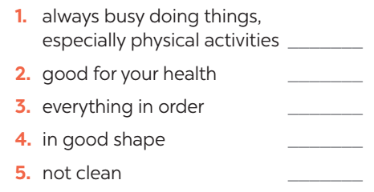

VOCABULARY REVIEW
2
Write the words below next to their definitions
tidy active fit dirty healthy
active
healthy
tidy
fit
dirty

Slide 10
LESSON 7: LOOKING BACK & PROJECT
WARM-UP
Brainstorming
Task 1: Complete the sentences with the verbs below.
Task 2: Make Write the words below next to their definitions.
VOCABULARY REVIEW
Task 3: Tick the simple sentences.
Task 4: Change the following sentences into simple ones.
GRAMMAR REVIEW

Slide 11

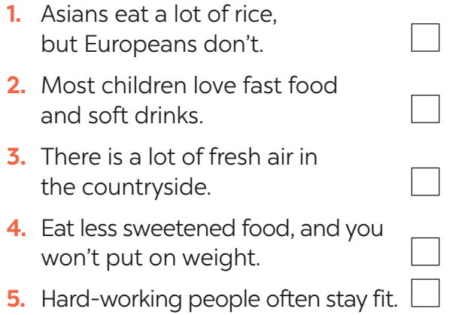

GRAMMAR REVIEW
3
Tick the simple sentences.

Slide 12
GRAMMAR REVIEW
4
Change the following sentences into simple ones.
1. You are active, and your brother is active too.
→ Both you and ______________________________.
2. Your room looks dark, and it looks untidy too.
→ Your room _________________________________.
3. The Japanese work hard, and they exercise regularly.
→ The Japanese _______________________________.
4. My mother eats a lot of fruit, and she eats a lot of vegetables too.
→ My mother eats _____________________________.
your brother are active
looks dark and untidy
work hard and exercise regularly
a lot of fruit and vegetable

Slide 13
LESSON 7: LOOKING BACK & PROJECT
WARM-UP
Brainstorming
Task 1: Complete the sentences with the verbs below.
Task 2: Make Write the words below next to their definitions.
VOCABULARY REVIEW
Task 3: Tick the simple sentences.
Task 4: Change the following sentences into simple ones.
GRAMMAR REVIEW
PROJECT
Build healthy habits
Task 5: Posters exhibition

Slide 14
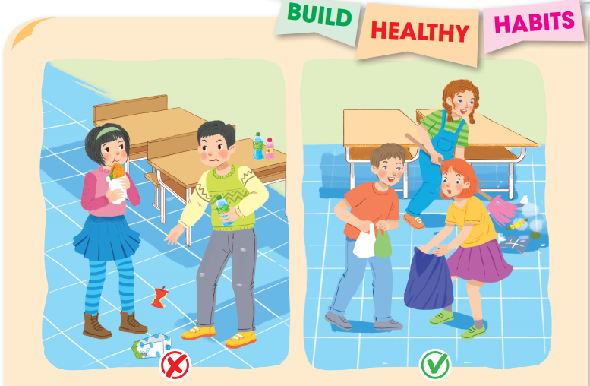
PROJECT
5
Your class is starting a campaign to make your school a healthier place. In groups, make a poster about a bad habit that the students in your school often do and give some tips to change that habit.
Discuss and find a bad habit and some tips to change it.

Slide 15
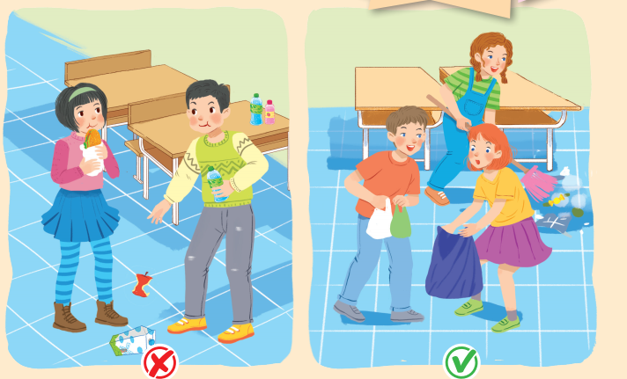
PROJECT
5
5
Posters exhibition
- Show your group’s poster about a bad habit that the students in your school often do and give some tips to change that habit.
- Present your poster to the class.

Slide 16
LESSON 7: LOOKING BACK & PROJECT
WARM-UP
Brainstorming
Task 1: Complete the sentences with the verbs below.
Task 2: Make Write the words below next to their definitions.
VOCABULARY REVIEW
Task 3: Tick the simple sentences.
Task 4: Change the following sentences into simple ones.
GRAMMAR REVIEW
PROJECT
Build healthy habits
Task 5: Posters exhibition
CONSOLIDATION
Wrap-up
Homework

Slide 17
CONSOLIDATION
1
WRAP-UP
Vocabulary review
Grammar review
Project: Design film posters

Slide 18

CONSOLIDATION
2
HOMEWORK
Prepare for the next lesson: Unit 3 – Getting started.

Slide 19

Website: sachmem.vn
Fanpage: facebook.com/sachmem.vn/

