Slide 1
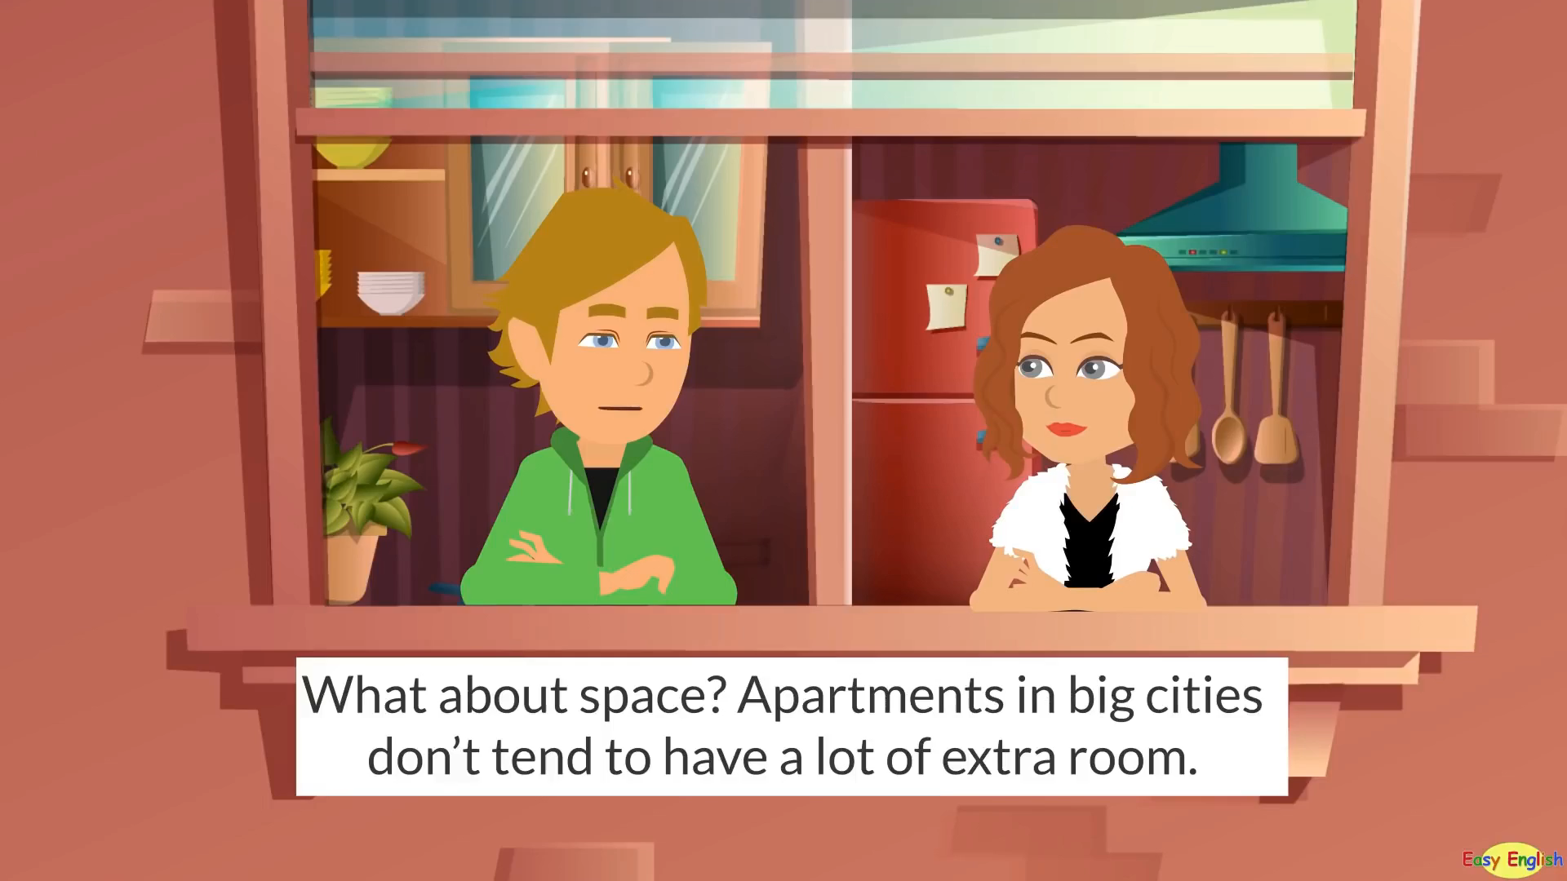
Watch video and answer the question
What are they talking about?
Apartment
Appliances
Types of rooms
Locations
Surroundings

Slide 2
Unit 10.
Our houses in the future.
Lesson 1. Getting started

Slide 3
OBJECTIVES
01
02
03
By the end of the lesson, students will be able to:
Use the lexical items related to types of houses and appliances in the house.
Identify the types of houses, locations and appliances.
Identify the phrases about places.

Slide 4
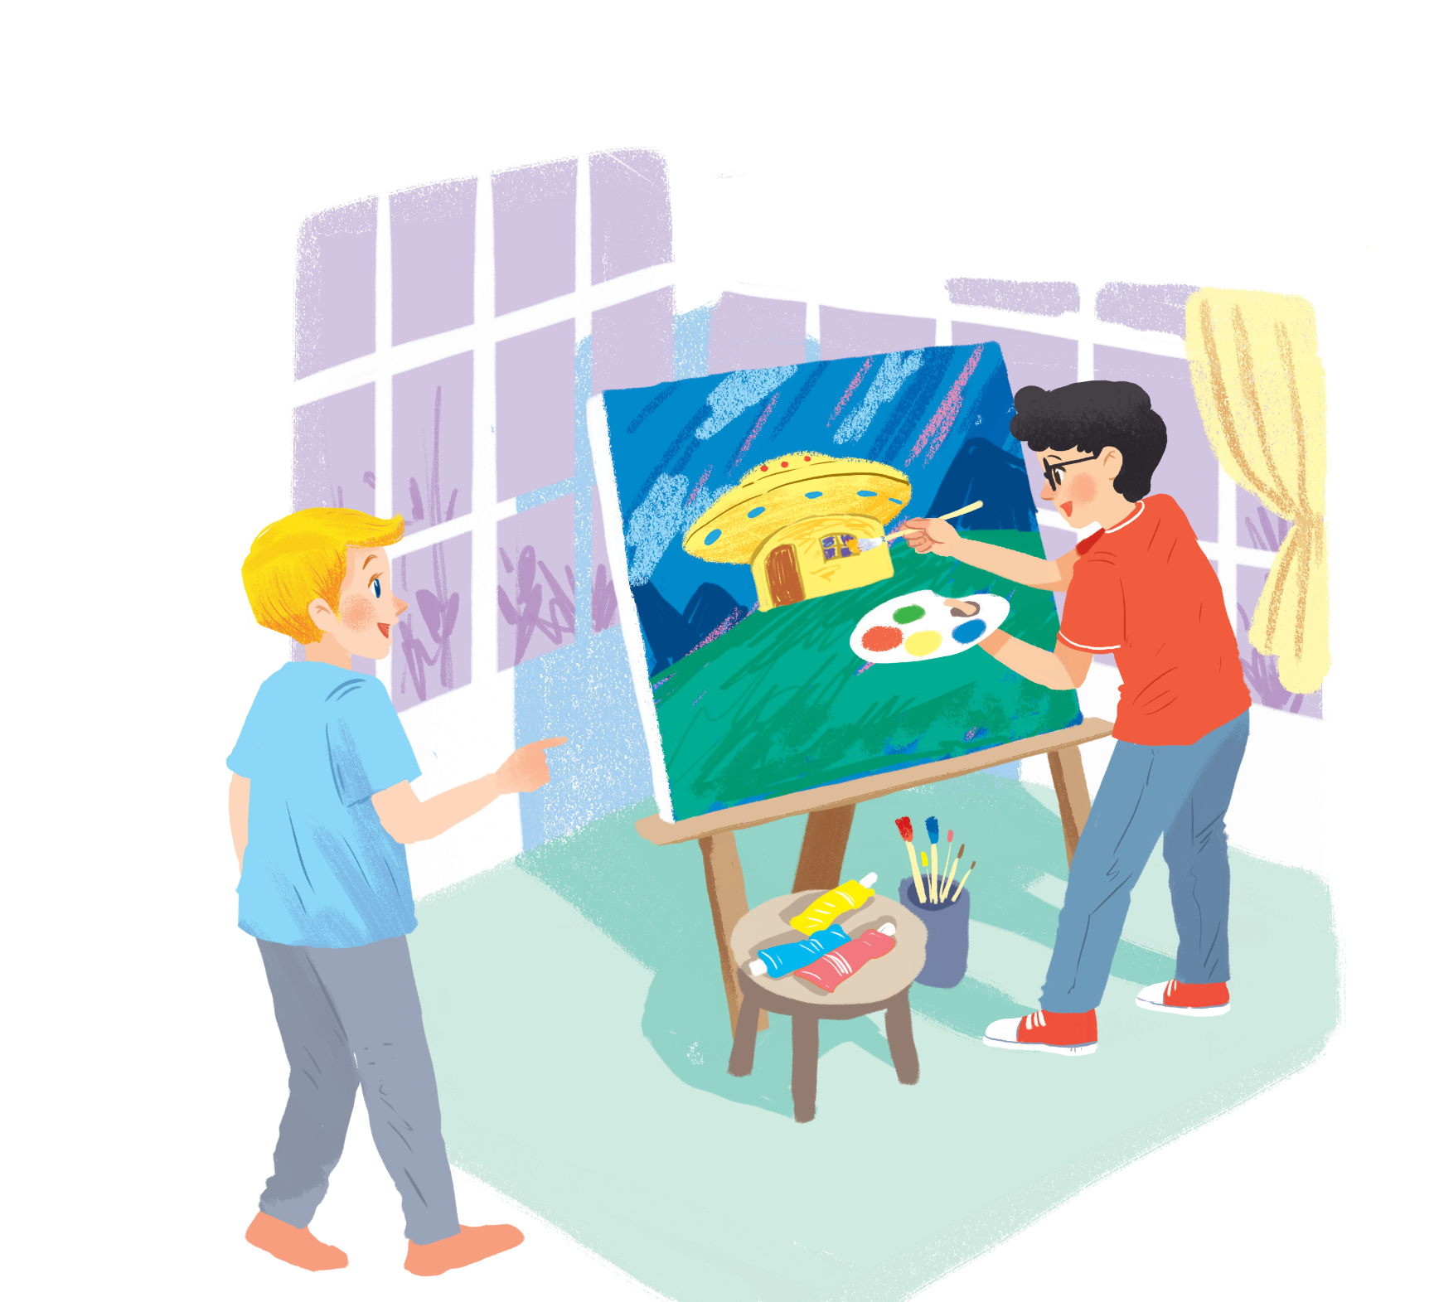
1. What can you see?
Ex 1. (p 38) Listen and read.
Nick
2. What is Phong doing?
3. What are they talking about?
Phong
Notes:
Click vào loa để nghe audio

Slide 5


MY FUTURE HOUSE
Ex 1. (p 38) Listen and read.
Nick: What are you doing, Phong?
Phong: I'm painting a picture of my house.
Nick: Your house! That's a UFO.
Phong: It looks like a UFO but it's my house in the future.
Nick: Where will it be?
Phong: It'll be in the mountains.
Nick: What will it be like?
Phong: It'll be a large house. It'll have twenty rooms.
Nick: Twenty rooms!
Phong: Yes, and it'll have solar energy.
Nick: Fantastic! Which room will you like best?
Phong: My bedroom, of course.
Nick: What appliances might the house have?
Phong: My house might have some smart TVs and ten robots.
Nick: Sounds great! And how much will...
Notes:
Click vào loa để nghe audio

Slide 6
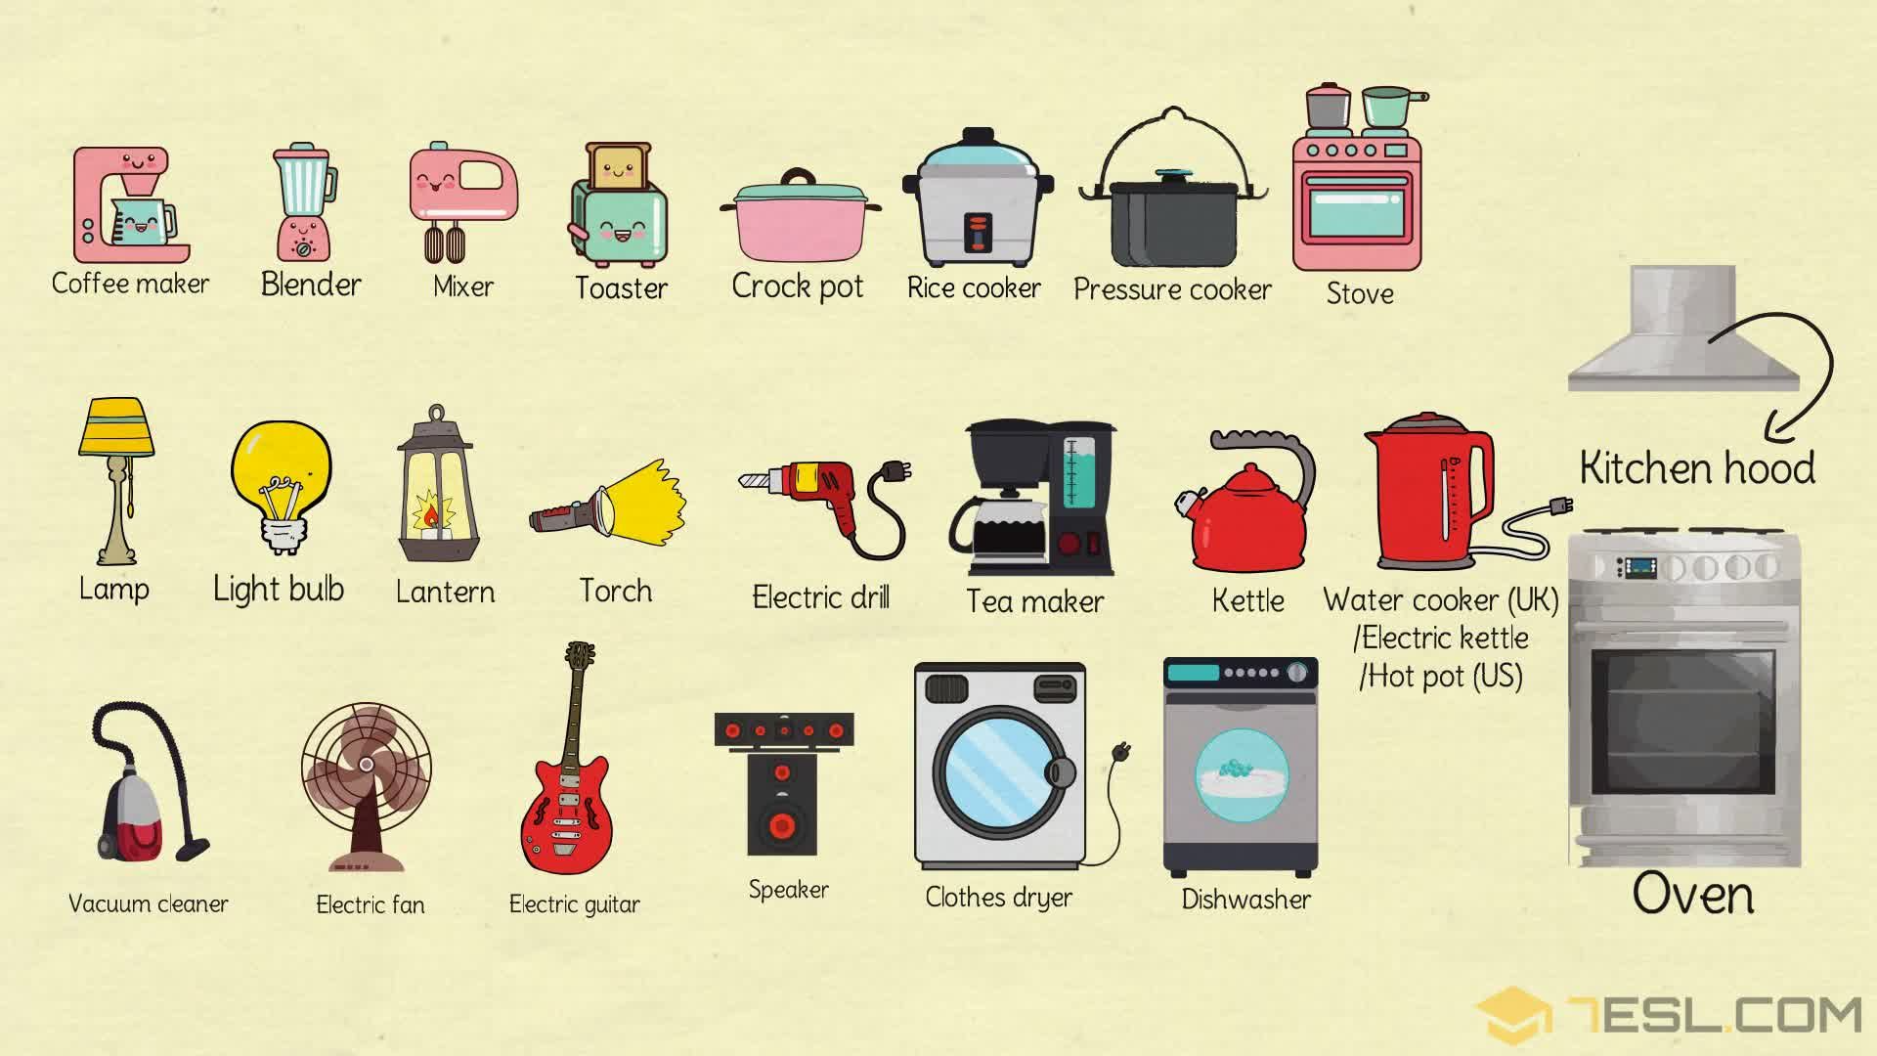
appliances (n)
/əˈplaɪənsɪz /
thiết bị,
đồ gia dụng

Slide 7
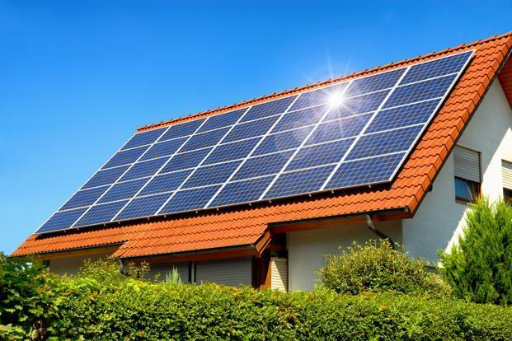
solar energy (np)
/ˌsəʊlər ˈenədʒi/
năng lượng mặt trời

Slide 8
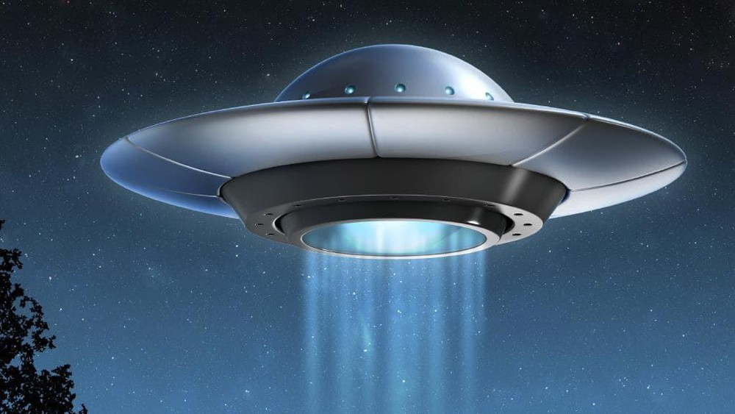
UFO = unidentified flying object
vật thể bay không xác định

Slide 9
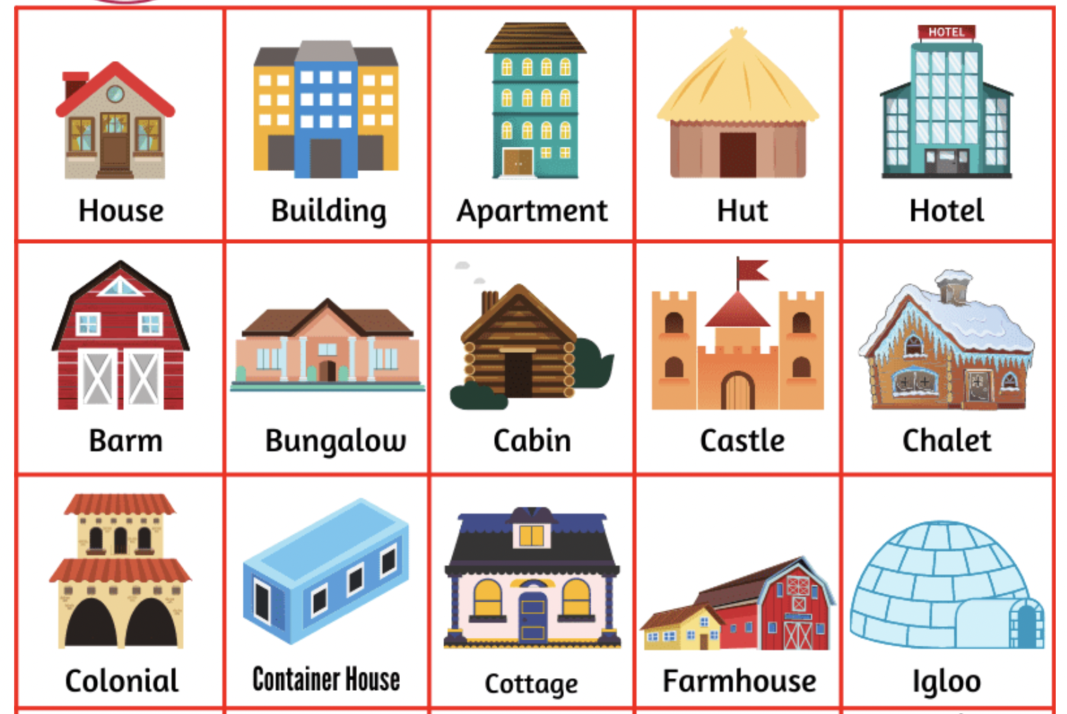
type of house (np)
loại nhà,
kiểu nhà

Slide 10
Checking vocabulary
1. UFO = unidentified flying object:
2. solar energy /ˌsəʊlər ˈenədʒi/ (np):
3. appliances /əˈplaɪənsɪz / (n):
4. type of house (np):
vật thể bay không xác định
năng lượng mặt trời
thiết bị, đồ gia dung
loại nhà, kiểu nhà

Slide 11
Practice
Ex 2. (p 39) Read the conversation again. Find and write down the words or phrases that show:
Type of house:
Location:
Appliances in the house:

Slide 12
Type of house:
UFO house
Nick: What are you doing, Phong?
Phong: I'm painting a picture of my house.
Nick: Your house! That's a UFO.
Phong: It looks like a UFO but it's my house in the future.

Slide 13
Location:
mountains
Nick: Where will it be?
Phong: It'll be in the mountains.

Slide 14
Appliances in the house:
twenty rooms, solar energy, some smart TVs and 10 robots.
Nick: What will it be like?
Phong: It'll be a large house. It'll have twenty rooms.
Nick: Twenty rooms!
Phong: Yes, and it'll have solar energy.
Nick: Fantastic! Which room will you like best?
Phong: My bedroom, of course.
Nick: What appliances might the house have?
Phong: My house might have some smart TVs and ten robots.

Slide 15
Ex 3. (p 39) Read the conversation again. Tick ✓ True (T) or False (F).
Ex 3. (p 39) Underline the keyword.
T
F
1. Phong's house will be in the mountains.
2. His house will be large.
3. There'll be a lot of rooms in his house.
4. He might have a smart TV and five robots.

Slide 16

Ex 3. (p 39) Read the conversation again. Tick ✓ True (T) or False (F).
T
F
1. Phong's house will be in the mountains.
Nick: Where will it be?
Phong: It'll be in the mountains.

Slide 17
Ex 3. (p 39) Read the conversation again. Tick ✓ True (T) or False (F).
T
F
2. His house will be large.
Nick: What will it be like?
Phong: It'll be a large house. It'll have twenty rooms.

Slide 18
Ex 3. (p 39) Read the conversation again. Tick ✓ True (T) or False (F).
T
F
3. There'll be a lot of rooms in his house.
Nick: What will it be like?
Phong: It'll be a large house. It'll have twenty rooms.

Slide 19
Ex 3. (p 39) Read the conversation again. Tick ✓ True (T) or False (F).
T
F
4. He might have a smart TV and five robots.
Nick: What appliances might the house have?
Phong: My house might have some smart TVs and ten robots.

Slide 20
Ex 4. (p 39) Order the words to make a phrase about a place. Each group has one extra word.
Example: ocean / in / on / the
→ in the ocean
1. sea/ a/ in/ the
...........................................
2. on/ in/ the / city
............................................
3. the / in/ at / town
..........................................
4. the/ on/ in/ mountains
...........................................
5. countryside / a/ the / in
.............................................
6. Moon / in / the / on
............................................
7. in / at/ the / sky
...........................................
in the sea
in the countryside
in the city
on the Moon
in the town
in the sky
in the mountains

Slide 21
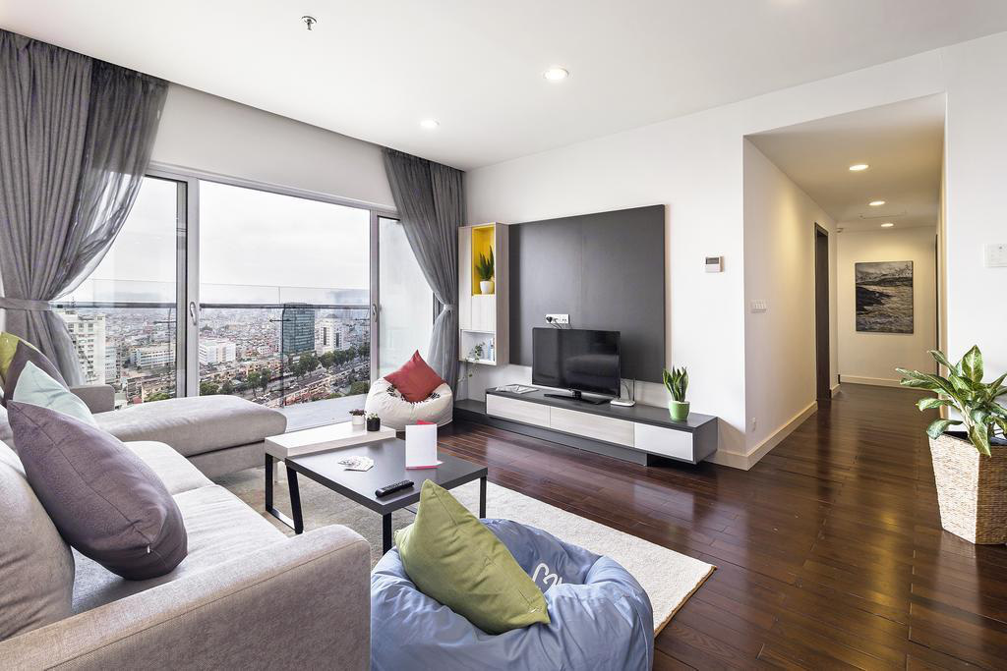

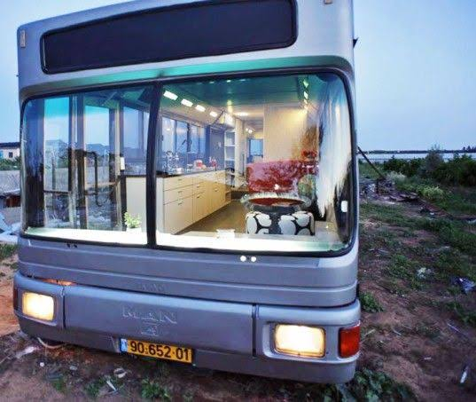
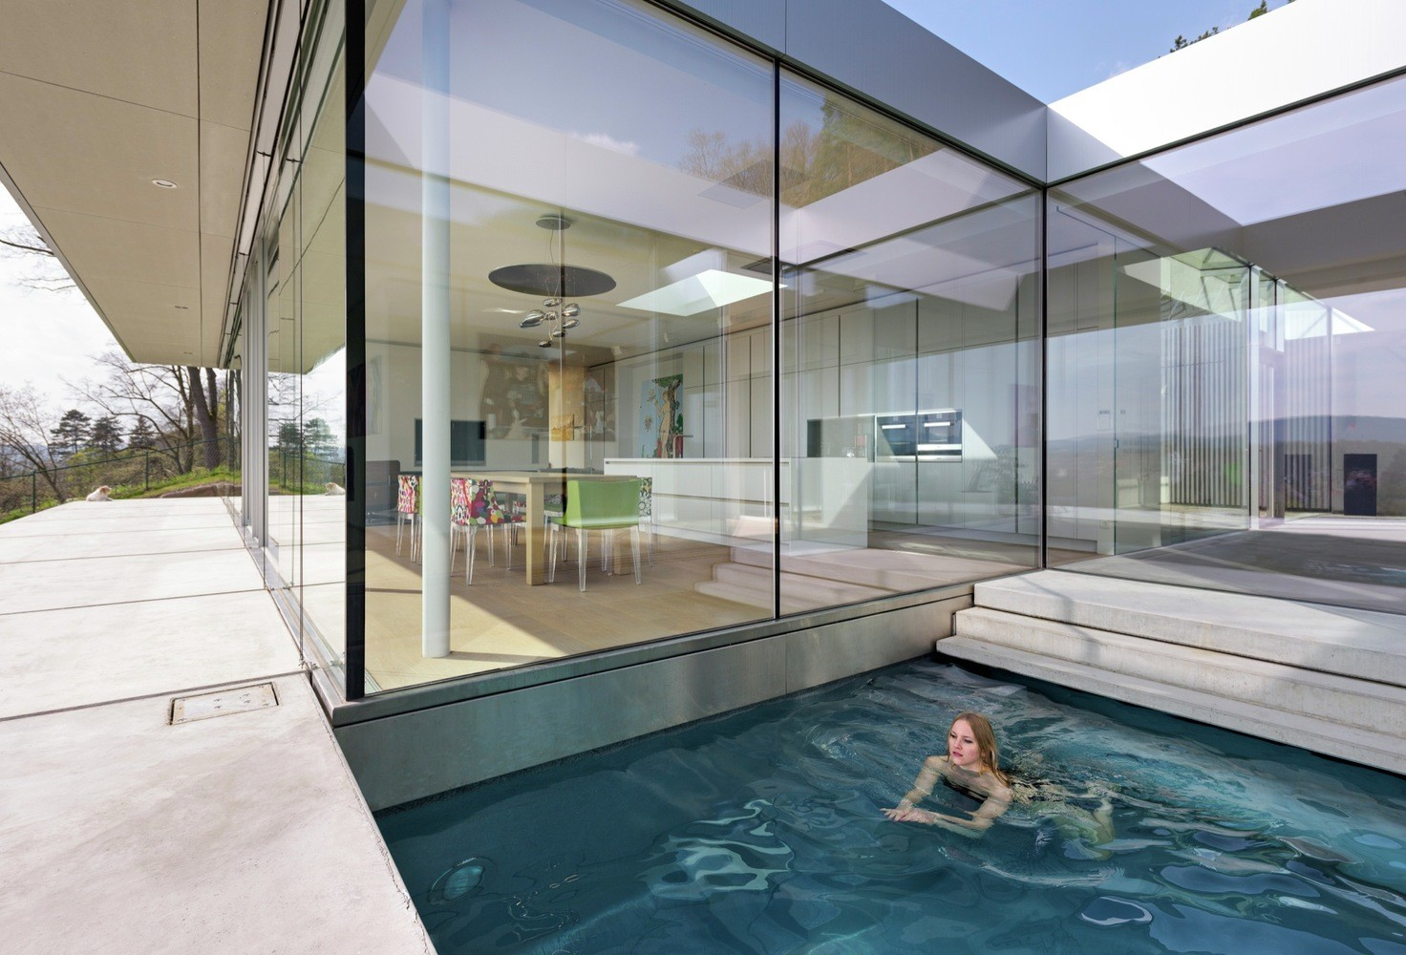
Ex 5. (p 39) Describe to your classmates what can you see outside the window of your future houses. Your group tries to guess where your house is.
Apartment
UFO
Villa
Motorhouse
Notes:
Click vào từng bức tranh để hiện ra đáp án

Slide 22
RECAP
Tick the correct answers
After the lesson, we have made phrases about the places.
After the lesson, we have learnt vocabulary about appliances and types of house.
After the lesson, we have talked about the house in the future.
After the lesson, we have talked about Nick and Phong’s house.

Slide 23
RECAP
Matching
Types of houses
Phrases about the place
UFO
is on the ocean
VILLA
is in the town
CASTLE
is in the sky

Slide 24

Thank you!

