Slide 1




UNIT 5:
Natural wonders of Viet Nam
Lesson 2: A closer look 1

Slide 2


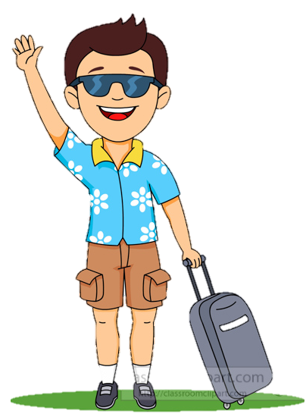
What should I bring???
I’m going to travel next month.
This is Tim.
Notes:
I have a friend, his name is ______ he wants to go travelling somewhere. But he doesn’t know what they should bring, they ask me.

Slide 3
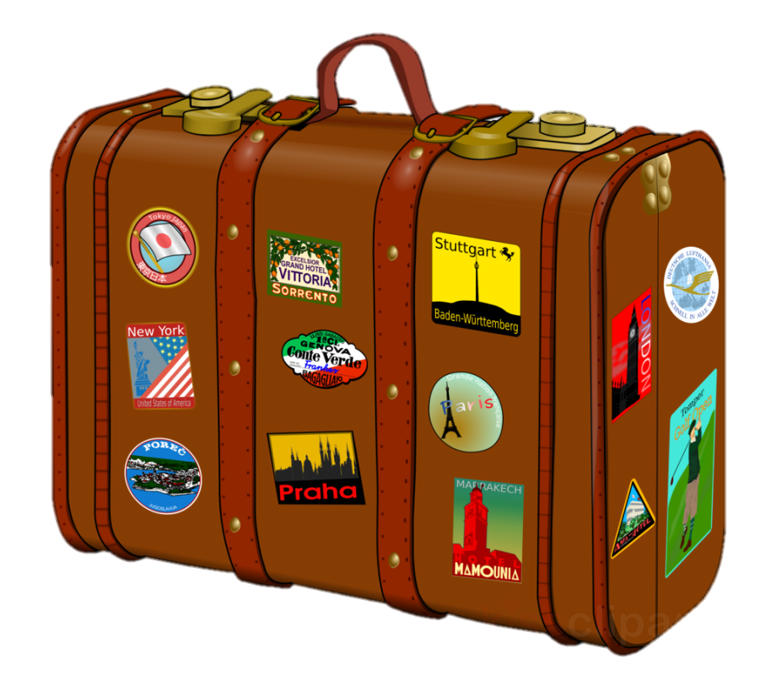

What are in the suitcase?
Guess and list in the chat box.
2 minutes
Open it
Notes:
Now I have a secret suitcase. In this suitcase, there are a lot of things in that. Now, let’s guess what are in the suitcase- 2 mins

Slide 4


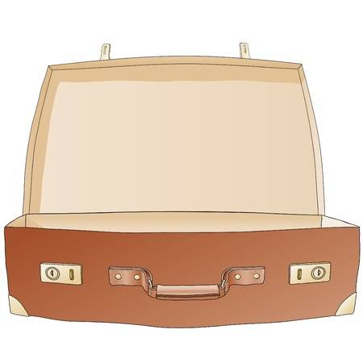
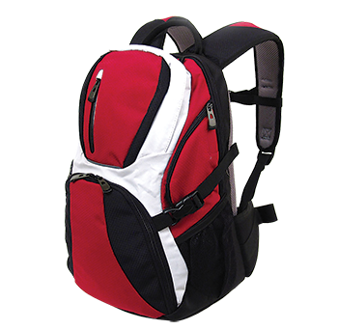
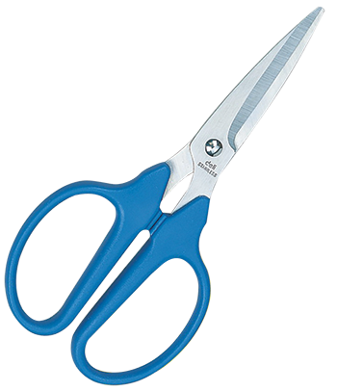

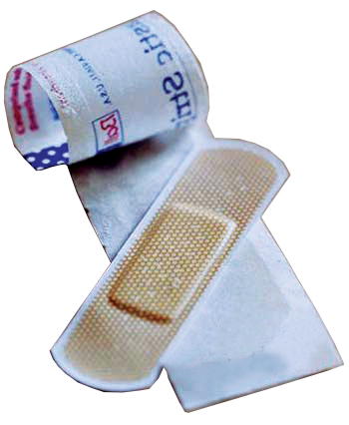
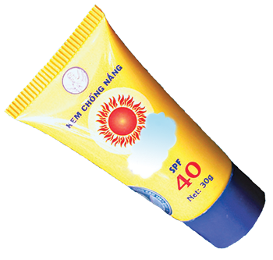
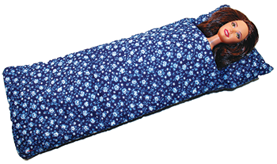
sleeping bag
suncream
backpack
compass
plaster
Let’s check!
scissors
Notes:
Now, lets check wwhat I have in the suitcase

Slide 5


1. Listen and repeat
3.
suncream
sleeping bag
1.
2.
plaster
scissors
4.
6.
5.
compass
backpack

Slide 6

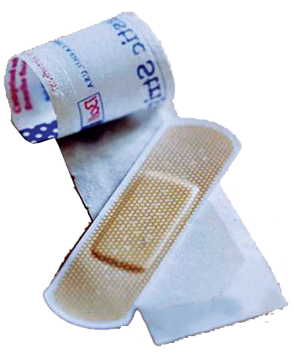
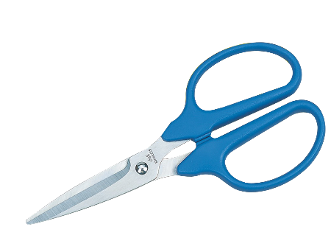
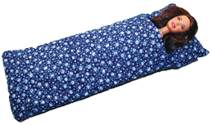
VOCABULARY:
Compass /'kʌmpəs/(n):
La bàn
Plaster /ˈplɑː.stər/ (n):
Băng dán cá nhân
Scissors /ˈsɪz.əz/ (n):
Cái kéo
Sleeping bag (n):
Túi ngủ
Suncream /ˈsʌn ˌkriːm/ (n):
Kem chống nắng

Slide 7

Complete the sentences. Use the words in 1.
plaster
suncream
sleeping bag
backpack
scissors
compass
1. We're lost. Please give me the ____________.
2. It's so sunny today. I need to put on some ____________.
3. A ____________ is very useful when you go camping overnight.
4. I've finished packing. All my things are in my ____________.
5. My foot hurts. I need to put a ____________ on my foot.
compass
suncream
sleeping bag
backpack
plaster

Slide 8
Put the items in order of usefulness. Why?
plaster
suncream
sleeping bag
backpack
scissors
compass
1. ____________________
2. ____________________
3. ____________________
4. ____________________
5. ____________________
6. ____________________
The most useful item
The least useful item
Notes:
Type the order in the chat box.

Slide 9
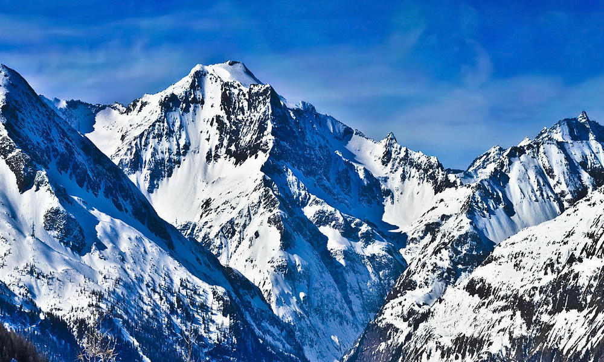
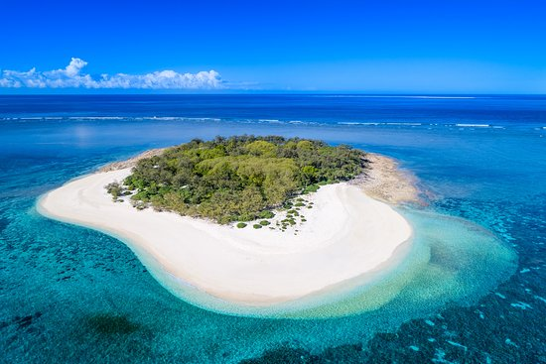
What’s it?
mountain
island
mountain
island
/t/
/d/
Notes:
Type the order in the chat box.

Slide 10



PRONUNCIATION
/t/
/d/

Slide 11
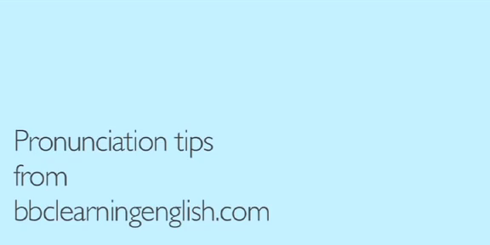

Slide 12

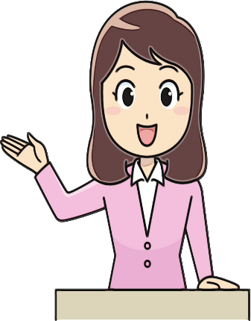
4. Listen and repeat the words
mountain
wonder
waterfall
island
desert
guide
plaster
holiday

Slide 13

5. Listen and repeat.
1. – Where's my hat?
– Oh, it's on your head.
2. Where do they stay on their holiday?
3. I need some meat for my cat.
4. The Sahara is a very hot desert.
5. I want to explore the island by boat.

Slide 14


THANKS!

