Slide 1
Unit 5
Natural wonders of Vietnam
Lesson 1: Getting started

Slide 2
OBJECTIVES
By the end of the lesson, students will be able to:
□ have an overview of the topic: Natural wonders of Vietnam
□ Know more nouns for things in nature through pictures and listening exercise.

Slide 3

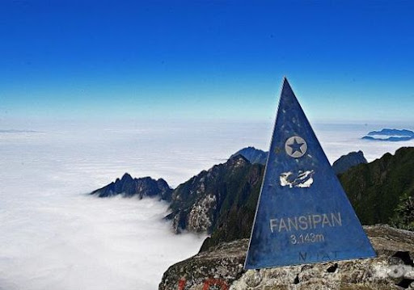
Vocabulary
Scenery (n):
Phong cảnh
The scenery on Fanxipang is very beautiful.

Slide 4
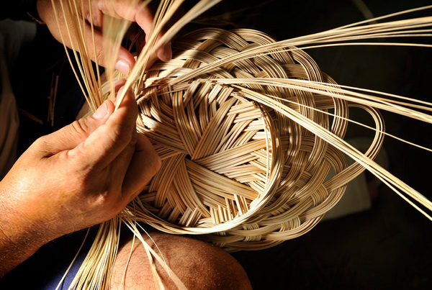
Vocabulary
Natural (adj)
Tự nhiên
>< man-made (adj)

Slide 5
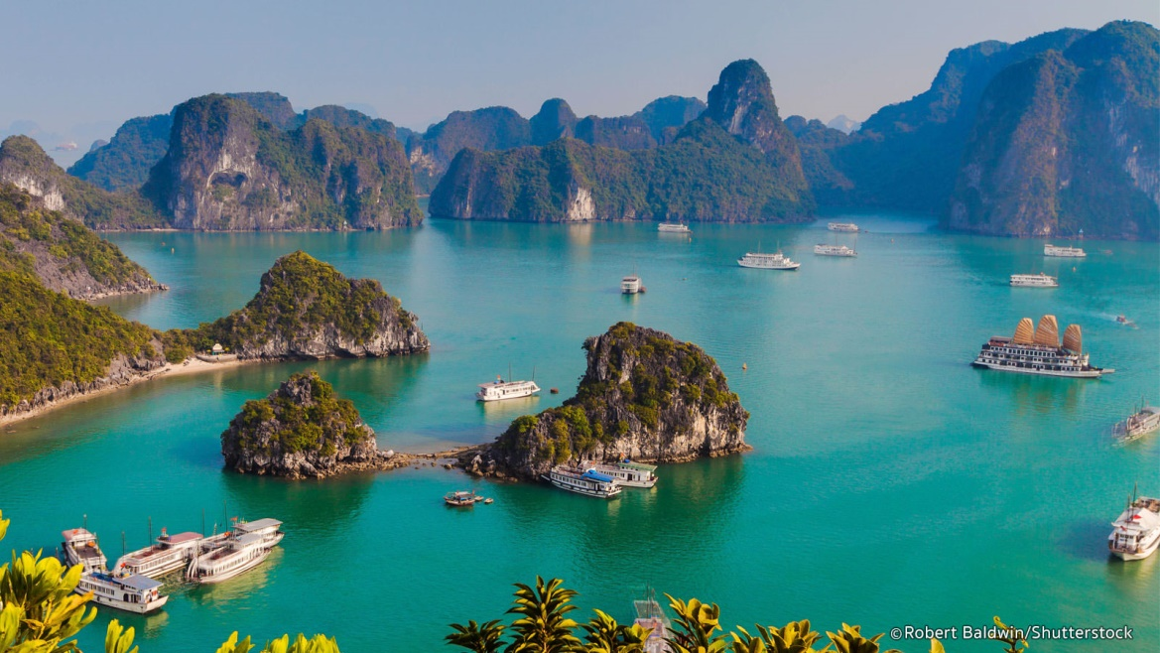
Vocabulary
wonder (n):
Kì quan
Ha Long Bay is a natural wonder of Vietnam.
amazing (adj)
= very good (adj)
:Tuyệt vời, đáng ngạc nhiên

Slide 6
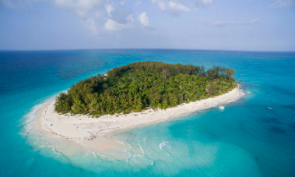
Vocabulary
An island (n):
Hòn đảo

Slide 7
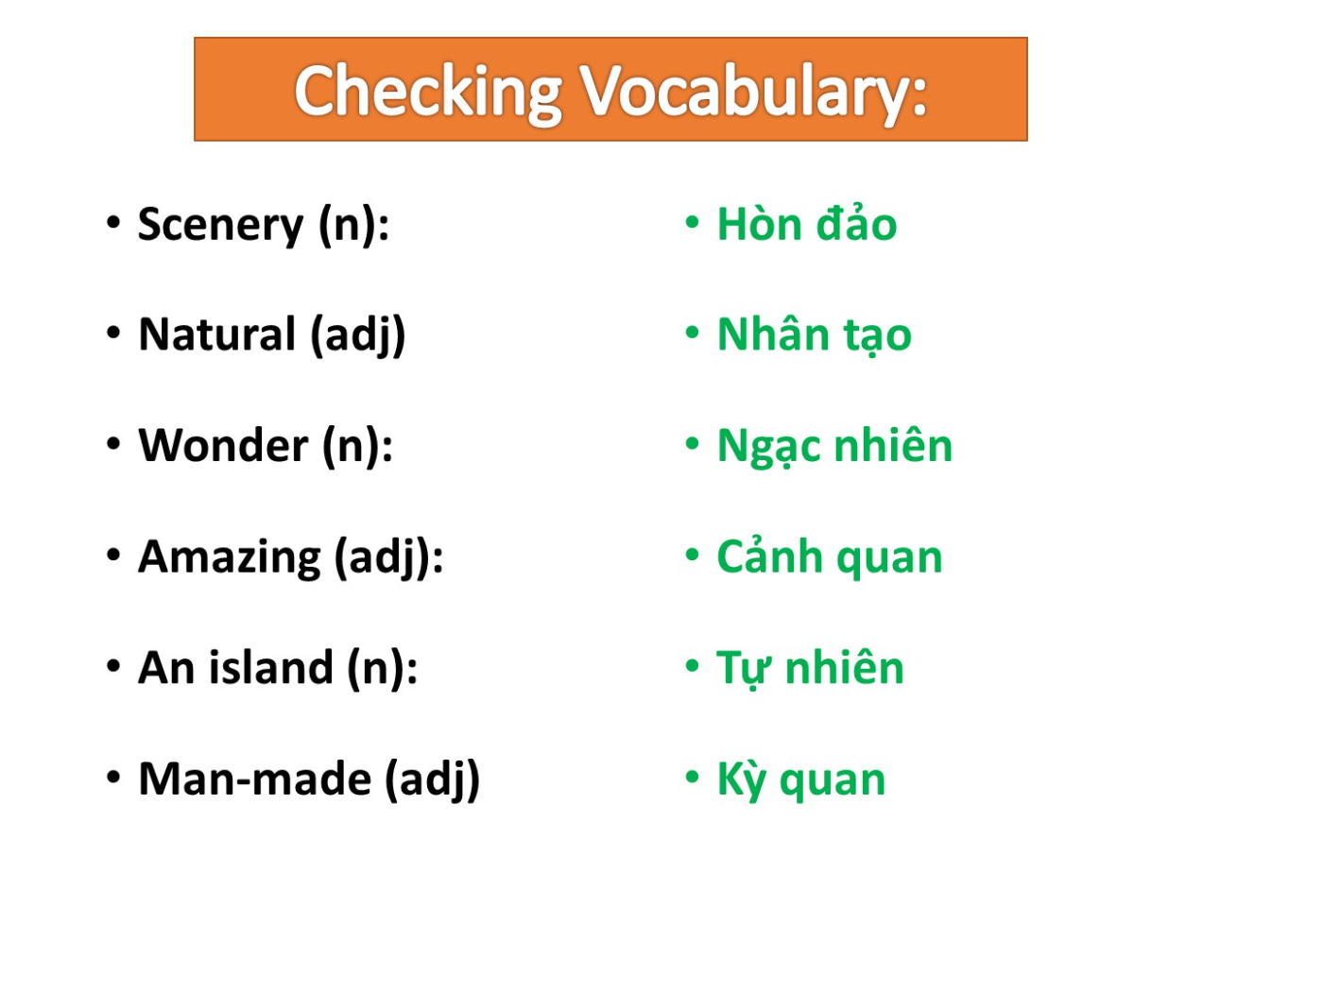

Slide 8


Listen and check.
Look and guess.
Alice
What club is it?
Nick
What are they talking about?
Tommy
Elena

Slide 9
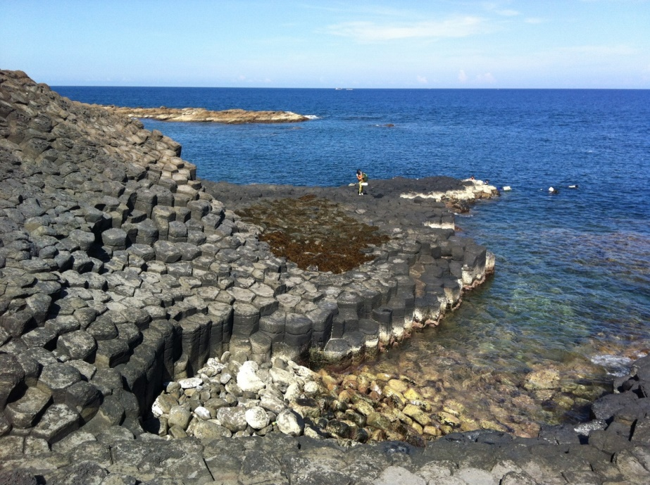
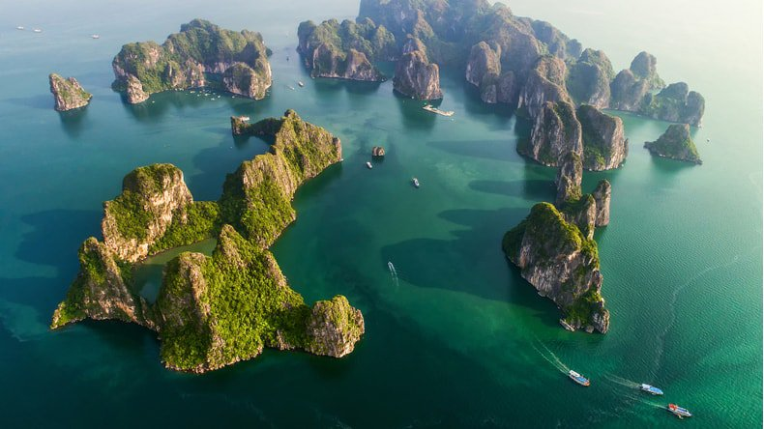
What places are they talking about?
Ha Long Bay
Ganh Da Dia

Slide 10
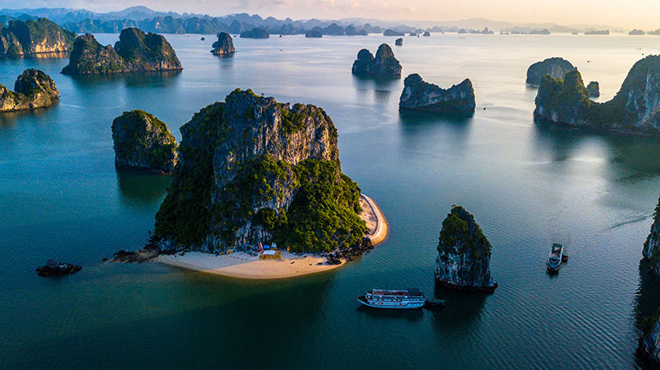
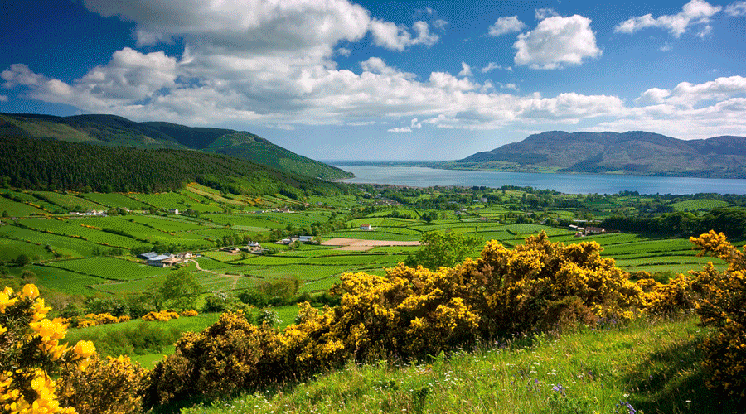
Ex2 (p.49) Complete the following sentences with the words from the box.
scenery natural wonders amazing islands
natural
natural not made by people
1. People didn't make Ganh Da Dia. They are _________ rocks.
2. Ha Long Bay has thousands of big and small _________.
3. The town is charming and the surrounding _________is wonderful.
4. It’s _________to visit Ban Gioc Waterfall in September.
5. There are many natural and man-made _________in Viet Nam.
islands
scenery
amazing
amazing very surprising
wonders

Slide 11


START
What’s behind the wall?
BRICKS DOWN
NATURAL WONDERS

Slide 12
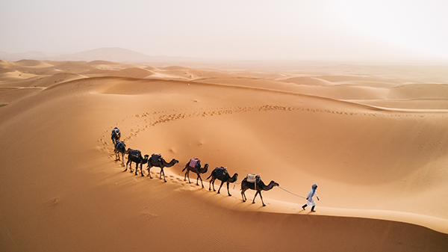
desert
NEXT
Click on the bricks
CHECK

Slide 13
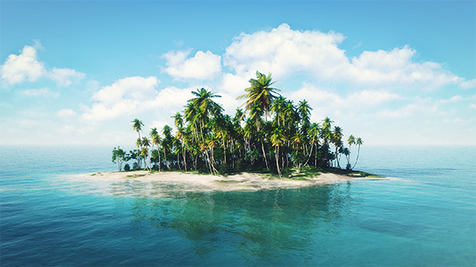
island
NEXT
Click on the bricks
CHECK

Slide 14
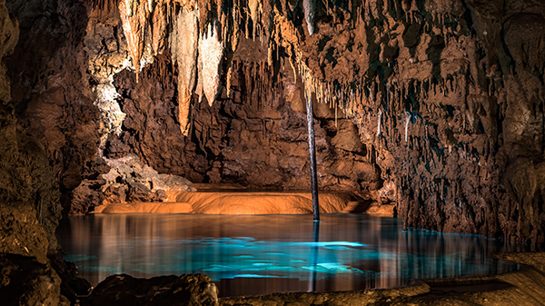
cave
NEXT
Click on the bricks
CHECK

Slide 15
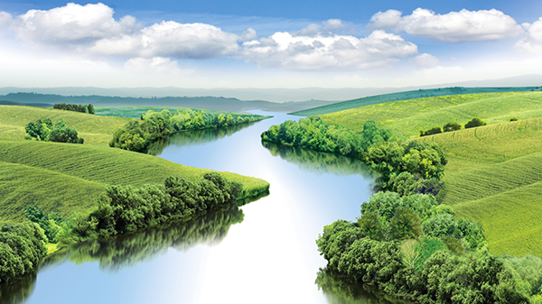
river
NEXT
Click on the bricks
CHECK

Slide 16
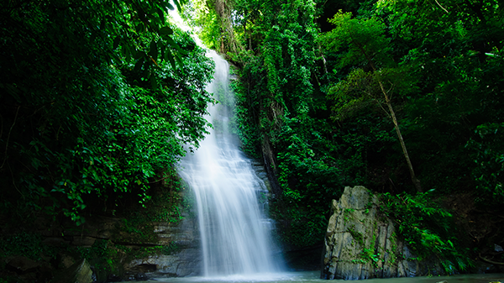
waterfall
NEXT
Click on the bricks
CHECK

Slide 17
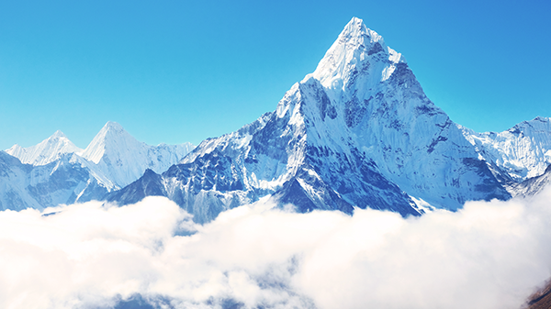
mountain
NEXT
Click on the bricks
CHECK

Slide 18
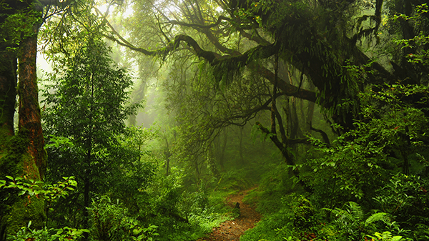
forest
NEXT
Click on the bricks
CHECK

Slide 19
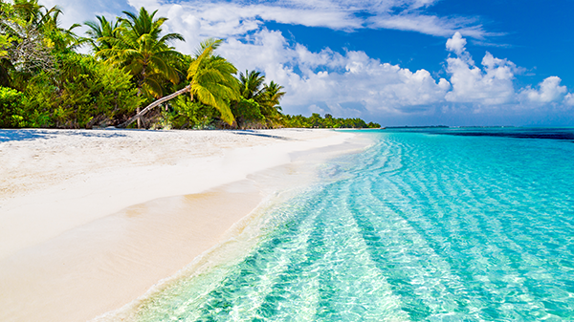
beach
NEXT
Click on the bricks
CHECK

Slide 20
1
2
3
4
desert
island
cave
river
5
6
7
8
waterfall
mountain
forest
beach

Slide 21

HOW WELL DO YOU KNOW?
1 min
Type the correct answer in the box chat
The fastest with 5 correct answers will get 1 bonus point.
1. Which is an island in Viet Nam?
A. Con Dao B. Son Doong
2. Where is Mount Fansipan?
A. In Lao Cai B. In Quang Binh
3. Which of the following is a national park?
A. Thong Nhat Park B. Cat Tien Park
4. Which of the following wonders is a cave?
A. Cuc Phuong B. Phong Nha
5. Which waterfall is in Cao Bang?
A. Giang Dien Waterfall B. Ban Gioc Waterfall

Slide 22
Thanks for your attention!

