Slide 2

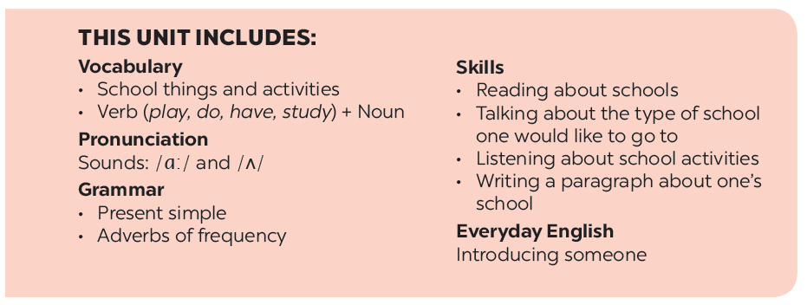

Slide 3







A special day
Listen and read.
Match the word with the school things. Then listen and repeat.
Read the conversation again
and tick () T (True) or F (False).
Look around the class. Write the names of the things you see in your notebook.
Write ONE word from the box in each gap.

Slide 4

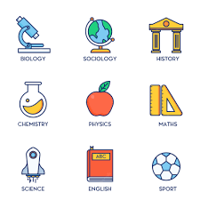
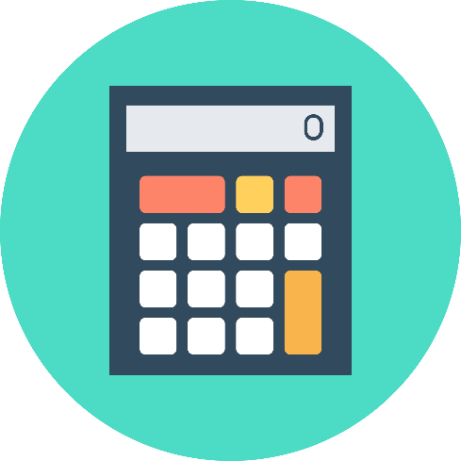
NEW WORDS
1. subject /ˈsʌbdʒekt/ (n) : môn học
2. uniform /ˈjuːnɪfɔːm/ (n) : đồng phục
3. calculator /ˈkælkjəleɪtər/ (n) : máy tính cầm tay

Slide 5
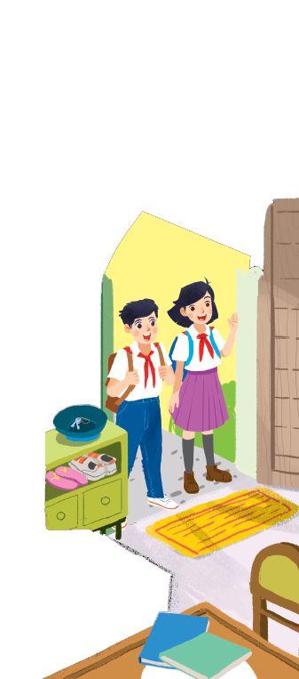
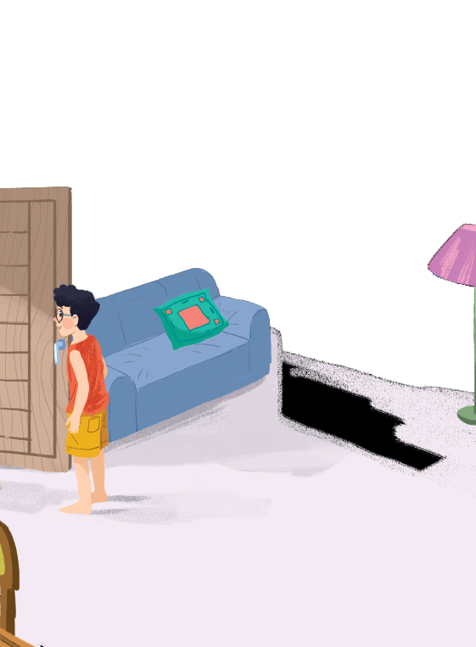



Listen and read.
A special day
Notes:
Thiếu tên bài đọc.

Slide 6
A special day
(Loud knock)
Phong: Hi, Vy.
Vy: Hi, Phong. Are you ready?
Phong: Just a minute.
Vy: Oh, this is Duy, my new friend.
Phong: Hi, Duy. Nice to meet you.
Duy: Hi, Phong. I live near here, and we go to the same school!
Phong: Good. Hmm, your school bag looks heavy.
Duy: Yes! I have new books, and we have new subjects to study.
Phong: And a new uniform, Duy! You look smart!
Duy: Thanks, Phong. We always look smart in our uniforms.
Phong: Let me put on my uniform. Then we can go.

Slide 7

Read the conversation again and tick () T (True) or F (False).
 |  | T | F
1. | Vy, Phong, and Duy go to the same school.
2. | Duy is Phong’s friend.
3. | Phong says Duy looks smart in his uniform.
4. | They have new subjects to study
5. | Phong is wearing a school uniform.
✓
✓
✓
✓
✓

Slide 8

Write ONE word from the box in each gap.
go
subjects
has
wear
uniforms
Students their uniforms on Monday.
1.
wear
has
2.
Vy a new friend, Duy.
- Do Phong, Vy, and Duy to the same school?
3.
go
- Yes, they do.
Students always look smart in their .
4.
uniforms
5.
- What do you like to study?
subjects
- I like to study English and history.

Slide 9

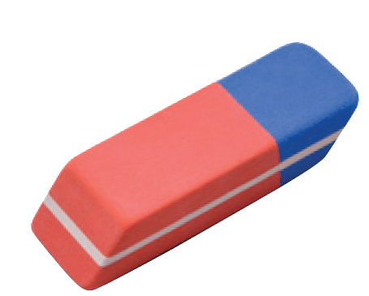
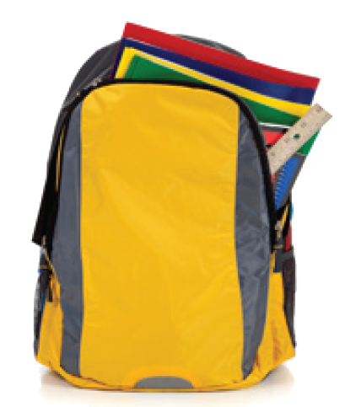
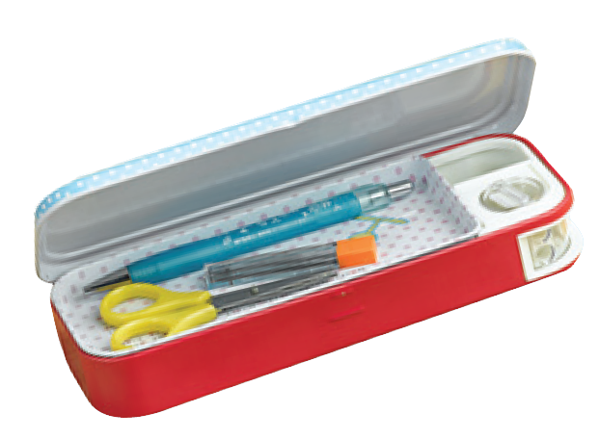
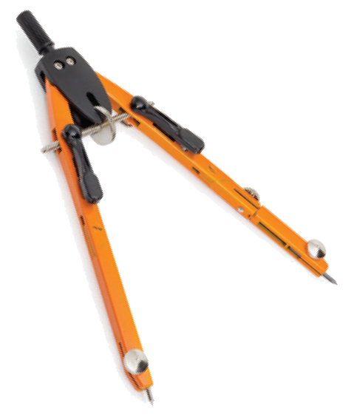
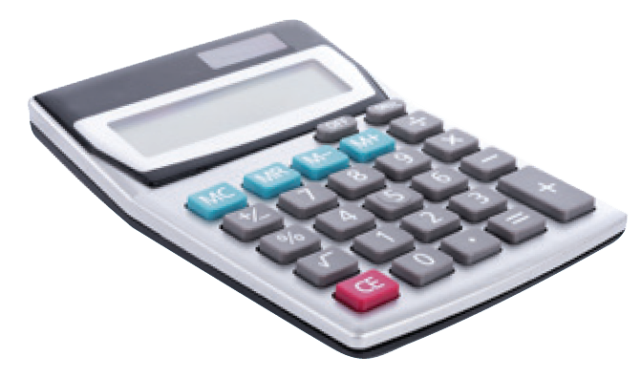
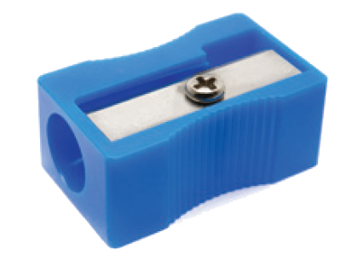
Match the word with the school things. Then listen and repeat.
pencil sharpener
4
compass
1
school bag
2
calculator
5
rubber
3
pencil case
6

Slide 10
Match the word with the school things. Then listen and repeat.
school bag
rubber
4
1
compass
pencil case
2
5
pencil sharpener
calculator
3
6

Slide 11

Look around the class. Write the names of the things you see in your notebook.

Slide 12
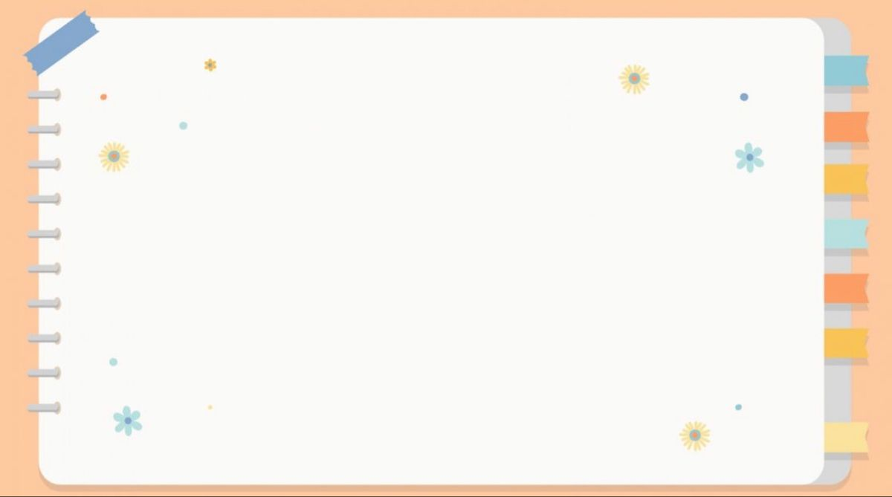

QUIZ
1. I ________football every weekend.
A. study B. have C. play D. do
2. I always ________a cooked breakfast.
A. have B. do C. play D. study
3. I’m ________physics, biology and chemistry.
A. playing B. having C. doing D. going
4. Do you want to ________cards with me?
A. play B. come C. have D. learn
5. Let’s ___________ our school uniform and go to school.
A. take off B. put off C. turn on D. put on
6. My sister and I want to _______ in the same school.
A. play B. go C. have D. study

Slide 13


