Slide 1
Unit 3: MY FRIENDS Lesson 2: A CLOSER LOOK 1

Slide 2
WARM-UP
- 2 TEAMS
- WRITE BODYPARTS in 2 MINUTES

Slide 3


Vocabulary
Personality adjectives

Slide 4


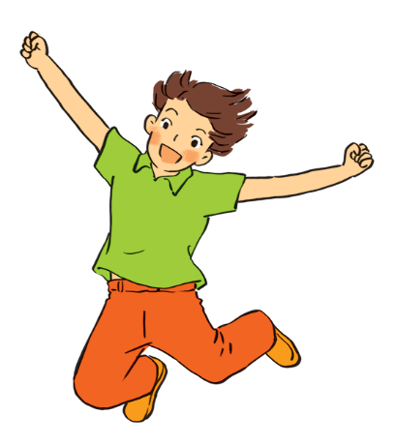
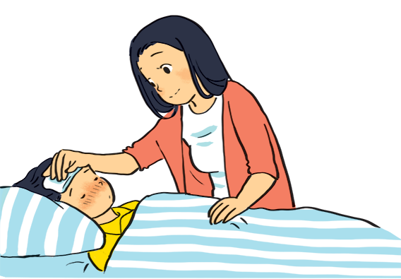
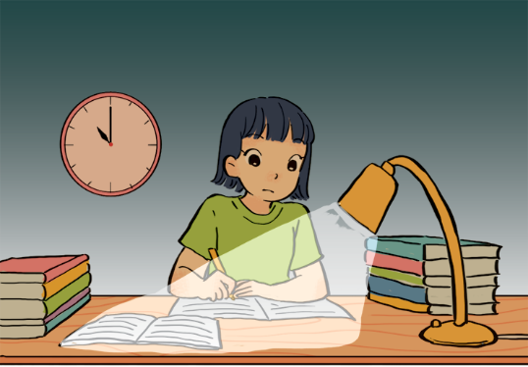
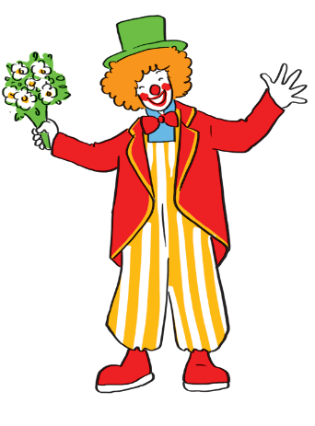
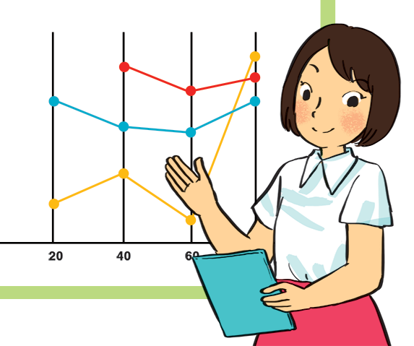
Match the adjectives to the pictures.
a
a
1. hard - working
b
b
2. confident
4. caring
3. funny
4. caring
4. caring
5. active
5. active
5. active
c
d
e
1. hard - working
3. funny
2. confident

Slide 5

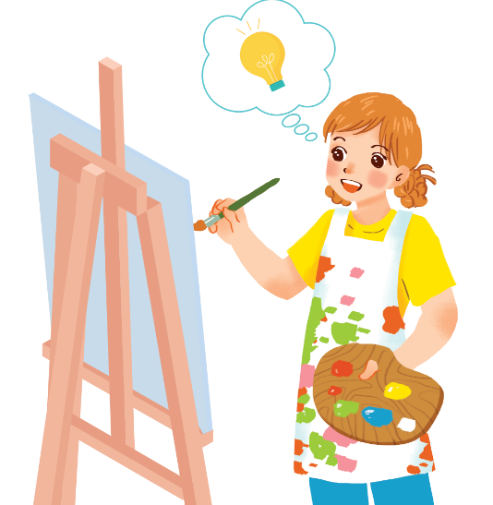
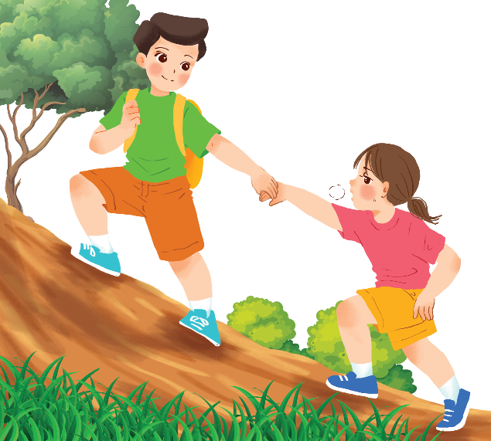
Use the adjectives in the box to complete the sentences.
Pay attention to the highlighted words / phrases.
carefull
clever
shy
kind
creative
friendly
1.
Mina is very . She likes drawing pictures. She always has lots of new ideas.
creative
kind
2.
Nam is .
He likes helping his friends.

Slide 6
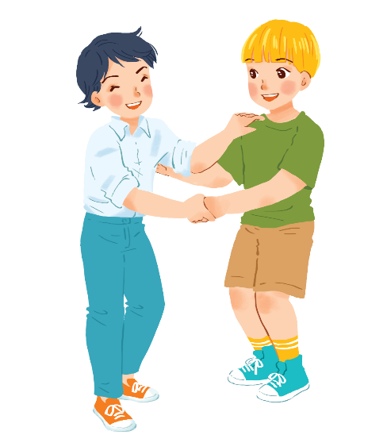
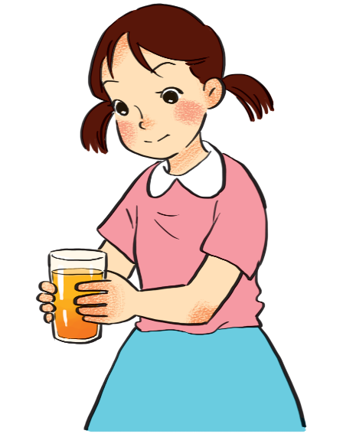
Use the adjectives in the box to complete the sentences.
Pay attention to the highlighted words / phrases.
carefull
clever
shy
kind
creative
friendly
friendly.
3.
Minh Duc is
He likes meeting new people.
.
careful
4.
Kim is very .
She pays attention to what she’s doing.

Slide 7
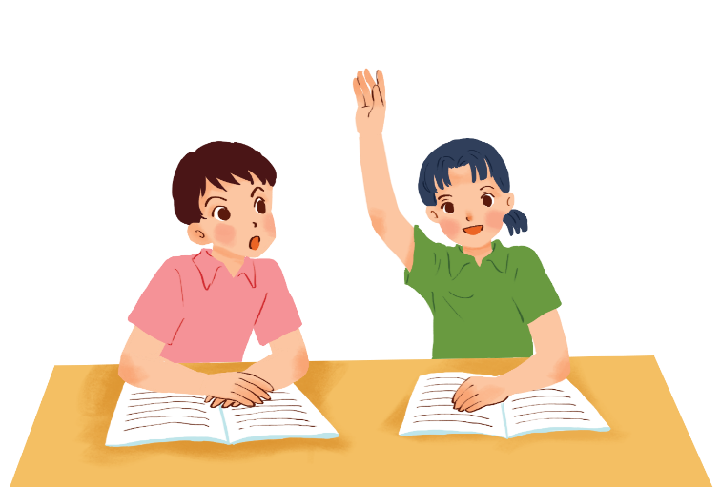
Use the adjectives in the box to complete the sentences.
Pay attention to the highlighted words / phrases.
carefull
clever
shy
kind
creative
friendly
5.
clever
Mai is .
She learns things quickly and easily.

Slide 8



Friendship ﬂower.
Work in groups. Write two personality adjectives for each group member.
Minh: kind funny

Slide 9
Pronunciation
/b/ and /p/

Slide 10


Listen and circle the words you hear. Then repeat.
 | /b/ | /p/
1. | big | pig
2. | bear | pear
3. | buy | pie
4. | robe | rope

Slide 11


Listen. Then practise the chant. Notice the rhyme.
We’re having a picnic
We’re having a picnic
Fun! Fun! Fun!
We’re bringing some biscuits
We’re bringing some biscuits
Yum! Yum! Yum!
We’re playing together
We’re playing together
Hurrah! Hurrah! Hurrah!

Slide 12
UP AND DOWN
Round 1:
Teacher: says 1-15
personalities
Students: stand up for the positive ones, sit down for the negative ones.

Slide 13
UP AND DOWN
Round 2:
Teacher: says 1-15 words containing the sound /b/ and /p/.
Students: stand up for the ones with the “b” sound, sit down for “p” sound.

