Slide 1

Unit 2:
MY HOUSE
Lesson 6:
Skills 2

Slide 2
WARM-UP
Lucky numbers
Students work in 2 teams
Chooses a number, and answer the question
The team which has more points will be the winner.

Slide 3
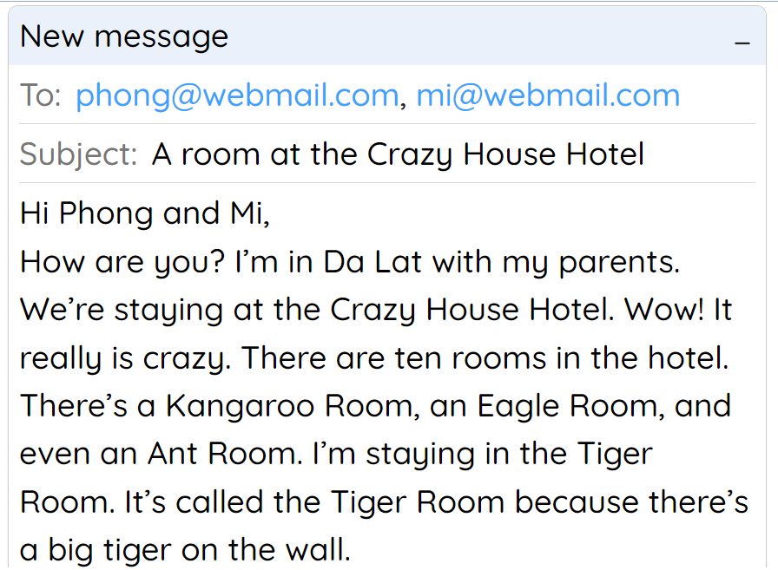
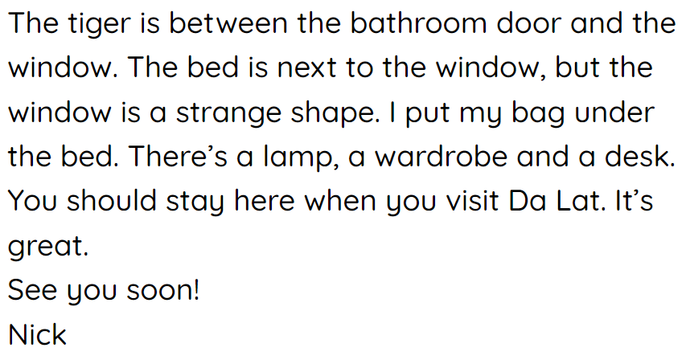
WARM-UP

Slide 4
WARM-UP
Lucky numbers
https://www.baamboozle.com/game/1822377

Slide 5


I. Listening

Slide 6


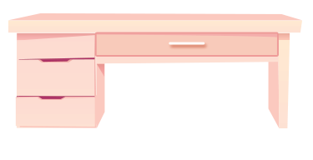

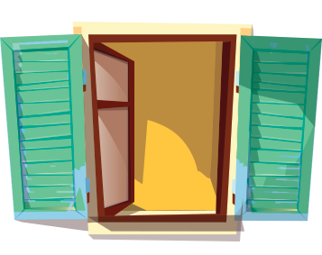

LISTENING
1
Look at the pictures. Name each of them. Guess if they are mentioned in the listening text.
1
2
3
sofa
desk
bookself
4
5
clock
window
Now listen and check your guess

Slide 7
LISTENING
2
Listen to Mai talking about her house. Tick () T (True) or F (False)
 |  | T | F
1. | There are four people in Mai’s family.
2. | Mai’s house has seven rooms.
3. | The living room is next to the kitchen.
4. | In her bedroom, there’s a clock on the wall.
5. | She often listens to music in her bedroom.

There are three people in Mai’s family.

Mai’s house has six rooms.



She often reads books in her bedroom.

Slide 8
II. Writing

Slide 9
Necessary parts of an email
address
1
subject (topic)
To: phong@webmail.com; mi@webmail.com
Subject: A room at the Crazy House Hotel
1. greeting
Hi Phong and Mi,
How are you? I’m in Da Lat with my parents. We’re staying at the Crazy House Hotel. Wow! It really is crazy.
There are ten rooms in the hotel. There’s a Kangaroo Room, an Eagle Room, and even an Ant Room. I’m staying in the Tiger Room. It’s called the Tiger Room because there’s a big tiger on the wall.
The tiger is between the bathroom door and the window. The bed is next to the window, but the window is a strange shape. I put my bag under the bed. There’s a lamp, a wardrobe and a desk.
You should stay here when you visit Da Lat. It’s great.
See you soon!
Nick
2. introduction
3. body
4. conclusion

Slide 10


How to write email to friend?
2.
Begin the email with a greeting (Dear/ Hi/ Hello).
3
3. INTRODUCTION.
Ask about his/ her health
thank him/ her for the previous email or write the reasons for the email, etc.
1. SUBJECT:
- what the email is about.
EMAIL TO A FRIEND
4. BODY = SUBJECTS
Write the subject(s) of the email.
Each subject = new paragraph
5. Conclusion
- Say goodbye, ask your friend to write back, etc.

Slide 11
WRITING
3
Answer the questions.
1. Where do you live?
2. How many rooms are there in your house? What are they?
3. Which room do you like the best in your house? Why?

Slide 12

WRITING
4
Write an email to Mira, your pen friend. Tell her about your house. Use the answers to the questions in 3.
To: mira@webmail.com
Subject: My house
Hi Mira,
Thanks for your email. Now I’ll tell you about my house.
What about you? Where do you live? Tell me in your next email.
All the best,

Slide 13

CONSOLIDATION
1
Wrap-up
What have we learnt in this lesson?
Use the lexical items related to the topic My house
Listen to get information about rooms and houses.
Write an e-mail to a friend

Slide 14

CONSOLIDATION
2
Homework
- Rewrite the email on the notebook.
- Do exercises in the workbook.

