Slide 1

Unit 2:
MY HOUSE
Lesson 4:
Communication

Slide 2


Everyday English
Giving suggestions

Slide 3
WARM-UP
Pictionary
2 TEAMS
Draw and describe the picture for TEAMMATES to guess

Slide 4

PRESENTATION
1
Elena and her mum are discussing how to decorate her bedroom. Listen and read the dialogue. Pay attention to the highlighted sentences.
…
Elena: My bedroom isn’t nice.
Mum: How about putting a picture on the wall?
Elena: Great idea, Mum.
Mum: Let’s go to the department store to buy one.
…

Slide 5
PRESENTATION
Structure
How about + V-ing?
Example: How about putting a picture on the wall?
Let’s + V
Example: Let’s go to the department store to buy one.

Slide 6

PRACTICE
2
Work in pairs. Make a similar dialogue. Remember to use the structures:
How about + Ving?
Let’s + V.
Situation 1: You want to buy some furniture for their homes.
Situation 2: You want to do some activities at the weekend with your friend.
Situation 3: You want to buy some new school things.

Slide 7
PRACTICE
2
Work in pairs. Make a similar dialogue. Remember to use the structures:
How about + Ving?
Let’s + V.
A: ______isn’t nice.
B: How about ________?
A: Great idea, Mum.
B: Let’s go to the department store to buy one

Slide 8
Living places

Slide 9
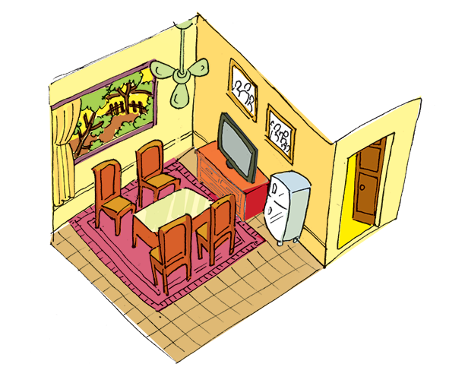
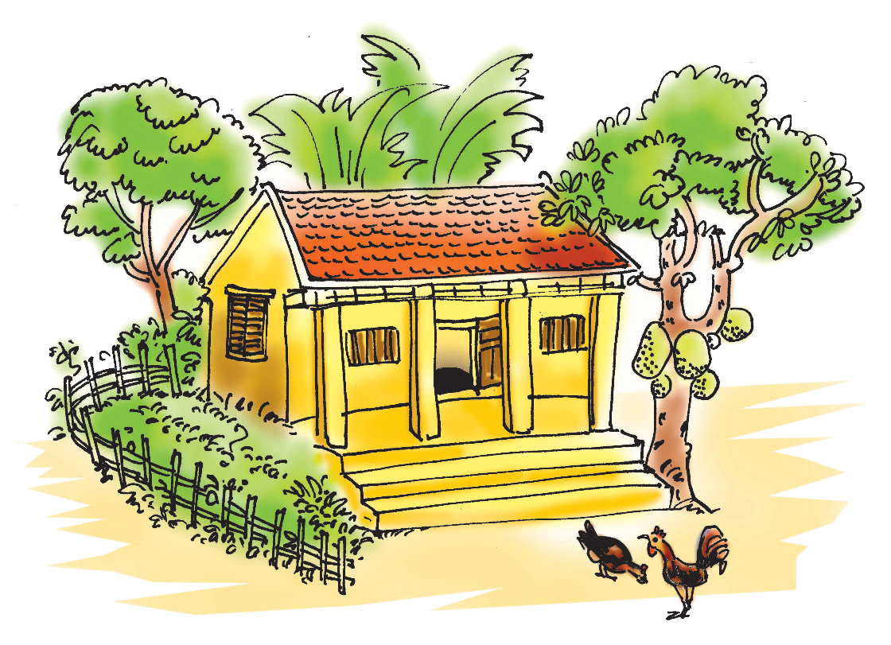
PRESENTATION
3
Mi tells Nick about her grandparents’ country house. Look at the pictures of her grandparents’ house and complete the sentences.

Slide 10
PRESENTATION
3
Mi tells Nick about her grandparents’ country house. Look at the pictures of her grandparents’ house and complete the sentences.
1. My grandparents live in a ________ house in Nam Dinh.
country
2. There ______ four rooms in the house and a big garden.
are

Slide 11
PRESENTATION
3
Mi tells Nick about her grandparents’ country house. Look at the pictures of her grandparents’ house and complete the sentences.
3. I like the living room. There ______ a big window in this room.
is
4. There are four ________ and a table in the middle of the room.
chairs

Slide 12
PRESENTATION
3
Mi tells Nick about her grandparents’ country house. Look at the pictures of her grandparents’ house and complete the sentences.
5. There are two family photos _____ the wall.
on

Slide 13

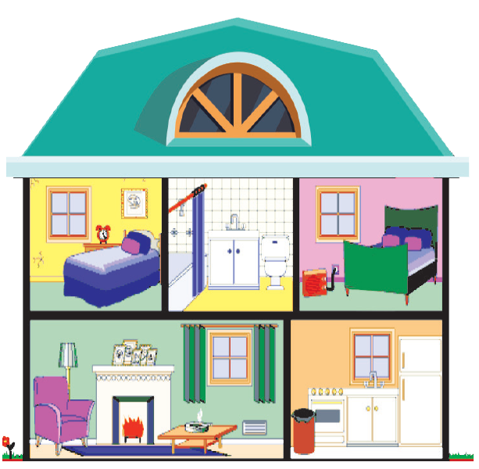
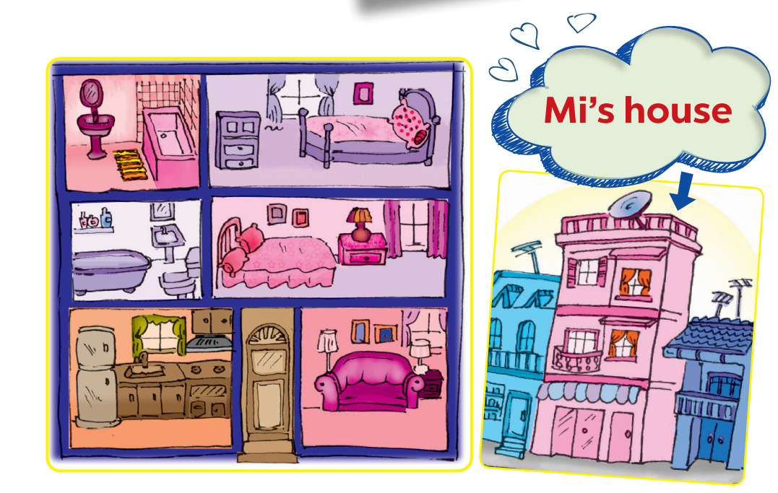
PRESENTATION
4
Student A looks at the pictures of Nick’s house on this page. Student B looks at the pictures of Mi’s house on page 25. Ask questions to find the differences between the two houses.
Example:
A: Where does Mi live?
B: She lives in a town house.

Slide 14



PRODUCTION
5
Draw a simple picture of your house. Tell your partner about it.

Slide 15

CONSOLIDATION
1
Wrap-up
What have we learnt in this lesson?
give suggestions
practice using some grammar points and vocabulary related to the topic

