Slide 1
Unit 1:
Hobbies
LESSON 5: SKILLS 1

Slide 2
OBJECTIVES
01
02
After this lesson, students will be able to:
Reading
reading skills for general and specific information about gardening
Speaking
talk about benefits of hobbies

Slide 3
01
Reading

Slide 4
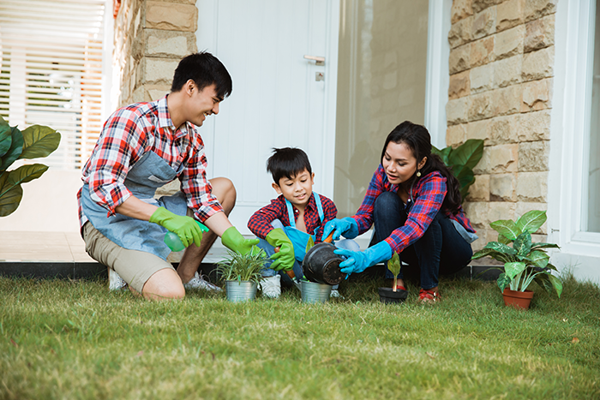
Look and discuss the questions below.
1. What can you see in the picture?
2. In your opinion, what is good about gardening?

Slide 5
2. Read the text about gardening. Match each word in column A with its definition in column B.
A
B
1. outdoor
a. a very developed form
2. patient
b. happening outside
3. responsibility
c. the duty of taking care of sth
4. majority
d. very helpful
5. valuable
e. able to wait for a long time

Slide 6

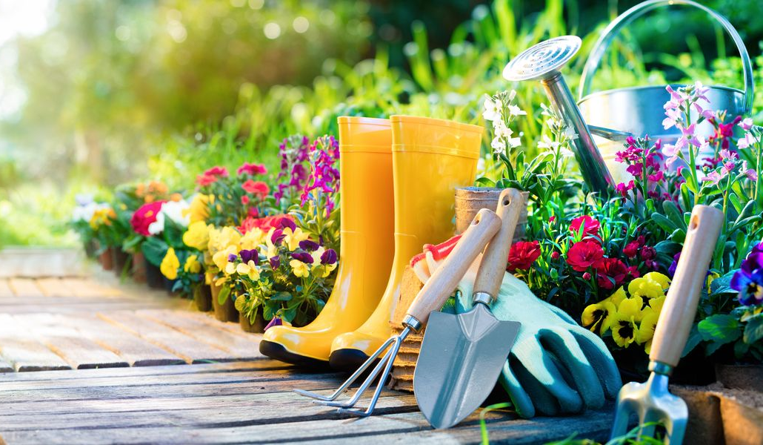
2. Read the text about gardening. Match each word in column A with its definition in column B.
A
B
1. outdoor
a. a very developed form
Gardening is one of the oldest outdoor activities.
b. happening outside
c. the duty of taking care of sth
d. very helpful
e. able to wait for a long time

Slide 7
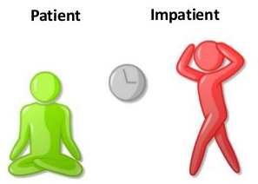
2. Read the text about gardening. Match each word in column A with its definition in column B.
A
B
2. patient
a. a very developed form
When gardening, children learn to be patient …
c. the duty of taking care of sth
d. very helpful
e. able to wait for a long time

Slide 8

2. Read the text about gardening. Match each word in column A with its definition in column B.
A
B
3. responsibility
a. a very developed form
When gardening, children learn to be patient and take on responsibility.
c. the duty of taking care of sth
d. very helpful

Slide 9
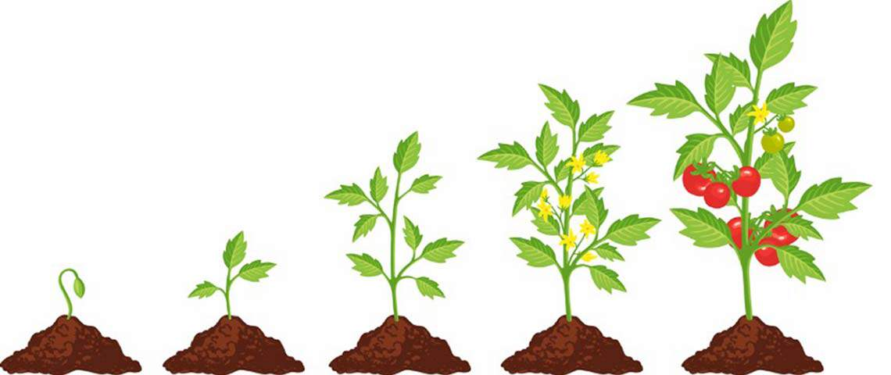

2. Read the text about gardening. Match each word in column A with its definition in column B.
A
B
4. maturity
a. a very developed form
5. valuable
d. very helpful
They learn to wait for the plants to grow to maturity.
This teaches them valuable lessons about responsibility.
Notes:
People divide hobbies into four big group: doing things, making things, collecting things, and learning things. Gardening belongs to the most popular group - doing things. Gardening is one of the oldest outdoor activities. It has something for everyone, even for children. Gardening teaches children about flowers, fruits, and vegetables. They can also learn about insects and bugs. When gardening, chidren learn to be patient and take on responsibility. They learn to wait for the plants to grow to maturity. And if they don't water their plants, their plants will die. This teaches them valuable lessons about responsibility. Gardening is also good because everyone in the family can join in and do something together. My mum and I love gardening. We usually spend an hour a day in our garden. It really makes us happy, and we love spending time together.

Slide 10
2. Read the text about gardening. Match each word in column A with its definition in column B.
A
B
1. outdoor
a. a very developed form
2. patient
b. happening outside
3. responsibility
c. the duty of taking care of sth
4. maturity
d. very helpful
5. valuable
e. able to wait for a long time

Slide 11
3 Read the text again. Complete each sentence with no more than three words.
1. Gardening belongs to the group of __________.
2. Gardening teaches children about flowers, fruits, vegetables, __________.
3. Gardening makes children become __________ and responsible.
4. It is an activity that everyone in the family can __________.
5. The author and her mother usually __________ garden for a day.

Slide 12
3 Read the text again. Complete each sentence with no more than three words.
1. Gardening belongs to the group of __________.
2. Gardening teaches children about flowers, fruits, vegetables, __________.
3. Gardening makes children become __________ and responsible.
4. It is an activity that everyone in the family can __________.
5. The author and her mother usually __________ garden for a day.
Gardening belongs to the most popular group – doing things.
doing things

Slide 13
3 Read the text again. Complete each sentence with no more than three words.
1. Gardening belongs to the group of __________.
2. Gardening teaches children about flowers, fruits, vegetables, __________.
3. Gardening makes children become __________ and responsible.
4. It is an activity that everyone in the family can __________.
5. The author and her mother usually __________ garden for a day.
doing things
insects and bugs
Gardening teaches children about flowers, fruits, and vegetables. They can also learn about insects and bugs.

Slide 14
3 Read the text again. Complete each sentence with no more than three words.
1. Gardening belongs to the group of __________.
2. Gardening teaches children about flowers, fruits, vegetables, __________.
3. Gardening makes children become __________ and responsible.
4. It is an activity that everyone in the family can __________.
5. The author and her mother usually __________ garden for a day.
doing things
insects and bugs
When gardening, children learn to be patient and take on responsibility.
patient

Slide 15
3 Read the text again. Complete each sentence with no more than three words.
1. Gardening belongs to the group of __________.
2. Gardening teaches children about flowers, fruits, vegetables, __________.
3. Gardening makes children become __________ and responsible.
4. It is an activity that everyone in the family can __________.
5. The author and her mother usually __________ garden for a day.
doing things
insects and bugs
Gardening is also good because everyone in the family can join in and do something together.
patient
join in

Slide 16
3 Read the text again. Complete each sentence with no more than three words.
1. Gardening belongs to the group of __________.
2. Gardening teaches children about flowers, fruits, vegetables, __________.
3. Gardening makes children become __________ and responsible.
4. It is an activity that everyone in the family can __________.
5. The author and her mother usually garden for __________ a day.
doing things
insects and bugs
patient
join in
We usually spend an hour a day in our garden.
an hour

Slide 17
Check your memory!!!
What’re the benefits of gardening?
Gardening teaches children about nature.
Children learn to be patient and take on responsibility.
Everyone in the family can join in and do something together.
Notes:
People divide hobbies into four big group: doing things, making things, collecting things, and learning things. Gardening belongs to the most popular group - doing things.
Gardening is one of the oldest outdoor activities. It has something for everyone, even for children. Gardening teaches children about flowers, fruits, and vegetables. They can also learn about insects and bugs. When gardening, chidren learn to be patient and take on responsibility. They learn to wait for the plants to grow to maturity. And if they don't water their plants, their plants will die. This teaches them valuable lessons about responsibility. Gardening is also good because everyone in the family can join in and do something together. My mum and I love gardening. We usually spend an hour a day in our garden. It really makes us happy, and we love spending time together.

Slide 18
02
Speaking

Slide 19
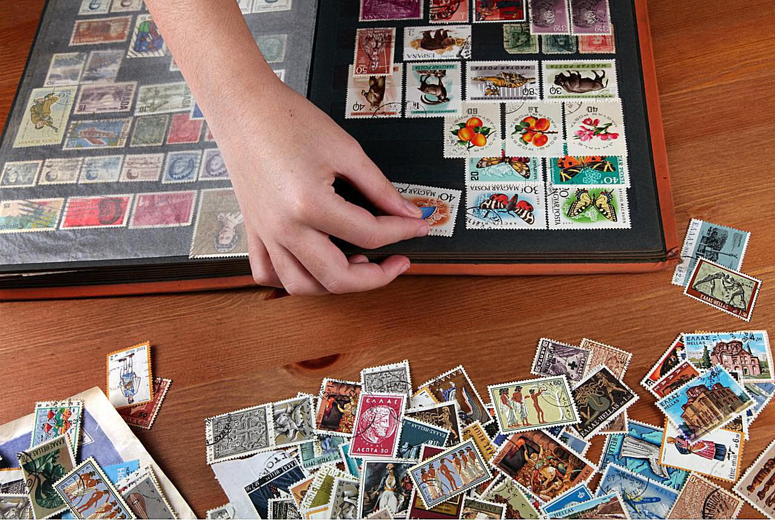
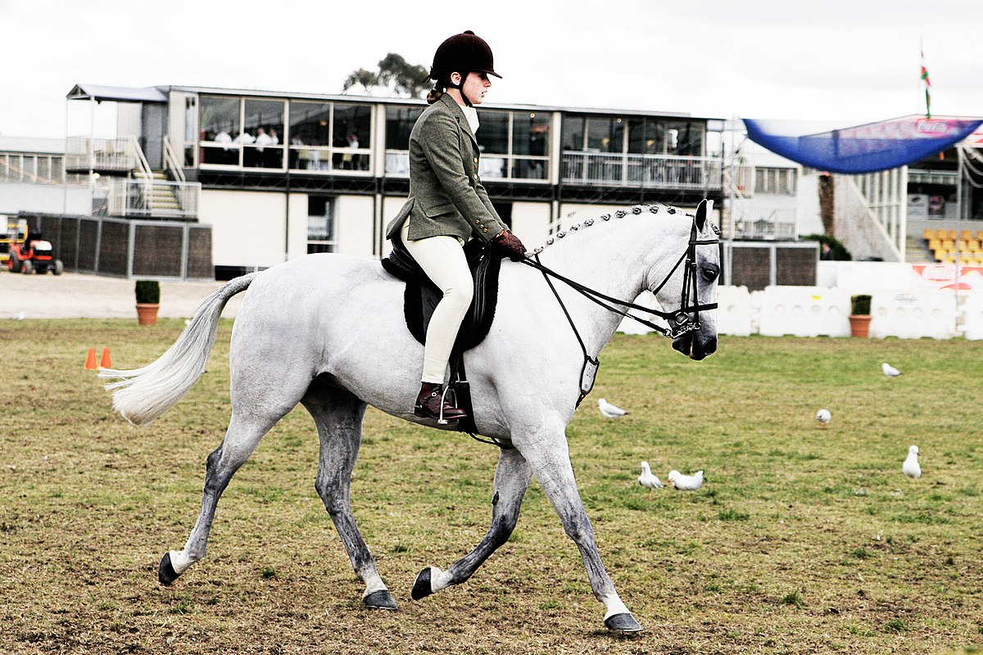
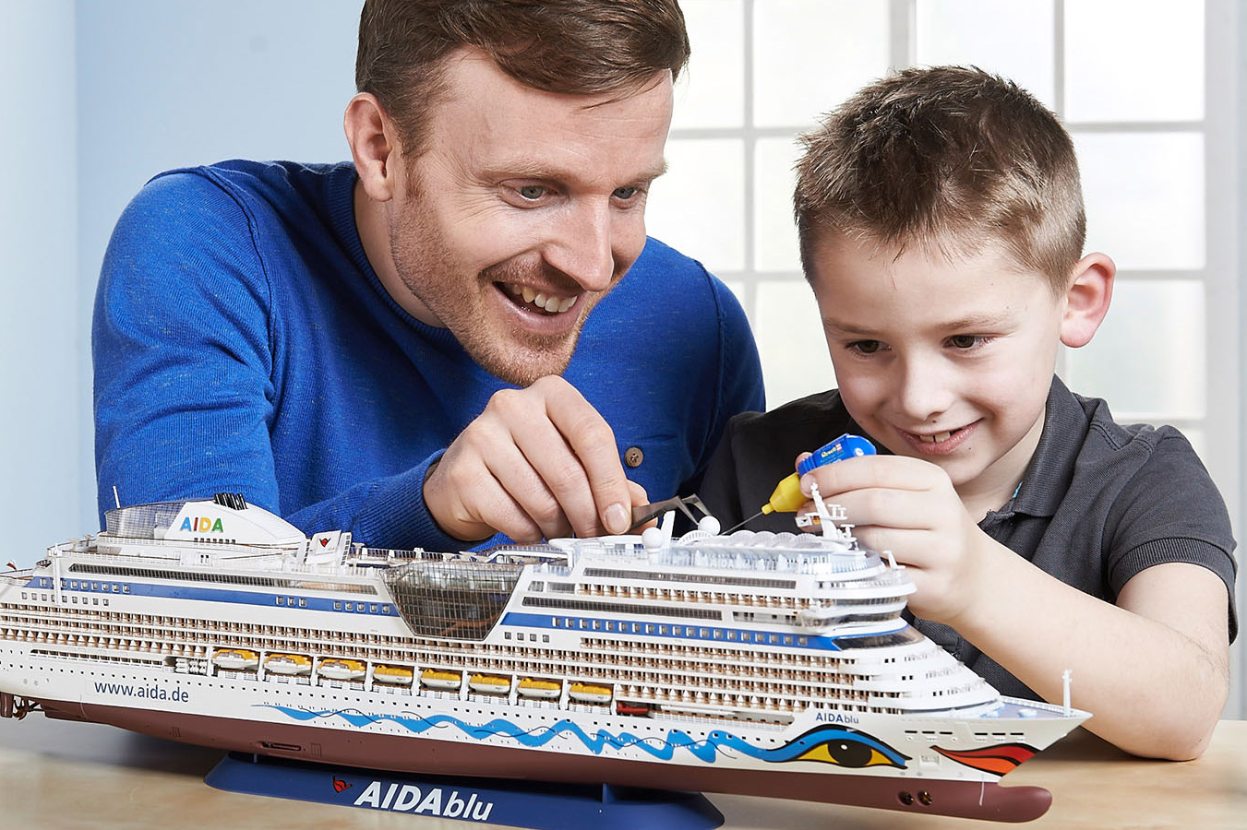
4 Match each hobby with its benefit(s). One hobby may have more than one benefit.
a. develops your creativity
e. helps your hands and eyes work well together
b. makes you strong
c. reduces stress
d. helps you more patient
1. Collecting stamps
2. Riding a horse
3. Making models
c. reduces stress
b. makes you strong
a. develops your creativity
d. helps you more patient
d. helps you more patient
c. reduces stress
c. reduces stress
e. helps your hands and eyes work well together
Notes:
makes you strong
'
helps your hands and eyes work well together

Slide 20
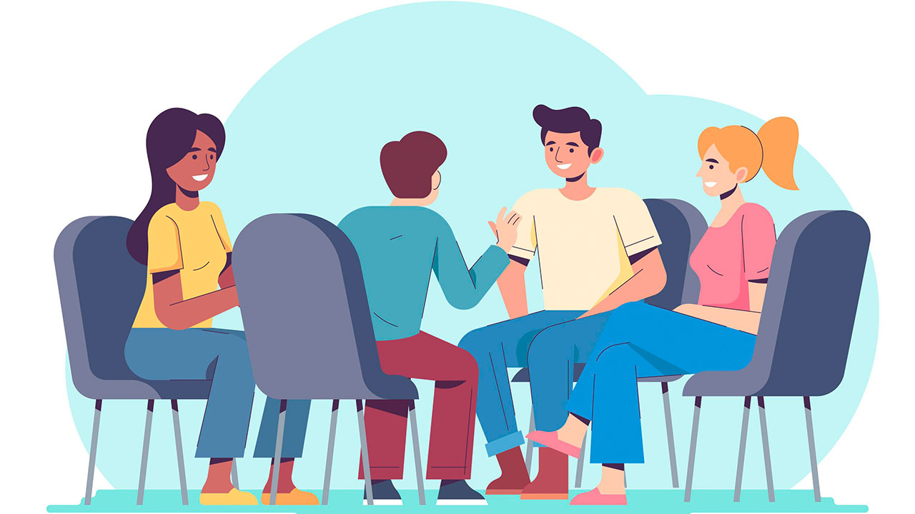

5 Now present your partners’ answers to the class.
My favorite hobby is collecting stamps.
What is your favourite hobby?
It helps me more patient.
What are its benefits?
Notes:
Then present your partners’ answers to the class.

Slide 21
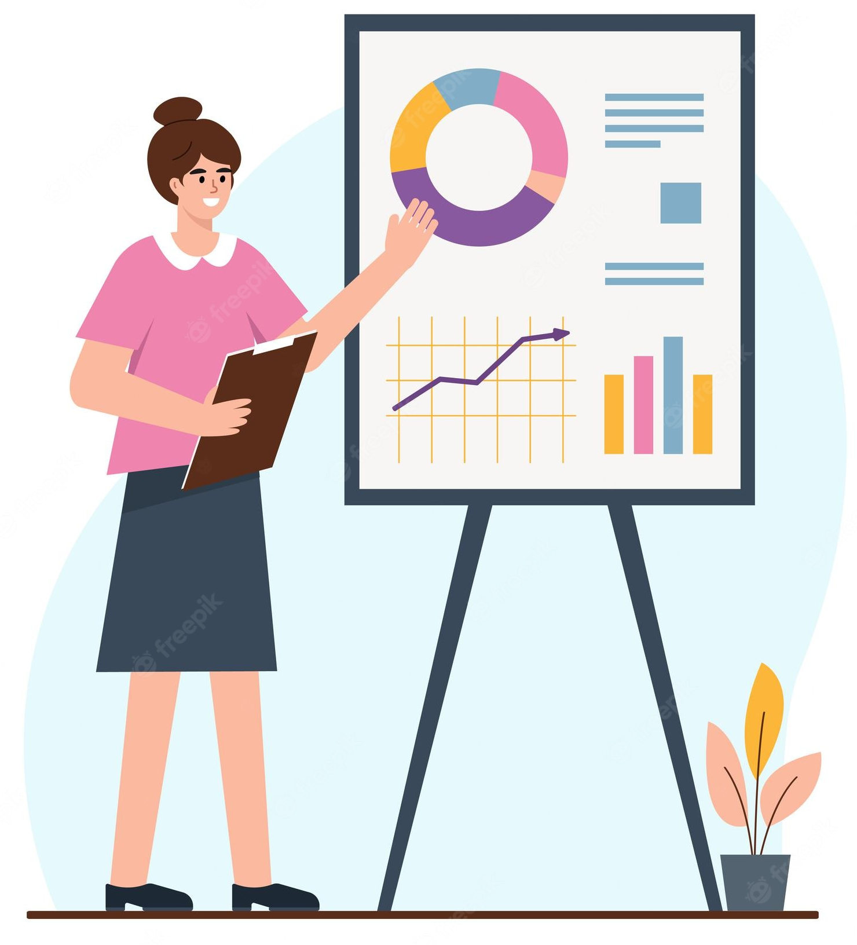
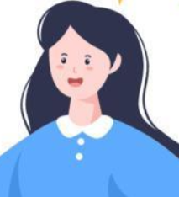
5 Work in groups. Ask one another the following questions.
My friend Mi’s favourite hobby is collecting stamps.
It helps her be more patient.

Slide 22
03

Slide 23
Recap
Reading
Speaking
Gardening as a hobby
Benefits of hobbies

Slide 24
Thanks!
Do you have any questions?
addyouremail@freepik.com
|+91 620 421 838 | yourcompany.com
Please keep this slide for the attribution

