Slide 1

Period 59: Unit 7: POLLUTION
Skills 1

Slide 2

OBJECTIVES
-Students learn vocabulary about pollution.
-You study reading and speaking skills.

Slide 3
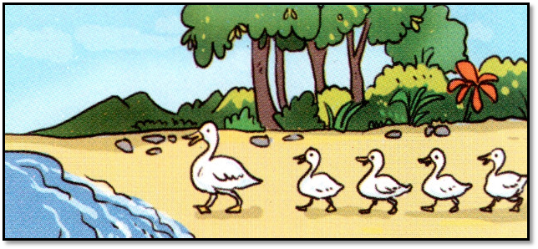
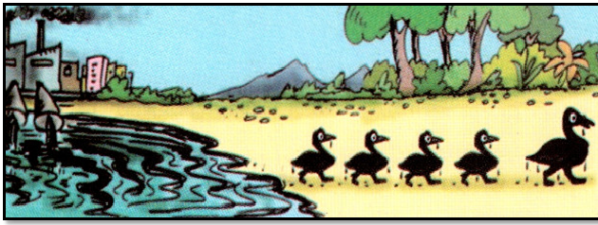
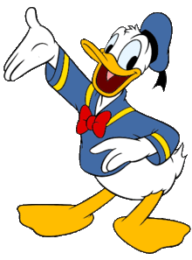
PICTURE A
PICTURE B
What are the DIFFERENCES?
+ ducks' color
+ Where are the ducks going to?
+ Are there any factories?
+ How is the lake? Which is dirty/clean.

Slide 4
PICTURE A | PICTURE B
The ducks are white. | The ducks are black.
They’re going to the lake. | They’re going from the lake.
There aren’t any factories near the lake. | There are some factories near the lake.
The lake water is clean. | The lake water is dirty.

Slide 5
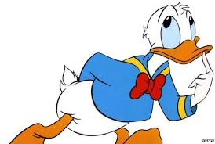
What does the picture tell you?
Water pollution

Slide 6
I. Warm up
II. Vocabulary
Water pollution is the contamination of bodies of water such as lakes, rivers, oceans and groundwater (the water beneath the Earth’s surface). It is one of the most serious types of pollution.
Water pollution can have many different causes. Factories dump industrial waste into lakes and rivers. Sewage from households is another cause. Farms using pesticides to kill insects and herbicides to kill weeds can also lead to water pollution. These factors cause ‘point source’ pollution while pollutants from storm water and the atmosphere result in ‘non-point source’ pollution.

Slide 7
Water pollution can have dramatic effects. In many poor nations, there are frequent outbreaks of cholera and other diseases because of people drinking untreated water. Humans can even die if they drink contaminated water. Polluted water also causes the death of aquatic animals such as fishes, crabs, or birds. Other animals eat these dead animals and may also get sick. In addition, herbicides in water can kill aquatic plants and cause further damage to the environment.
So what should we do to reduce water pollution?

Slide 8
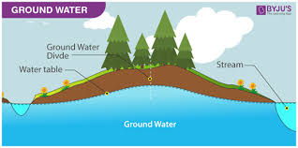
I. Warm up
II. Vocabulary
Water pollution is the contamination of bodies of water such as lakes, rivers, oceans and groundwater (the water beneath the Earth’s surface). It is one of the most serious types of pollution.
contamination = something is not clean

Slide 9
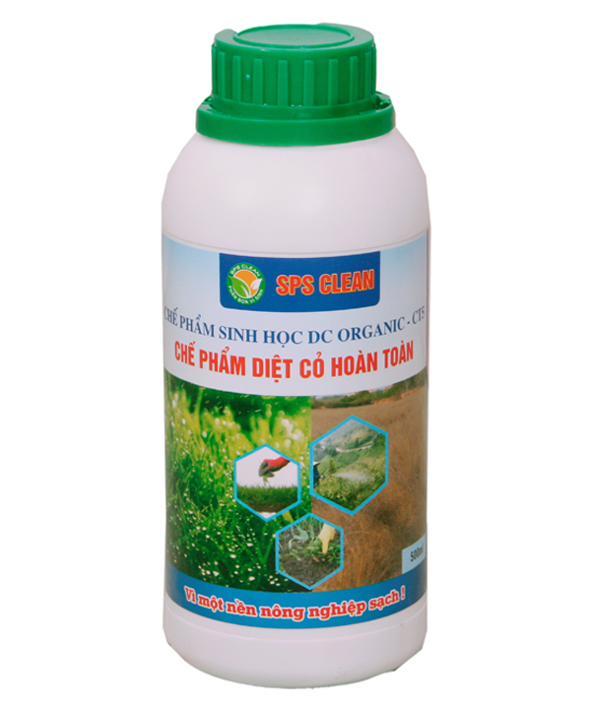
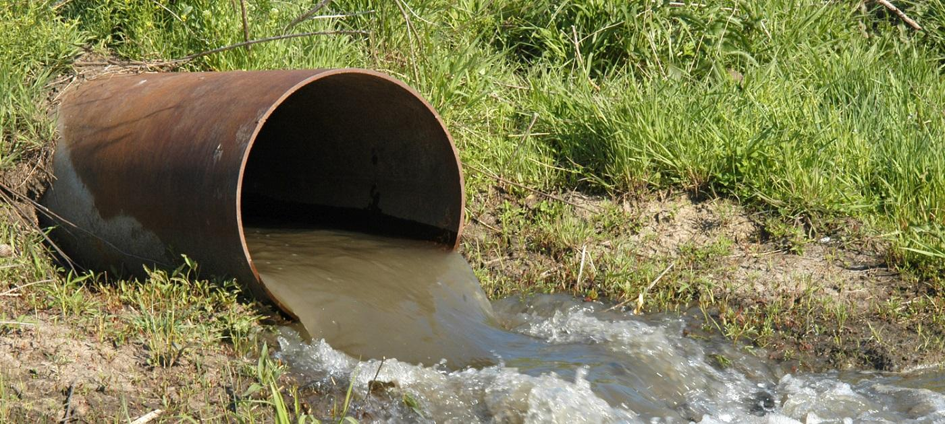
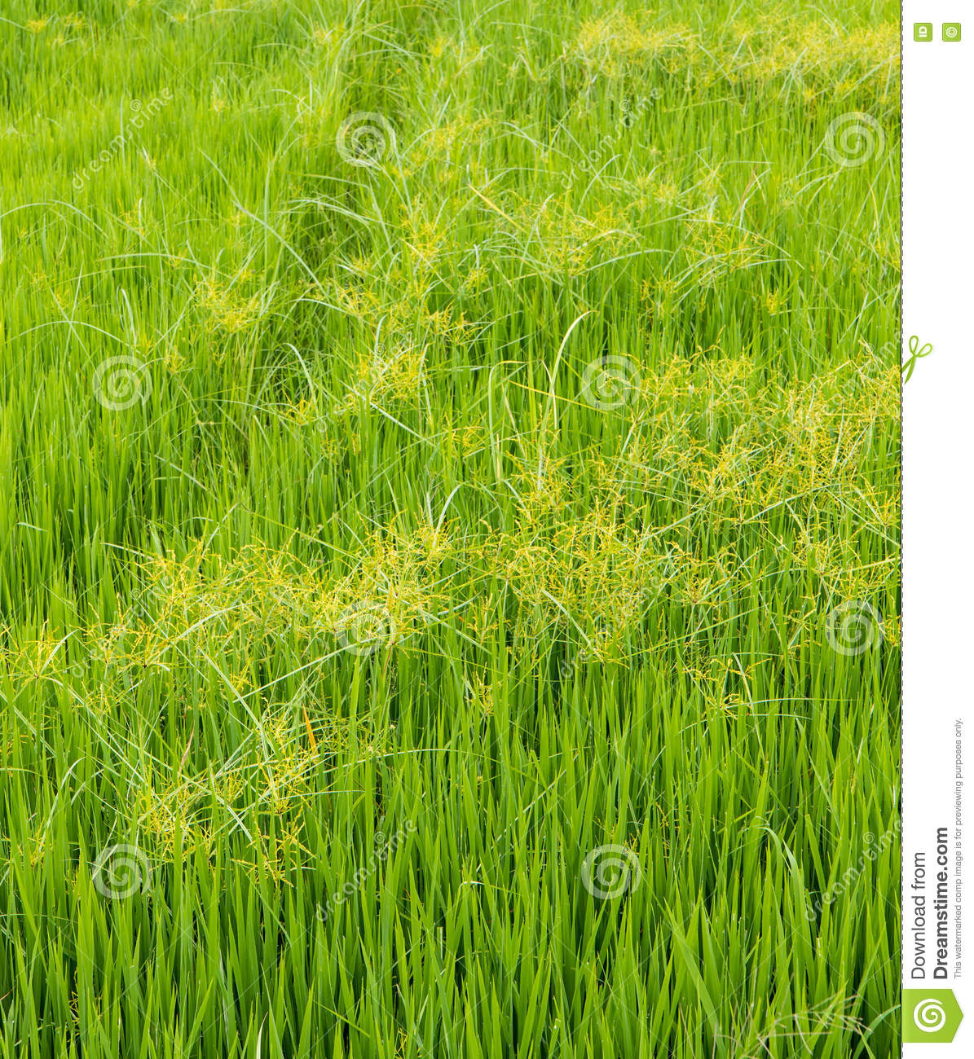

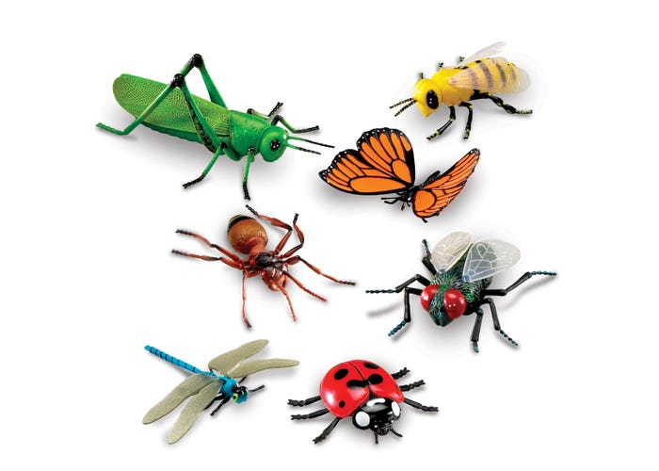
Water pollution can have many different causes. Factories dump industrial waste into lakes and rivers. Sewage from households is another cause. Farms using pesticides to kill insects and herbicides to kill weeds can also lead to water pollution. These factors cause ‘point source’ pollution while pollutants from storm water and the atmosphere result in ‘non-point source’ pollution.

Slide 10
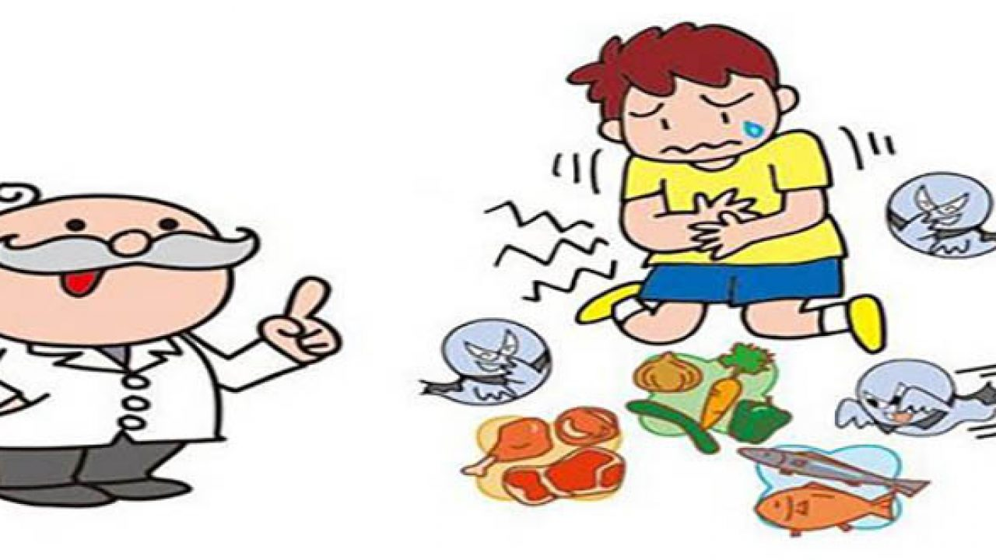
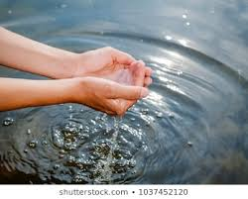
Water pollution can have dramatic effects. In many poor nations, there are frequent outbreaks of cholera and other diseases because of people drinking untreated water. Humans can even die if they drink contaminated water. Polluted water also causes the death of aquatic animals such as fishes, crabs, or birds. Other animals eat these dead animals and may also get sick. In addition, herbicides in water can kill aquatic plants and cause further damage to the environment.
So what should we do to reduce water pollution?

Slide 11
I. Warm up
II. Vocabulary
contamination (n)/kənˌtæmɪˈneɪʃn/ sự làm bẩn
groundwater (n)/ˈɡraʊndwɔːtə(r)/ nước ngầm
sewage (n)/ˈsuːɪdʒ/ nước thải
pesticide (n)/ˈpestɪsaɪd/ thuốc trừ sâu
insect (n)/ˈɪnsekt/ côn trùng
herbicide(n)/ˈhɜːbɪsaɪd/ thuốc diệt cỏ
weeds(n)/wiːd/ cỏ dại
cholera(n)/ˈkɒlərə/ dịch tả
untreated water(n)/ˌʌnˈtriːtɪd/ /ˈwɔːtər/ nước chưa qua xử lí

Slide 12
Checking vocabulary
groundwater
Sewage
pesticides
insects
herbicides
weeds
cholera
untreated water
weeds
groundwater
Sewage
herbicide
pesticide
insects
cholera
untreated water

Slide 13
III. Reading
Activity 1. Reading for general ideas: Skimming then answer the questions.
Water pollution is the contamination of bodies of water such as lakes, rivers, oceans and groundwater (the water beneath the Earth’s surface). It is one of the most serious types of pollution.
What does this paragraph tell you?
Definition of water pollution

Slide 14
Water pollution can have many different causes. Factories dump industrial waste into lakes and rivers. Sewage from households is another cause. Farms using pesticides to kill insects and herbicides to kill weeds can also lead to water pollution. These factors cause ‘point source’ pollution while pollutants from storm water and the atmosphere result in ‘non-point source’ pollution.
Q1. What does this paragraph tell you?
Causes of water pollution

Slide 15
Water pollution can have dramatic effects. In many poor nations, there are frequent outbreaks of cholera and other diseases because of people drinking untreated water. Humans can even die if they drink contaminated water. Polluted water also causes the death of aquatic animals such as fishes, crabs, or birds. Other animals eat these dead animals and may also get sick. In addition, herbicides in water can kill aquatic plants and cause further damage to the environment.
So what should we do to reduce water pollution?
Q2. What does this paragraph tell you?
Effects of water pollution

Slide 16
Water pollution is the contamination of bodies of water such as lakes, rivers, oceans and groundwater (the water beneath the Earth’s surface). It is one of the most serious types of pollution.
Q3. What is ground water?
the water beneath the Earth’s surface

Slide 17
Water pollution can have many different causes. Factories dump industrial waste into lakes and rivers. Sewage from households is another cause. Farms using pesticides to kill insects and herbicides to kill weeds can also lead to water pollution. These factors cause ‘point source’ pollution while pollutants from storm water and the atmosphere result in ‘non-point source’ pollution.
Q4. What are the point source pollutants?
waste, sewage, pesticides, and herbicides.

Slide 18
Water pollution can have many different causes. Factories dump industrial waste into lakes and rivers. Sewage from households is another cause. Farms using pesticides to kill insects and herbicides to kill weeds can also lead to water pollution. These factors cause ‘point source’ pollution while pollutants from storm water and the atmosphere result in ‘non-point source’ pollution.
Q5. What are the non-point source pollutants?
pollutants from storm water and the atmosphere

Slide 19
Water pollution can have dramatic effects. In many poor nations, there are frequent outbreaks of cholera and other diseases because of people drinking untreated water. Humans can even die if they drink contaminated water. Polluted water also causes the death of aquatic animals such as fishes, crabs, or birds. Other animals eat these dead animals and may also get sick. In addition, herbicides in water can kill aquatic plants and cause further damage to the environment.
So what should we do to reduce water pollution?
Q6. Why do people use herbicides?
to kill weeds.

Slide 20
III. Reading
Activity 2. Reading for specific ideas: scanning
Read the text again and fill each blank with no more than three words.
Water pollution can have dramatic effects. In many poor nations, there are frequent outbreaks of cholera and other diseases because of people drinking untreated water. Humans can even die if they drink contaminated water. Polluted water also causes the death of aquatic animals such as fishes, crabs, or birds. Other animals eat these dead animals and may also get sick. In addition, herbicides in water can kill aquatic plants and cause further damage to the environment.
So what should we do to reduce water pollution?
1. If the drinking water is untreated, an outbreak of_____________may happen
cholera
2. People drinking contaminated water
may ______________.
die
3. Fish, crabs or birds may also die because of ______________
polluted water
4.Other animals may become ill if they eat the ____________animals
dead
5. Herbicides kill both weeds and_____________.
aquatic plants

Slide 21
Activity 3. Further practice: Read the text again and decide T or F.
1.Groundwater is the water above the Earth's surface.
beneath
F
2. Industrial watse, sewage, pesticides and herbicides are factors cause 'point source pollution'.
T
3. The outbreaks of cholera, the death of aquatic animals and plants are the effects of water pollution.
T
4. Polluted water only make aquatic animals die.
F
not only

Slide 22
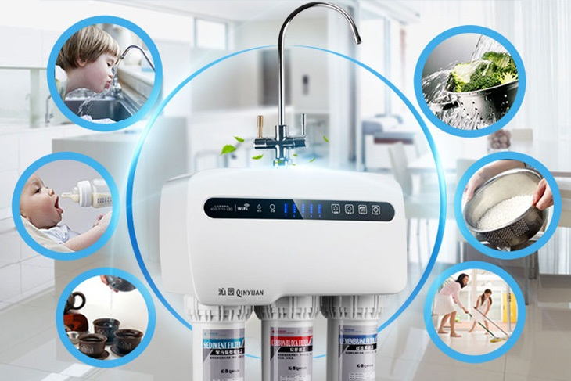
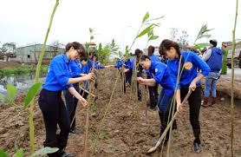
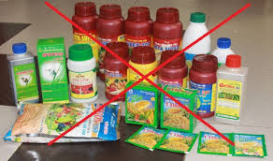
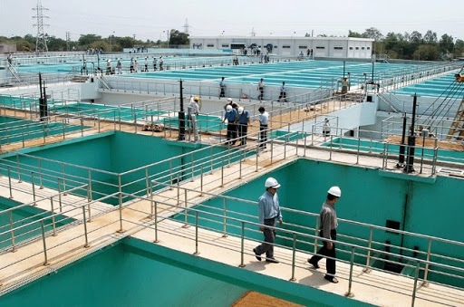
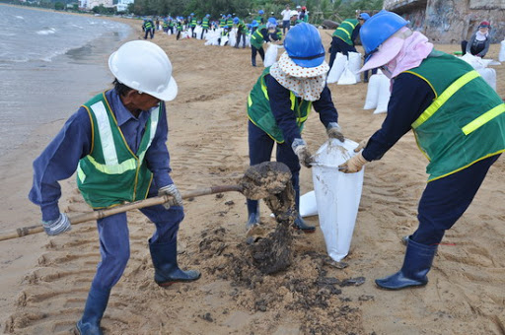
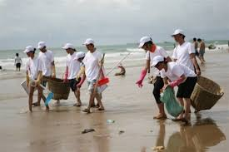
IV. SPEAKING
ACT 1. WORK IN GROUPS AND DISCUSS THE SOLUTION TO WATER POLLUTION.
Using purifier
ban using pesticide and hebicides
SOLUTIONS TO WATER POLLUTIONS
Plant more trees
treated waste water system
Collect trash along the beach
Collect oil spills

Slide 23




SPEAKING
ACT 2. COMPLETE THE DIAGRAM OF WATER POLLUTION.
WATER POLLUTION:
Definition:___________
CAUSES
- Point source pollutants
- Non-point source pollutants
SOLUTIONS:
-________
-_____
-_____
EFFECTS
- Humans:__
- Animals:___
- Plants:____

Slide 24
SPEAKING
ACT 3. MAKE A PRESENTATION ABOUT WATER POLLUTION.

Slide 25
WATER POLUTION
Definition: the contamination of body water, such as lakes, rivers, oceans, and ground water
SOLUTIONS:
-Government: +Ban or reduce using pesticides or herbicides.
+ Fine factories/ household dumps waste/sewage/ untreated water
- Humans:+ Collect oil spills, waste along the beaches, rivers, lakes.
+ Plant more tree
+ Using water purifiers, so on
CAUSES
- Point source pollutants:
+ Factories dump waste into lakes, river.
+ sewage from households
+ pesticides and herbicides
- Non-point source pollutants:
+ pollutants from storm water and the atmosphere.
EFFECTS
Humans: outbreaks o cholera and other diseases or die
Animals: some aquatic animals such as fish, crabs, bird may die or get sick.
Plants: die.

Slide 26
WRAP UP
-Students learn vocabulary about pollution. You can read them fluently.
-You study reading and speaking skills and can do exercises with them.

Slide 27

HOMEWORK
Copy and learn by heart vocabulary.
Do ex part D1,2,3,4 Workbook.
Write a pararaph (70-80 words) about the causes and effects of water pollution.

