Slide 1

PERIOD 63-UNIT 8-
ENGLISH SPEAKING COUNTRIES
A CLOSER LOOK 1

Slide 2

OBJECTIVES
-Students learn vocabulary, can read them fluently.
-You learn pronunciation Stress in words ending in -ese and –ee.

Slide 3
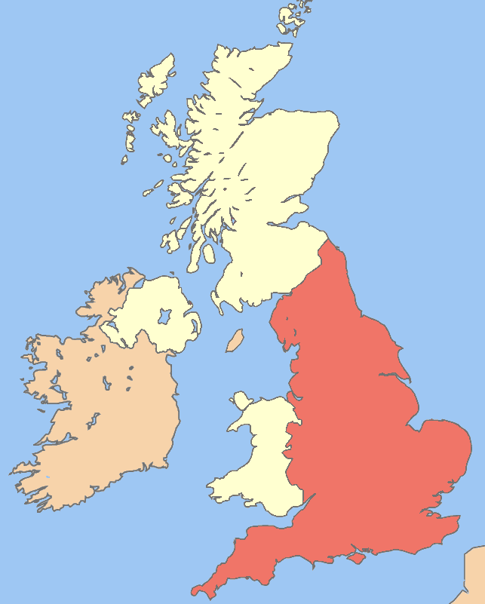
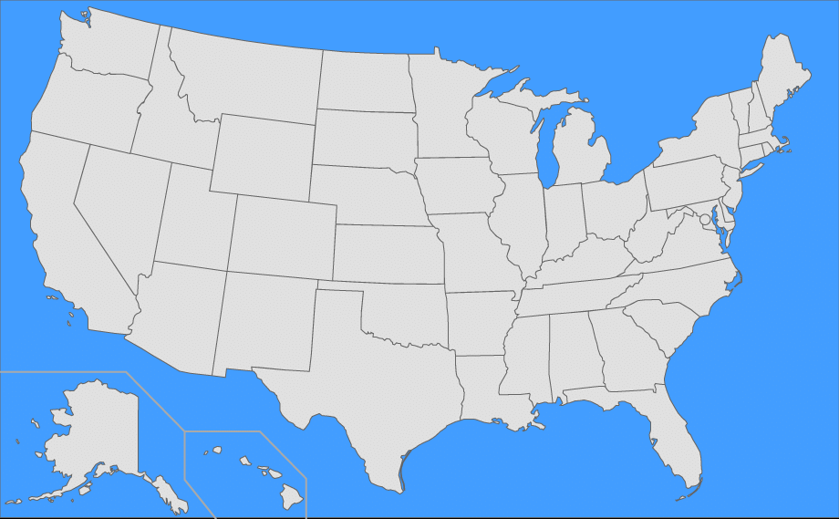

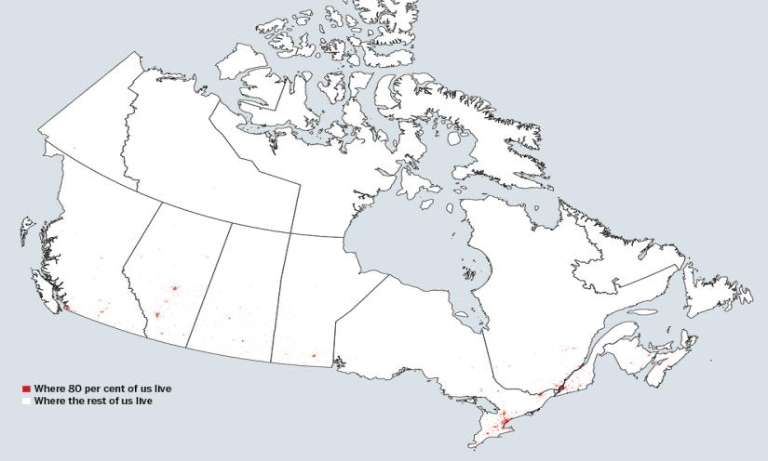
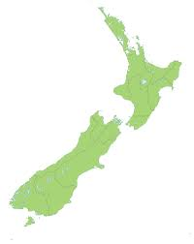
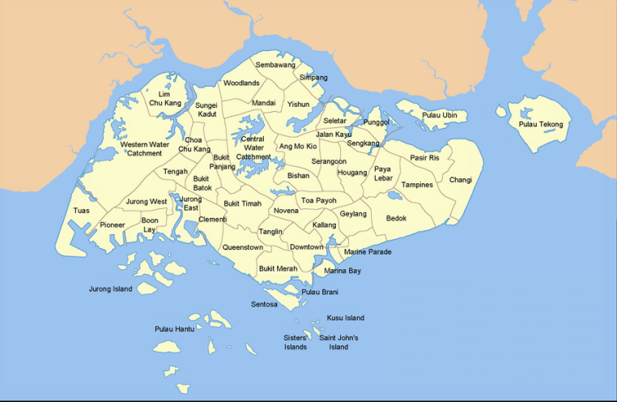
WARM-UP:
Name the maps.
the UK
the USA
Australia
Canada
New Zealand
Singapore

Slide 4
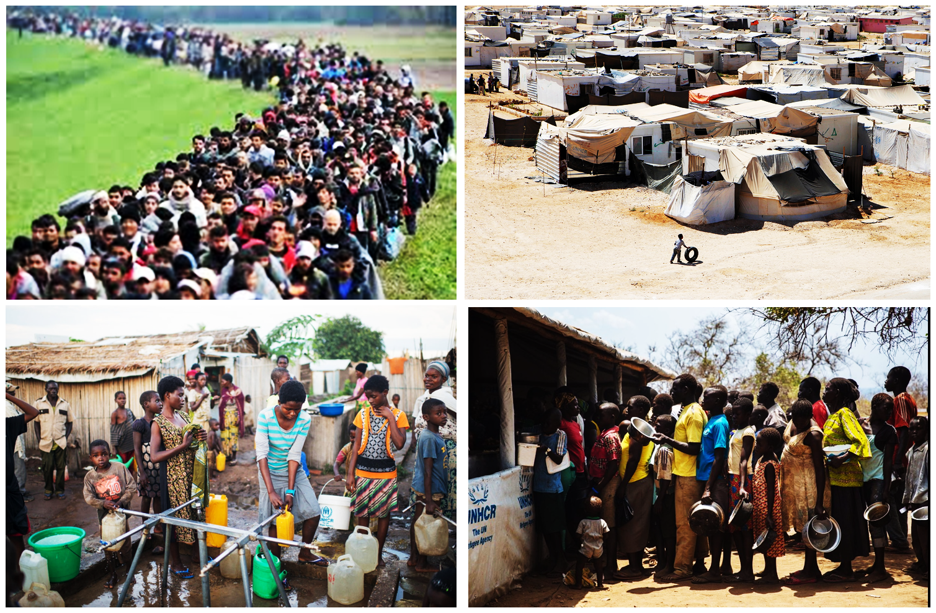
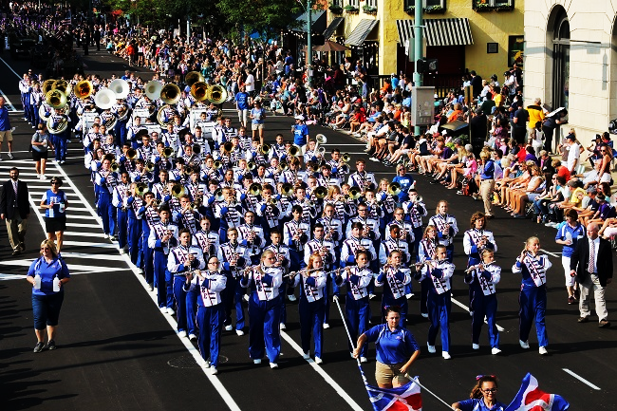
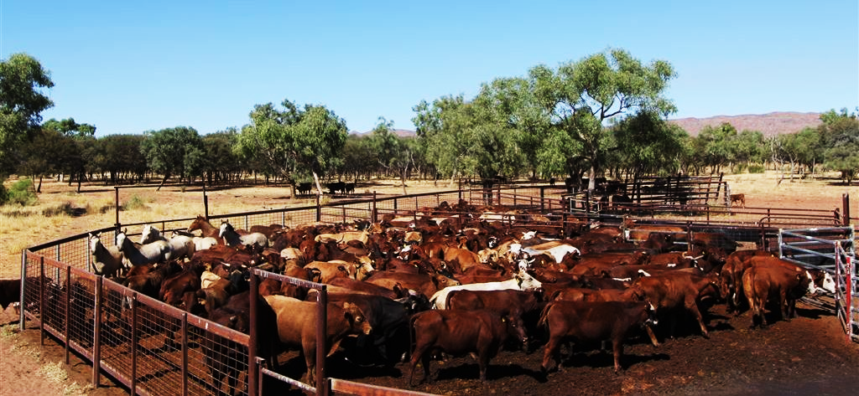
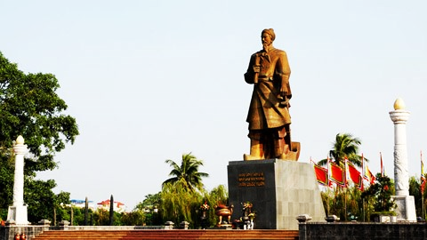
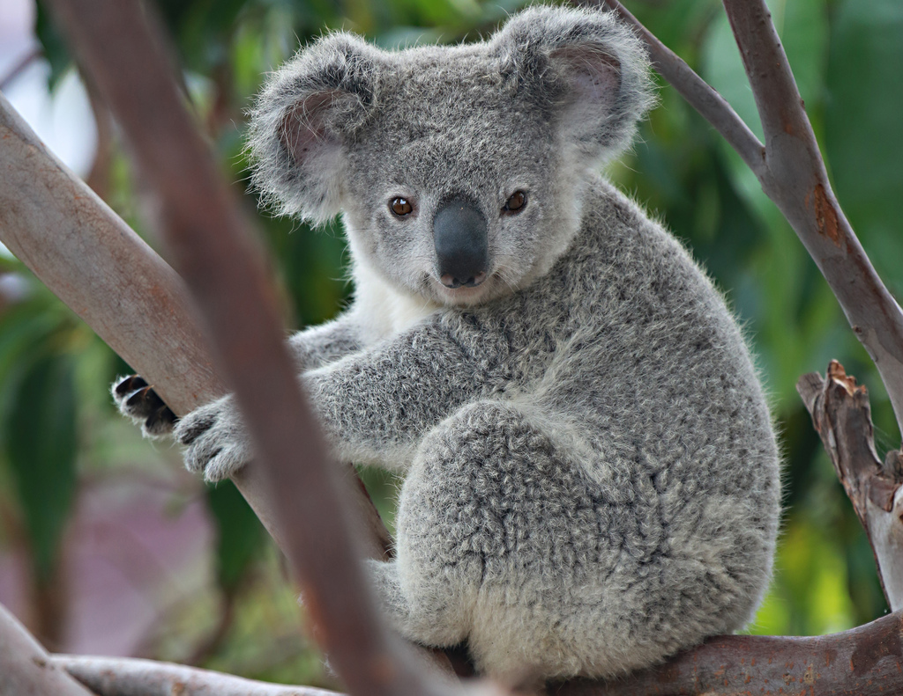

VOCABULARY
- icon (n) iconic (a)
- symbolise (v) - symbol (n) - symbolic (a)
- scene (n) – scenic (a)
- unique (a)
- attract (v) – attraction (n) – attractive (a)
- parade (v) – parade (n)
- cattle station (n)
- monument (n)
- refugee (n)
- guarantee (n)
- koala (n)
: biểu tượng
: tượng trưng
: quang cảnh
: độc nhất, độc đáo
: thu hút
: (cuộc) diễu hành
: trại gia súc
: đài tưởng niệm
: người tị nạn
: sự đảm bảo (hành)
: gấu túi

Slide 5
CHECKING VOCABULARY
- icon (n) iconic (a)
- symbolise (v) - symbol (n) - symbolic (a)
- scene (n) – scenic (a)
- unique (a)
- attract (v) – attraction (n) – attractive (a)
- parade (v) – parade (n)
- cattle station (n)
- monument (n)
- refugee (n)
- guarantee (n)
- koala (n)
: biểu tượng
: tượng trưng
: quang cảnh
: độc nhất, độc đáo
: thu hút
: (cuộc) diễu hành
: trại gia súc
: đài tưởng niệm
: người tị nạn
: sự đảm bảo (hành)
: gấu túi

Slide 6
1. Write the names for the people who belong to these places. Then listen and repeat the words.
Countries | People
1. the USA
2. England
3. Scotland
4. Wales
5. Ireland
6. Canada
7. Australia
8. New Zealand
the Americans
the English
the Scottish/ the Scots
the Welsh
the Irish
the Canadian
the Australian
the New Zealanders

Slide 7
2. Change the words into a noun (N), an adjective (A) or a verb (V).
1. | historic (a) | N = history
2. | symbol (n) | V =
3. | legend (n) | A =
4. | iconic (a) | N =
5. | spectacle (n) | A =
6. | festive (a) | N =
7. | scenery (n) | A =
8. | attraction (n) | V =
symbolise
legendary
icon
spectacular
festival
scenic
attract

Slide 8
3. Use the words in the box to complete the sentences.
icon
symbolises
scenic
unique
attracts
1. The Golden Gate Bridge in San Francisco is an ___________ of this famous city.
2. Big Ben is a major monument in London which ___________ the United Kingdom.
3. New Zealand is famous for the __________ beauty of its mountains and forests.
4. Australia is home to ___________ animals like the kangaroo and koala, which are native to Australia.
5. The Glastonbury Festival in England is a celebration of music and it __________ thousands of people.

Slide 9
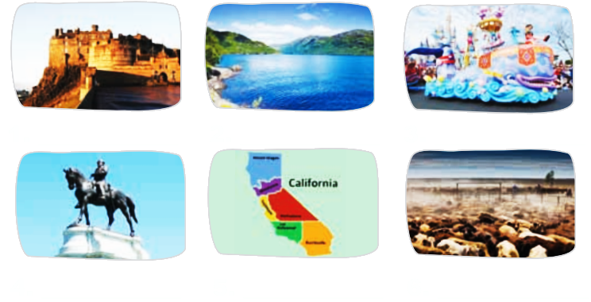
4. Match the words/ phrases with the pictures.
parade
state
loch
cattle station
monument
castle

Slide 10
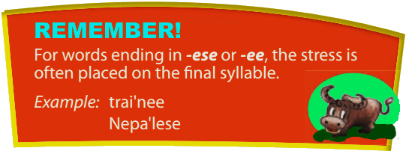
Pronunciation:
Stress in words ending in -ese and -ee

Slide 11

5. Listen and repeat the words.
-ese | -ee
1. Cantonese | 5. employee
2. Taiwanese | 6. adoptee
3. Japanese | 7. addressee
4. Portuguese | 8. interviewee

Slide 12
6. Mark the stress in the underlined words. Then listen and repeat the sentences.
1. One-fifth of the people in the world are Chinese.
2. A refugee is a person who is forced to leave a country.
3. My daughter is a trainee.
4. Japanese is the language of Japan.
5. This printer has a two-year guarantee.
Chi’nese
refu'gee
trai'nee.
Japa’nese
guaran'tee.

Slide 13
WRAP UP
-Students learn vocabulary, can read them fluently.
-You learn pronunciation Stress in words ending in -ese and –ee and can practice with them.

Slide 14

HOMEWORK
Learn the new words by heart.
- Stress with words ending in -ese and -ee.
- Do exercises A1, 2 in workbook (page 11).
- Prepare for Unit 8: Closer look 2.

