Slide 1

PERIOD 62-UNIT 8-
ENGLISH SPEAKING COUNTRIES
GETTING STARTED

Slide 2

OBJECTIVES
-Students learn conversation about English speaking countries.
-Learn vocabulary about this topic.

Slide 3
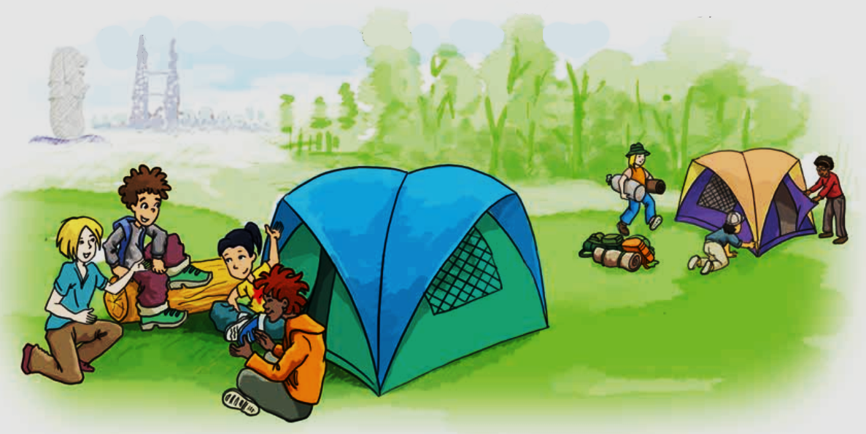
GETTING STARTED
HOW’S YOUR SUMMER CAMP?
Where are the children?
What do you think they are doing?

Slide 4
Vocabulary:
- awesome /ˈɔːsəm/ (a)
official / əˈfɪʃl / (a)
to make friends (exp)
to have difficulty + V-ing (exp)
accent /ˈæksent/ (n)
flight /flaɪt/ (n)
- to look forward to + V-ing (exp)
= wonderful
: chính thức
: kết bạn
: gặp khó khăn…
: giọng, chất giọng
: chuyến bay
: trông mong/đợi

Slide 5
Checking vocabulary:
- awesome /ˈɔːsəm/ (a)
- official / əˈfɪʃl / (a)
- to make friends (exp)
- to have difficulty + V-ing (exp)
- accent /ˈæksent/ (n)
- flight /flaɪt/ (n)
- to look forward to + V-ing (exp)
= wonderful
: chính thức
: kết bạn
: gặp khó khăn…
: giọng, chất giọng
: chuyến bay
: trông mong/đợi

Slide 6

1. Listen and read
N = Nick
P = Phong
N: How’s your international summer camp going, Phong?
P: Awesome, just awesome.
N: You sound so happy. What do you like about it?
P: It’s hard to say. Everything’s wonderful: the friends I’ve made, the places I’ve visited, the activities…
N: Oh… Your English has improved a lot!
P: Absolutely. I use English every day, with people from diﬀerent countries.
N: Where are they from?
P: Everywhere! Places like India, Canada… English is also an official language here in Singapore.

Slide 7
N: Right. Have you made any friends from English speaking countries?
P: I’m in a team with two boys from Australia and a girl from the USA.
N: Do you have difficulty understanding them?
P: I found it difficult to understand them at first. Perhaps it’s because of their accent, but it’s OK now.
N: It’s great that you can practise English with native speakers. When are you back?
P: Our camp closes on July 15th and I take the night ﬂight home the same day.
N: Looking forward to seeing you then. Enjoy!
P: I will. Thanks. Bye.

Slide 8
a. Find a word or an expression from the conversation which you use when you...
1. think something is wonderful
2. agree with somebody
3. cannot decide
4. are not sure about something
great
awesome
absolutely/ right.
sure/ of course
It’s hard to say.
cannot make up one’s mind
maybe
perhaps
Do you know any other expressions which have the same meaning?

Slide 9
b. Read the conversation again and answer the questions.
Where is Phong now?
He’s at an international summer camp (in Singapore).
2. Where do the campers come from?
They come from diﬀerent countries/from all over the world.
3. What has Phong done so far?
He has made new friends, visited places, (and taken part in diﬀerent activities.)
4. Why has he been able to improve his English?
Because he uses English every day with people from diﬀerent countries.
5. Who are in the same team with Phong?
Two boys from Australia and a girl from the USA.
6. When can Nick see Phong?
After July 15th.

Slide 10
2. Complete the sentences with words/ phrases from the box.
native speakers
The USA
official language
summer camp
English speaking countries
accents
1. Last year I had a wonderful time at a ___________ in Britain.
2. The USA, the United Kingdom and New Zealand are all ___________________.
3. Australians are ____________ of English because they use it as their mother tongue.
4. __________ is in the mid-north of America.
5. Usually, people from diﬀerent parts of a country speak their language with diﬀerent ___________.
6. English is an _____________ in countries like India, Malaysia and Singapore.

Slide 11
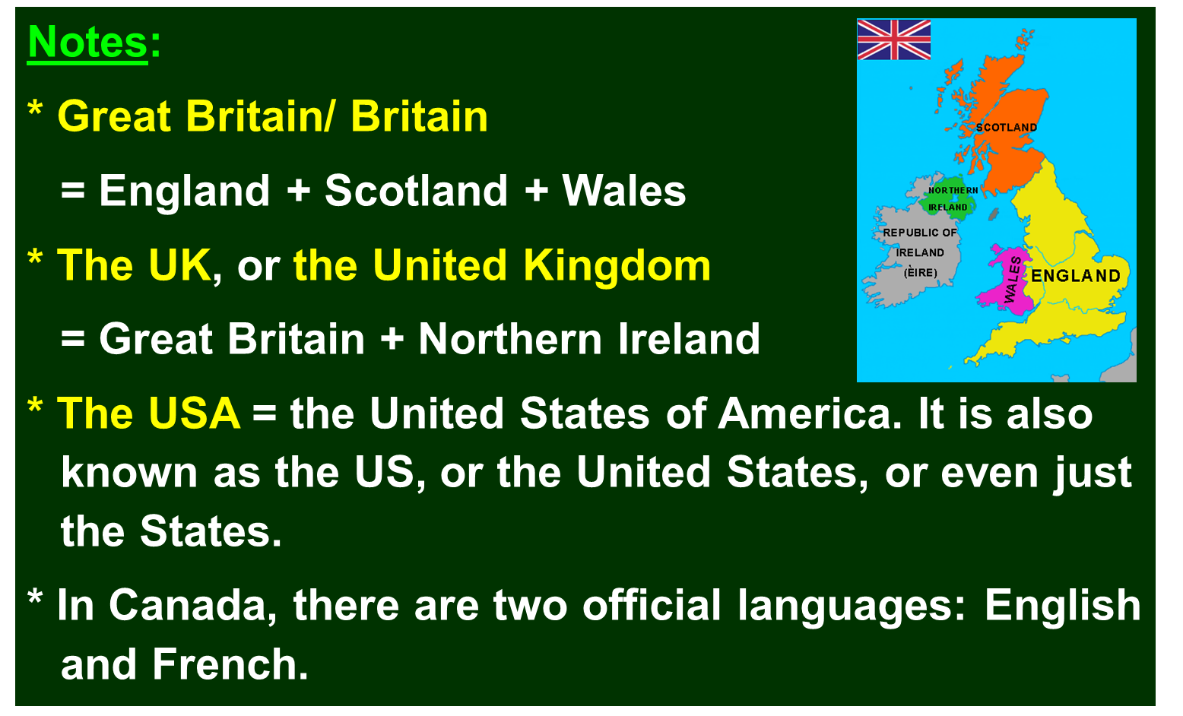


3. Put the names of the countries under their ﬂags.
Click
New Zealand
Singapore
Australia
The USA
Canada
the United Kingdom
1. _____________________ 2. ________________________ 3. ____________________
4. _____________________ 5. _____________________ 6. ______________________

Slide 12
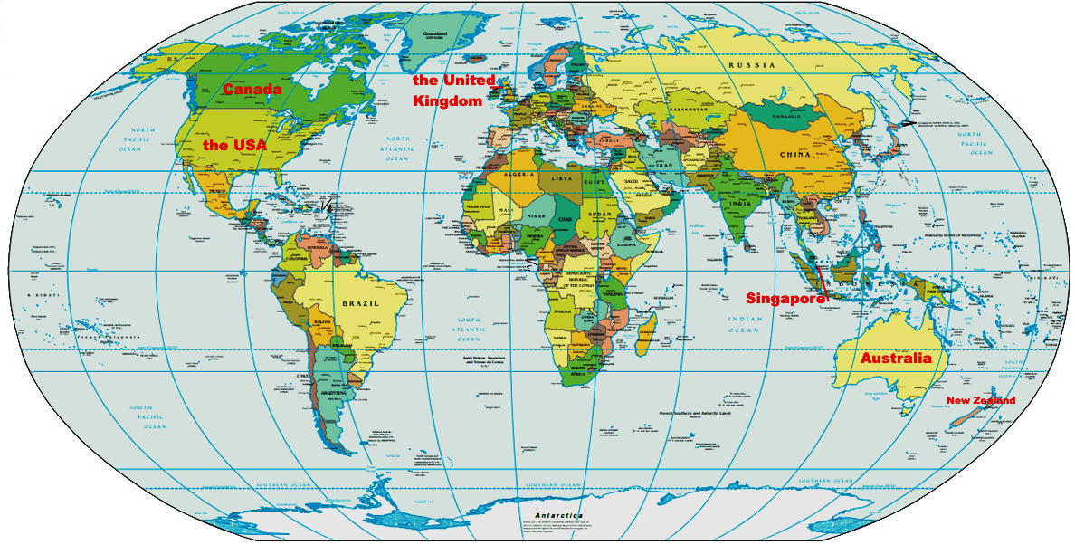
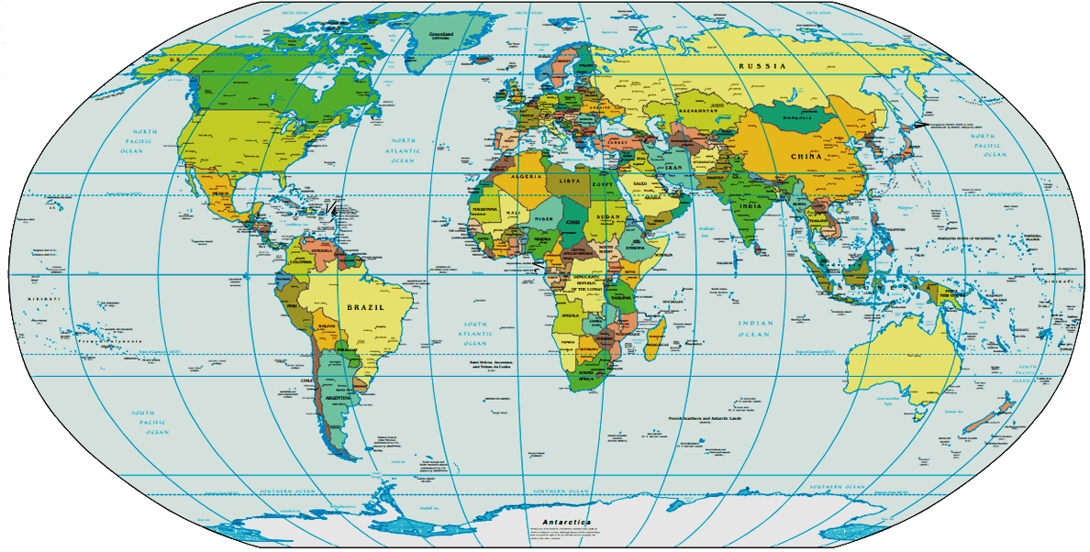
4. Game: Where are they?
Work in groups of five or six. Locate the six countries in 3 on the map below. The first group to find all the countries wins.

Slide 13
WRAP UP
-Students learn conversation about English speaking countries. You can read and do exercises with it.
-Learn vocabulary about this topic. Can apply in every day life.

Slide 14

HOMEWORK
Learn the new words by heart.
- Practice the dialogue again.
- Do exercises B1,2, 3 in workbook (page 12, 13).
- Prepare for Unit 8: A closer look 1.

