Slide 1

PERIOD 57-UNIT 7-POLLUTION
A CLOSER LOOK 2

Slide 2

OBJECTIVES
Students learn vocabulary about pollution.
Conditional sentence type 1
Conditional sentence type 2

Slide 3



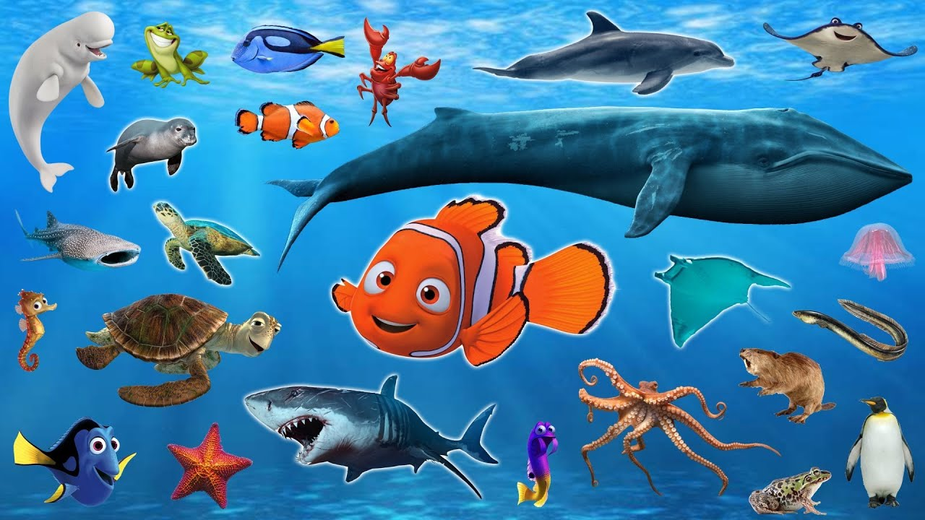
I. VOCABULARY
- increase (v) :
tăng lên
# decrease (v):
giảm xuống
- aquatic creatures (n):
sinh vật dưới nước
- reproduce (v):
sản xuất lại
- resident (n):
dân cư

Slide 4


* Checking : Jumbled words
1. niceraes
2. edecraes
3. auqatci cearteusr
4. perordecu
5. risedetn
increase
decrease
aquatic creatures
reproduce
resident

Slide 5
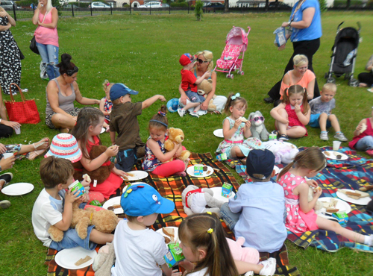
Is the weather beautiful or bad?
It’s beautiful
Where do they go ?
They go on a picnic
The weather is beautiful. They go on a picnic
If the weather is beautiful, they will go on a picnic.

Slide 6
II. Conditional sentence type 1
If the weather is beautiful, they will go on a picnic
If-clause
Main clause
1.Form:
If + S + V (present simple),
S + will/can/could/ + V (bare_inf)
Câu điều kiện loại 1 dùng để chỉ hành động hay sự việc có thể xảy ra ở hiện tại hoặc tương lai
2. Using:
EX : If it rains, I will stay at home
I will stay at home if it rains.

Slide 7

1. Put the verbs in brackets into the correct form. (EX 1)
recycle
1. If we (recycle)…………………….. more, we (help) …………………….. the Earth.
2. Factories (not dump) …………………….. waste into rivers if the government (fine)……………... ..them heavily.
3. If people (travel) ………………….. to work by bus, there (be) ……………………. fewer car fumes.
4. We (save) ……………….…. thousands of trees if we
(not waste) …………………… paper.
5. If we (use)…………………… water carefully, more people (have) ……………………. fresh water.
will help
will not/won’t dump
fines
travel
will be
will save
don’t waste
use
will have

Slide 8
2. Combine each pair of sentences to make a conditional sentences type 1. (EX 2)
1. Students are more aware of protecting the environment. Teachers teach environmental issues at school.
2. Light pollution happens. Animals change their behaviour patterns.
3. The levels of radioactive pollution decrease. We switch from nuclear power to renewable energy sources.
4. The water temperature increases. Some aquatic creatures are unable to reproduce.
5. People get more diseases. The water is contaminated.

Slide 9

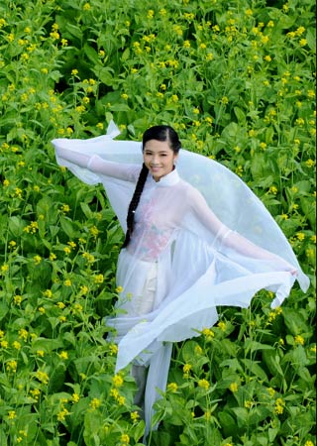
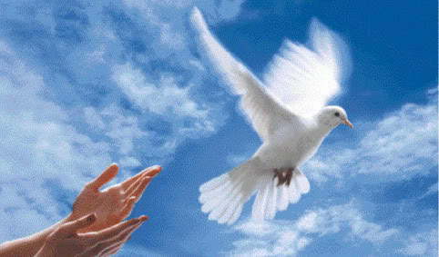


If she were a bird, she would be a dove.

Slide 10
III. Conditional sentence type 2
If she were a bird, she would be a dove.
If clause
Main clause
* Form:
(Past simple)
…,
S
+
would
If
+
+
S
V
V (ed/column 2)
tobe (was/were)
/should/ could/ might
V (bare-inf)
+
* Using:
- Câu điều kiện loại 2 dùng để chỉ hành động hay sự việc không thể xảy ra ở hiện tại hoặc tương lai
- Có thể dùng để chỉ lời khuyên
Ex: If I were you, I would see the doctor immediately.
I would see the doctor immediately If I were you

Slide 11

1. Match an If clause in A with a suitable main clause in B(EX3).
A | B
1. If I were you, | a. What would happen?
2. If Lan wasn’t ill, | b. I’d look for a new place to live.
3. If there were fewer cars on the road, | c. She would join our tree planting activity.
4. If people really cared about the environment, | d. There would be less pollution.
5. If there was no fresh water in the world, | e. They wouldn’t dump waste into the lake.

Slide 12
2. Put the verbs in brackets into the correct form (EX 4).
were
If you (be) …………… the president, what you (do) …………………… to help the environment?
2. They get sick so often. If they (exercise) ……………. more, they (be) ……………….. healthier.
3. If I (have) …………… one million US dollars, I (build) ……………….. more parks in our city.
4. Ngoc’s mother is unhappy. If Ngoc (tidy) …………….. her room every day, her mother (not be) ……………… so upset.
5. There isn’t a garden at our house. If there (be) …………, we (grow) ………………… vegetables.
would you do
exercised
would be
had
would build
tidied
wouldn’t be
was / were
would grow

Slide 13
3. Write a conditional sentence type 2 for each situation, as in the example (EX 5)
1. There are so many billboards in our city. People can not enjoy the view
2. There is so much light in the city at night. We can not see the stars clearly.
3. We turn on the heater all the time. We have to pay three million dong for electricity a month.
4. The karaoke bar makes so much noise almost every night. The residents complain to its owner.
5. She has a headache after work every day. She works in a noisy office.

Slide 14
1. There are so many billboards in our city. People can not enjoy the view.
→ If there weren’t so many billboards in our city, people could enjoy the view.

Slide 15
2. There is so much light in the city at night. We can not see the stars clearly.
→If there wasn’t so much light in the city at night, we could see the stars clearly.
3. We turn on the heater all the time. We have to pay three million dong for electricity a month.
→ If we didn’t turn on the heater all the time, we wouldn’t have to pay three million dong for electricity a month.
4. The karaoke bar makes so much noise almost every night. The residents complain to its owner.
→ If the karaoke bar didn’t make so much noise almost every night, the residents wouldn’t complain to its owner.
5. She has a headache after work every day. She works in a noisy office.
→ She wouldn’t have a headache after work every day if She didn’t work in a noisy office.

Slide 16

GAME: PELMANISM
1
1. If there were
fewer people ill,
3. If she has time ,
4. If we feel hungry
after that,
2
3
4
He would come
to see you
The world would
be happier
I would learn
very hard
6
5
8
We will eat some
hamburgers
2. If I were you,
She will help you
7
9

Slide 17
WRAP UP
Students learn vocabulary about pollution. They can read them well.
Conditional sentence type 1
Conditional sentence type 2

Slide 18

Homework:
Learn by heart the vocabulary and the conditional sentences
Do all the exercises
Prepare: Unit 7 (Communication)

