Slide 1

PERIOD 56- UNIT 7-POLLUTION
A CLOSER LOOK 1

Slide 2
OBJECTIVES
Students learn vocabulary about pollution.
You learn phrases of cause and effect.

Slide 3

Warm-up
What kind of pollution is it ?

Slide 4
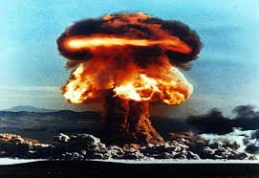
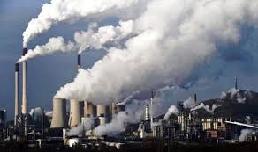
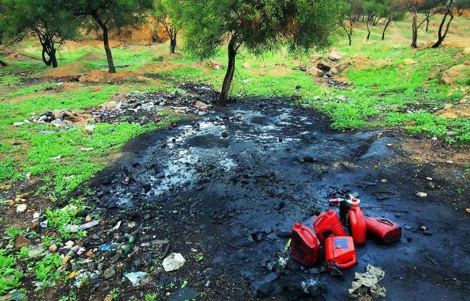
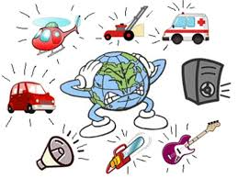
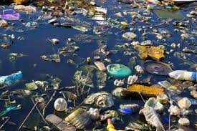
DOES POLLUTION AFFECT OUR LIFE ?
WATER POLLUTION
AIR POLLUTION
SOIL / LAND POLLUTION
RADIOACTIVE POLLUTION
NOISE POLLUTION

Slide 5
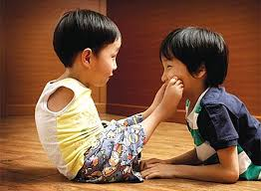
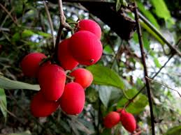
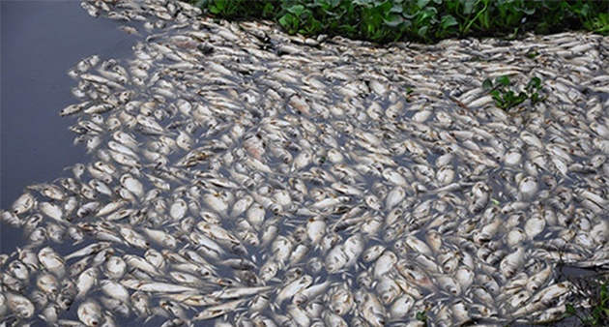
1. Vocabulary
- Poisonous(adj):
có độc, độc
- Cause(n/v):
nguyên nhân, gây ra
- Effect (n):
kết quả, hậu quả
You mustn’t eat the fruits
- Birth defect (n):
dị tật bẩm sinh
- Lead to (v):
dẫn đến
The water is polluted → the fish die
(cause) (effect)

Slide 6
1. Vocabulary
- Poisonous(adj):
có độc, độc
- Cause(n/v):
nguyên nhân, gây ra
- Effect (n):
kết quả, hậu quả
- Birth defect (n):
dị tật bẩm sinh
- Lead to (v):
dẫn đến

Slide 7
Ex1. Complete the table with appropriate verbs, nouns and adjectives:
Verb | Noun | Adjective
to poison | (1)------------------ | poisonous
(2)----------------- | contamination contaminant | contaminated
to pollute | pollution (3)------------------ | (4)------------------
to die | (5)------------------- | Dead
to damage | damage | (6)------------------
1.
poison
.contaminate
(làm bẩn)
(chất gây bẩn)
pollutant
polluted
(chất gây ô nhiễm)
death
damaged

Slide 8
Ex 2. Complete the sentences with the words from the table in 1. You do not need to use all the words. The first letter of each word has been provided.
oisonous
1. The p____________ chemical waste is dumped into the river
2. Do you know what p__________ cause air pollution ?
ollutants
ead
3. The d _________ fish are floating in the water.
ontaminated
4. Don’t drink that water. It’s c____________ .
amage
5. The acid rain has caused d____________ to the trees in the area.
6. If we p _____ the air, more people will have breathing problems.
ollute

Slide 9
Phrases of cause and effect
(Cụm từ chỉ nguyên nhân và hậu quả)

Slide 10
1. Since / because + S + V
CAUSE
(Vì/do)
- Since the water is polluted, the fish are dead.
- Because the water is polluted, the fish are dead.
2. due to / because of + N_{phrases}
(Vì/do)
- The fish are dead because of the polluted water .
- The fish are dead due to the polluted water .

Slide 11
1. ..., so + S + V
EFFECT
- The water is polluted, so the fish are dead.
2. to cause sth / to lead to sth / to result in sth
- The polluted water causes/results in the death of the fish
3. to make sb/sth V-inf … .
- The polluted water makes the fish die .

Slide 12
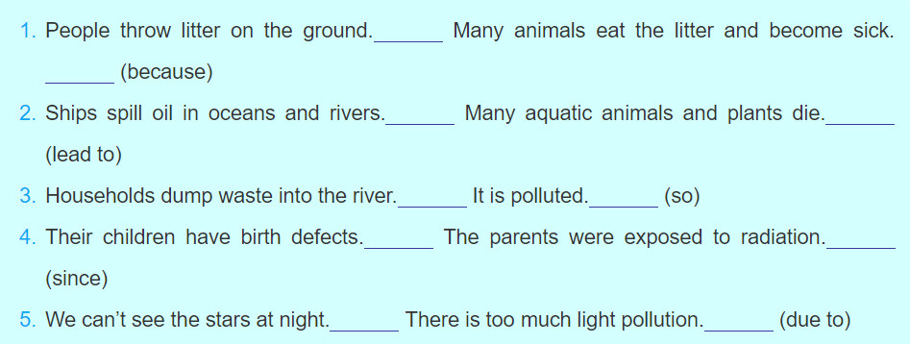
Ex 3. a. Decide which sentence in each pair of sentences is a cause and which is an effect. Write C (for cause) or E (for effect) next to each sentence. Note that the words in brackets relate to Activity 3b.
C
E
C
E
C
E
E
C
E
C

Slide 13
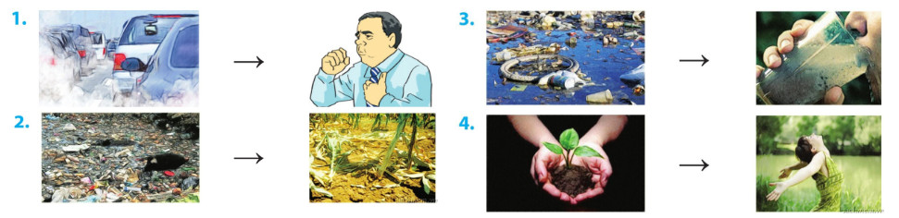
Ex4. Look at the pairs of pictures. Join the pairs of sentences to make ones showing cause/ effect relationships.
Example
1. People cough. They breathe in the dirty air.
People cough because they breathe in the dirty air.
Or: People breathe in the dirty air, so they cough.
….

Slide 14
2. The soil is polluted. The plants can’t grow.
3. We can’t drink water. It is polluted.
4. We plant trees. We have fresh air.

Slide 15

Ex5. Listen and mark the stress in each word, then repeat it.
Artistic
Athletic
Historic
Historical
Logical
6. Physical
7. Heroic
8. Poetic
9. Botanic
10. Botanical

Slide 16
Trọng âm rơi vào âm đứng trước đuôi -ic.

Slide 17
5. Listen and mark the stress in each word, then repeat it.
Artistic
Athletic
Historic
Historical
Logical
6. Physical
7. Heroic
8. Poetic
9. Botanic
10. Botanical

Slide 18
Đuôi –al thêm vào không thay đổi trọng âm từ gốc.

Slide 19
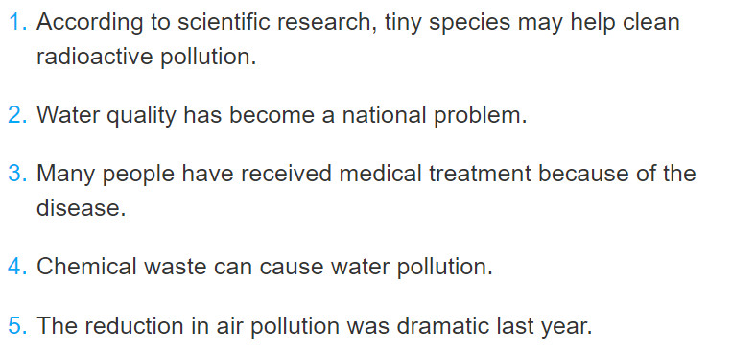
Ex 6. Underline the words ending in -ic and circle the words ending in -al in the following sentences. Mark the stress in each word. Listen and check your answer, then repeat the sentences.

Slide 20
Choose the correct answer
Question 1
Don’t eat that fruit. It is…
poisonous
poison
to poison
1
5
6
7
8
9
4
2
3
Finish
Key

Slide 21
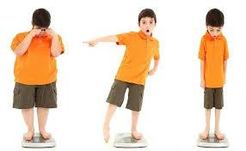
Choose the correct answer
Question 2
He is fat … he doesn’t do exercise.
so
because
because of
Finish
1
2
3
4
5
6
7
8
9
Key

Slide 22
Choose the correct answer
Question 3
Which one has correct stress pattern?
fantastic
fantastic
fantastic
Finish
1
2
3
4
5
6
7
8
9
Key

Slide 23
Choose the correct answer
Question 4
He studies hard, … he gets a mark 10.
because
so
due to
Finish
1
2
3
4
5
6
7
8
9
Key

Slide 24
WRAP UP
Students learn vocabulary about pollution. They can read them well.
You learn phrases of cause and effect and can do exercises with them.

Slide 25

HOMEWORK
Revise the new words, exercises, pronunciation.
Make sentences with the way to use “cause and effect” in the notebook.
Complete Exercises 3b, 4.
Prepare the new lesson : A closer look 2

