Slide 1



Unit
12
ENGLISH-SPEAKING COUNTRIES
LESSON 1: GETTING STARTED
A holiday in Australia

Slide 2
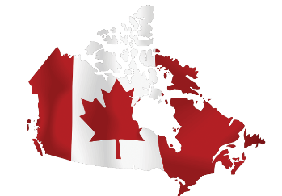
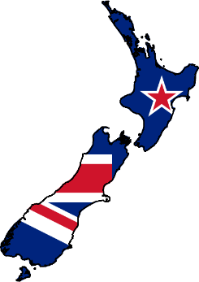
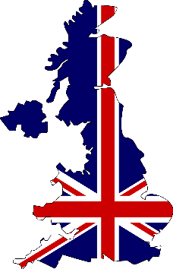


LESSON 1: GETTING STARTED
WARM-UP
Flags matching
1.
2.
3.
4.
5.

Slide 3
WARM-UP
Flags matching
New Zealand
Canada
The USA
The UK
Australia

Slide 4
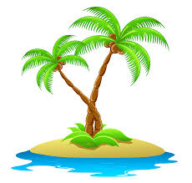

VOCABULARY
island (n)
/ˈaɪ.lənd/
Hòn đảo

Slide 5
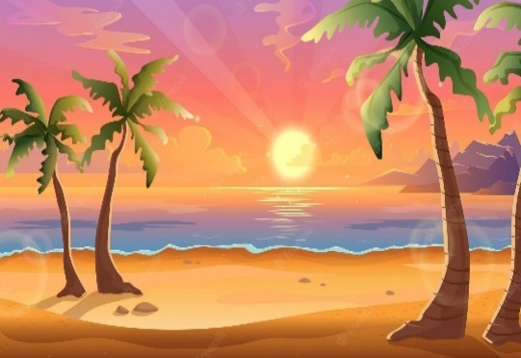
VOCABULARY
sunset (n)
/ˈsʌn.set/
Hoàng hôn

Slide 6

VOCABULARY
landscape (n)
/ˈlænd.skeɪp/
Phong cảnh

Slide 7
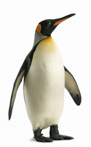
VOCABULARY
penguin (n)
/ˈpeŋ.ɡwɪn/
Chim cánh cụt

Slide 8
VOCABULARY
New words | Pronunciation | Meaning
island (n) | /ˈaɪ.lənd/ | Hòn đảo
sunset (n) | /ˈsʌn.set/ | Hoàng hôn
landscape (n) | /ˈlænd.skeɪp/ | Phong cảnh
penguin (n) | /ˈpeŋ.ɡwɪn/ | Chim cánh cụt

Slide 9
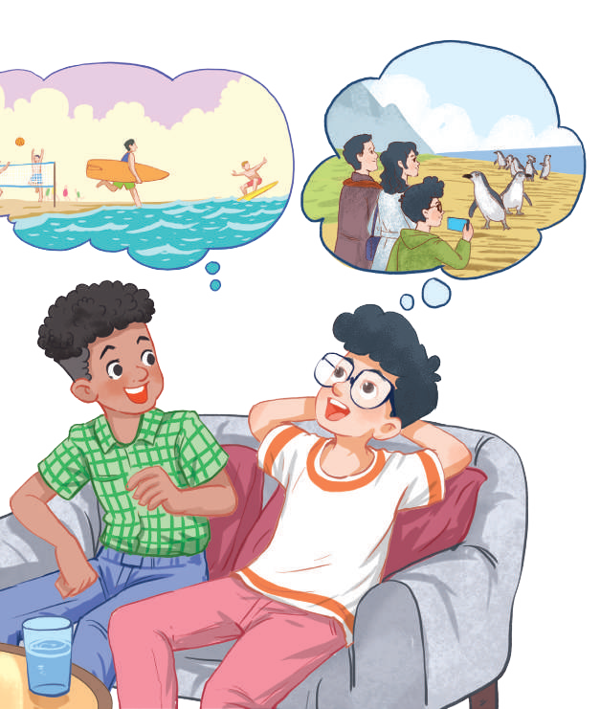
PRACTICE
1
Listen and read.
Mark: How was your holiday in Australia, Phong?
Phong: It was fantastic! I got to use my English in real life: asking for directions, reading maps, talking to local people ...
Mark: Oh … Your English is much better.
Phong: Thanks.
Mark: Did you travel a lot?
Phong: Just around Melbourne, the city with four seasons in a day.
Mark: Wow ... I didn’t know that. How was it?
Phong: It was great! We took a tour to Phillip Island.
Mark: What did you see?
Phong: We went penguin watching.
Mark: It sounds pretty exciting.
Phong: It was. Australia has amazing landscapes.
Mark: Yes, and Australians love outdoor activities.
Phong: Right. There were plenty of people enjoying the parks and beaches.
Mark: I’m glad that you had a wonderful time there.
Phong: Thanks, Mark.

Slide 10
PRACTICE
2
What are Phong and Mark talking about?
A. Phong’s holiday in Australia B. English-speaking countries C. The tour to Phillip Island

Slide 11

PRACTICE
3
Read again and tick the information you can find in the conversation.
1. In Australia, Phong used English in real life. 2. Phong visited some museums. 3. Phillip Island is far from Melbourne. 4. Australia is beautiful. 5. Australians love outdoor activities.

Slide 12
PRACTICE
4
Complete the sentences with the words and phrases from the box.
island, sunset, landscape, Australians, penguin watching
1. This is a picture of the __________________ in my village. 2. – Where did you go ______________________________? – On the beach. 3. – Is Phu Quoc a(n) __________________? – Yes, it is. 4. We had dinner on the beach after __________________. 5. Most ______________________ like outdoor sports and games.
landscape
penguin watching
island
sunset
Australians

Slide 13
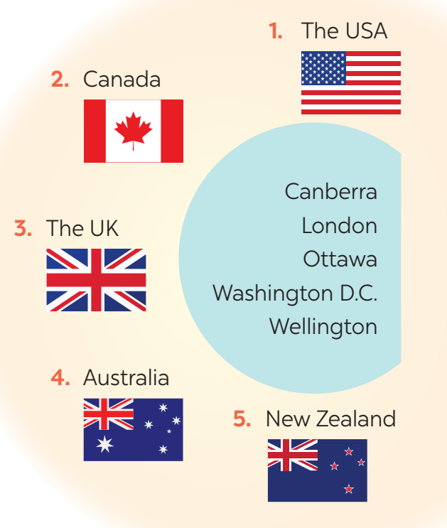
PRODUCTION
5
Matching game: What’s its capital city?
1. Washington D.C.
2. Ottawa
3. London
4. Canberra
5. Wellington

Slide 14

CONSOLIDATION
1
WRAP-UP
What have we learnt in this lesson?
identify the topic of the unit
lexical items related to people and places in English-speaking countries
identify the language features that are covered in the unit.

Slide 15
CONSOLIDATION
2
HOMEWORK
- Learn by heart all the new words.
- Read the dialogue again.
- Prepare lesson 2 (A closer look 1).

Slide 16


