Slide 1
Unit 5 Natural wonders of Vietnam
Lesson 5: Skills 1

Slide 2

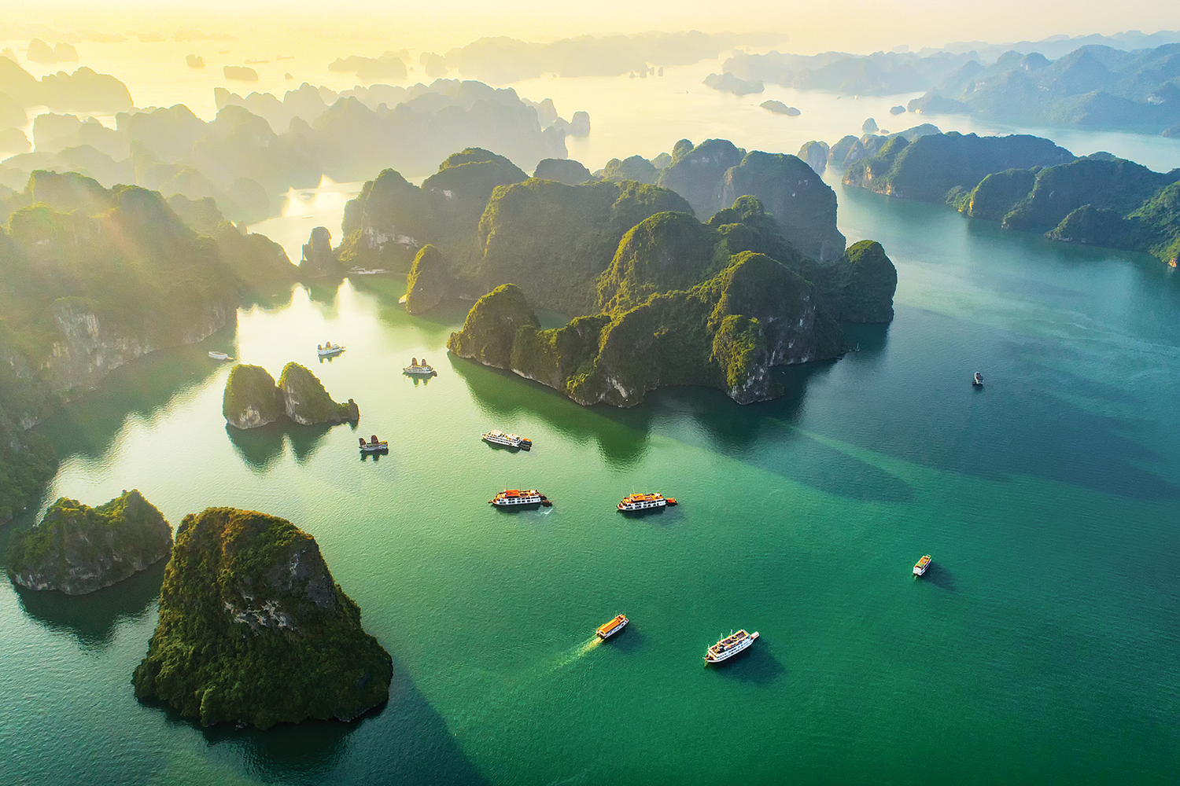
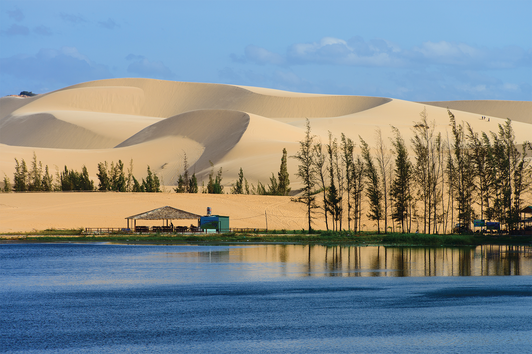
I want to visit some natural wonders in Vietnam. Now, let's read a brochure.
1. Can you guess what is it about?
Ha Long Bay is in Quang Ninh. …
Mui Ne is popular for its amazing landscapes. …
Tom
2. What do you know about these places?

Slide 3
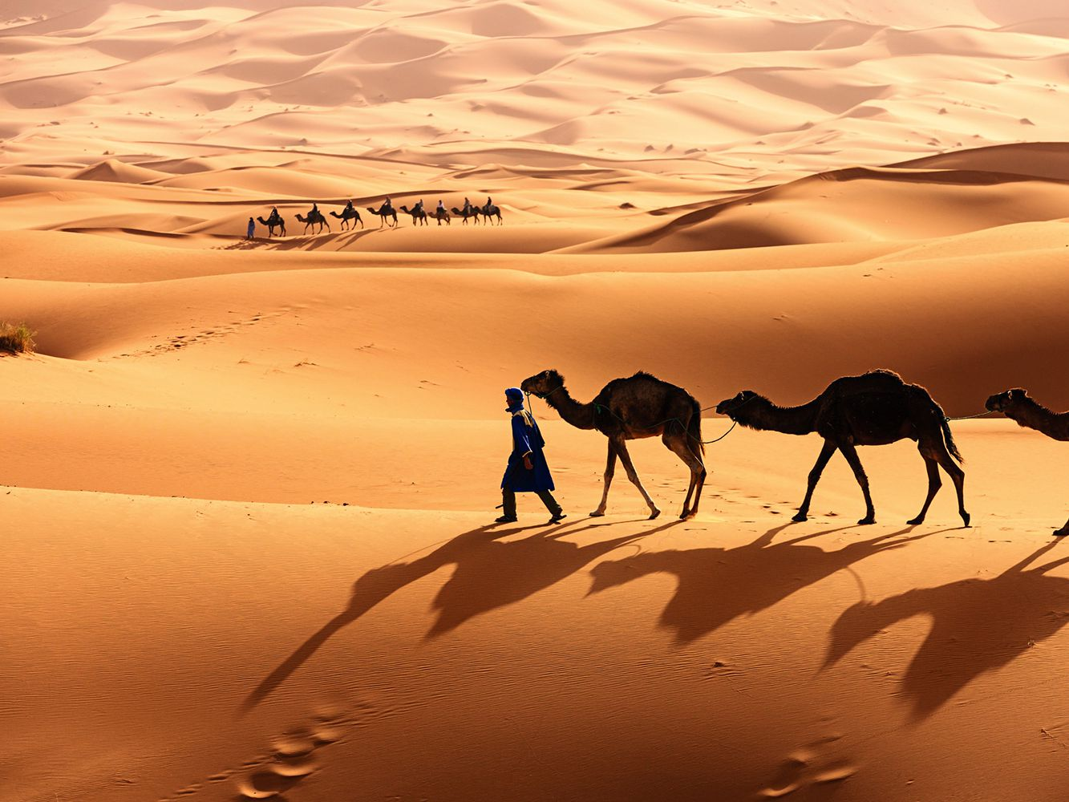
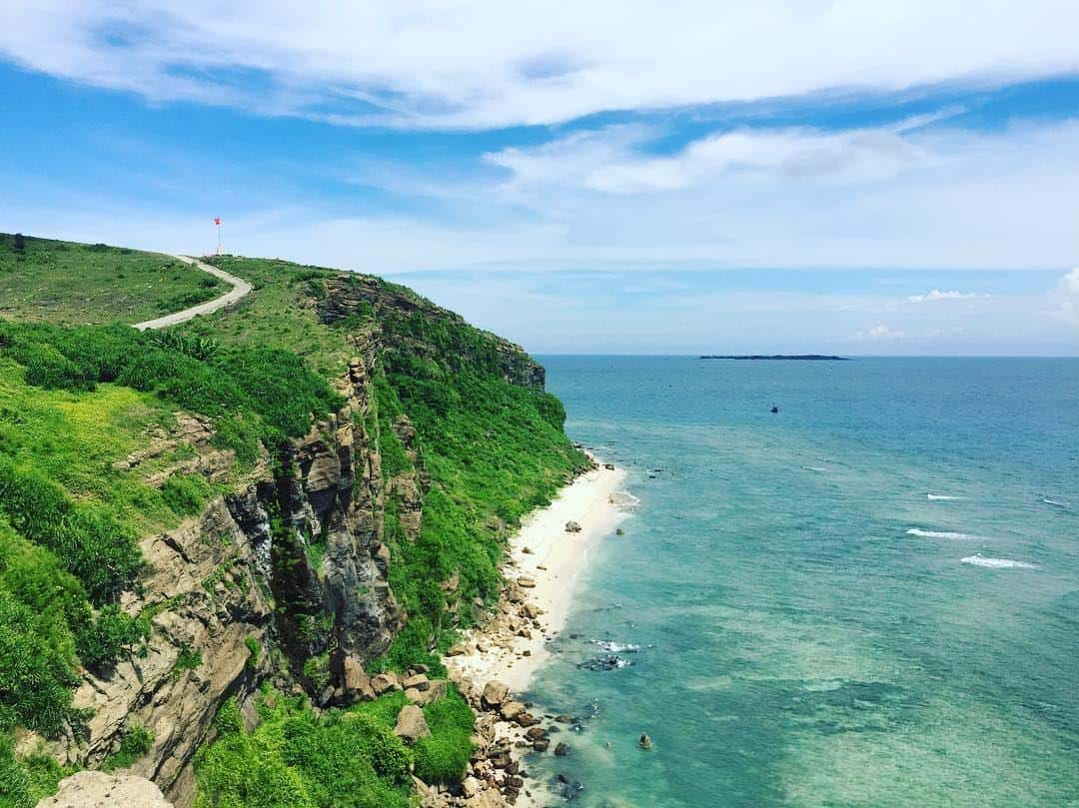
Ex 2 (p.45) Complete the sentences, using the words from the box.
desert wonder visit islands remember
islands
1. Ha Long Bay is famous for its beautiful ________.
2. Ha Long Bay is the number one natural ________ in Viet Nam.
3. A ________ is a large area of land with very little water.
4. __________ to bring an umbrella, as it often rains there.
5. A lot of people ________ Ly Son Island in the summer.
wonder
desert
Remember
visit

Slide 4
Ex 3 (p.45) Read the text again. Answer the following questions.
Ha Long Bay is in Quang Ninh. It has many islands and cave. Tuan Chau, with its beautiful beaches, is a popular tourist attraction in Ha Long Bay. There you can enjoy great seafood. And you can join in exciting activities. Ha Long Bay is Viet Nam's best natural wonder.
Mui Ne is popular for its amazing landscapes. The sand has different colours: white, yellow, red ... Its like a desert here. You can ride a bike down the slopes. You can also fly kites, or have a picnic by the beach. The best time to visit the Mui Ne Sand Dunes is early morning or late afternoon. Remember to wear suncream and bring water.
1. Where is Ha Long Bay?
2. What can do at Ha Long Bay?
3. Is there a desert in Mui Ne?
4. Where can you have a picnic in Mui Ne?
5. What is the best time to visit the Mui Ne Sand Dunes?
In Quang Ninh.
We can enjoy (great) seafood and join in exciting activities.
No, there isn’t.
By the beach.
Early morning or late afternoon

Slide 5

To describe a tourist attraction, what should you talk about?
Ha Long Bay is in Quang Ninh. It has many islands and cave. Tuan Chau, with its beautiful beaches, is a popular tourist attraction in Ha Long Bay. There you can enjoy great seafood. And you can join in exciting activities. Ha Long Bay is Viet Nam's best natural wonder.
Mui Ne is popular for its amazing landscapes. The sand has different colours: white, yellow, red ... Its like a desert here. You can ride a bike down the slopes. You can also fly kites, or have a picnic by the beach. The best time to visit the Mui Ne Sand Dunes is early morning or late afternoon. Remember to wear suncream and bring water.
Name of the attraction
Its special features / beauty / interesting things
What you can do there?
…

