Slide 1


Making and accepting appointments
Ex 1. Listen to Duong and Steven. Highlight the ways to make and accept appointments.
Steven: Duong, let’s go for a picnic this Sunday.
Duong: That’s fine. What time can we meet?
Steven: How about 9 o’clock?
Duong: Sure. I’ll meet you at that time.
Making appointments
accepting
Making appointments
accepting
Practice in pairs!

Slide 2
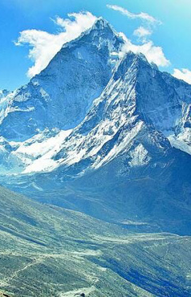
Unit 5:
Natural wonders of Viet Nam
Natural wonders of Viet Nam
Lesson 4: Communication

Slide 3
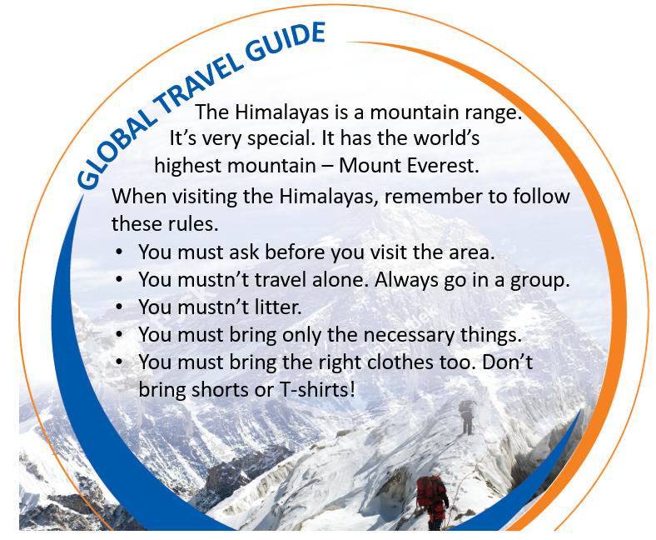
Ex 3. Read the travel guide entry.
2 minutes
Make a list of things you must and mustn’t do.
MUST | MUSTN’T
ask before you visit the area
travel alone
go in a group
litter
bring only the necessary things
bring shorts or T-shirts!
bring the right clothes

Slide 4
Ex 4. Make a list of the things you must bring to the Himalayas. Add things you mustn’t bring.
Suggested answers
MUST BRING | MUSTN’T BRING
compass
bicycle
backpack, painkillers, map, plaster, sleeping bag, tent, waterproof coat, torch
…
T-shirts
shorts
computer
…

