Slide 1
Unit 4:
My neighbourhood
LESSON 5: SKILLS 1

Slide 2
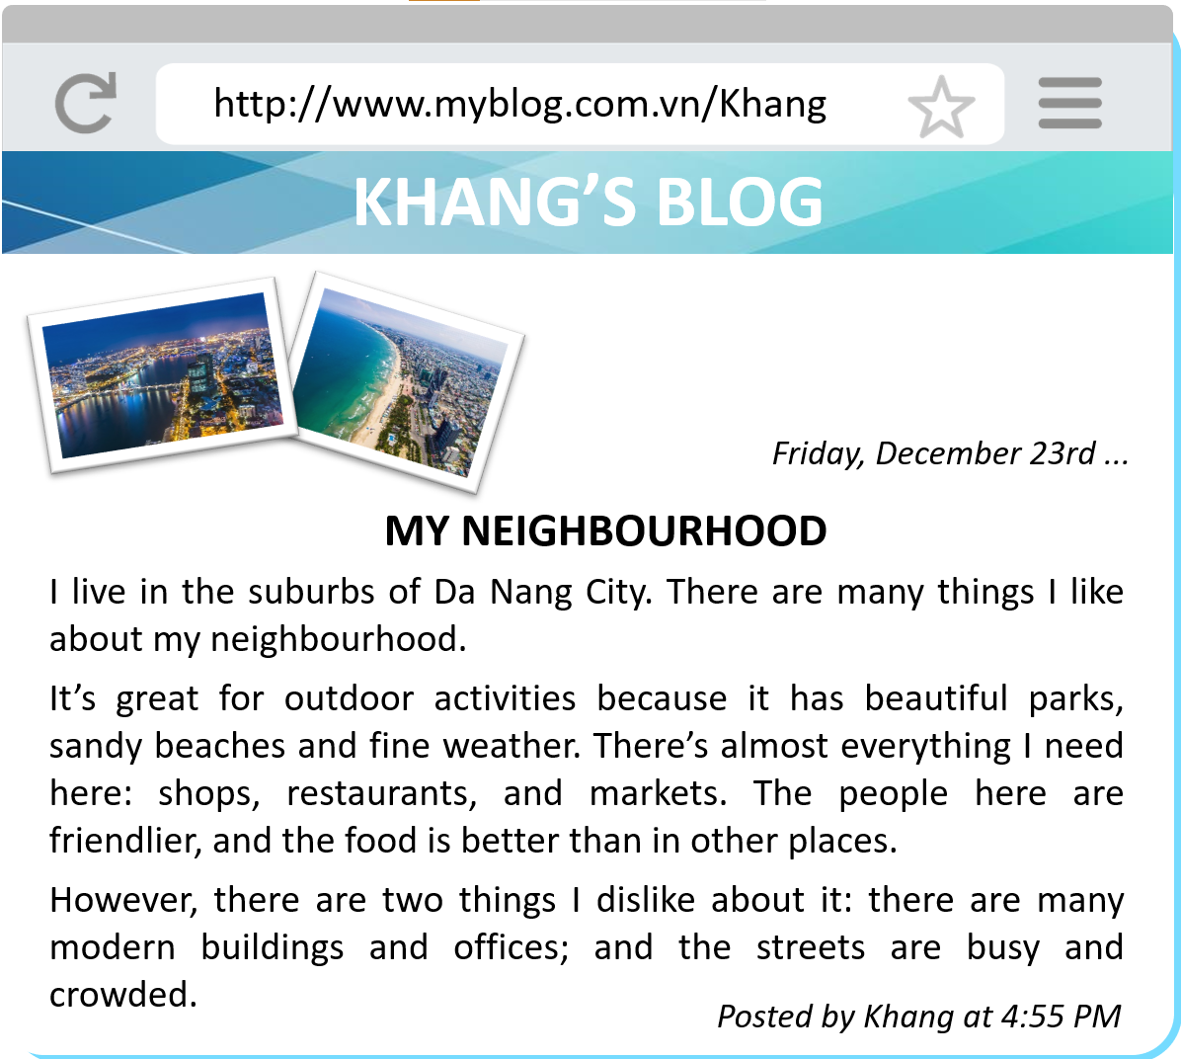
What type of the text is it?
A blog
What is the topic?
Khang’s neighbourhood

Slide 3
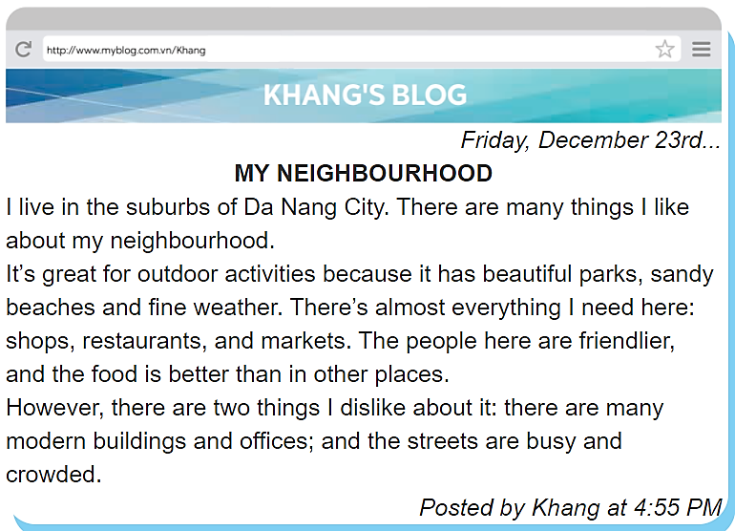
Find the words in the blog – 15 seconds
suburbs
dislike
outdoor
START
STOP
TIME
:
0
0
0
00
59
58
57
56
55
54
53
52
51
50
49
48
47
46
45
44
43
42
41
40
39
38
37
36
35
34
33
32
31
30
29
28
27
26
25
24
23
22
21
20
19
18
17
16
15
14
13
12
11
10
09
08
07
06
05
04
03
02
01
00
Notes:
15 seconds

Slide 4
Find the words in the blog
suburbs
dislike
outdoor
Notes:
15 seconds

Slide 5
Read and answer
1. Where is Khang’s neighbourhood?
Place
2. Why is his neighbourhood great for outdoor activities?
Reason (because)
3. What are the people in his neighbourhood like?
Adj
4. How are the street in his neighbourhood?
Adj

Slide 6

Read again and fill
LIKES | DISLIKES
beautiful parks

Slide 7
Answers
LIKES | DISLIKES
beautiful parks
many modern buildings and offices
sandy beaches
fine weather
busy and crowded streets
There’s almost everything: shops, restaurants and markets.
friendly people
good food

