Slide 1
UNIT 2: MY HOUSE
LESSON 7: LOOKING BACK

Slide 2
OBJECTIVES
Review the vocabulary and grammar of Unit 2

Slide 3
Mark the letter A, B, C or D on your answer sheet to indicate the word whose underlined part differs from the other three in pronunciation in each of the following questions.
1. A. coughs B. sings C. stops D. sleeps
2. A. signs B. profits C. becomes D. survives
3. A. walks B. steps C. shuts D. plays
4. A. wishes B. practices C. introduces D. leaves
5. A. grasses B. stretches C. comprises D. potatoes
6. A. desks B. maps C. plants D. chairs
7. A. pens B. books C. phones D. tables
Cách phân âm đuôi s/es
1. phát âm là /s/
âm cuối là âm vô thanh: /f/, /t/, /k/, /p/, /θ/
2. phát âm là /iz/
kết thúc là các phụ âm gió sau: /s/, /z/, /∫/, /t∫/, /dʒ/, /ʒ/
3. phát âm là /z/
âm cuối là âm hữu thanh
/kɒfs/ /sɪŋz/ /stɒps/ /sliːps/
/saɪnz/ /ˈprɒfɪts/ /bɪˈkʌmz/ /səˈvaɪvz/
/wɔːks/ /steps/ /ʃʌts/ /pleɪz/
/wɪʃɪz/ /ˈpræktɪsɪz/ /ˌɪntrəˈdjuːsɪz/ /liːvz/
/ɡrɑːsɪz/ /stretʃɪz/ /kəmˈpraɪzɪz/ /pəˈteɪtəʊz/
/desks/ /mæps/ /ˈplɑːnts/ /tʃeə(r)z/
/penz/ /ˈbʊks/ /fəʊnz/ /ˈteɪblz/

Slide 4
Ex1: Put the words into the correct group. Add a new word to each group.
kitchen
bedroom
dishwasher
country house
sink
fridge
town house
chest of drawers
flat
bathroom
cupboard
living room
Types of house | Rooms | Furniture
flat
bedroom
chest of drawers
town house
bathroom
sink
country house
kitchen
fridge
living room
dishwasher
cupboard

Slide 5
Ex2: Complete the second sentence with the correct possessive form.
1.
My teacher has a house next to our house.
teacher’s
→ Our house is next to my _____________ house.
2.
My brother has a TV.
brother’s
→ This is my _____________ TV
3.
Elena has a big bookshelf in her bedroom.
Elena’s
→ There’s a big bookshelf in _____________ bedroom
4.
My grandfather likes the kitchen the best.
grandfather’s
→ The kitchen is my _____________ favourite room
5.
My aunt has a daughter, Vy.
Vy’ss
→ I’m _____________ cousin.

Slide 6
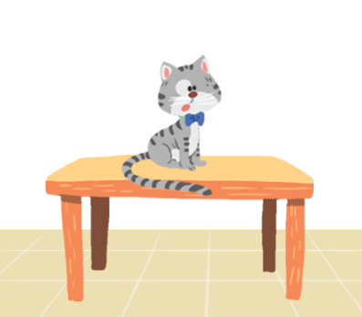
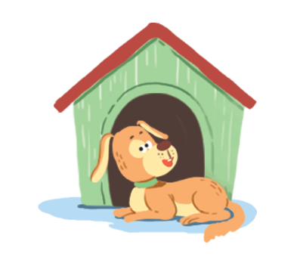
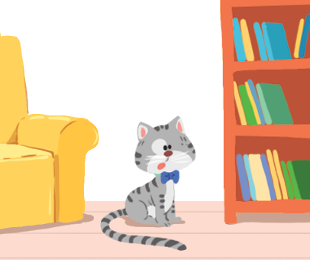

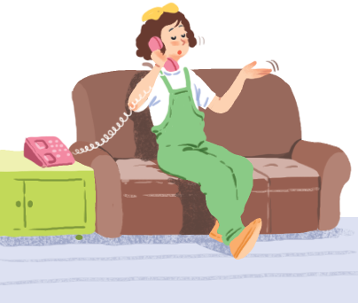
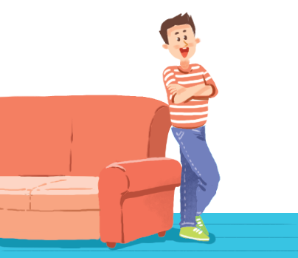
Ex3: Make sentences. Use prepositions of place.
on
in front of
between
1
2
3
behind
on
next to
4
5
6

Slide 7
Ex3: Make sentences. Use prepositions of place.
is on the table
1. The cat _______________.
is in front of the doghouse
2. The dog _______________________.

Slide 8
Ex3: Make sentences. Use prepositions of place.
3. The cat _______________________________.
is between the sofa and the bookself
is behind the computer
4. The cat _______________________.

Slide 9
Ex3: Make sentences. Use prepositions of place.
is on the sofa
is next to the sofa
5. The girl ____________________.
6. The boy __________________.

Slide 10
Thanks!
SEE YOU NEXT TIME

