Slide 1
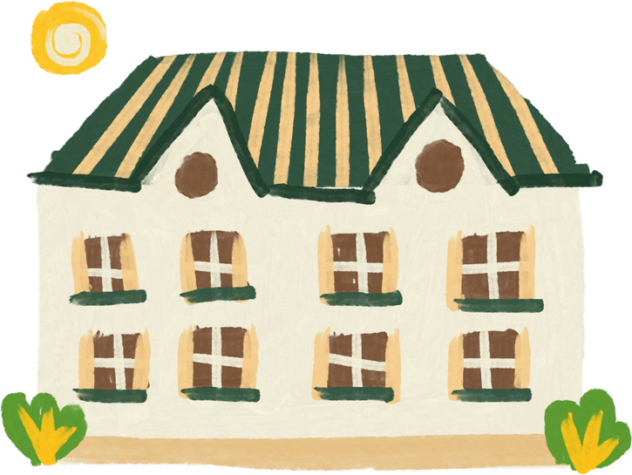
UNIT 2
MY HOUSE
Lesson 6: skills 2

Slide 2
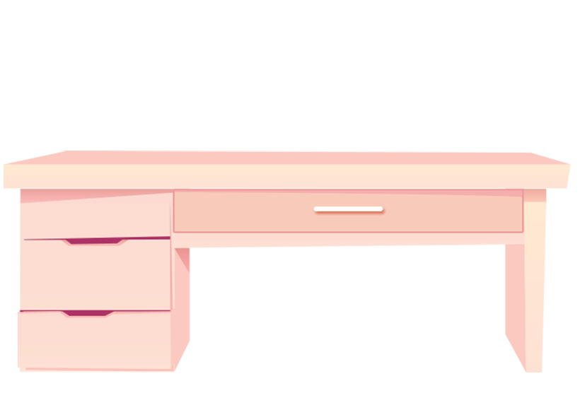

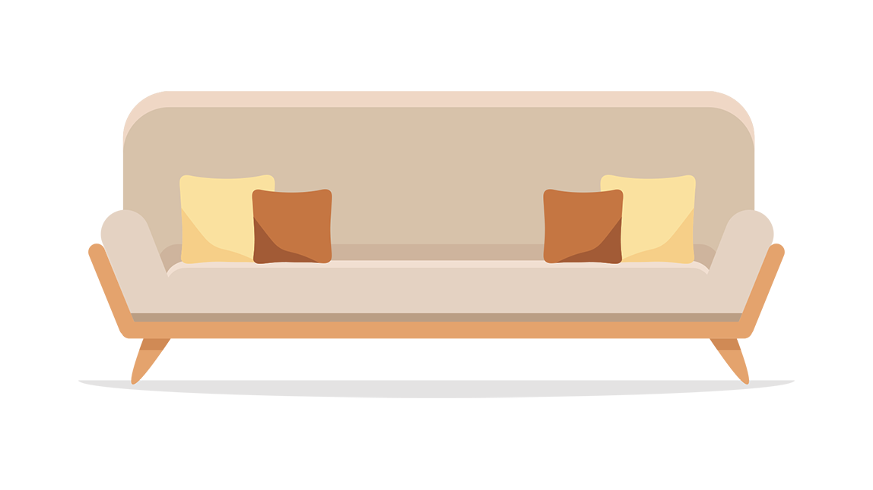

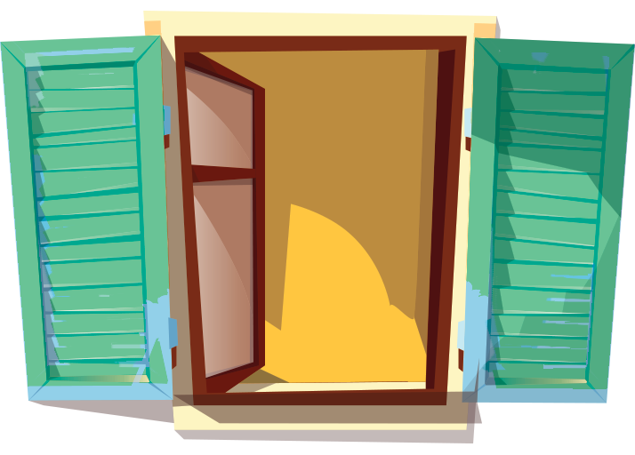

✓
2. SOFA
3. DESK
✓
1. BOOKSHELF
Guess what is mentioned in the listening text
Listen and tick (✓) things you hear
✓
✓
4. CLOCK
5. WINDOW

Slide 3
Ex 2: Listen and tick ( ) T (True) or F (False).
Correct the false ones.
✓
 | T | F
1. There are four people in Mai's family.
2. Mai's house has seven rooms.
3. The living room is next to the kitchen.
4. In her bedroom, there's a clock on the wall.
5. She often listens to music in her bedroom.
three
✓
six
✓
✓
✓
reads books
✓

Slide 4
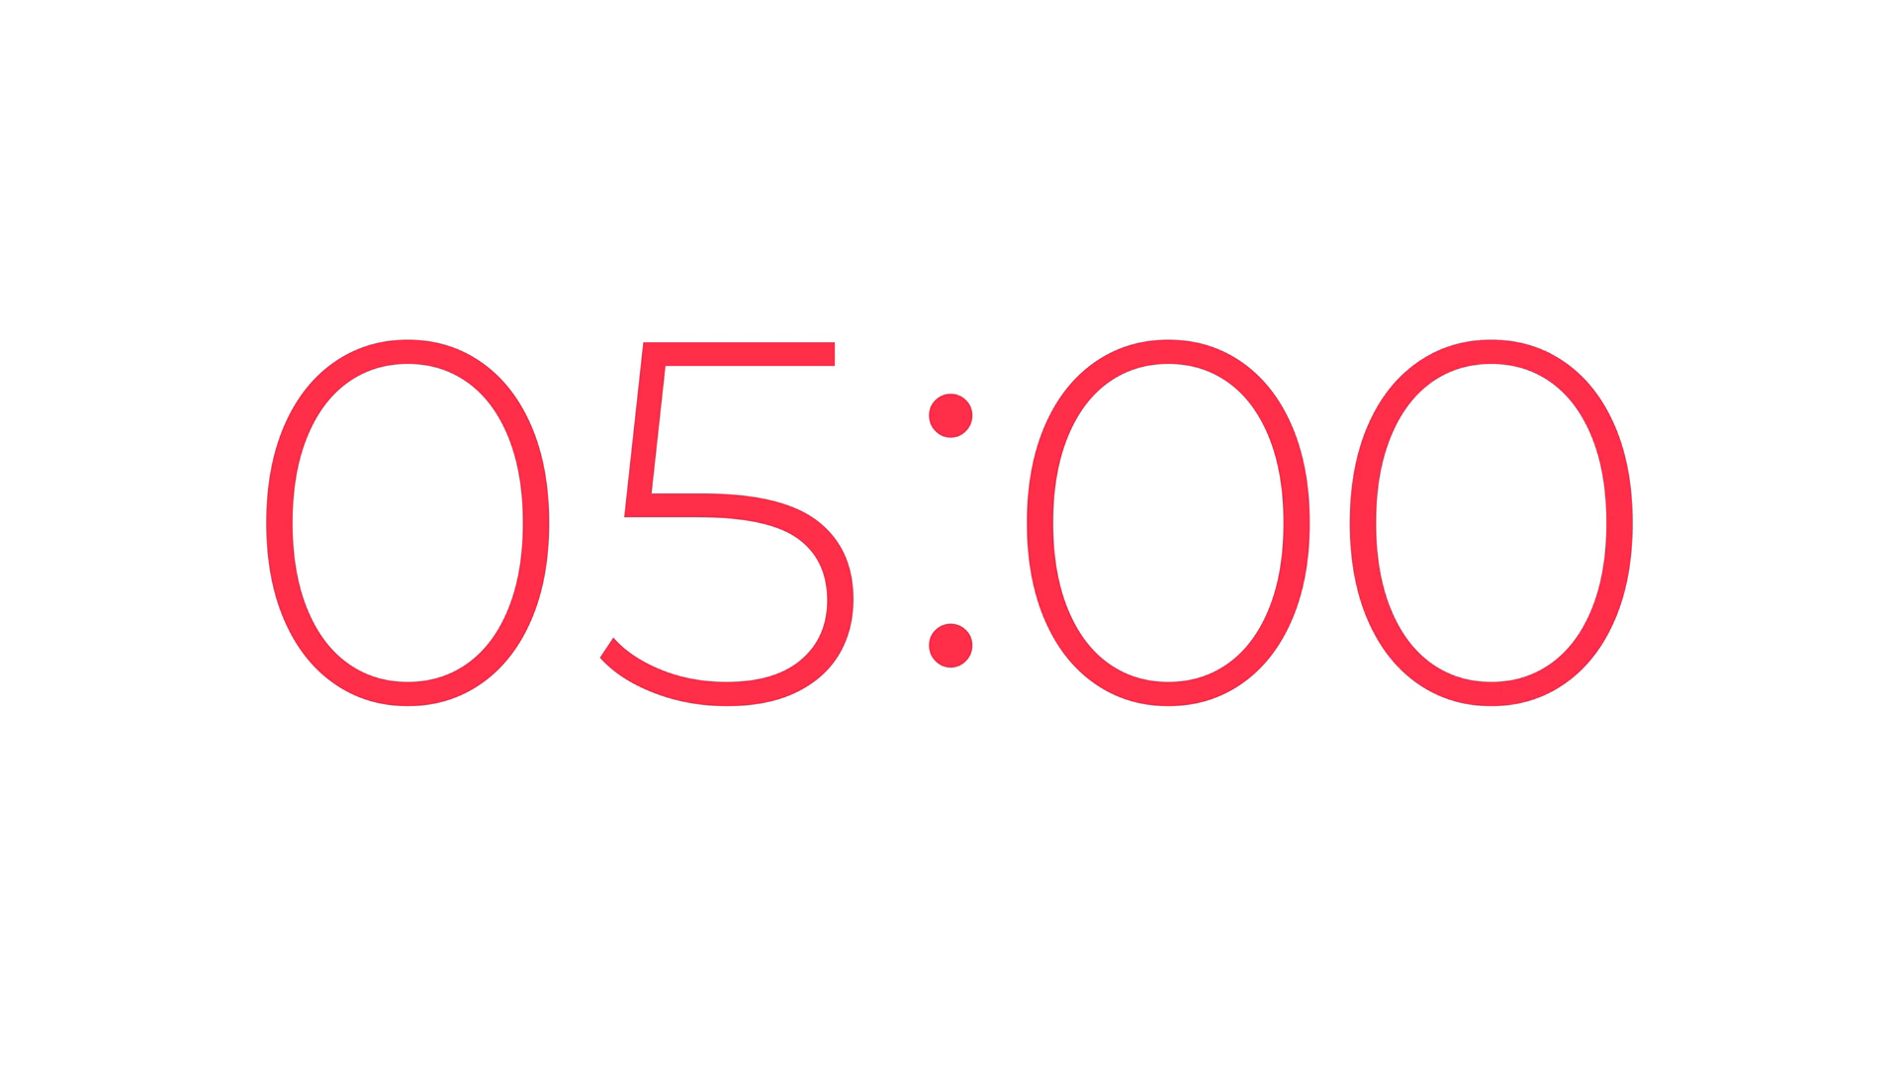
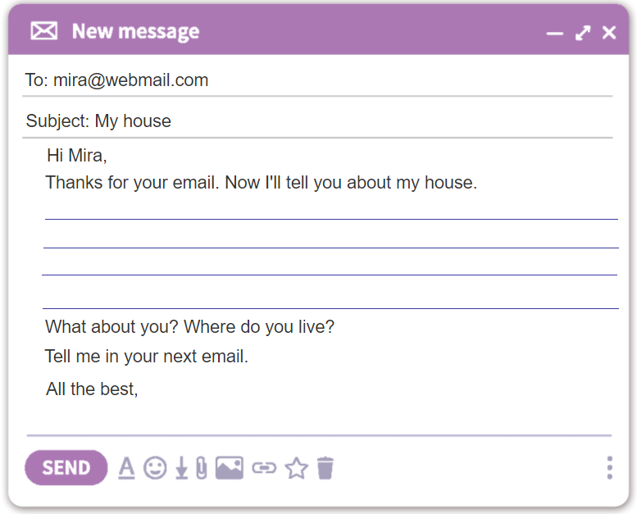
Ex.4: Write an e-mail to your pen friend.
Tell him/ her about your house. Use the answers in Ex.3
1. Where do you live?
2. How many rooms are there in your house? What are they?
3. Which room do you like the best in your house? Why?

Slide 5
1. Write an email to your teacher about your room in A4 paper.
3. Prepare next lesson: Looking back and project.
Homework

