Slide 1


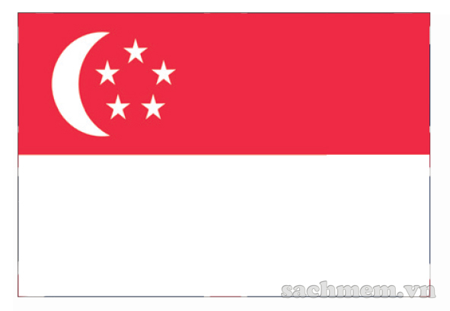



Put the names of the countries under their flags.
New Zealand
Singapore
Australia
The USA
Canada
The United Kingdom
1.
2.
3.
4.
5.
6.

Slide 2
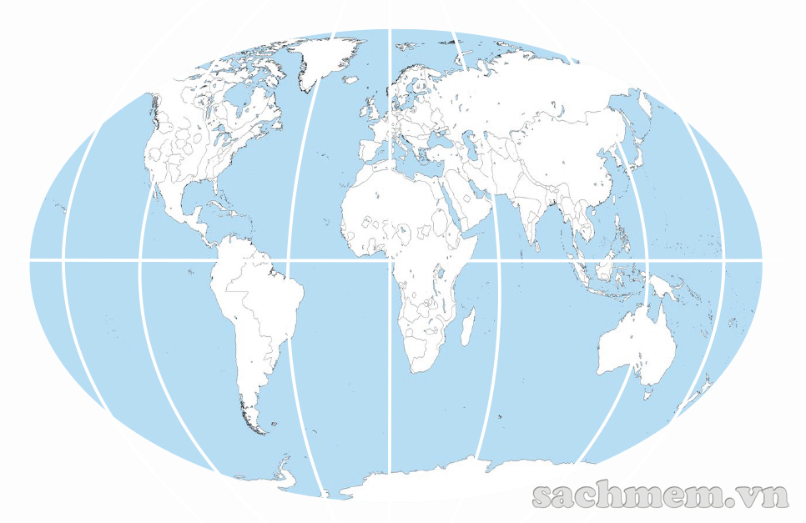
Work in groups of four. Locate the six countries in on the map below.
THE UNITED KINGDOM
CANADA
SINGAPORE
THE USA
AUSTRALIA
New Zealand

Slide 3

Unit 8:
English speaking countries
Lesson 1: Getting Started

Slide 4

1. Have you ever joined an English summer camp?
2. How was your experience?

Slide 5


Slide 6
Check your memory
1. Where is Phong now?
2. Where do the campers come from?
3. What has Phong done so far?
4. Why has he been able to improve his English?
5. Who are in the same team with Phong?
6. When can Nick see Phong?

Slide 7
Exercise 1b. Read the conversation and answer the questions.
1. Where is Phong now?
2. Where do the campers come from?
3. What has Phong done so far?
4. Why has he been able to improve his English?
5. Who are in the same team with Phong?
6. When can Nick see Phong?
He’s at an international summer camp (in Singapore).
They come from different countries/ from all over the world.
He has made new friends, visited places
Because he uses English every day with people from different countries.
Two boys from Australia and a girl from the USA.
After July 15th.

Slide 8
Exercise 1.a. Find a word or an expression from the conversation which you use when you…
1. think something is wonderful: ……………………………………
2. agree with somebody: …………………………
3. cannot decide: ………………………
4. are not sure about something: ……………
Awesome, just awesome
Absolutely/ Right
It’s hard to say
Perhaps

Slide 9
Exercise 2. Discuss in tables and complete the sentences with words/ phrases from the box.
1. Last year I had a wonderful time at a ………………..…… in Britain.
2. The USA, the United Kingdom and New Zealand are all
………………………………… .
3. Australians are …….………………... of English because they use it as their mother tongue.
4. …................. is in the mid-north of America.
5. Usually, people from different parts of a country speak their language with different ………….
6. English is an ………….………………. in countries like India, Malaysia and Singapore.
summer camp
English speaking countries
native speakers
The USA
accents
official language

Slide 10
Thank you

Slide 11

Nick: How’s your international summer camp going, Phong?
Phong: Awesome, just awesome.
Nick: You sound so happy. What do you like about it?
Phong: It’s hard to say. Everything’s wonderful: the friends I’ve made, the places I’ve visited, the activities…
Nick: Oh… Your English has improved a lot!
Phong: Absolutely. I use English every day, with people from different countries
Nick: Where are they from?
Phong: Everywhere! Places like India, Canada… English is also an official language here in Singapore.
Nick: Right. Have you made any friends from English speaking countries?
Notes:
And now, look at Exercise 1. page 16, we are going to listen to Nick and Phong’s conversation about it. Và bây giờ, cô mời các em mở trang 16 bài tập số 1, chúng ta sẽ cùng nghe đoạn hội thoại giữa Nick và Phong về kỷ nghỉ đó.

Slide 12
Phong: I’m in a team with two boys from Australia and a girl from the USA.
Nick: Do you have difficulty understanding them?
Phong: I found it difficult to understand them at first. Perhaps it’s because of their accent, but it’s OK now.
Nick: It’s great that you can practise English with native speakers. When are you back?
Phong: Our camp closes on July 15th and I take the night flight home the same day.
Nick: Looking forward to seeing you then. Enjoy!
Phong: I will. Thanks. Bye.

Slide 13
Nick: How’s your international summer camp going, Phong?
Phong: Awesome, just awesome.
Nick: You sound so happy. What do you like about it?
Phong: It’s hard to say. Everything’s wonderful: the friends I’ve made, the places I’ve visited, the activities…
Nick: Oh… Your English has improved a lot!
Phong: Absolutely. I use English every day, with people from different countries
Nick: Where are they from?
Phong: Everywhere! Places like India, Canada… English is also an official language here in Singapore.
Nick: Right. Have you made any friends from English speaking countries?
Notes:
Để hiểu rõ hơn câu chuyện giữa Nick và Phong, chúng ta sẽ cùng nghe lại lời thoại của từng bạn. Chúng ta sử dụng câu hỏi How’s something going? Để hỏi cái gì như thế nào? Các em lưu ý giúp cô câu nói của Nick ‘You sound so happy”, ở đây Nick muốn nói rằng nghe Phong kể, Nick thấy Phong rất hạnh phúc.

Slide 14
Phong: I’m in a team with two boys from Australia and a girl from the USA.
Nick: Do you have difficulty understanding them?
Phong: I found it difficult to understand them at first. Perhaps it’s because of their accent, but it’s OK now.
Nick: It’s great that you can practise English with native speakers. When are you back?
Phong: Our camp closes on July 15th and I take the night flight home the same day.
Nick: Looking forward to seeing you then. Enjoy!
Phong: I will. Thanks. Bye.

Slide 15
Exercise 2. Discuss in tables and complete the sentences with words/ phrases from the box.
1. Last year I had a wonderful time at a ………………… in Britain.
2. The USA, the United Kingdom and New Zealand are all
………………………………… .
3. Australians are …………………... of English because they use it as their mother tongue.
4. ................. is in the mid-north of America.
5. Usually, people from different parts of a country speak their language with different ………….
6. English is an ……………………. in countries like India, Malaysia and Singapore.
summer camp
English speaking countries
native speakers
The USA
accents
official language

Slide 16

Thank you!

