Slide 1
Guess the story
Work in 3 groups
Look at the hints and guess the story

Slide 2

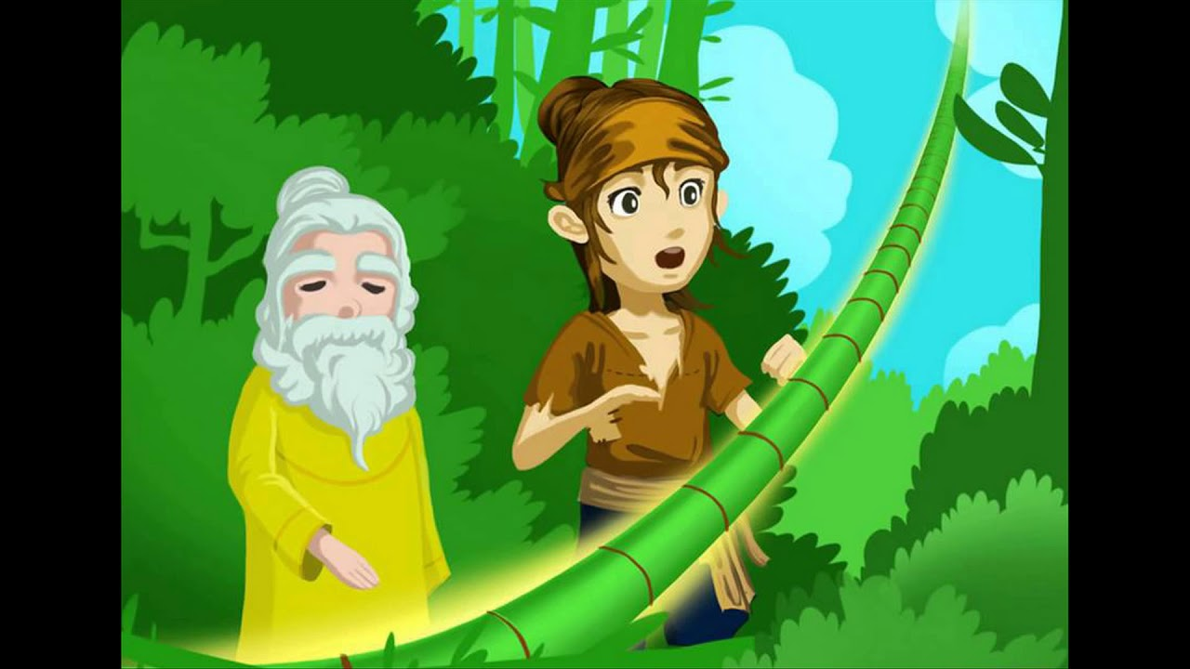

The hundred-knot bamboo tree

Slide 3

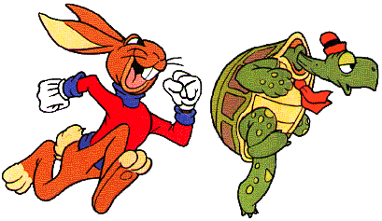
The hare and the tortoise

Slide 4
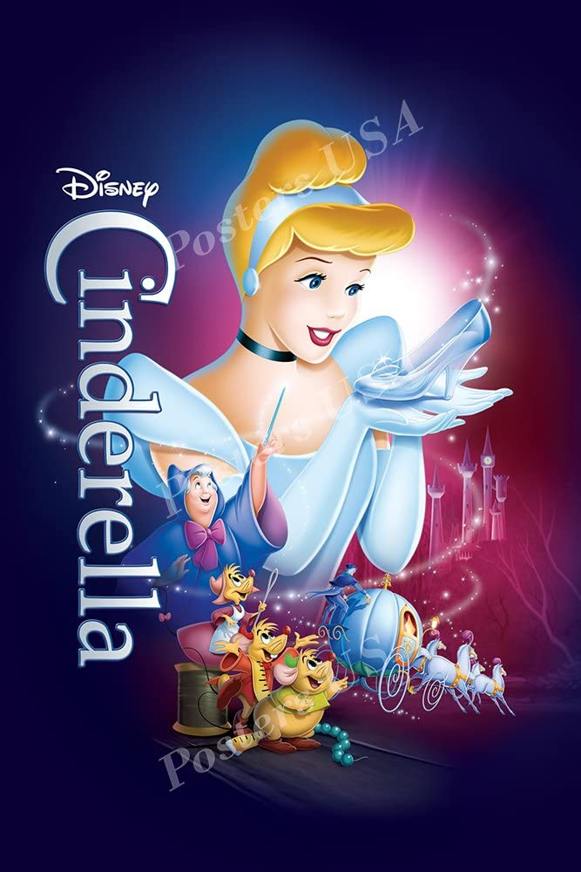
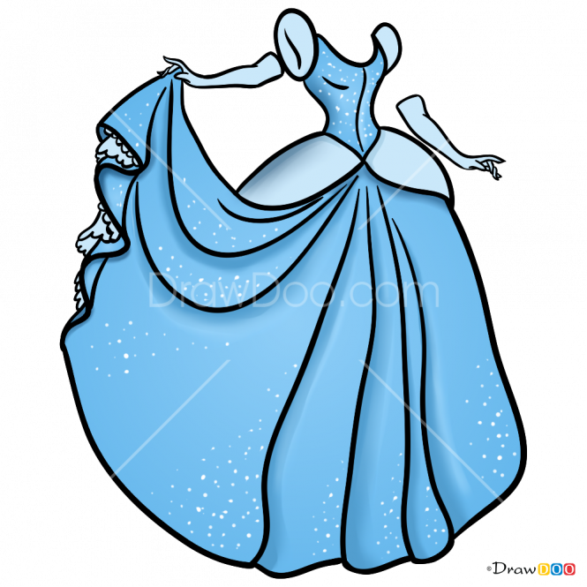
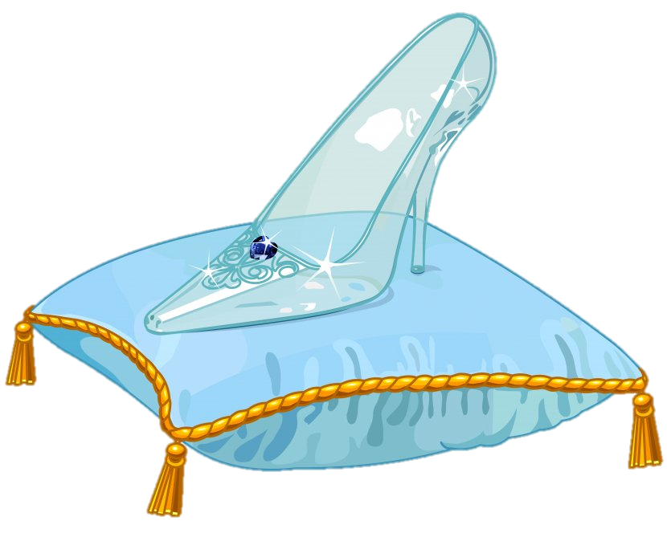
Cinderella

Slide 5
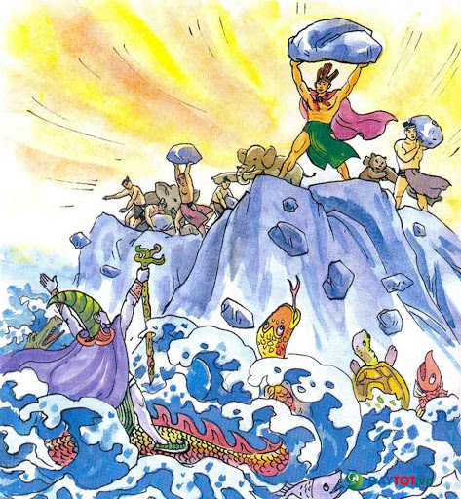
Legend of Son Tinh Thuy Tinh

Slide 6
Unit 6
Folk tales
Lesson 1: Getting started

Slide 7

A. legend
Match the words with its definition
Listen and check.
1. a traditional short story that teaches a moral lesson, especially a story about animals
2. a children’s story in which magical things happen
B. folk tale
3. a story that parents have passed on to their children through speech over many years
C. fable
4. an old well-known story, often about brave people, adventures, or magical events
D. fairy tale

Slide 8
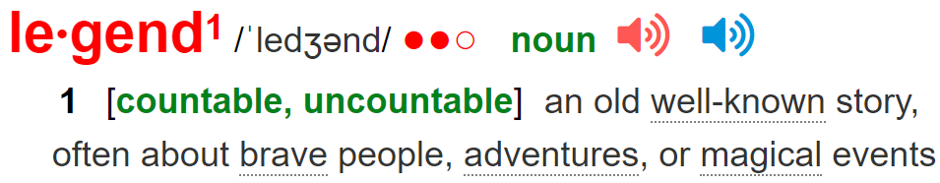
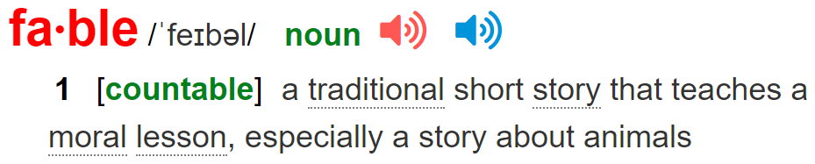

Slide 9
Vocabulary:
- reply /rɪˈplaɪ/ (v)
legend / legend/ (n)
folk tale /ˈfəʊk teɪl/ (n)
fable /ˈfeɪbl/ (n)
origin /ˈɒrɪdʒɪn/(n)
produce / prəˈdjuːs / (v)
- give birth to /gɪv bɜːθ tə(r)/ (exp)
imaginary /ɪˈmædʒɪnəri/ (a)
arrogant /ˈærəɡənt/ (a)
: đáp lời, trả lời
: truyền thuyết, sự tích
: truyện kể dân gian
: truyện ngụ ngôn
: nguồn gốc
: tạo ra, sinh (đẻ) ra
: sinh nở, sinh con
: tưởng tượng
: kiêu ngạo, ngạo mạn

Slide 10
Checking vocabulary:
- reply /rɪˈplaɪ/ (v)
legend / legend/ (n)
folk tale /ˈfəʊk teɪl/ (n)
fable /ˈfeɪbl/ (n)
origin /ˈɒrɪdʒɪn/(n)
produce / prəˈdjuːs / (v)
- give birth to /gɪv bɜːθ tə(r)/ (exp)
imaginary /ɪˈmædʒɪnəri/ (a)
arrogant /ˈærəɡənt/ (a)
: đáp lời, trả lời
: truyền thuyết, sự tích
: truyện kể dân gian
: truyện ngụ ngôn
: nguồn gốc
: tạo ra, sinh (đẻ) ra
: sinh nở, sinh con
: tưởng tượng
: kiêu ngạo, ngạo mạn

Slide 11
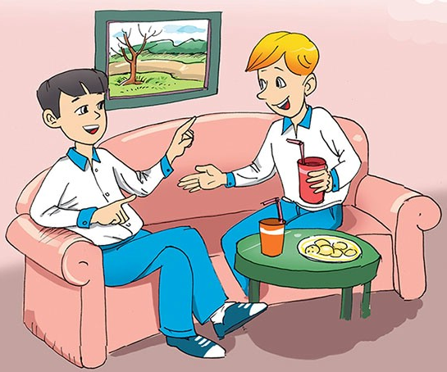
A suggestion for Nick's project
Have you ever read or been told a famous Vietnamese legend?
What is its title?
What is it about?
What are the main characters in it?
Nick
Duong

Slide 12
Ex1a (p.59) Listen and choose the correct answers.
1. What was Duong doing at 9 p.m. last night?
A. He was coming to Nick’s house.
B. He was phoning Nick.
C. He was talking to Nick.
2. What was Nick doing at 9 p.m. last night?
A. He was watching a TV show.
B. He was talking about his project.
C. He was searching for information on the Web.
3. What legend did Duong recommend to Nick?
A. A legend about how Viet Nam began.
B. A legend about Vietnamese people being original
C. A legend that isn’t well-known
4. Who was Lac Long Quan?
A. A fairy B. Au Co’s father C. The dragon king of the ocean
5. Where did Au Co take half of the sons?
A. To the mountains B. To the sea C. To Lac Long Quan’s land.
Read again and check.

Slide 13
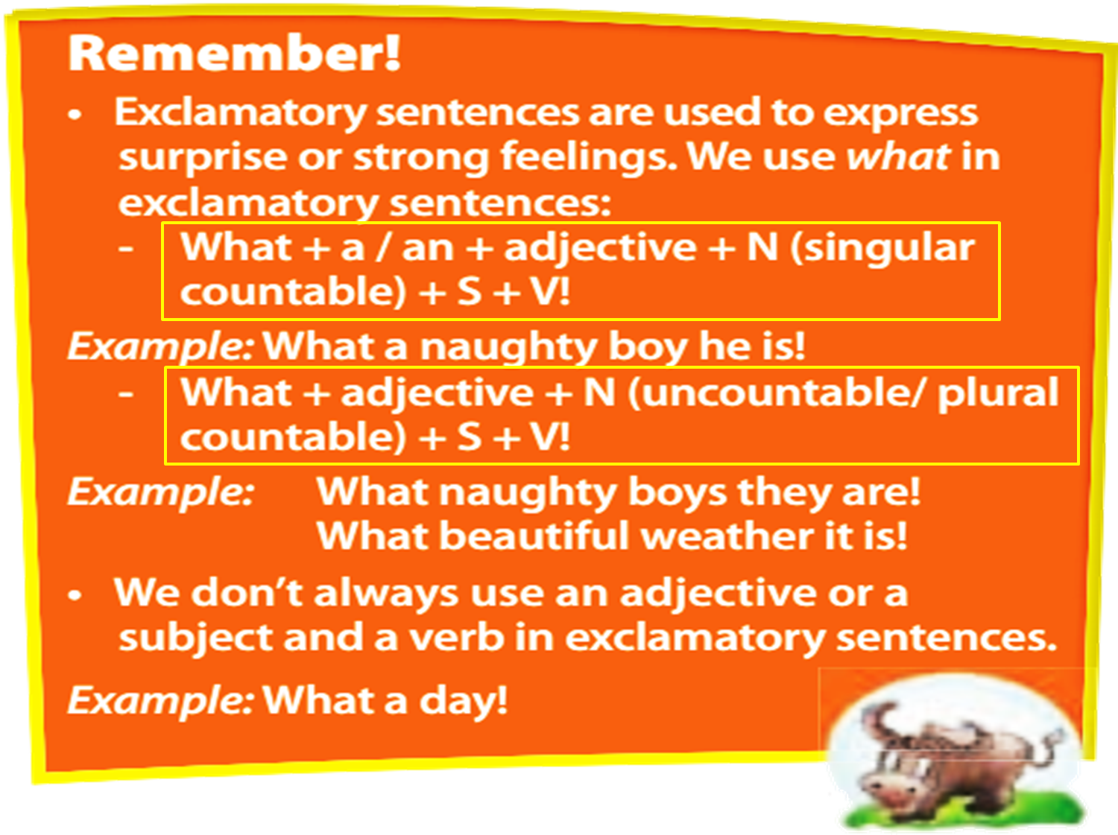
Ex1d. What does this sentence from the conversation express?
EXCLAMATORY SENTENCES
What a naughty boy he is !
What an interesting legend it is!
Do you know what kind of sentence it is?
What
a/an
Adj
N (singular countable)
S
V
!
What naughty boys they are!
What
Adj
N (uncountable/ plural countable)
S
V
!
Exclamatory sentences are used to express surprise or strong feelings.

Slide 14
Make exclamatory sentences.
1. handsome / man
What a handsome man (he is)!
2. interesting / game
What an interesting game (it is)!
3. good / news
What good news (it is)!
4. lovely / dogs
What lovely dogs (they are)!
5. brave / women
What brave women (they are)!

Slide 15
Ex1b Match the words to their meanings
1. title
c. the name of the story
2. genre
d. the type of story it is
3. main characters
a. the people the story is about
a. the people the story is about
4. plot
b. the content of the story
b. the content of the story
c. the name of the story
d. the type of story it is

Slide 16
Ex1c. Find the information in the conversation to complete the table.
Title | Lac Long Quan and Au Co
Genre
Main characters
Plot | - Lac Long Quan married Au Co.
Legend
Lac Long Quan, Au Co, and their sons
- Au Co gave birth to one hundred baby boys.
- Lac Long Quan missed the sea.
- Lac Long Quan took fifty of their sons to the sea.
- Au Co took the others to the mountains.

Slide 17
Ex1d. Work individually in 2 mins. Think of a legend, folk tale, fable or fairytale you know. Complete the table below.
Title
Genre
Main characters
Plot

Slide 18

Role play
Work in pair.
Student A: You’re going to have a project about folks tales. Then you ask your friends
Student B: You will give him/her some advice.

Slide 19
THANKS!
Do you have any questions?

