Slide 1
Warm up
Home robot
Worker robot
Doctor robot
Care robot
Match the robot’s name with its ability
 | Care for the elderly and children
 | Repair machinery
 | Do housework
 | Examine and prescribe medicine for patients
Care robot
Worker robot
Home robot
Doctor robot

Slide 2
Unit 12
Robots
6th Grade
LESSON 4. COMMUNICATION

Slide 3
OBJECTIVES
01
Express agreement and disagreement
02
Talk about what a robot can do
By the end of the lesson, students will be able to:

Slide 4
Everyday English
How to express agreement and disagreement?

Slide 5

Ex 1. (p 63) Listen and read the dialogues. Pay attention to the highlighted sentences.
Agreement
Disagreement
A: I think robots can help us a lot in our daily life.
B: I agree with you.
A: Peter says robots can do everything like humans.
B: I don’t agree with him.
Which ones show agreement and
which ones show disagreement?

Slide 6

Ex 2. (p 63) Work in pairs. Express your opinions about the following statements.
Use the highlighted phrases in the dialogues in Ex 1.
Home robots are the most useful of all types of robots.
Some people can use robots to do bad things.
- Express agreement or disagreement.
- Tell me why do you think so.
Robots will use too much electricity in the future.

Slide 7
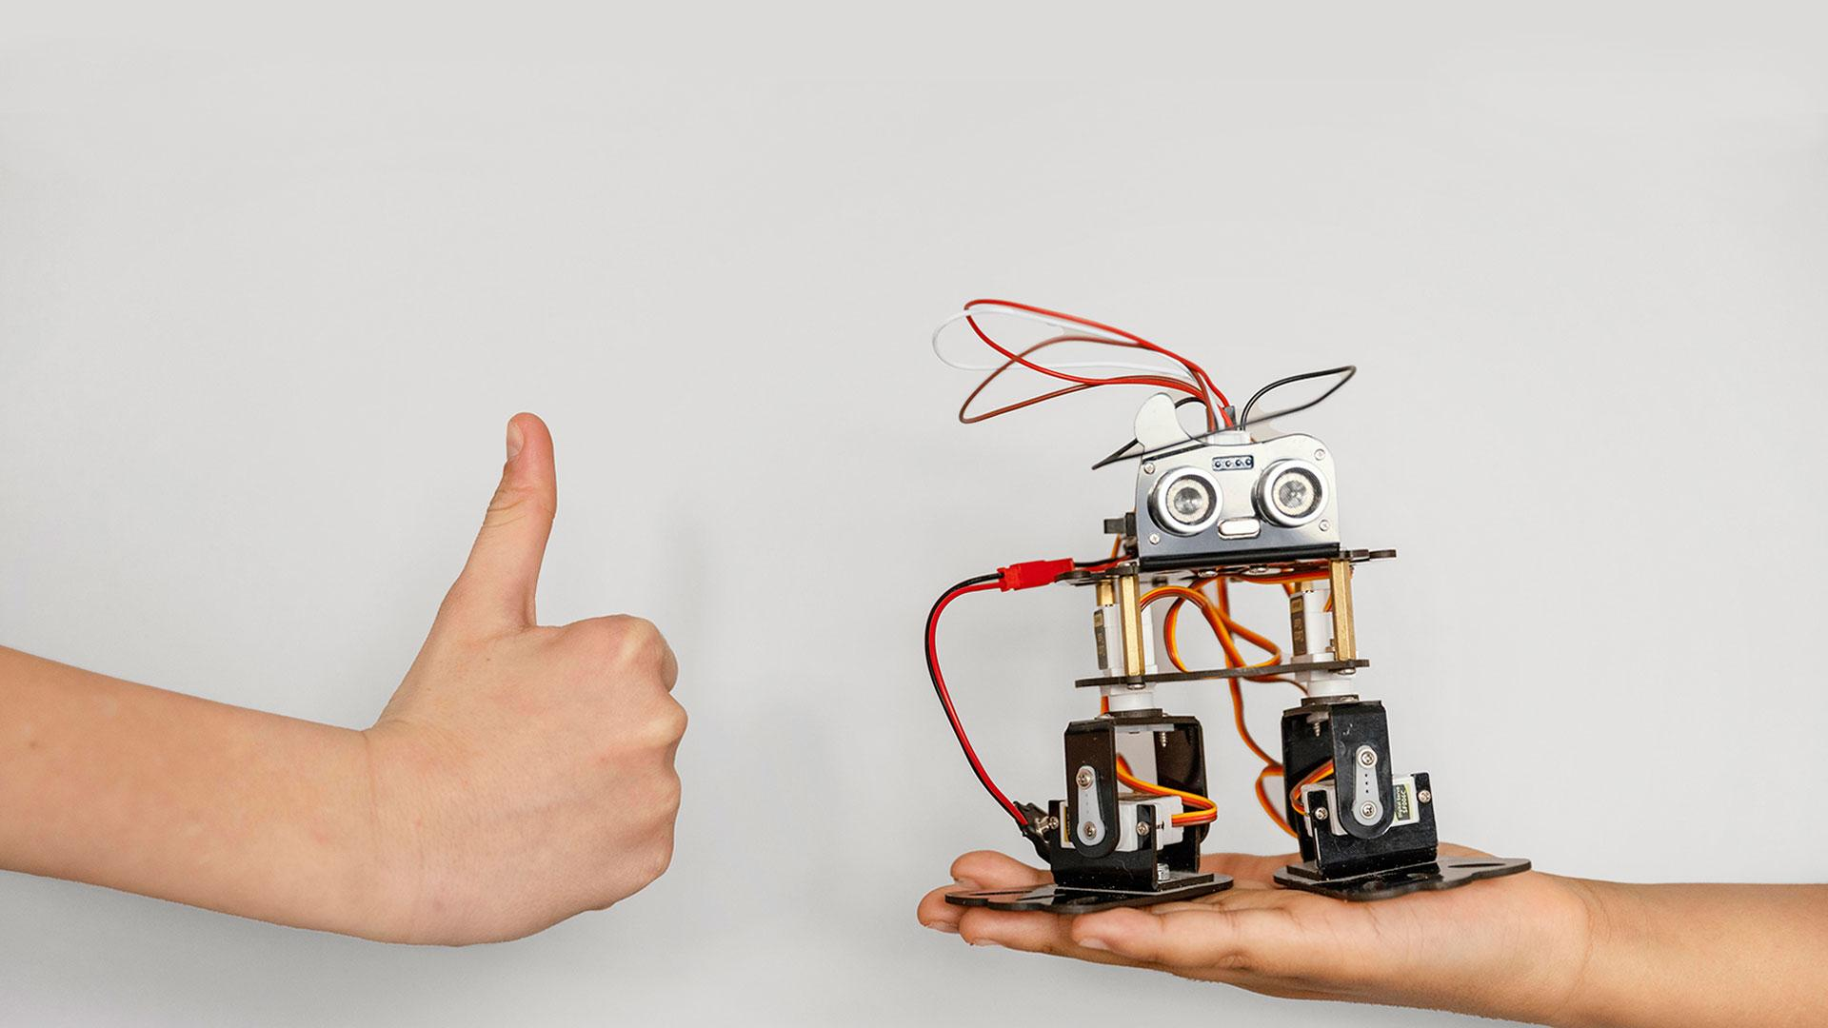
My robot’s abilities

Slide 8
Ex 3. (p 63) Listen to the radio programme from 4Teen News. Then fill the blanks with the words you hear.
Speaker: Today we asked our friends: Tom from Australia, Linh from Viet Nam and Nobita from Japan to tell us about their robots. Tom, would you like to start?
Tom: Well my robot can (1) __________ what i say. It can also understand my feelings. It's the (2) __________ robot.
Speaker: Linh?
Linh: My robot is my best friend. It does a lot for me: clean the floor, (3) __________ my toys away, and…
Speaker: And Nobita?
Nobita: My robot is very useful. It helps me a lot. It can (4) __________ my plants and even work as a (5) __________.
understand
smartest
put
water
guard

Slide 9

Friend 1
Robot’s abilities
Friend 2
Robot’s abilities
Friend 3
Robot’s abilities
Ex 4. (p 63) Interview 3 friends about what abilities they want their robots have.
1
2
3
Example:
A: What is the robot's abilities you want?
B: I think home robots will do housework.

Slide 10
Report your results to the class
I interviewed three of my friends about the abilities they want their robots to have. Minh Anh wants her robots to cook meals. Ha An wants her robot to do her homework. And Tan Phong wants his robot to play with him.

Slide 11
What have you learnt today?
Talk about robot’s abilities
RECAP
Express agreement and disagreement.
I agree with you.
I disagree with you.

Slide 12
Thank you!

