Slide 1
Unit 7:
TELEVISION

Slide 2
Odd one out.
1. A. talk show B. channel C. game show D. film
chương trình trò chuyện kênh chương trình trò chơi phim
2. A. viewer B. MC C. studio D. newsreader
người xem MC phòng thu người đọc tin tức
3. A. programme B. reporter C. journalist D. weatherman
chương trình phóng viên nhà báo nhà thời tiết
4. A. interesting B. boring C. thrilling D. shopping
thú vị nhàm chán hồi hộp mua sắm
5. A. cartoon B. character C. weather forecast D. comedy
phim hoạt hình nhân vật dự báo thời tiết hài kịch

Slide 3

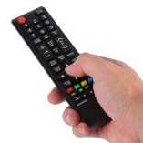
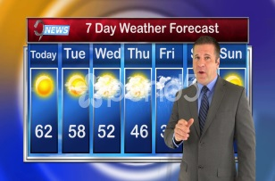

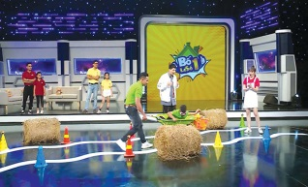
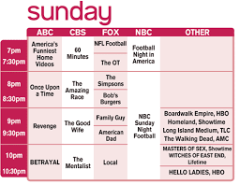
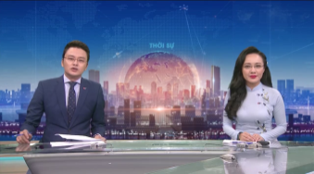

Write the word below each picture.
weatherman | comedy | news programme | TV schedule
national television | game show | cartoon | remote control
1……………………… | 2……………………… | 3……………………… | 4………………………
­­­­­­­­­­­­
5……………………… | 6……………………… | 7……………………… | 8………………………
cartoon
remote control
weatherman
national television
game show
comedy
TV schedule
news programme

Slide 4
Choose the best option A, B, C or D to indicate the correct answer to each of the following questions.
1. VTV2 and VTV3 are well-known ______ channels in Viet Nam.
foreign B. national
C. local D. international
2. He is one of the most famous ______ in Viet Nam. You can see him appear on weather forecast every day.
MCs B. comedians
C. newsreaders D. weathermen
3. Did you watch the ________ about the history of India?
documentary B. sitcom
C. news D. game
National channels: kênh quốc gia
Documentary: phim tài liệu Sit com: hài kịch
News: tin tức Game: trò chơi

Slide 5
Choose the best option A, B, C or D to indicate the correct answer to each of the following questions.
4. Disney Channel is one of the most _______ channels _____children.
good - for B. exciting - of
C. popular - to D. popular – for
5. Let’s take a look at the weather ________ now!
forecast B. presentation
C. broadcast D. programme
6. I love ________. Tom and Jerry are my favorite characters.
romances B. comedies
C. documentaries D. cartoons
Good: tốt
Popular: phổ biến
Exciting: kích thích
Weather forecast: dự báo thời tiết

Slide 6
Reorder the words and phrases to make complete sentences.
1. like/ change/ to/ channel/ I’d/ the/.
→ I’d like to change the channel.
2. educational/ programmes/ This/ has/ many/ channel/.
→ This channel has many educational programmes.
3. guests/ They/ to/ appear/ show/ in/ invite/ the/ special/.
→ They invite special guests to appear in the show.

Slide 7
Reorder the words and phrases to make complete sentences.
4. wants/ become/ actor/ My/ to/ an/ brother/.
→ My brother wants to become an actor.
5. Xuan Bac/ best/ The/ is/ comedian/ I/ like/.
→ The comedian I like best is Xuan Bac.
6. interesting/ is/ talent/ show/ very/ This/ music.
→ This music talent show is very interesting.

Slide 8
Thank you!

