Slide 1


Slide 2

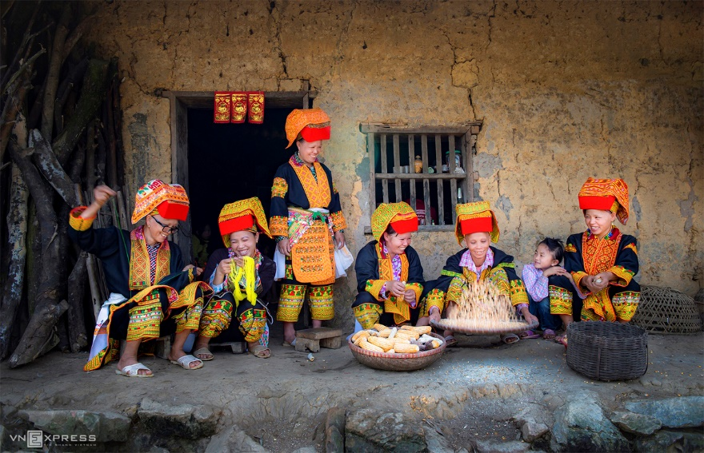
Unit
4
ETHNIC GROUPS OF VIET NAM
Unit
ETHNIC GROUPS OF VIET NAM
LESSON 6: SKILLS 2
LESSON 3: A CLOSER LOOK 2
Unit
HOBBIES

Slide 3
LESSON 6: SKILLS 2
WARM-UP
Chatting
Vocabulary
Task 1: Match the phrases with the correct pictures.
Task 2: Listen and tick the activities that minority children do to help their families.
Task 3: Listen again and circle the correct answer A, B, or C.
LISTENING
Task 4: Note five things you do to help your family.
Task 5: Write a paragraph about the things you do to help your family. Use the ideas in 4.
WRITING
CONSOLIDATION
Wrap-up
Homework

Slide 4
*WARM-UP
1
Match the phrases with the correct pictures.
1. catching fish
2. weaving clothing
3. growing crops
_______________
_______________
_______________

Slide 5
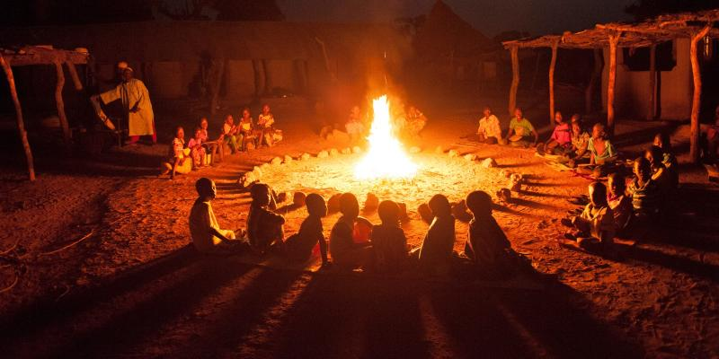
VOCABULARY
gather (v)
/ˈɡæðər/
tụ họp

Slide 6
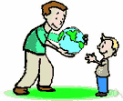
VOCABULARY
pass on (v)
/pɑːs ɒn/
để lại,
truyền lại

Slide 7

VOCABULARY
legend (n)
/ˈledʒənd/
truyền thuyết

Slide 8
VOCABULARY
New words | Pronunciation | Meaning
1. gather (v) | /ˈɡæðər/ | tụ họp
2. pass on (v) | /pɑːs ɒn/ | để lại, truyền lại
3. legend (n) | /ˈledʒənd/ | truyền thuyết

Slide 9
VOCABULARY
New words |  | Meaning
1. gather (v)
2. pass on (v)
3. legend (n)
để lại
truyền thuyết
tụ họp

Slide 10


LISTENING
2
Listen and tick ( ) the activities that minority children do to help their families.
1. look after the house
2. weave clothing
3. prepare food
4. build houses
5. grow crops
6. raise livestock

Slide 11
LISTENING
3
Listen again and circle the correct answer A, B, or C.
1. Minority children usually learn to work at ______.
A. twelve B. ten C. six
2. Girls ______.
A. weave clothing
B. do the gardening
C. catch fish
3. Boys ______.
A. prepare food
B. raise livestock
C. do housework
4. Children learn traditions through _____
A. work B. music C. stories
5. The number of minority children going to school is ______.
A. going up
B. going down
C. staying the same

Slide 12
WRITING
4
Note five things you do to help your family.
- cook meals
- Clean the floor
- sweep the floor
- Feed the arnimals
- Water the flowers

Slide 13
WRITING
5
Write a paragraph (80 - 100 words) about the things you do to help your family. Use the ideas in 4.
Suggested answer:
I learnt to share housework with other members of the family when I was seven or eight. I always start the day by tidying up my bed. Then I prepare breakfast for me and my brother. I usually help prepare dinner or do the washing afterwards. At the weekend, I usually spend an hour cleaning and tidying up my room and collecting dirty clothes of the whole family for washing. I sometimes do other work like planting vegetables or ﬂowers on the top open ﬂoor of our house with my mother, repairing our bikes with my father, or repainting the gate. I think doing housework together connects our family’s members.

Slide 14

CONSOLIDATION
1
Wrap-up
In this lesson, you have:
learnt new words related the topic of the listening text.
understood more about ethnic children through listening tasks.
written a paragraph about the things you do to help your family.

Slide 15

CONSOLIDATION
2
Homework
Learn by heart all the new words.
Do exercises in the workbook.
Prepare for Lesson 7 – Looking back & project.

Slide 16

Website: hoclieu.vn
Fanpage: facebook.com/www.tienganhglobalsuccess.vn/

