Slide 1


Slide 2
10
1
P
O
L
L
U
T
I
O
N
P L A S T I C
2
C O R A L
3
L I G H T
I L L
4
5
R U B B I S H
6
T R E E S
7
V E H I C L E S
8
O C E A N
9
A N I M A L S

Slide 3
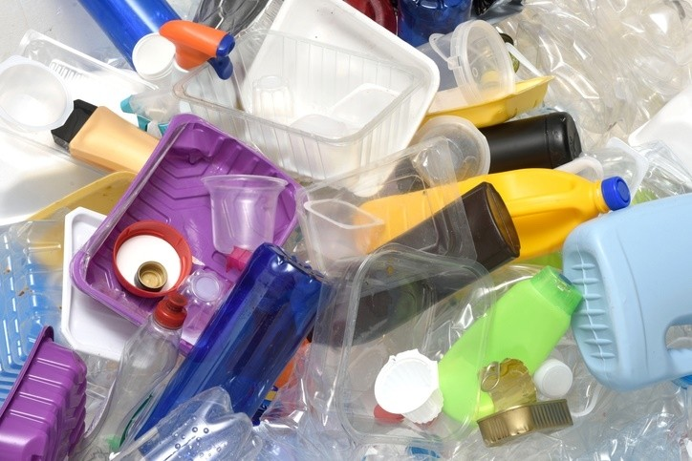

Slide 4
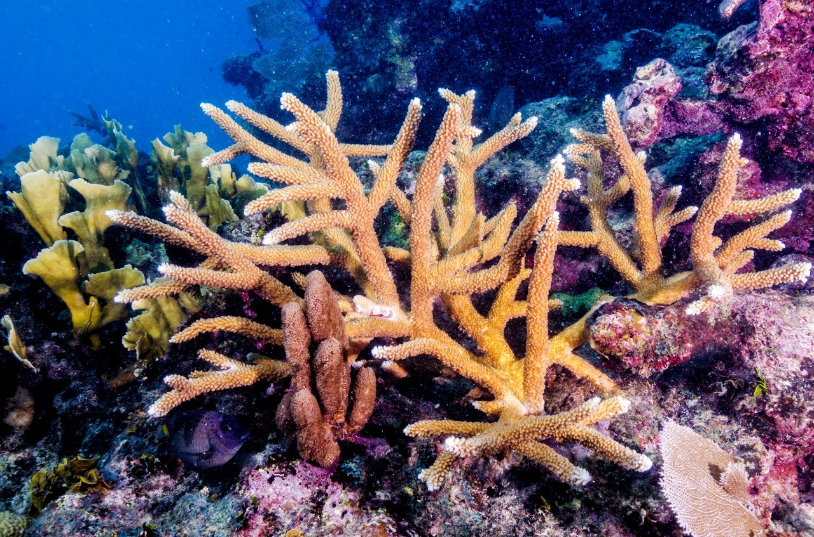

Slide 5
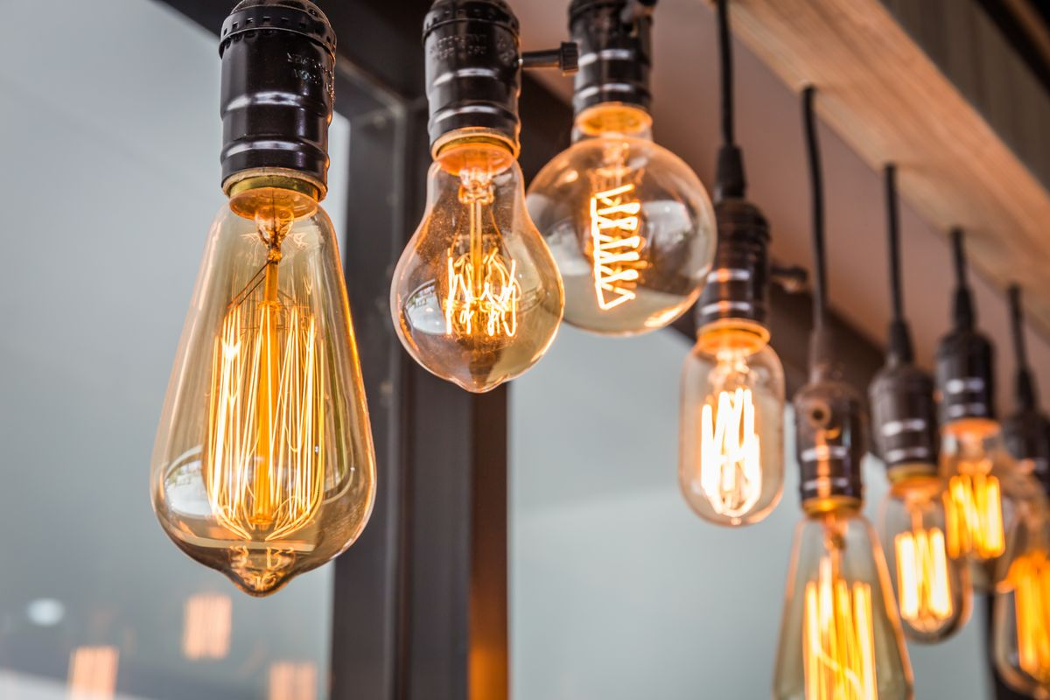

Slide 6


Slide 7
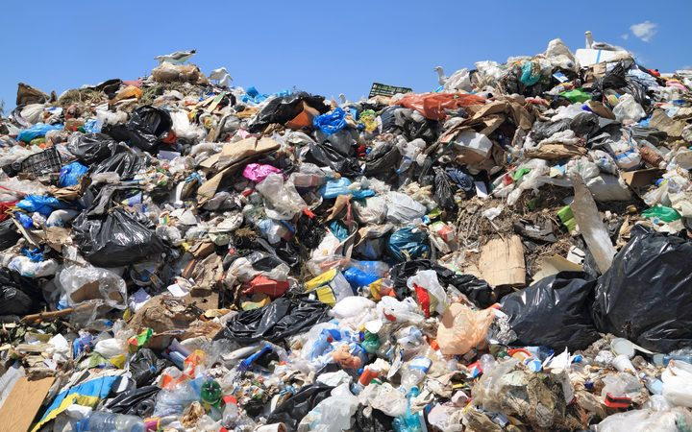

Slide 8
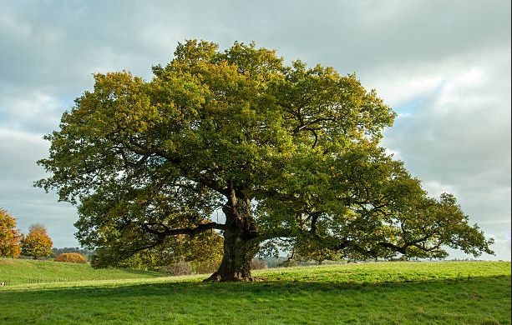

Slide 9
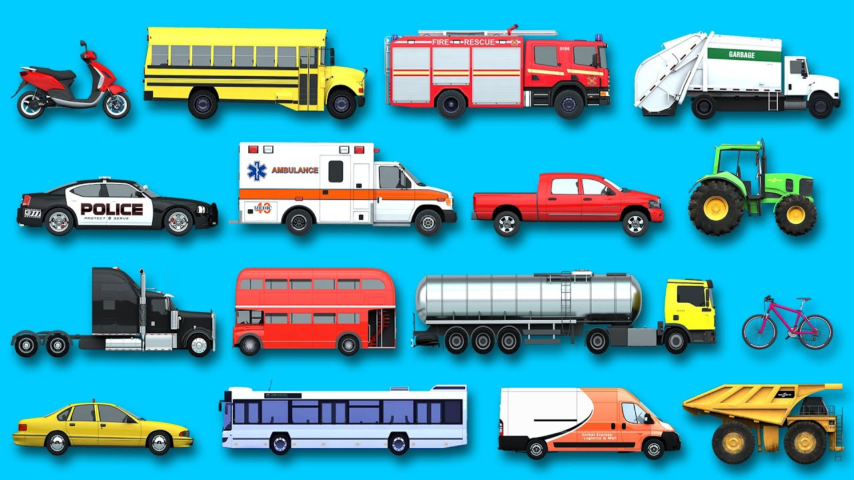

Slide 10
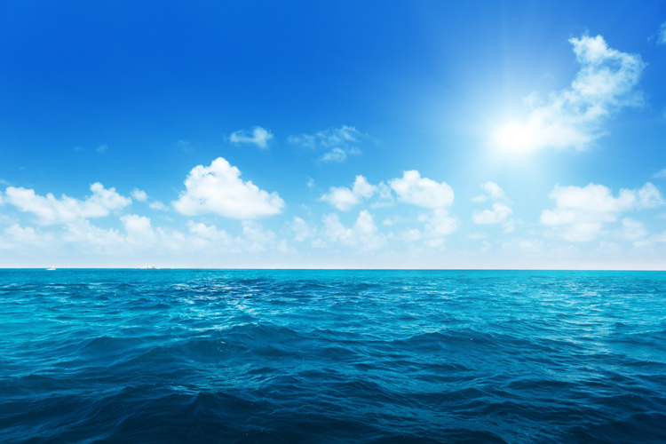

Slide 11
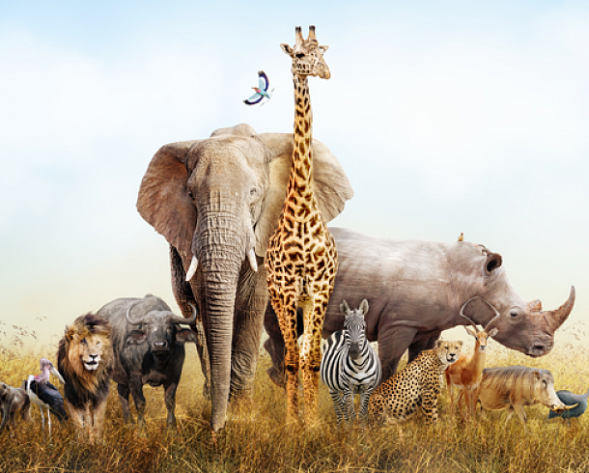

Slide 12
UNIT 7. POLLUTION
Period 55. Lesson 1. Getting started

Slide 13
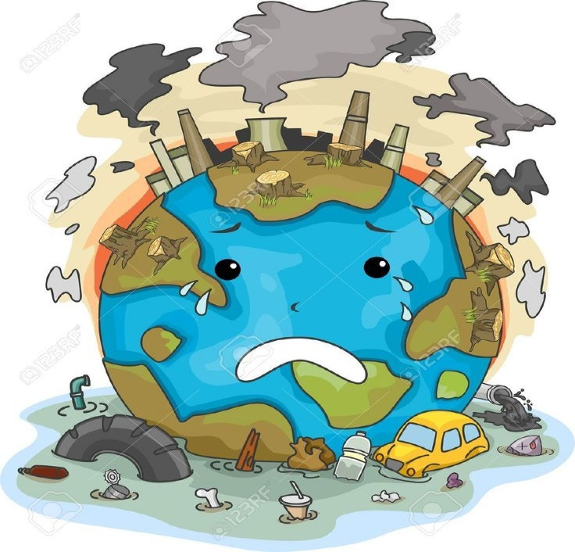

I. New words
Illustrate(v)
/ˈɪləstreɪt/
come up with
/kʌm ʌp wɪð /
Minh họa
nghĩ ra

Slide 14
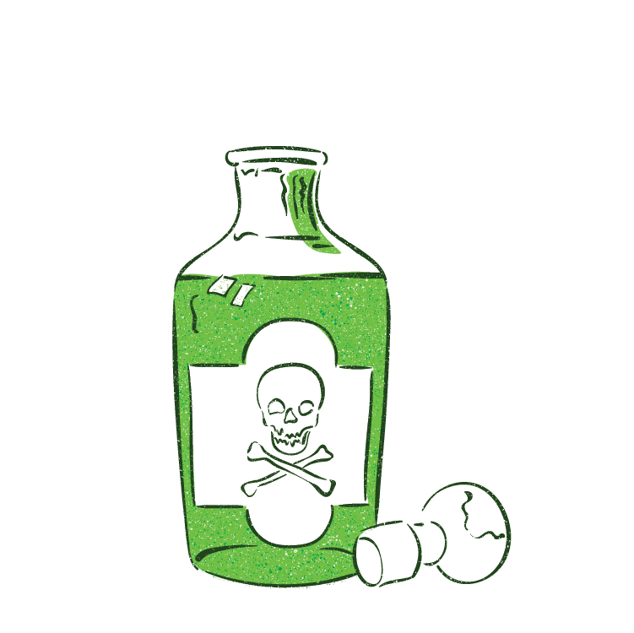
I. New words
- die /daɪ/ (v)
- dead /ded/ (adj)
- death /deθ/ (n)
Poison (n)
/ˈpɔɪzən/
: chất độc
poisonous ( adj)
/ˈpɔɪ.zən.əs/
: độc hại

Slide 15
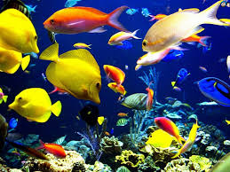
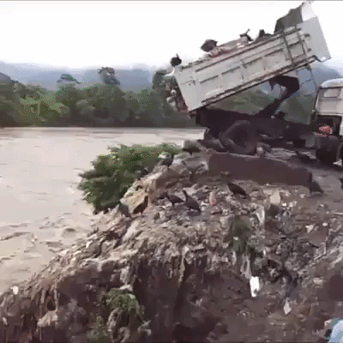
I. New words
Aquatic (adj)
/əˈkwæt̬ɪk/
dump….into
/dʌmp/
dưới nước
vứt, đổ

Slide 16
Matching
Word | Meaning | Key
1. aquatic | A. no longer alive
2. dump…into | B. a substance that can make people or animals ill or kill them if they eat or drink
3. poison | C. throw away sth you don’t want, especially in a place which is not allow
4. illustrate | D. growing or living in, on or near water
5. pollute | E. think of and idea, or a plan
6. come up with | F. explain sth by using examples
7. dead | G. made unclean or unsafe to use
1-D
2-C
3-B
4-F
5-G
6-E
7-A

Slide 17
I. New words
- Illustrate(v) /ˈɪləstreɪt/
:Minh họa
- come up with/kʌm ʌp wɪð /
:nghĩ ra
- die /daɪ/ (v)
: chết/cái chết
- dead /ded/ (adj)
- death /deθ/ (n)
- Poison/ˈpɔɪzən/(n)
: chất độc
poisonous /ˈpɔɪ.zən.əs/( adj)
: độc hại
- aquatic/əˈkwæt̬ɪk/(adj)
: dưới nước
- dump….into/dʌmp/
: vứt, đổ

Slide 18
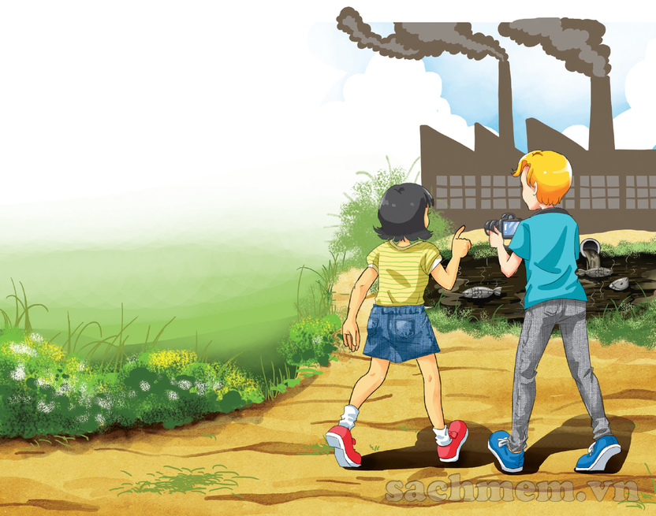

Slide 19

II. Reading
A project on pollution
Nick: Your home village is so beautiful. There are so many trees, flowers and birds.
Mi: Yes, that’s why I like coming back here on holiday.
Nick: Mi, what’s that factory? It looks new.
Mi: I don’t know. There wasn’t a factory here last year.
Nick: Mi, look at the lake! Its water is almost black.
Mi: Let’s go closer. ... I can’t believe my eyes. The fish are dead!
Nick: I think the waste from the factory has polluted the lake. The fish have died because of the polluted water.
Mi: That’s right. If the factory continues dumping poison into the lake, all the fish and other aquatic animals will die.
Nick: Ahchoo!
Mi: Bless you! What’s the matter?
Nick: Thanks. Ahchoo! I think there’s air pollution here as well. If the air wasn’t dirty, I wouldn’t sneeze so much. Ahchoo!
Mi: I’ve come up with an idea about our environmental project! How about giving a presentation about water and air pollution?
Nick: That’s a good idea. Let’s take some pictures of the factory and the lake to illustrate our presentation. Ahchoo!

Slide 20
b. Read and tick (✓)
Statements | T | F | NI
1. The water in the lake has been polluted by a ship.
2. Water pollution in the lake has made the fish die.
3. Aquatic plants may also die because of the polluted water.
4. Nick wouldn’t sneeze so much if the air was clean.
5. Nick and Mi will give a talk about water and air pollution.
✓
The factory
✓
✓
✓
✓

Slide 21
a. Answer the questions
Q1.Where are Nick and Mi?
Q2.What does the water in the lake look like?
Q3.Why is Mi surprised when they get closer to the lake?
Q4.What is the factory dumping into the lake?
Q5.Why is Nick sneezing so much?

Slide 22
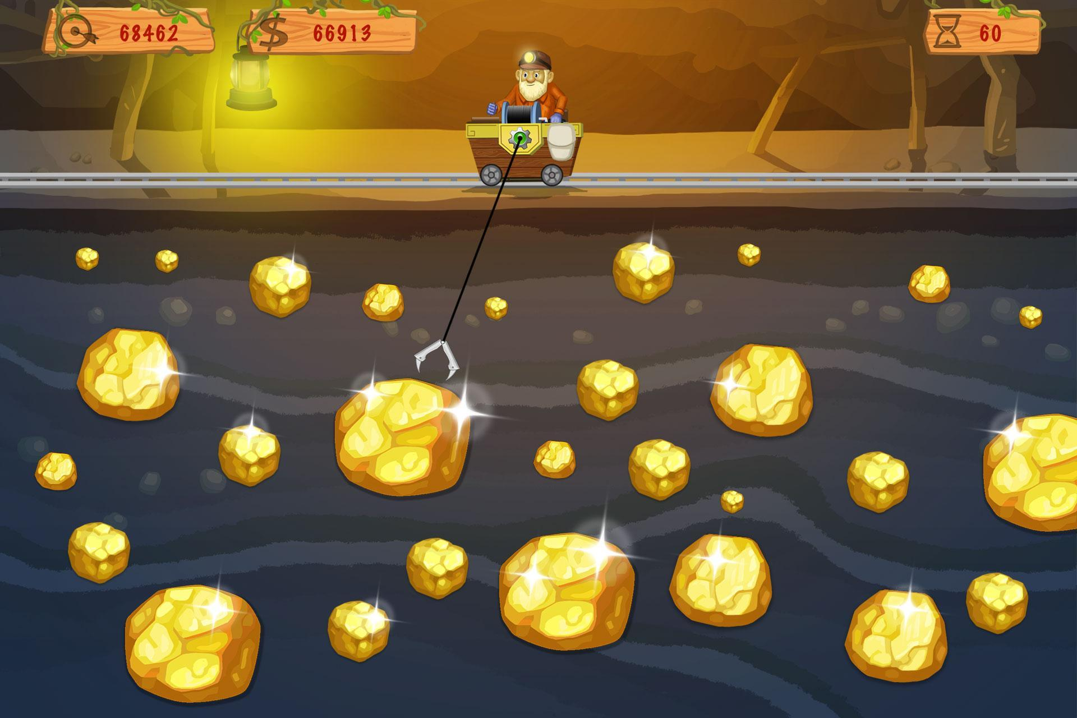
Next
1
5
2
8
6
4
3
7

Slide 23
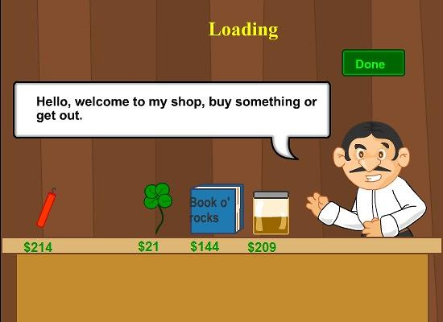
Done
Q1.Where are Nick and Mi?
They are in Mi’s home village.

Slide 24
Done
Q2.What does the water in the lake look like?
It’s almost black.

Slide 25
Done
Q3.Why is Mi surprised when they get closer to the lake?
Because she sees the fish are dead.

Slide 26
Done
Q4.What is the factory dumping into the lake?
It’s dumping poison into the lake.

Slide 27
Done
Q5.Why is Nick sneezing so much?
Because the air is not clean.

Slide 28

Done

Slide 29
b. Answer the questions.
1. Where are Nick and Mi ?
→ They are in Mi’s home village.
2. What does the water in the lake look like ?
→ It’s almost black.
3. Why is Mi surprised when they get closer to the lake?
→ Because she sees the fish are dead.
4. What is the factory dumping into the lake?
→ It’s dumping poison into the lake.
5. Why is Nick sneezing so much ?
→ Because the air is not clean.

Slide 30
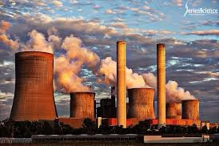
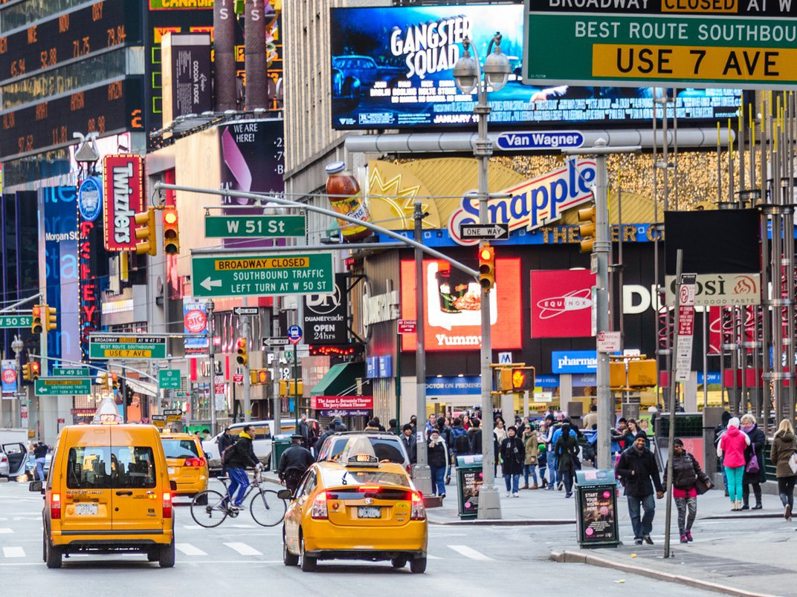
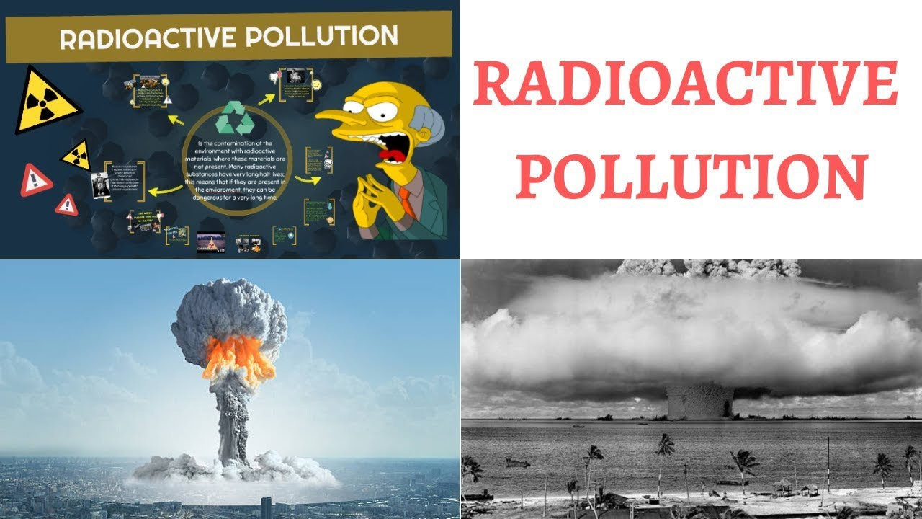
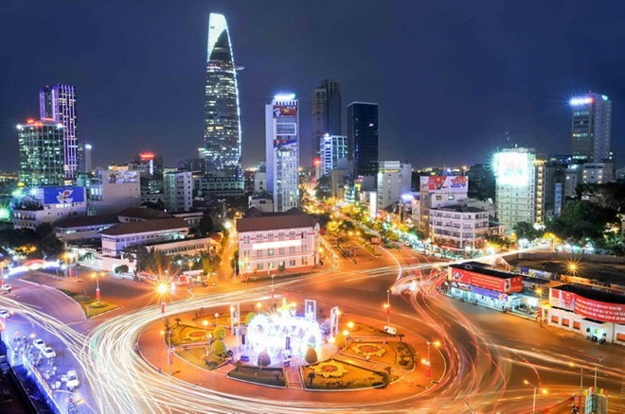
thermal /ˈθɝːməl/ pollution
visual ˈvɪʒuəl/ pollution
Radioactive
ˌreɪ.di.oʊˈæk.tɪv/
pollution
light /laɪt/ pollution
Ô nhiễm nhiệt
Ô nhiễm hình ảnh
Ô nhiễm phóng xạ
Ô nhiễm ánh sáng

Slide 31
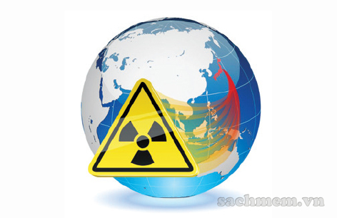
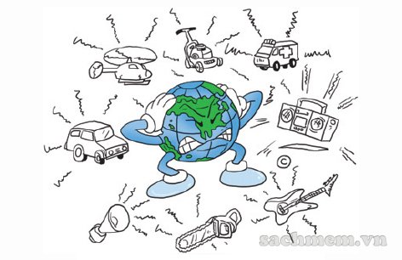
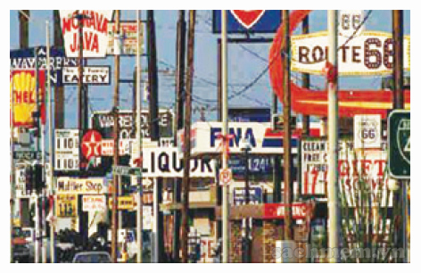
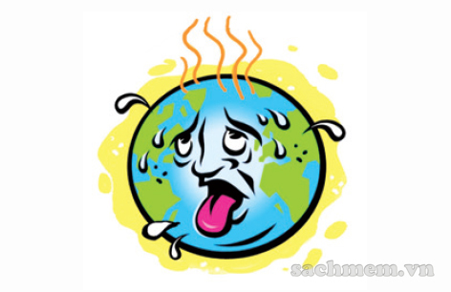
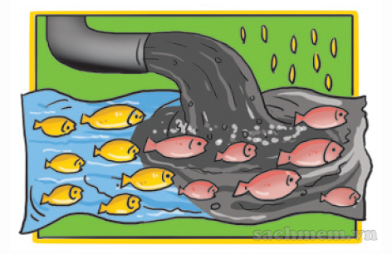
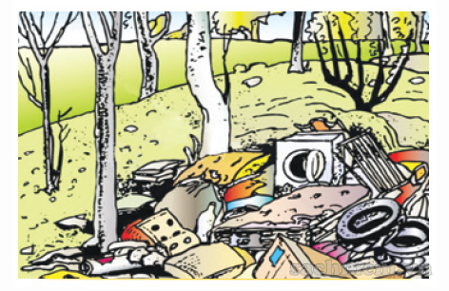
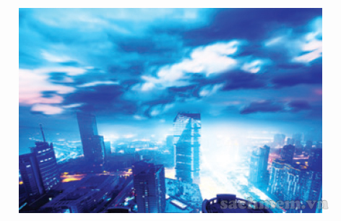
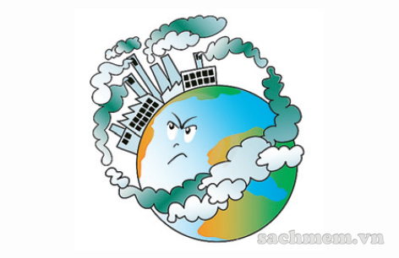
2. Write each type under a picture.
radioactive pollution land/soil pollution air pollution
water pollution thermal pollution light pollution
visual pollution noise pollution
1._________________
radioactive
pollution
2._________________
noise
pollution
3._________________
4._________________
visual
pollution
thermal
pollution
soil
pollution
air
pollution
water
pollution
light
pollution
8._________________
5._________________
6._________________
7._________________

Slide 32
3. Complete the sentences with the types of pollution.
thermal pollution
1. When………………………………………happens, the water temperature in streams, rivers, lakes, or oceans changes.
2……………………………………occurs when the atmosphere contains gases, dust, or fumes in harmful amounts.
3.When radiation goes into the land, air or water, it is called……………………….
4.Too much use of electric lights in cities may cause…………………………….
5…………………………………..is the contamination of lakes, rivers, oceans, or groundwater, usually by human activities.
6………………………………………happens when human activities destroy the Earth’s surface.
7…………………………………occurs because there are too many loud sounds in the environment.
8.The sight of too many telephone poles, advertising billboards, overhead power lines, or shop signs may cause………………………………. .
Air pollution
radioactive pollution
light pollution
Water pollution
Land/Soil pollution
Noise pollution
visual pollution

Slide 33

Revise the new words, exercises
Prepare the new lesson : A closer look 1

