Slide 1


Slide 2



Review
4
UNIT 10 – 11 – 12
LESSON 1: SKILLS
Reading
Speaking & Listening
Writing
Unit

Slide 3

OBJECTIVES
By the end of the lesson, students will be able to:
practice on the vocabulary items and grammar points Ss have already studied and the skills they have practised in Units 10, 11, 12.

Slide 4
LESSON 2: SKILLS
WARM-UP
Chatting
Task 1: Read the passage. Find a word and a phrase from the passage and write them under their correct pictures.
Task 2: Choose the correct answer A, B, or C to complete each sentence.
READING
Task 3: Read the list of activities and discuss which ones are energy-saving and which ones are not. Explain your answer.
Task 4: Listen and complete each sentence with ONE word.
SPEAKING &
LISTENING
Task 5: Choose one of the future means of transport below. Write a paragraph of about 70 words about it.
WRITING
CONSOLIDATION
Wrap-up
Home work

Slide 5
LESSON 2: SKILLS
Chatting
WARM-UP
Aims of the stage:
To increase students’ interest and lead them into the lesson.
ALASKA
Notes:
Wordwall link to spin the wheel in real time: https://wordwall.net/resource/27022823

Slide 6

LESSON 2: SKILLS
WARM-UP
Chatting
Task 1: Read the passage. Find a word and a phrase from the passage and write them under their correct pictures.
Task 2: Choose the correct answer A, B, or C to complete each sentence.
READING

Slide 7
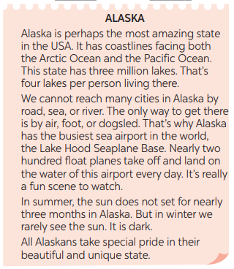
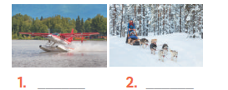
READING
1
Read the passage. Find a word and a phrase from the passage and write them under their correct pictures.
float plane
dogsled

Slide 8
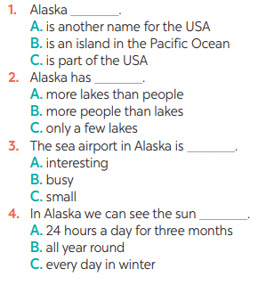
READING
2
Choose the correct answer A, B, or C to complete each sentence.

Slide 9
LESSON 2: SKILLS
WARM-UP
Chatting
Task 1: Read the passage. Find a word and a phrase from the passage and write them under their correct pictures.
Task 2: Choose the correct answer A, B, or C to complete each sentence.
READING
Task 3: Read the list of activities and discuss which ones are energy-saving and which ones are not. Explain your answer.
Task 4: Listen and complete each sentence with ONE word.
SPEAKING &
LISTENING

Slide 10
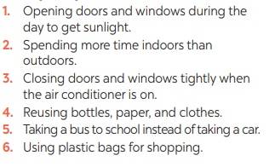
SPEAKING & LISTENING
3
Read the list of activities and discuss which ones are energy-saving and which ones are not. Explain your answer.
Aim of the task:
To help Ss revise and talk about energy-saving activities.

Slide 11
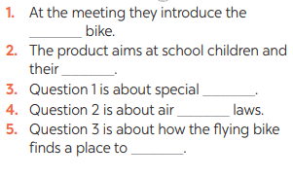

SPEAKING & LISTENING
4
Listen and complete each sentence with ONE word.
Aim of the task:
To help Ss practise listening for specific information.
flying
parents
lanes
traffic
land

Slide 12
LESSON 2: SKILLS
WARM-UP
Chatting
Task 1: Read the passage. Find a word and a phrase from the passage and write them under their correct pictures.
Task 2: Choose the correct answer A, B, or C to complete each sentence.
READING
Task 3: Read the list of activities and discuss which ones are energy-saving and which ones are not. Explain your answer.
Task 4: Listen and complete each sentence with ONE word.
SPEAKING &
LISTENING
Task 5: Choose one of the future means of transport below. Write a paragraph of about 70 words about it.
WRITING
CONSOLIDATION
Wrap-up
Home work

Slide 13
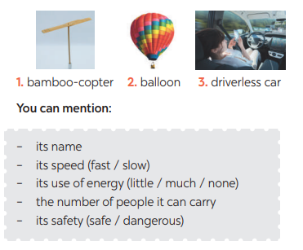
WRITING
5
Choose one of the future means of transport below. Write a paragraph of about 70 words about it.
Aim of the task:
To help Ss practise writing a paragraph describing a future means of transport

Slide 14
CONSOLIDATION
1
WRAP-UP
Reading
Speaking & Listening
Writing

Slide 15
CONSOLIDATION
2
HOMEWORK
Prepare for the next lesson: The last term test.

Slide 16


