Slide 1

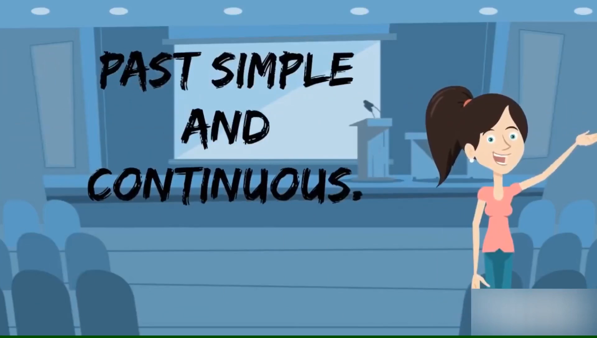
Which tenses are mentioned in the video?

Slide 2
Monday, 13th December 2021
UNIT 6. FOLK TALES
Period 44. Lesson 3.
A closer look 2

Slide 3
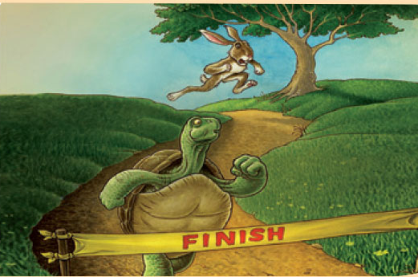
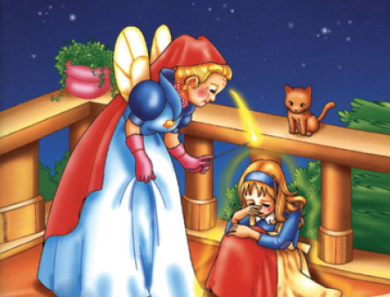
I. Grammar: Past continuous tense
1. Usages :
3.00p.m
At 3.00p.m, the tortoise was running ahead of the hare.
When she was crying, a fairy appeared.

Slide 4
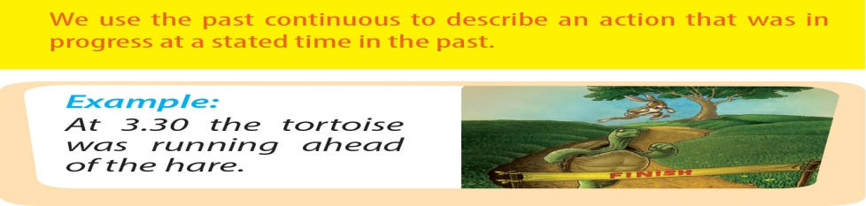

Slide 5
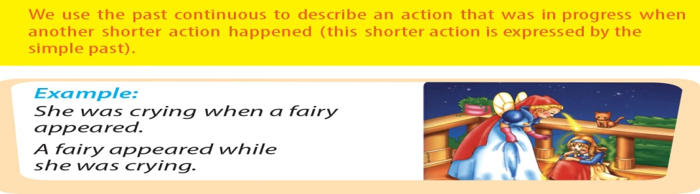

Slide 6
I. Grammar: Past continuous tense
2. Form:
I was reading a fairy story at 9 p.m yesterday.
(+) S + was/were + Ving
(-) S + wasn’t/weren’t + Ving
(?) Was/Were + S + Ving?
3. Signal words:
at……..am/pm + last ….,
at this time + last, when, while,…

Slide 7
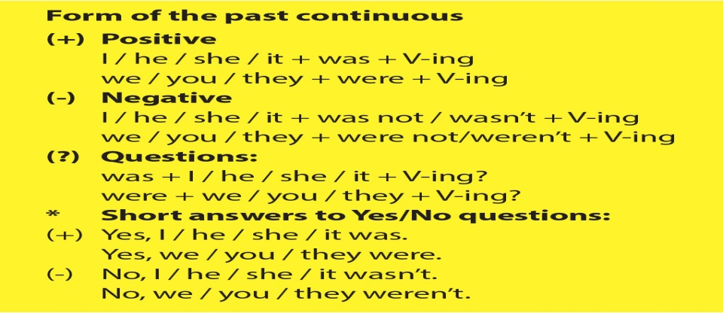

Slide 8
II. Practice
2. Give the correct form of verbs
1. When the prince saw Cinderella at the party, she (wear) ………….………... a beautiful gown.
2. What (you/ do) …………………….…….this time yesterday?
3. When Jack (go) ……………….........to the market, he met a magician.
4. While the hare was sleeping, the tortoise (run) …………… to the finish as fast as he could.
5. When the princess returned, the prince (not wait) …………………………for her.
was wearing
were you doing
was going
was running
wasn’t waiting

Slide 9




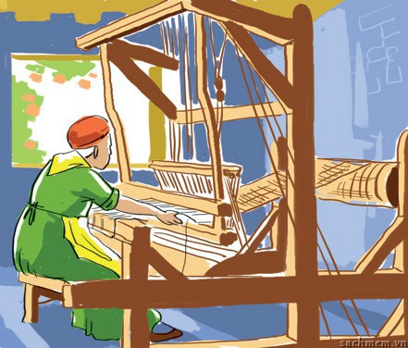
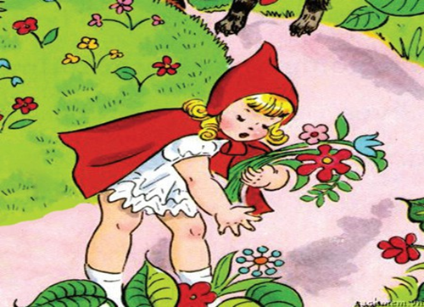
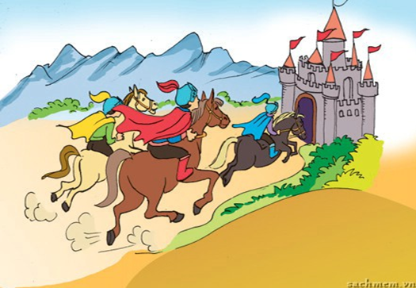



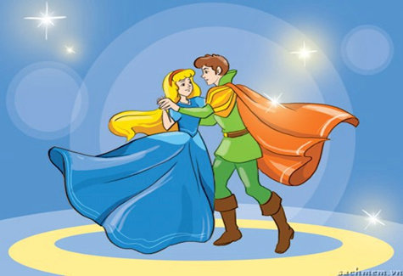


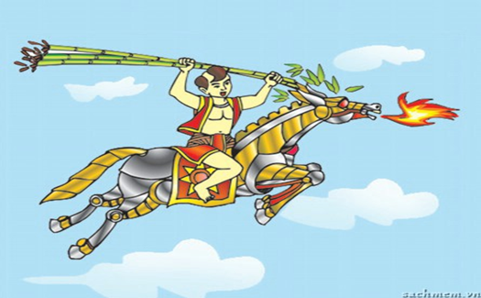
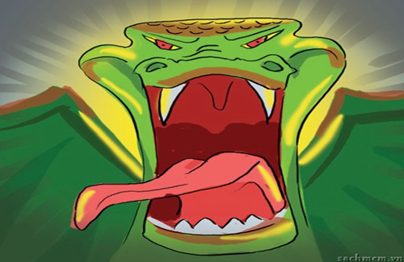
II. Practice
3a. Write a full sentence
1.The servant was spinning in the woods.
2. The girl was picking flowers by the side of the road
3. The knights were riding horses to the castle
1
2
3
4
Congratulations!
4. Cinderella was dancing with the prince
5. Saint Giong was flying to heaven.
6. The ogre was roaring with anger.
5
6
Congratulations!
7
8

Slide 10
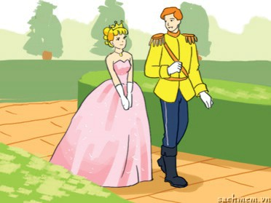
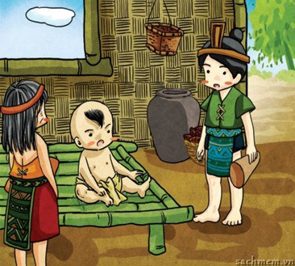

II. Practice
4. Give the correct form of verbs
1.The prince (walk) ……………….……….along the road when he met a princess, so he (stop)……….…….......and (have)……………....a chat with her.
2.When Saint Giong (lie)………………..on the bed, he (hear).………...
an announcement that the emperor (need).................brave men to protect his land.
3.Alice was walking alone in the woods when she suddenly (hear)…………. footsteps behind her. Someone (follow) …........................her. She was frightened and she (start)………………..to run.
was walking
was lying
heard
heard
stopped
had
was following
needed
started

Slide 11
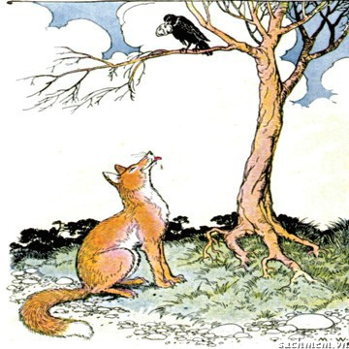
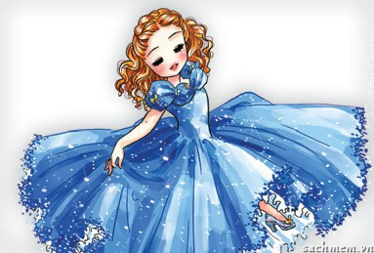
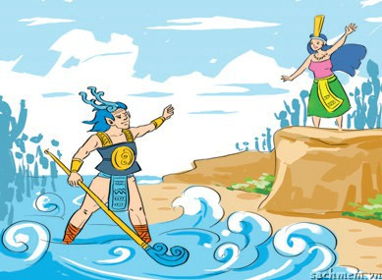
II. Practice
4. Give the correct form of verbs
4. When the crow
(drop)………..…………..
the cheese, the fox (eat)…………it.
5. They (dance)…………...
………………merrily when Cinderella suddenly
(leave)……… the party.
6. Lac Long Quan (miss) …………………his life under the sea, so he (decide)………………….
to take fifty of his sons back there.
were
dropped
dancing
missed
ate
left
decided

Slide 12
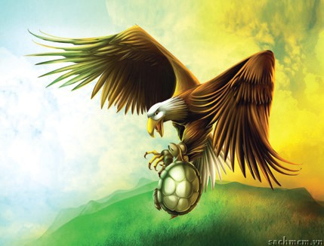
II. Practice
5. Complete the passage
An eagle and a tortoise
It was a nice day. The sun (1. shine) …...........…..…………..… and a tortoise (2. sleep) ……………………………….in the sun. He opened his eyes and saw that an eagle was flying in the sky. “I want to fly like that!” the tortoise said. The eagle heard him and agreed to help. The eagle picked up the tortoise, and off they (3. go) …………... When they (4. fly)…………………………….very high in the sky, the eagle (5. open) …………. his claws for the tortoise to fly. But the poor tortoise (6. fall) ……………all the way down to earth.
was shinning
was sleeping
went
were flying
opened
fell

Slide 13


Slide 14
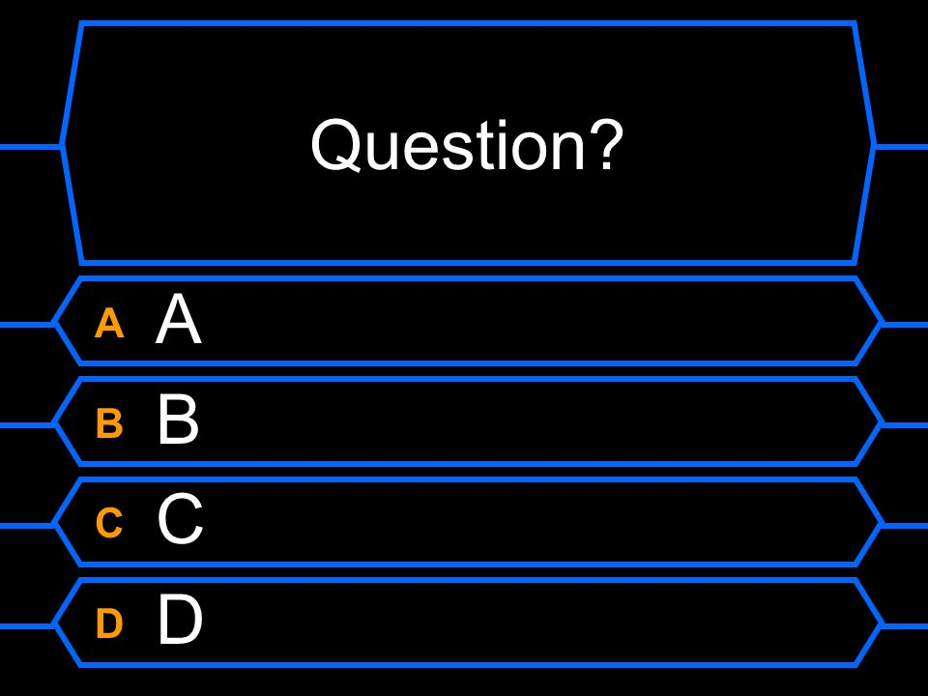
Question 1. (2000$)
We (have) ………. dinner when he came.
having
were having
had
have

Slide 15
Question 2. (4000$)
What (you/do) ………. from 3p.m to 6 p.m yesterday?
did you do
do you do
are you doing
were you doing

Slide 16
Question 3. (6000$)
When I (come) …….. home, my mother was cooking dinner.
came
were coming
come
comes

Slide 17
Question 4. (8000$)
Last night, I (watch) ………….. TV with my brother.
am watching
were watching
watch
watched

Slide 18
Question 5. (10.000$)
He (plant) ….. trees in the garden at 4 pm yesterday.
plant
were planting
was planting
planted

Slide 19
Question 6. (12.000$)
At this time last year, I (attend) …… an English course.
was attending
were attending
attending
attended

Slide 20
Question 7. (14.000$)
When I (go) ……shopping, I (meet)
...........my old friend.
went/ was meeting
were going/ met
was going/ met
am going/ meet

Slide 21
II. Practice
5. Complete the passage
An eagle and a tortoise
It was a nice day. The sun (1. shine) …...........…..…………..… and a tortoise (2. sleep) ……………………………….in the sun. He opened his eyes and saw that an eagle was flying in the sky. “I want to fly like that!” the tortoise said. The eagle heard him and agreed to help. The eagle picked up the tortoise, and off they (3. go) …………... When they (4. fly)…………………………….very high in the sky, the eagle (5. open) …………. his claws for the tortoise to fly. But the poor tortoise (6. fall) ……………all the way down to earth.
went
was sleeping
opened
were flying
was shinning
fell

Slide 22
II. Practice
5. Complete the passage
An eagle and a tortoise
It was a nice day. The sun (1. shine) …...........…..…………..… and a tortoise (2. sleep) ……………………………….in the sun. He opened his eyes and saw that an eagle was flying in the sky. “I want to fly like that!” the tortoise said. The eagle heard him and agreed to help. The eagle picked up the tortoise, and off they (3. go) …………... When they (4. fly)…………………………….very high in the sky, the eagle (5. open) …………. his claws for the tortoise to fly. But the poor tortoise (6. fall) ……………all the way down to earth.
was shinning
was sleeping
went
were flying
opened
fell

