Slide 1
Unit 19
Which place would you like to visit?
Lesson 2

Slide 2
Vocabulary
expect
exciting
beautiful
interesting
attractive
delicious
friendly
/ɪkˈspekt/
/ɪkˈsaɪtɪŋ/
/ˈbjuːtɪfl/
/ˈɪntrestɪŋ/
/əˈtræktɪv/
/dɪˈlɪʃəs/
/ˈfrendli/
: Chờ đợi, tưởng
: Thú vị
: Đẹp
: hấp dẫn
: hấp dẫn
: thơm ngon
: thân thiện

Slide 3
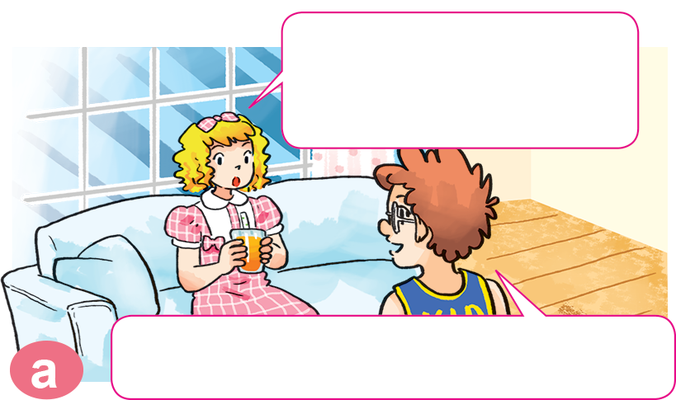
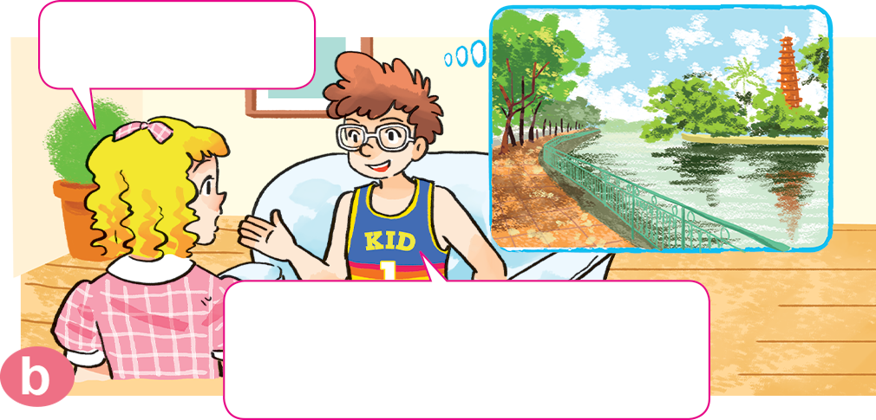

1. Look, listen and repeat.
What did you do yesterday?
Where is it?
It's on an island in the middle of West Lake.
I visited Tran Quoc Pagoda.

Slide 4
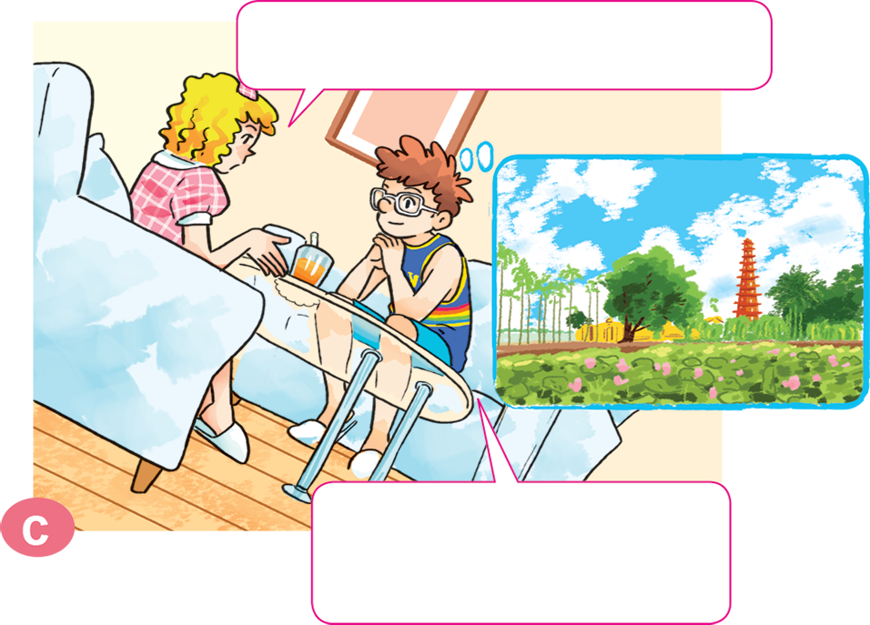
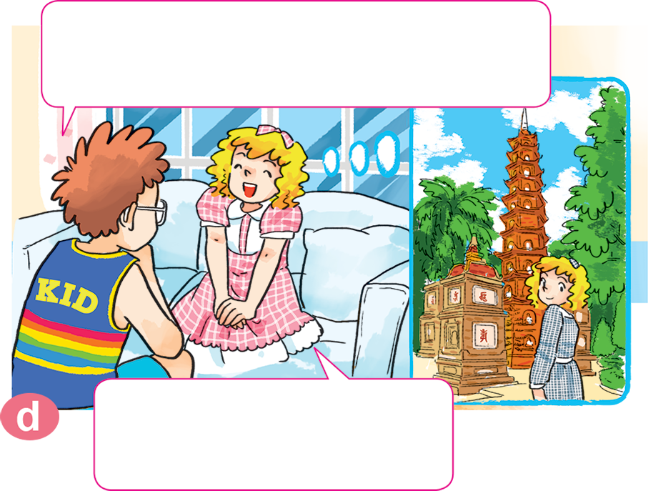
1. Look, listen and repeat.
What do you think of it?
The pagoda is really beautiful. I enjoyed the visit very much.
It's more beautiful than I expected.
That's great. I think I'll visit it one day.

Slide 5



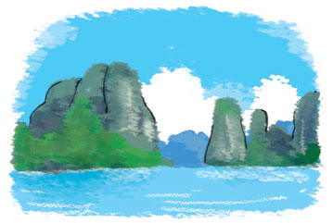
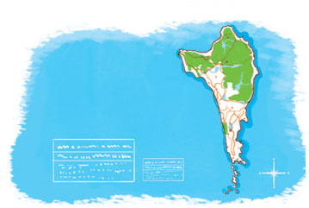
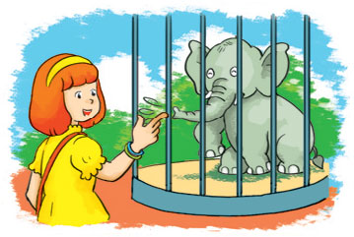
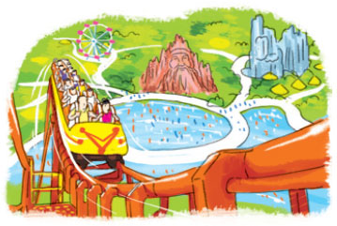
2. Point and say
What do you think of _______?
It's more___ than I expected.
Ha Long Bay
Phu Quoc Island
Thu Le Zoo
Dam Sen Park
attractive
beautiful
exciting
interesting

Slide 6

3. Let’s talk.
Where did you go ______________?
I went to ______________.
What do you think of ______________?
It's more ______________ than I expected.

Slide 7
4. Listen and circle a or b.
1. Tom thinks Phu Quoc is more ___________
than he expected.
a. exciting b. beautiful
2. Phong thinks Dam Sen Park is more ___________
than he expected.
a. interesting b. exciting
3. Tony thinks Nha Trang is more ___________
than he expected.
a. attractive b. exciting

Slide 8

5. Read and complete.
Tom: What did you do last weekend?
Nam: I went to (1) _________.
Tom: What do you think of it?
Nam: It's more (2) _________ than I expected. The food was (3) _________ and the people were (4) _________. I had a good time there.
Tom: Will you go there (5) _________.
Nam: Yes, I will!
friendly
again
delicious
exciting
Can Tho
Can Tho
exciting
delicious
friendly
again

Slide 9


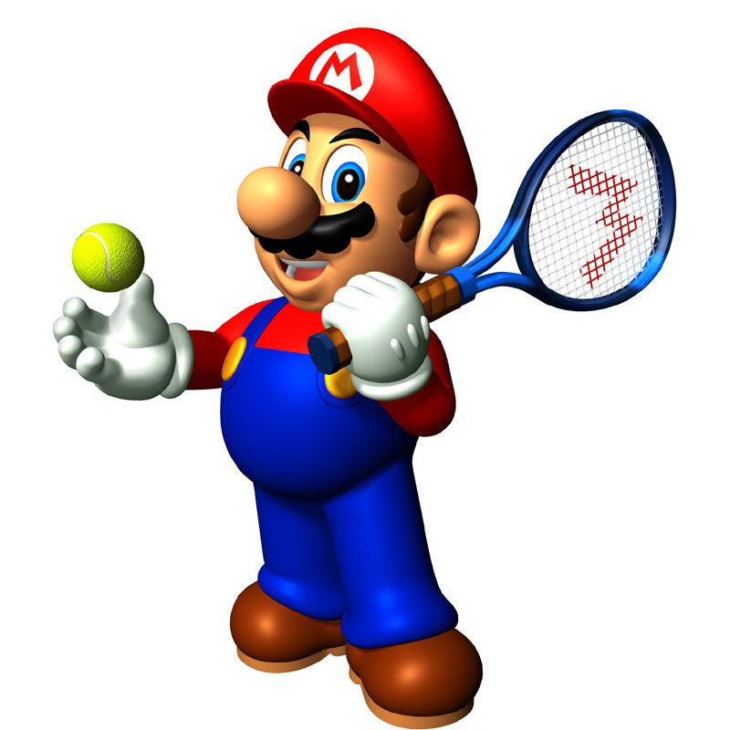





Slide 10
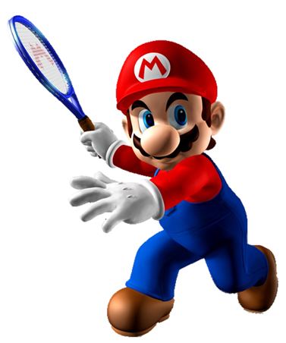
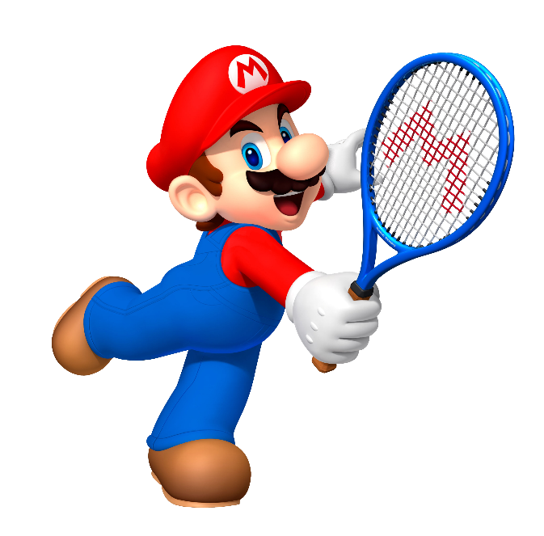


attractive
What do you think of
Ha Long Bay?
It’s more _________ than
I expected.
big

Slide 11
small
What do you think of
Dam Sen Park?
It’s more _________ than
I expected.
exciting

Slide 12
beautiful
What do you think of
Phu Quoc Island?
It’s more _________ than
I expected.
far

Slide 13
bored
What do you think of
Thu Le Zoo?
It’s more _________ than
I expected.
interesting

Slide 14
I expecting
I expect
What do you think of Nha Trang?
It’s more beautiful than
____________.
I expected

Slide 15
usually
more
What do you think of Ha Noi?
It’s ____ interesting than
I expected.
very

Slide 16
think of
think
What do you _____ Vietnamese?
They’re more friendly than
I expected.
thinking of

Slide 17
What are you think of
What do you think of
____________ Vietnamese food?
They’re more delicious than
I expected.
What do you think

Slide 18
more interesting than
interesting than
What do you think of Cat Ba Island?
It’s ___________I expected.
more interesting

Slide 19
atractive
more than
More than atractive
What do you think of Hue Imperia City?
It’s ________I expected.
more atractive
than

Slide 20
Time’s up!

