Slide 1
Unit 18
What will the weather
be like tomorrow?
Lesson 1

Slide 2
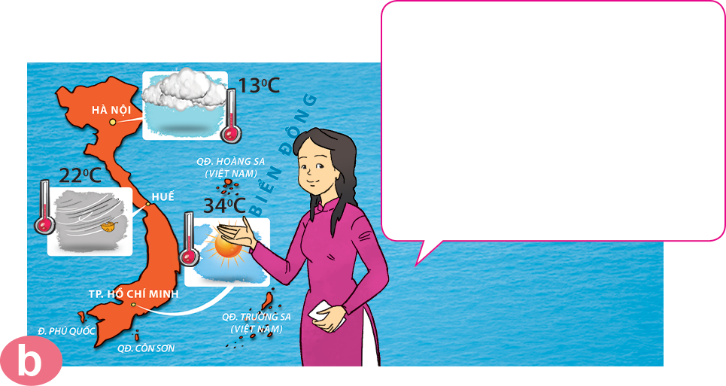
Vocabulary
weather forecast
/ˈweðə fɔːkɑːst/

Slide 3
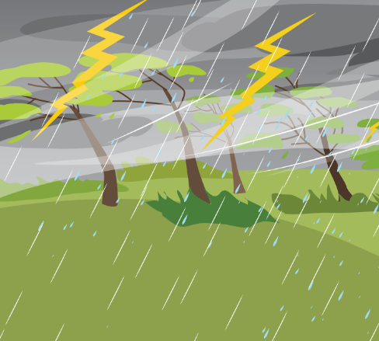





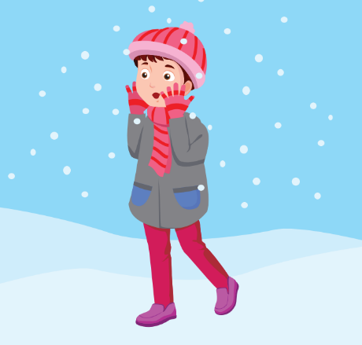


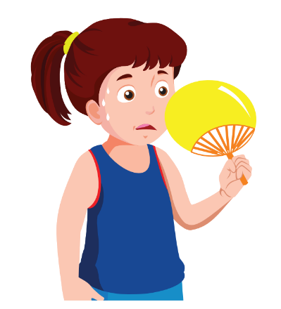
Vocabulary
stormy
cloudy
rainy
sunny
windy
snowy
cold
cool
warm
hot

Slide 4

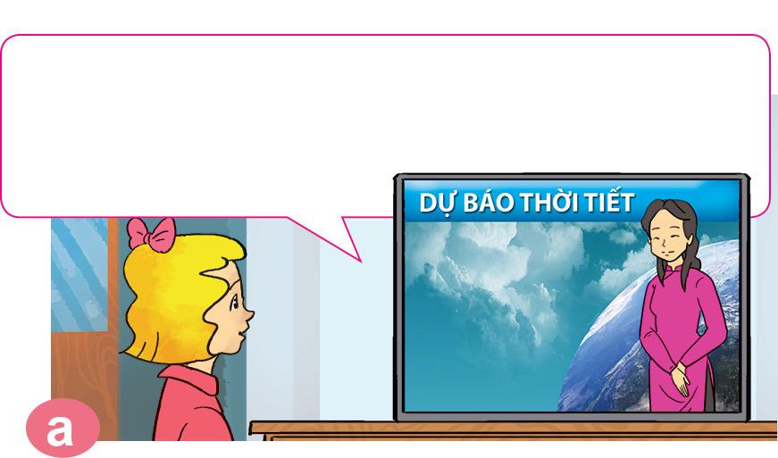
1. Look, listen and repeat.
It's cold and cloudy in Ha Noi. It's cool and windy in Hue. It's hot and sunny in Ho Chi Minh City.
Good evening and welcome to the weather forecast. Let's take a look at the weather today.

Slide 5
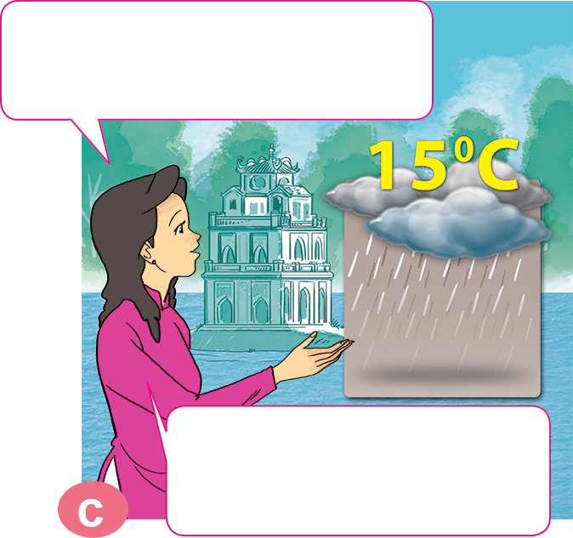
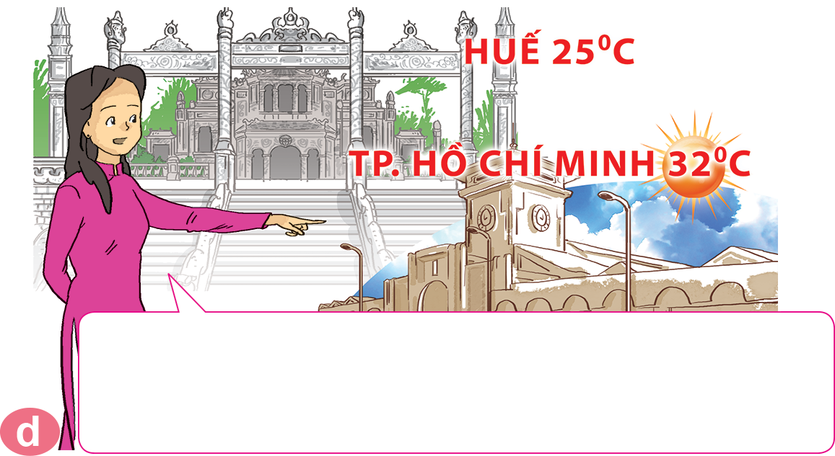
1. Look, listen and repeat.
What will the weather be like tomorrow?
It will be warm and foggy in Hue. In Ho Chi Minh City, it will be hot and sunny. That's the weather forecast for tomorrow.
Well, it will be cold and rainy in Ha Noi.

Slide 6


Structure:
What will the weather be like tomorrow?
It will be __________________.

Slide 7
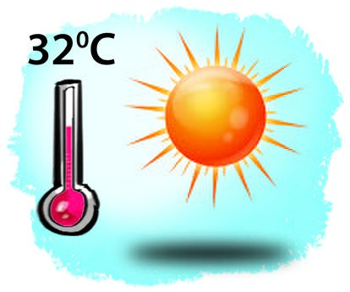
2. Point and say.
What will the weather be like tomorrow?
It will be __________________.
hot and sunny

Slide 8
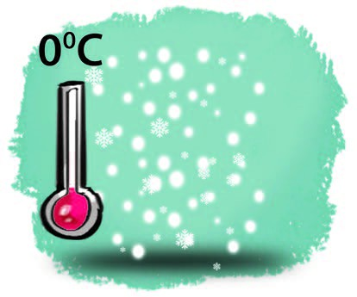
2. Point and say.
What will the weather be like tomorrow?
It will be __________________.
cold and snowy

Slide 9
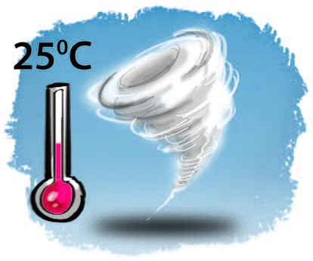
2. Point and say.
What will the weather be like tomorrow?
It will be __________________.
warm and stormy

Slide 10

2. Point and say.
What will the weather be like tomorrow?
It will be __________________.
cool and cloudy

Slide 11
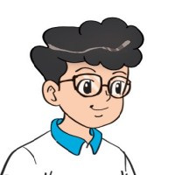

3. Let’s talk
What's the weather like today?
It's _____ and _______.
What will the weather be like tomorrow?
It will be _____ and ______.

Slide 12
4. Listen and circle a, b or c.
a. snowy and stormy.
b. snowy and very cold.
c. stormy and very cold.
1
It will be ___________
in Sa Pa tomorrow.
a. foggy and windy.
b. snowy and windy.
c. cold and windy.
2
It will be ____________
in Ha Noi tomorrow.
a. sunny and foggy.
b. stormy and cloudy.
c. sunny and windy.
It will be ___________
in Da Nang tomorrow.
3

Slide 13
5. Read and complete.
Mai: Let's (1) _______ for a picnic tomorrow.
Tony: What will the (2) _______ be like tomorrow?
Linda: Well, it will be cold and (3) ________.
Mai: How do you know that?
Linda: I watched the weather (4) ________ on TV.
Tony: We can't go for a picnic if it's stormy.
Mai: OK, let's stay home, eat popcorn and
(5) _________ cartoons.
Tony and Linda: Great idea!
go
weather
watch
forecast
go
stormy
weather
stormy
forecast
watch

Slide 14








Ms Huyền Phạm
0936.082.789
Notes:
Ms Huyền Phạm - 0936.082.789 – YOUTUBE: MsPham. Facebook: Dạy và học cùng công nghệ.

Slide 15

tomorrow
What will the weather
be like _________?
yesterday
Ms Huyền Phạm
0936.082.789
Notes:
Ms Huyền Phạm - 0936.082.789 – YOUTUBE: MsPham. Facebook: Dạy và học cùng công nghệ.

Slide 16


What will the weather
be like tomorrow?
It’ll be cool and windy.
It’s cool and windy.
Ms Huyền Phạm
0936.082.789
Notes:
Ms Huyền Phạm - 0936.082.789 – YOUTUBE: MsPham. Facebook: Dạy và học cùng công nghệ.

Slide 17

It’ll be stormy.
What will the weather
be like tomorrow?
It will stormy.
Ms Huyền Phạm
0936.082.789
Notes:
Ms Huyền Phạm - 0936.082.789 – YOUTUBE: MsPham. Facebook: Dạy và học cùng công nghệ.

Slide 18
will the weather like
What ____ next sunday?
will the weather be like
Ms Huyền Phạm
0936.082.789
Notes:
Ms Huyền Phạm - 0936.082.789 – YOUTUBE: MsPham. Facebook: Dạy và học cùng công nghệ.

Slide 19
be will
What will the weather
be like tomorrow?
It ____ rainy and cool.
will be
Ms Huyền Phạm
0936.082.789
Notes:
Ms Huyền Phạm - 0936.082.789 – YOUTUBE: MsPham. Facebook: Dạy và học cùng công nghệ.

Slide 20
wind and hot
It will be ____ tomorrow.
windy and hot
Ms Huyền Phạm
0936.082.789
Notes:
Ms Huyền Phạm - 0936.082.789 – YOUTUBE: MsPham. Facebook: Dạy và học cùng công nghệ.

Slide 21

Good job!
Ms Huyền Phạm
0936.082.789
Notes:
Ms Huyền Phạm - 0936.082.789 – YOUTUBE: MsPham. Facebook: Dạy và học cùng công nghệ.

